Slide 1
Mentor Curriculum 3.3
ITE Mentor Curriculum
Understanding trainee knowledge & development: Being an RPT mentor in your school
ITT Mentors Placement B
[Name]
ITTCo
Notes:
Meeting to take place between week beginning in February (before the start of School B placement) ​

Slide 2
Reading Initial Teacher Training
Placement B Mentors
Key dates and Programme Structure
Placement B RPTs
Communication
Consistency
Manual of Guidance (MoG) key information
ITAPs
Professional Studies
What next?

Slide 3
The Manual of Guidance (MOG)
All the information in presentation is taken from key parts of the MOG. Please ensure you have downloaded this and read it.
University of Reading Secondary Mentor Hub
Reading Mentor Hub

Slide 4
Key Dates
Event | Date | For whom
Induction of RTPs | School induction: Thursday 12th February | ITTCos & RPTs
RTPs commence second placement | Thursday 26th February | ITTCos, Mentors, RPTs
Placement B Generic mentor training | 3.40-5pm, Thursday 5th February (online) | New Mentors
Spring Term Subject Mentor Training | Tuesday 3rd March 3.40-5pm (online) | All mentors
PPR visiting window (tutor visits) | 20th April – 12th June | RPTs, mentors, tutors
Report 2 deadline | Friday 20th March | RPTs, mentors, ITTCos
Report 3 deadline | Friday 19th June | RPTs, mentors, ITTCos

Slide 5
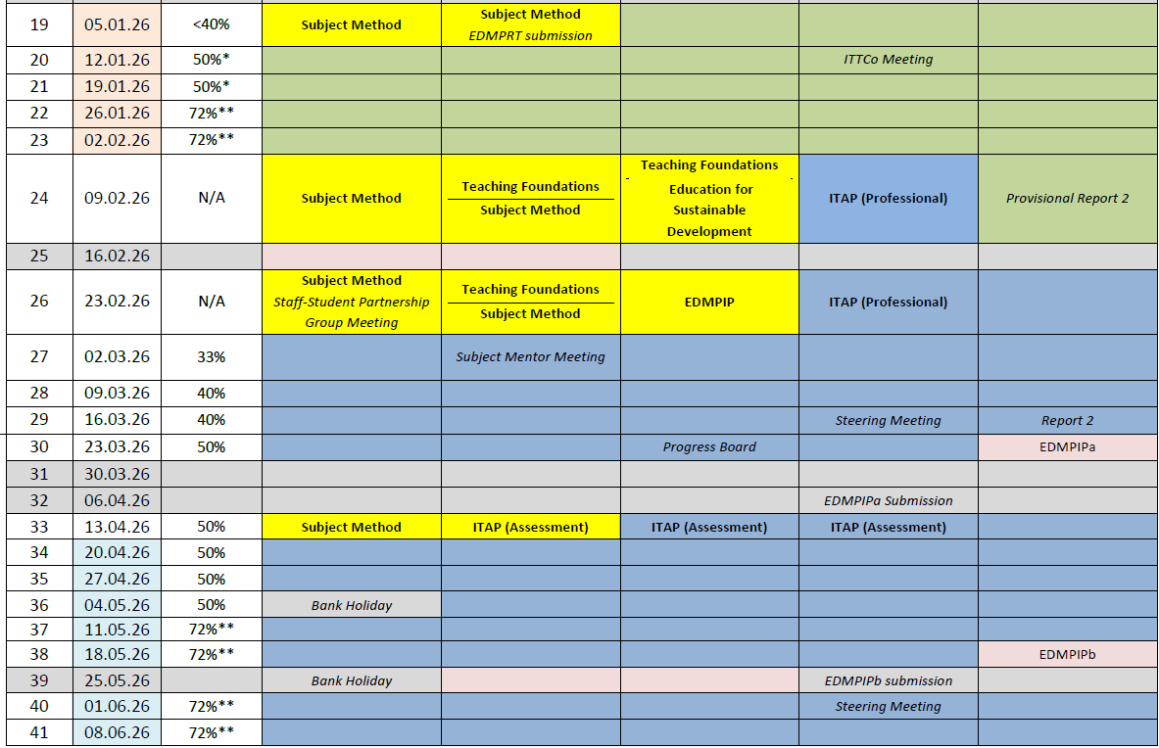
Programme Structure
Placement B
26th February – 19th June
Notes:
MoG pp9-11

Slide 6
Communication: Getting it right
The school-based mentor has responsibility for day-to-day communication with RPT and informing ITTCo of any issues. They also have a direct link with University tutor
The RPT could choose to involve the ITTCo and/or University Tutor / Subject leader – the version of events can sometimes become blurred when multiple people are involved
School Based Mentor
ITTCo (placement A and B)
RPT
University Tutor/SL
The ITTCo should be copied in on emails to university tutor / external communication with UoR
The University tutor / Subject Leader will sometimes communicate directly with the mentor/RPT and not necessarily the ITTCo so as mentor, please reply and CC ITTCO

Slide 7
Subject leader and LM contacts UoR-
(please CC ITTCo in any communication)
Name |  | Role |  | Office |  | Email
Art & Design |  | Jo Giles |  | L19 G29 |  | joanne.giles@reading.ac.uk
Design & Technology |  |  | Jo Giles |  | L19 G29
English | Dr Rachel Roberts | Dr Rachel Roberts |  | L19 G07 |  | r.l.roberts@reading.ac.uk
Geography | Martin Sutton | Martin Sutton |  | L19 G20 |  | m.sutton@reading.ac.uk
History | Will Bailey-Watson | Will Bailey-Watson |  | L19 G26 |  | w.baileywatson@reading.ac.uk
Maths | Lindsey Ford | Lindsey Ford |  | L16 102 L16 102 |  | l.a.ford@reading.ac.uk f.r.curtis@reading.ac.uk
MFL | Barbara King | Barbara King |  | L19 G16 |  | b.king@reading.ac.uk
PE | Harvey Grout | Harvey Grout |  | L19 G14 L33 G04 |  | h.grout@reading.ac.uk g.m.lappin@reading.ac.uk
Science | Dr Caroline Foulkes Andrew Happle | Dr Caroline Foulkes Andrew Happle |  | L16 112 L19 G29 |  | c.s.foulkes@reading.ac.uk a.j.happle@reading.ac.uk

Slide 8
Consistency and Support
ITTCo and mentor joint observation (new Placement B mentors)
ITTCo / Mentor to review e-Portfolios
Mentor Bulletins
ITTCo to join university visits from tutors if possible
Mentors to ensure consistency of high-quality feedback in department – model the REVIEW feedback style (see later). Sit in on feedback given by other members of your department

Slide 9
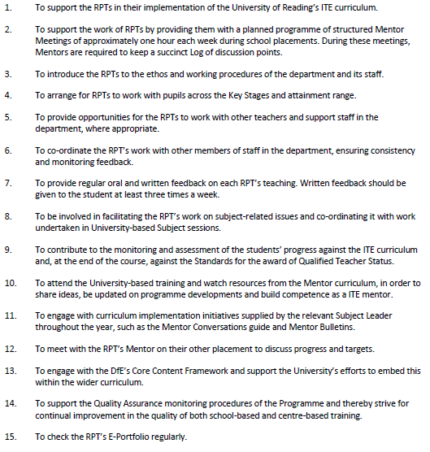
MoG: Subject Mentor Role

Slide 10
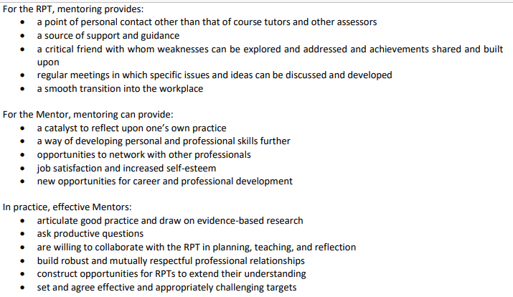
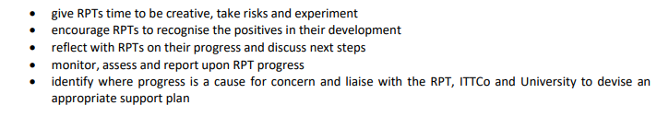
What this means in practice:

Slide 11
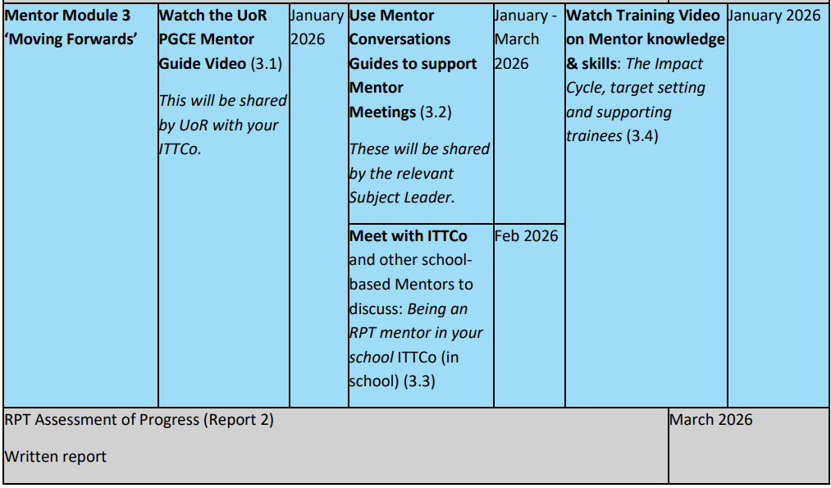
Mentor curriculum with UoR
PLUS: New Sch B Mentor training: Thurs 5th Feb, 3.40-5pm, online
Notes:
See Mentor HB (pp4-6) https://sitesb.reading.ac.uk/ioe-mentoring/wp-content/uploads/sites/41/2025/09/Secondary-ITE-Mentor-Handbook-2526-FINAL.pdf
on the Mentor Hub: https://sitesb.reading.ac.uk/ioe-mentoring/sample-page/pgce-secondary/

Slide 12
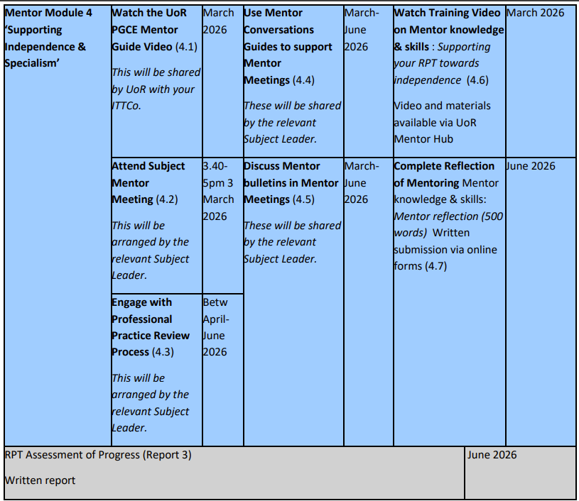

Slide 13
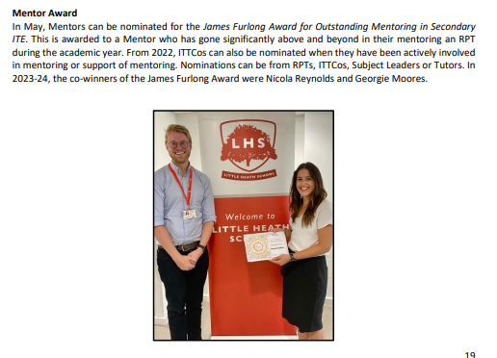
Mentor awards

Slide 14
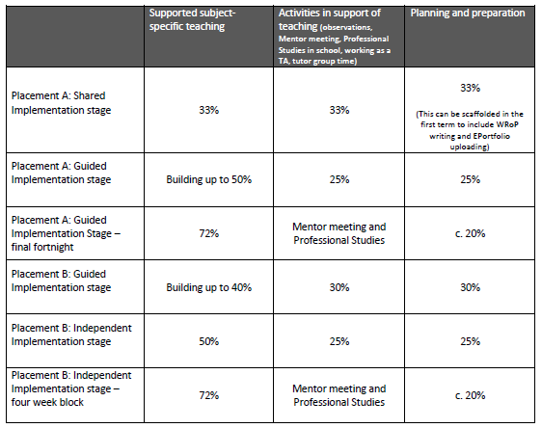
Timetable requirements
Please note Trainees are in 5 days per week.
40% timetable for first 4 weeks of placement A
50% two weeks before Easter
72% last 4 weeks (12th May to 13th June(

Slide 15
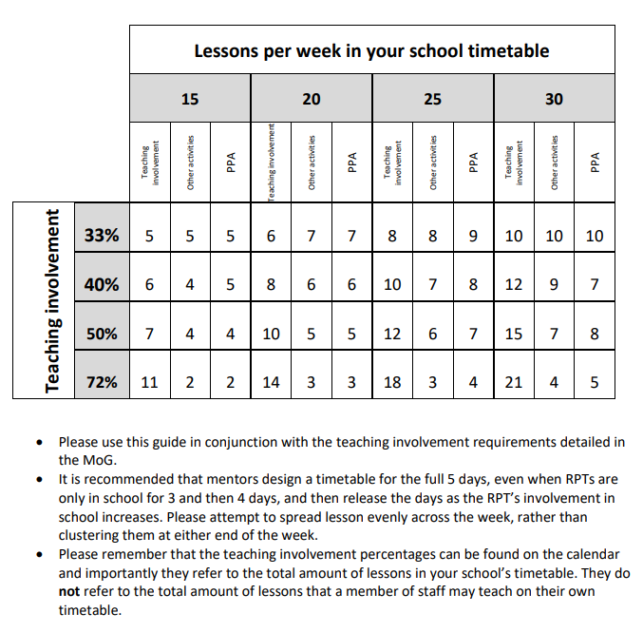

Slide 16
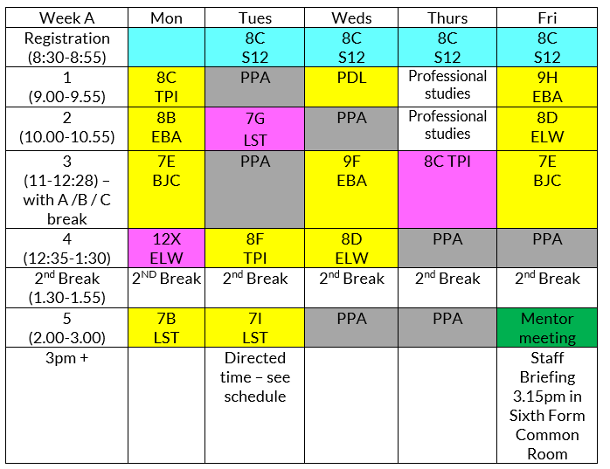
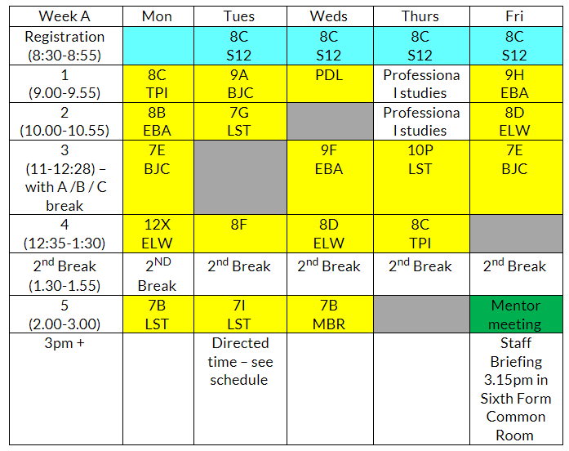
Making a 72% TT work
25 periods per week - example
The mentor always has some discretion to reduce the teaching involvement for targeted periods to address specific RPT needs but this should always be done in conversation with the Academic tutor and ITTCo
Reduce observations (purple), increasing ownership of tutor time
Load | Teaching | Other | PPA
50% | 12 | 6 | 7
Load | Teaching | Other | PPA
72% | 18 | 3 | 4
Timetable WRoPs and e-portfolio admin

Slide 17
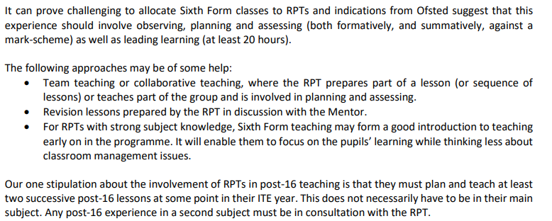
Sixth form teaching

Slide 18
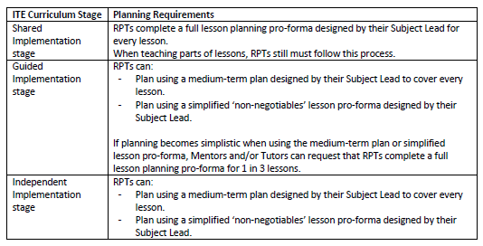
Lesson Planning

Slide 19
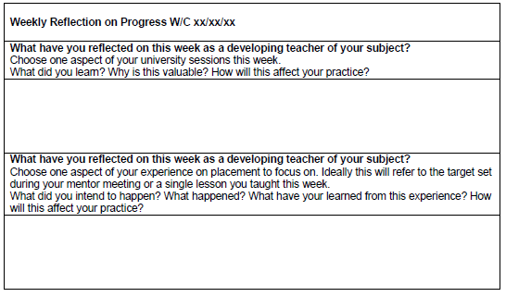
Weekly Records of Progress (WRoPs)
Notes:
Captures RPTs’ learning over the course of the week. RPTs’ responsibility to maintain. Kept in the E-Portfolio

Slide 20
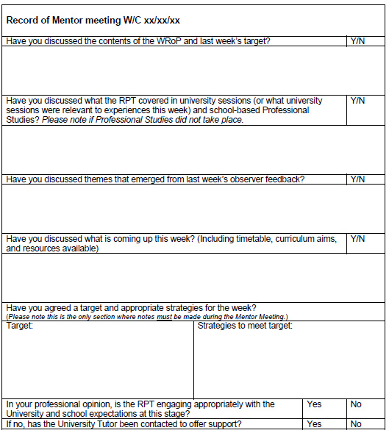
Mentor Meeting Log
Mentor to complete
Kept in E-Portfolio
Please contact university tutor if there are any issues with the RPT not engaging with course expectations

Slide 21
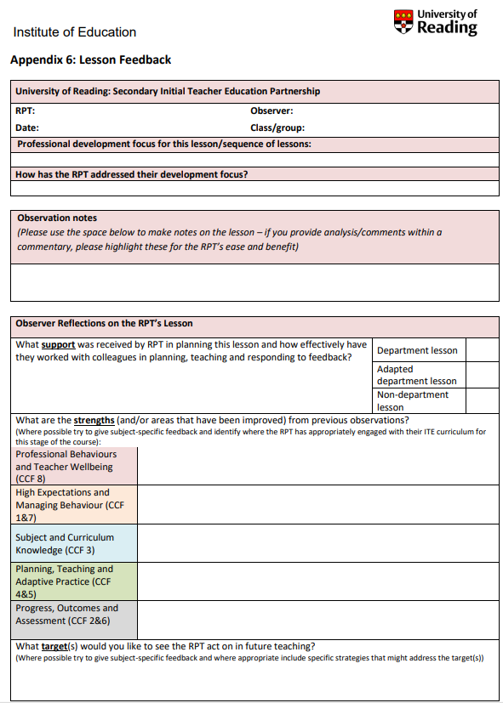
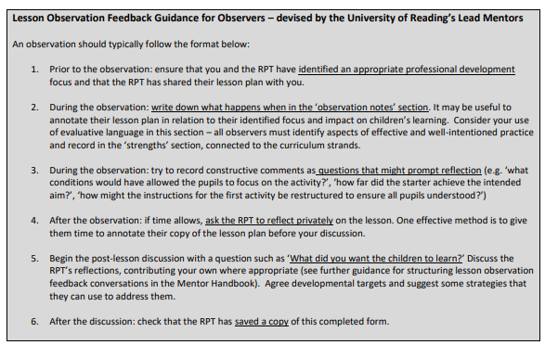
Lesson Feedback – MoG App. 7
Notes:
Please use this proforma every time you observe your RPT. A Word version will be available for you to use in their E-Portfolio.
Also share with any other members of staff who may observe and feedback to your RPT.

Slide 22
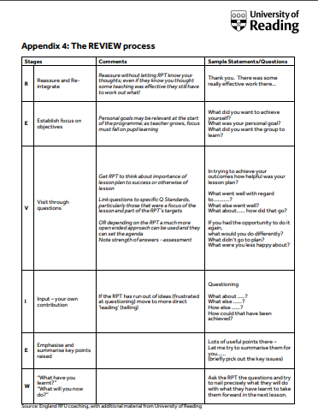
Lesson Feedback:
The REVIEW process
(UoR ECTs will be used to this style of feedback)
Reassure and re-integrate
Establish focus on objectives
Visit through questions
Input – your own contribution
Emphasis and summarise key points raised
What have you learnt? What will you do now?
Please ensure this guidance is shared with ALL teachers who will be giving feedback

Slide 23
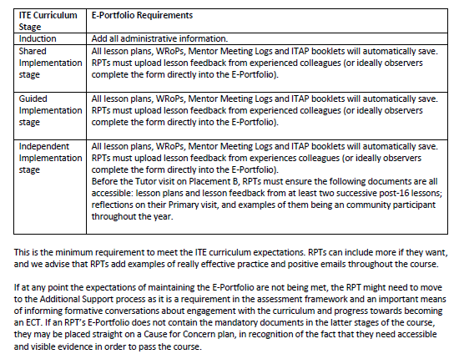
E-Portfolio
Housed in OneDrive. RPTs will be able to share the link with you directly.

Slide 24
Professional Studies
Notes:
Please share the PS timetable with mentors, and ask them to ensure this is included in their RPTs’ timetable.

Slide 25
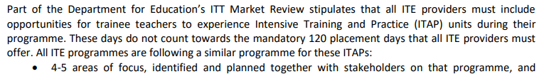
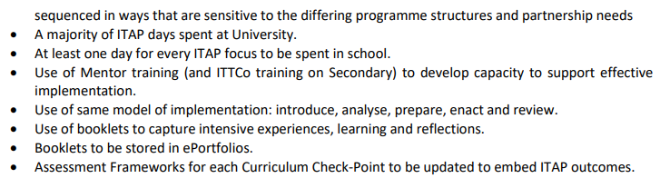
ITAPs: Intensive Training and Practice units
RPTs will be responsible for completing a booklet. Ensure you are aware of when ITAPs are and refer to these in mentor meetings.

Slide 26
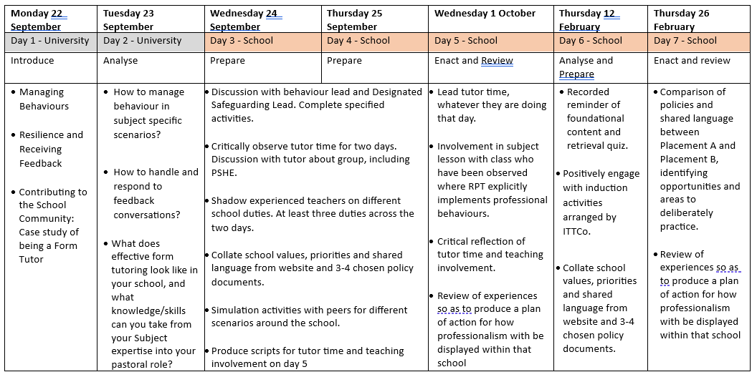
Notes:
ITAP2 Professional Behaviours

Slide 27
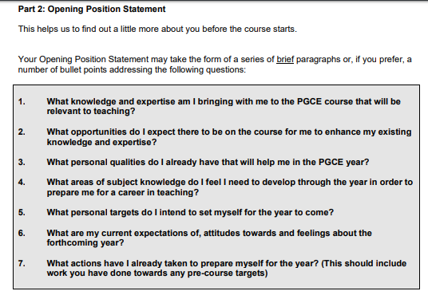
What next…ask to see RTP Opening Position Statement
(available in the E-Portfolio)

Slide 28
Any questions?

