Slide 1
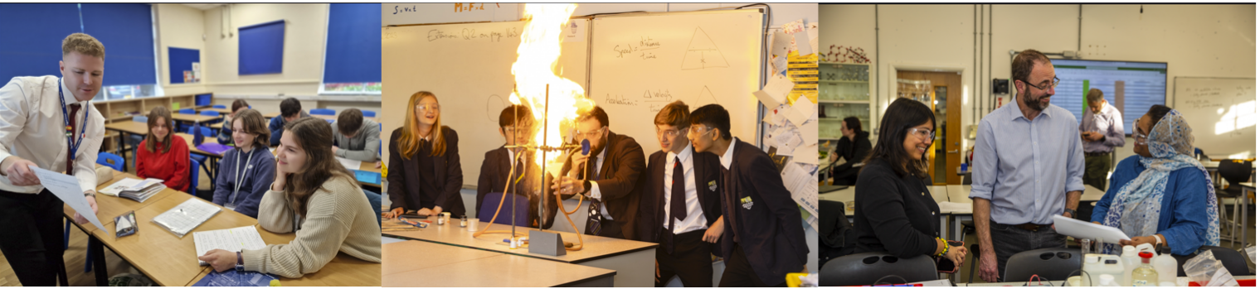
Mentor Training Materials (1.6)
Secondary ITE – Mentor Curriculum 2025-26
‘Being an RPT mentor in your school’
ITTCo-Mentor Training
Notes:
This ppt is a suggested template; ITTCos are encouraged to adapt as they see fit to reflect the unique nature of their school’s setting, cohorts, ethos and the experience of your mentors.

Slide 2
Being an RPT Mentor in your school
ITTCo to lead with mentors in their school
1hr; mid-September
Focus: What does it mean to be a mentor in this school?

Slide 3
Key Dates
Event | Date | For whom
Induction of RTPs | 11 / 12 / 18 / 19 September | RTP and mentors
Subject Specific training at UoR (remote) | 16th September 2025 (3.40-5pm via Teams) | RTP Mentors
RTPs commence first teaching involvement | 24th September (in Weds – Fri until Oct half term then Tuesday –Friday after) – see guidance on % timetable | RTPs
Placement B Generic mentor training | February 2026 via Teams | RPT Mentors
Spring Term Subject Mentor Training | 3rd March (3.40-5pm via teams) | RTP Mentors
Report 1 deadline | 12 December 2025 | RTPs / RTP mentor / ITTCo
Report 2 deadline | Provisional Report 13th February 2026 Final report 20th March 2026 | RTPs / RTP mentor / ITTCo
Report 3 deadline | 19th June 2026 | RTPs / RTP mentor / ITTCo
Notes:
Please ensure mentors have downloaded and read the Manual of Guidance and the Mentor Handbook.

Slide 4
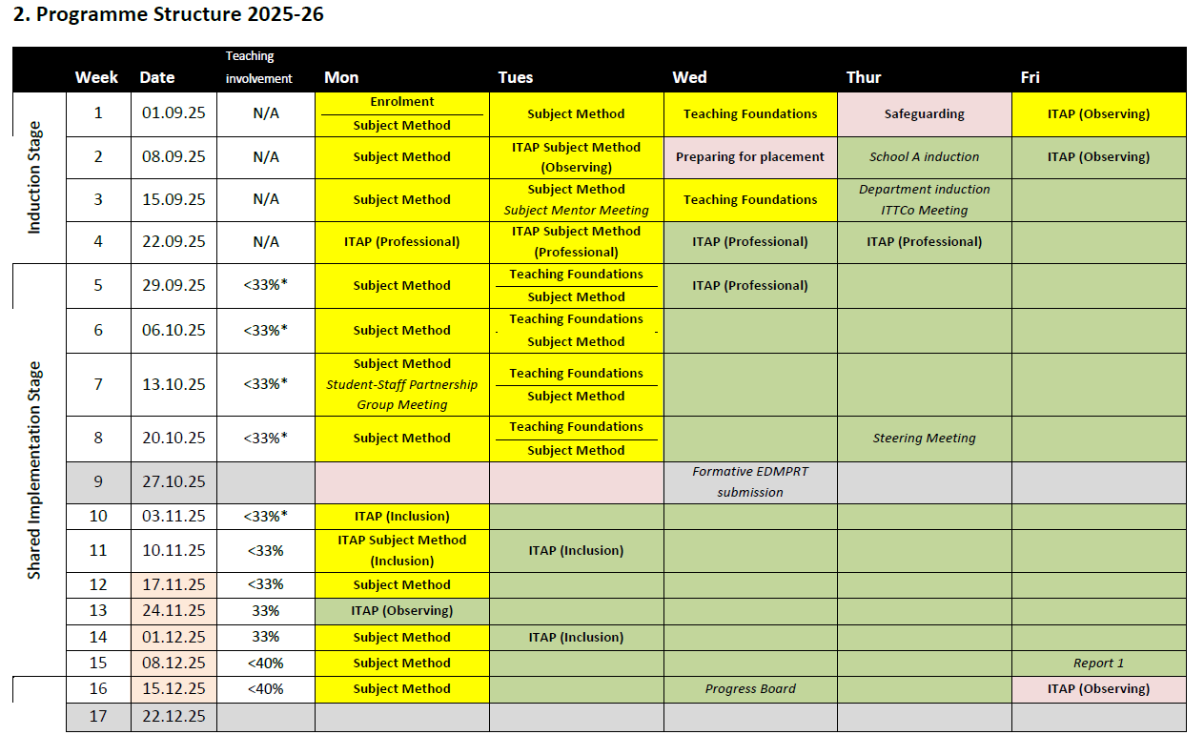
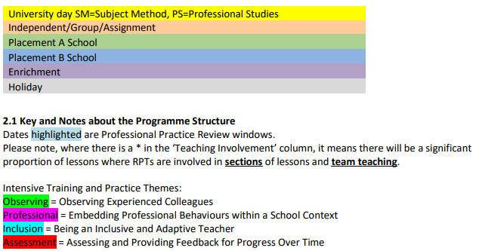
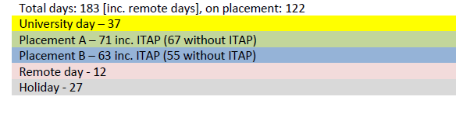
Programme Structure
Placement A 11th September- 13th February

Slide 5
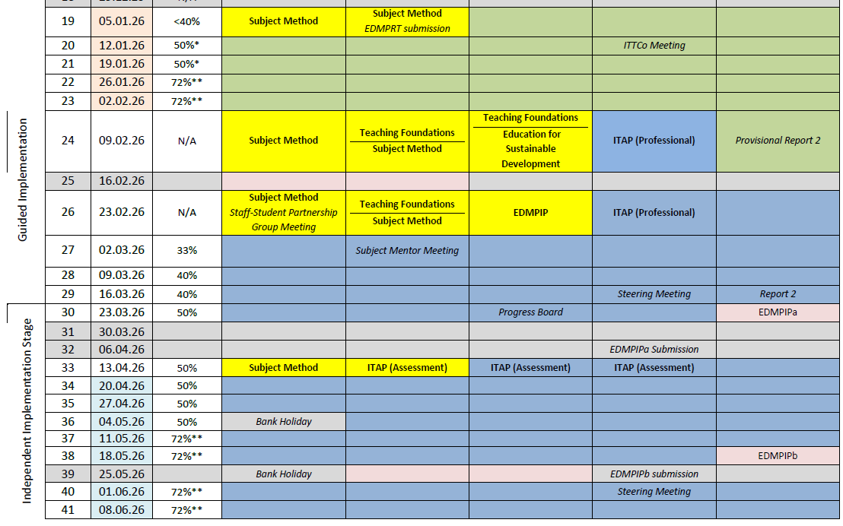
Placement B
26th February – 19th June

Slide 6
Our trainee teachers 2025-2026
Notes:
Share the names and subject specialisms of the trainee teachers you will be hosting this year. Depending on whether or not your mentors have met their RPTs, this is a good opportunity for them to share some information/background/experience/subject knowledge specialisms that they are bringing to the programme (the RPTs' Opening Position Statements are helpful here). This would also allow a discussion of how mentors might personalise their training to meet their RPTs' needs, and possibly considerations that they may need to have with regards, for example, if their RPT has very little/no school experience.

Slide 7
Communication: Getting it right
The school based mentor has responsibility for day to day communication with RPT and informing ITTCo of any issues. They also have a direct link with University tutor
The RPT could choose to involve the ITTCo and/or University Tutor / Subject leader – the version of events can sometimes become blurred when multiple people are involved
School Based Mentor
ITTCo (placement A and B)
RPT
University Tutor/SL
The ITTCo should be copied in on emails to university tutor / external communication with UoR
The University tutor / Subject Leader will sometimes communicate directly with the mentor/RPT and not necessarily the ITTCo so as mentor, please reply and CC ITTCO
Notes:
If communicating with university tutors/subject leads, it is helpful to cc the ITTCo

Slide 8
Consistency
ITTCo and mentor joint observation and feedback in Term 1
ITTCo / Mentor to review e-Portfolios
Fortnightly bulletin if necessary
ITTCo to join university visits from tutors if possible
Mentors to ensure consistency of high-quality feedback in department – model the REVIEW feedback style (see slide 19). Sit in on feedback given by other members of your department
Notes:
These are some of the ways in which ITTCos can ensure consistency in mentoring in their setting.

Slide 9
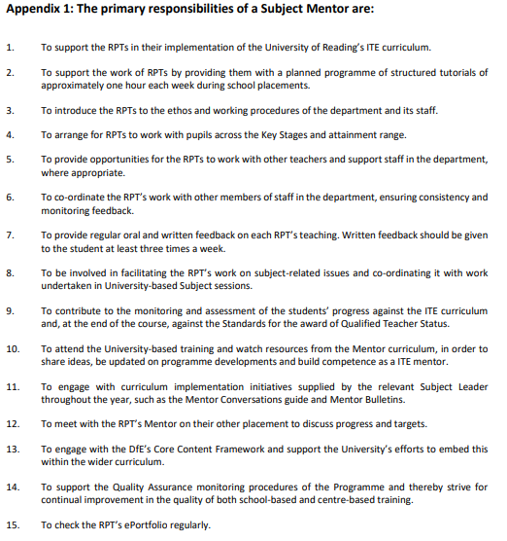
MOG: Subject Mentor Role

Slide 10
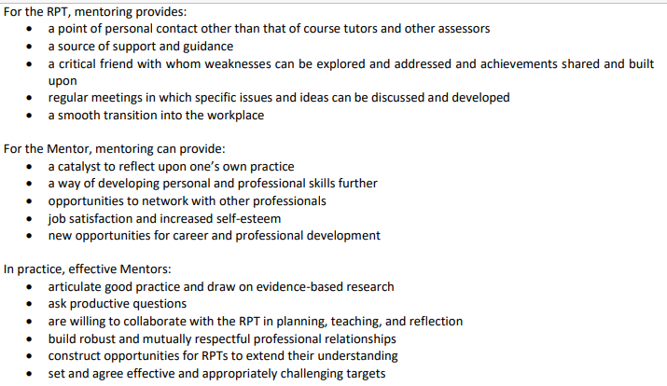
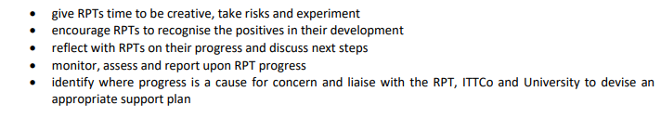
What this means in practice:
What does it mean to be a mentor in our school?
Notes:
Use this opportunity to discuss why they’ve been asked to be a mentor and what being a mentor means in the context of your school. You could frame this around your school ethos, for example, and draw out some of the considerations that might need to be made/mentors might need to think about to help their RPTs acclimatise to your school. For example, if your school is single sex or selective etc.

Slide 11
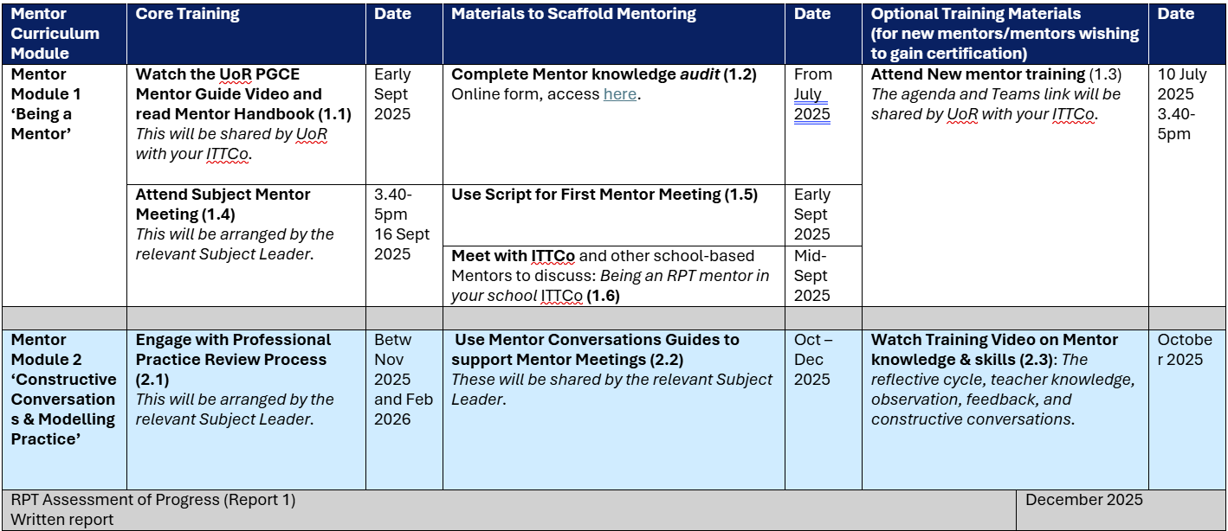
Notes:
This is the outline for the UoR Mentor Curriculum for 2025-26. Please direct them to the UoR Mentor Hub: https://sitesb.reading.ac.uk/ioe-mentoring/ All Mentors must engage with all Core Training. All Mentors can benefit from Materials to Scaffold Mentoring. New Mentors and Aspiring Mentors can engage with Optional Training Materials. Mentors who complete all Core and Optional Training will achieve UoR Mentor Certification.

Slide 12
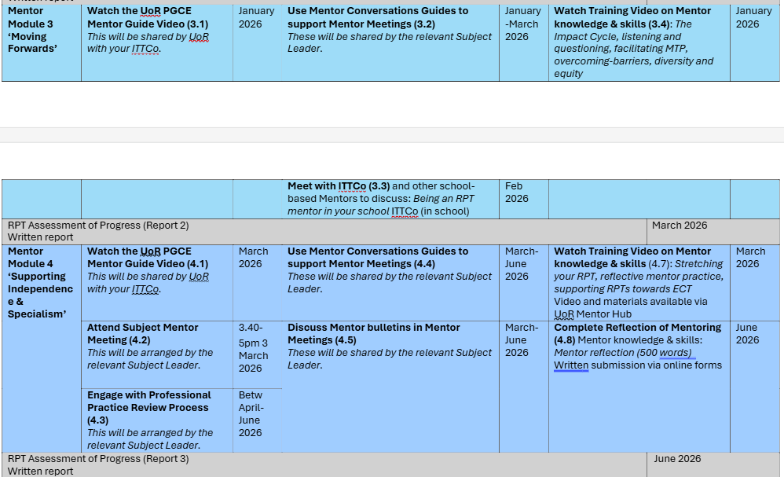

Slide 13
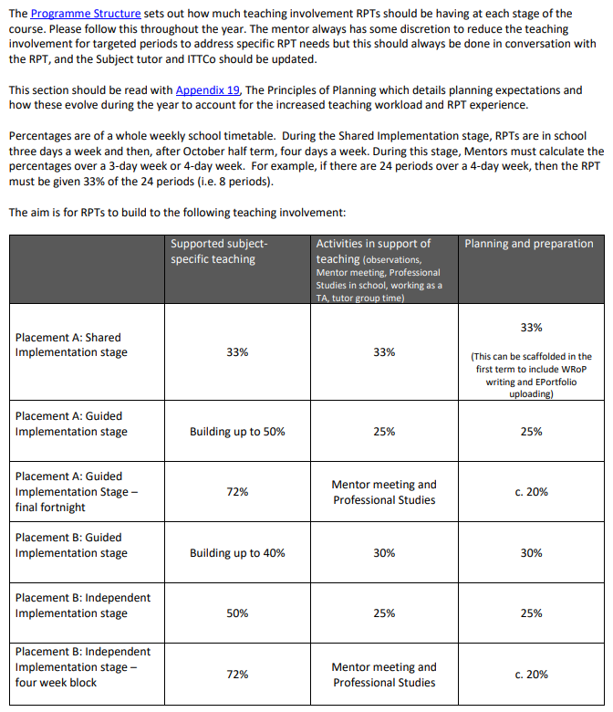
Timetable requirements
Please note Trainees are Wednesday-Friday until October half term (so 33% teaching load of 15 periods per week).
After October half term, Trainees are in school Tuesday-Friday so please bare this in mind for class allocation.
Please position mentor meeting on a Wednesday, Thursday or Friday each week.
Notes:
Slides 13 and 14 provide information on teaching involvement and timetabling from the MoG. Please talk this through with your mentors, as they should be aware of when the RPTs' teaching involvement increases.

Slide 14
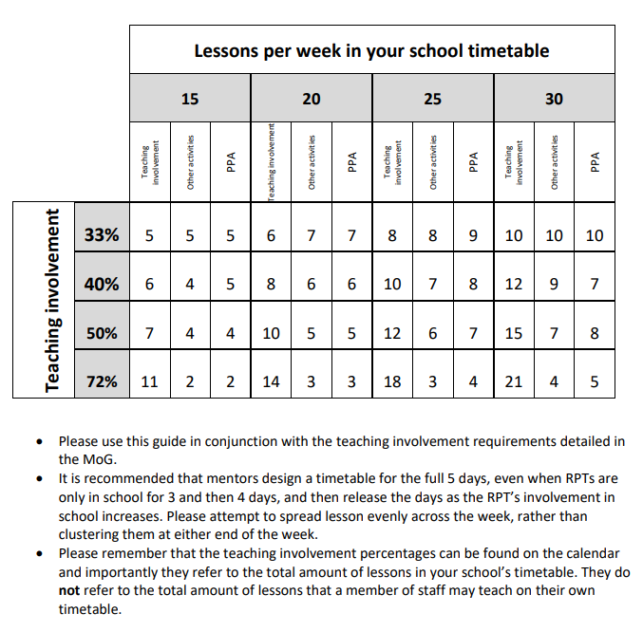

Slide 15
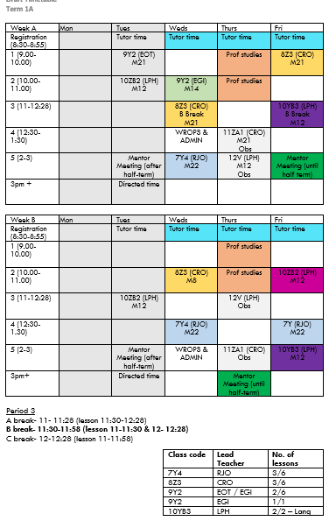
Example timetable
The mentor always has some discretion to reduce the teaching involvement for targeted periods to address specific RPT needs but this should always be done in conversation with the Academic tutor and ITTCo
Before half term: 5 lessons per week (can add more which are just observation lessons)
Should cover KS3, 4 and 5 (shared teaching)
Build in adding Tuesday for after half term
Timetable WRoPs and e-portfolio admin
Notes:
This is an example timetable, based on a 5 period day/two week timetable. Sharing an example timetable can be helpful for new mentors to see how this works in practice (and how they might want to plan for 72% teaching timetable, which the RPT will gradually build up to.
From the MoG:
‘Supported subject-specific teaching’ can involve:
• Teaching small sections of a lesson, using resources that the RPT has already observed being used effectively • Teaching small sections of a lesson from established resources
• Co-planning resources and observing an experienced teacher deliver them
• Micro-teaching within lessons, focussing on a particular aspect (e.g. substantive content exposition, welcoming pupils and setting starter, managing a transition, questioning pupils after a task, discussing homework, setting a difficult task by modelling an outcome with pupils, etc), with detailed planning and explicitly stated rationale
• Co-planning a full lesson with an experienced teacher, then teaching • Co-planning a lesson that is not currently taught or resourced, with an experienced teacher, then teaching
• Co-planning a short sequence of lessons, with an experienced teacher, then teaching.’
You may also want to discuss opportunities for 6th Form teaching, if that is appropriate for your school setting (see MoG, section 8.4)

Slide 16
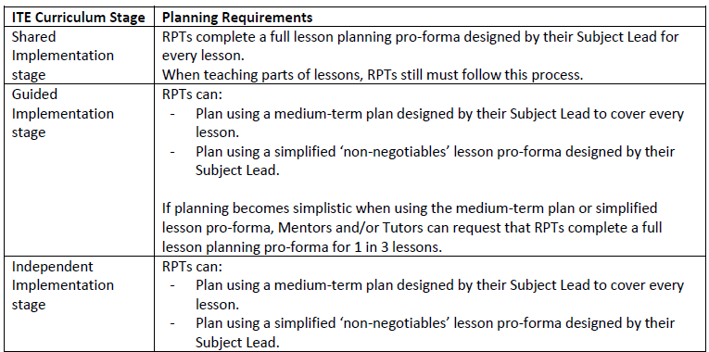
Lesson Planning
See MoG App. 19
Notes:
These are the lesson planning expectations across the different phases of the course.
There is opportunity here to discuss mentors’ facilitating RPTs’ access to teaching resources and existing plans (curriculum maps, schemes of work/medium term plans). Talking the RPTs through existing materials, how to access them, how and when to use them (and how they might be adapted) is really helpful.

Slide 17
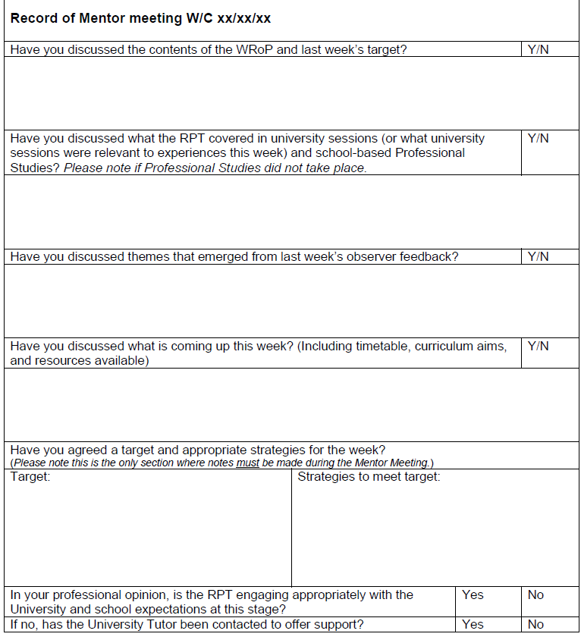
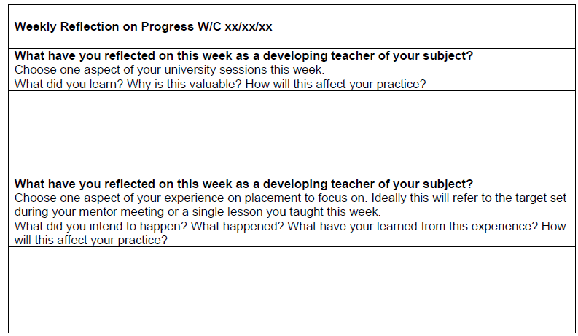
Weekly Records of Progress (WRoPs) & Mentor Meeting Logs
Notes:
One of the most important parts of the University of Reading Partnership programme is the WRoP. The purpose of this document is for RPTs to embed critical and constructive reflective practice into their day-to-day teaching. It is the RPT’s responsibility to write WRoPs. The WRoP will then be discussed as part of each Mentor Meeting, giving RPTs a chance to share and discuss with their Mentor their reflection upon some of their powerful experiences. Subject Leaders will share examples of effective and ineffective WRoPs; the important thing is that it should not be a description of all RPTs have done but a summary of their key learning ‘moments’.
During the Mentor Meeting each week, the Mentor will complete a Mentor Meeting Log. Guidance on completing this document is given here:
We recommend one target should be set, focusing on an area that will be most helpful to the RPT’s development in the following week. Targets will be informed by feedback given to RPTs on their teaching by staff in the previous week.
Each target should relate to an aspect of their development as a teacher (e.g. “Communicate effectively with parents regarding their child’s learning”) not to specific tasks (such as “prepare, attend and participate in Year 8 parents’ evening”, which is a strategy (or way) for meeting the target). If RPTs or Mentors want guidance on the distinction, they should discuss it with the University Tutor.
Targets should be SMART (Specific, Measurable, Achievable, Relevant, Time-bound).
Possible strategies or ways for meeting targets might include reading around an issue or aspect of their subject specialism, researching teaching resources, observations of teachers, trying out a strategy with a particular class.
This is a good opportunity to discuss how to set targets, SMART targets are helpful and should address the intended learning of RPT. For example 'improve timings' as a target is too vague and could be re-worded to something like: 'Consider the timing of activities for your Yr7 lesson, so that things don't overrun/there is dead time in the lesson'. Strategies can then be suggested to support the target, such as 'Observe the Yr7 lesson with teacher X, making a note of how much time is assigned to activities. Use a timer in your lesson as a reminder for yourself' etc.

Slide 18
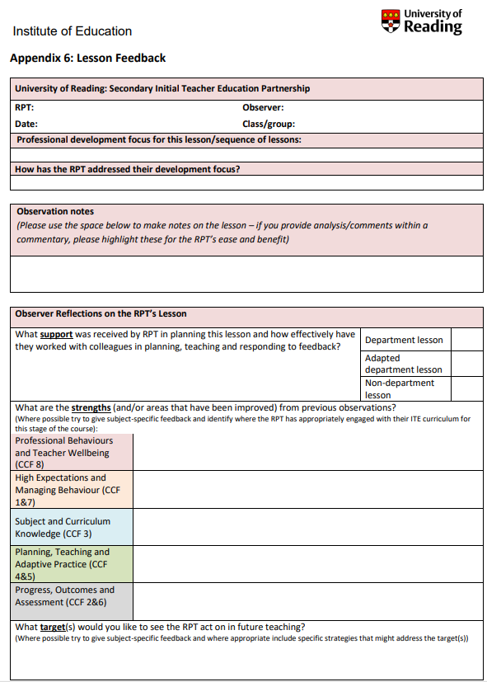
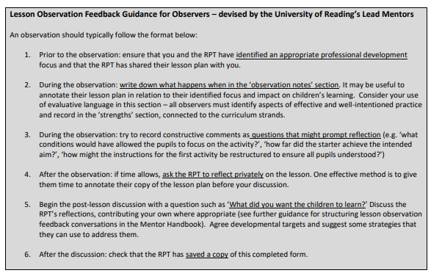
Lesson Feedback – App. 7 MOG
Notes:
Note that we’ve added guidance for observers to the lesson feedback form. Please encourage mentors to refer to this and disseminate good practice with other colleagues who are not mentors but may observe their RPT and provide feedback.

Slide 19
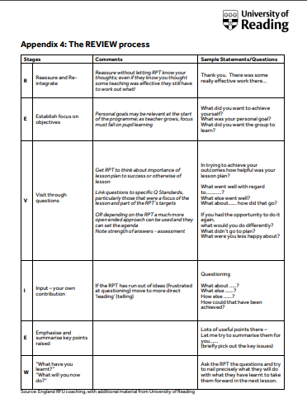
Lesson Feedback: The REVIEW process (UoR ECTs will be used to this style of feedback)
Reassure and re-integrate
Establish focus on objectives
Visit through questions
Input – your own contribution
Emphasis and summarise key points raised
What have you learnt? What will you do now?
Please ensure this guidance is shared with ALL teachers who will be giving feedback
Notes:
You can use the opportunity to discuss how and when feedback should be given (positive framing; and soon after the observation wherever possible). Rather than asking how the RPT thought the lesson went, mentors/observers can ask: 'what did you want the pupils to learn? How far do you feel this was achieved?'
Note that mentor training 2.3 (a video released in October) will cover observation and feedback.

Slide 20
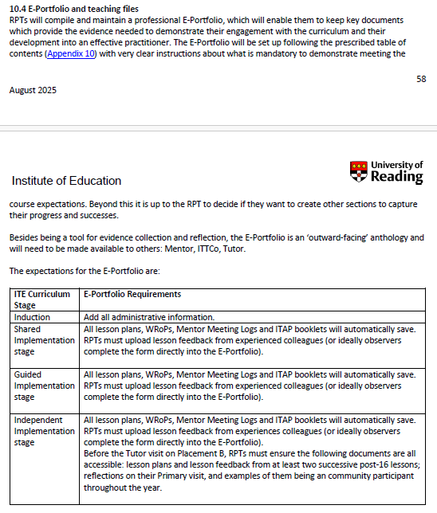
E-Portfolio
You trainee will be trained in how to complete these and they will show you.
You will be emailed a link so you can access.
Previous mentors can offer support if necessary

Slide 21
School-Based Professional Studies
Notes:
Please share your PS timetable with your mentors, so that they are aware of what is covered when (it may form part of the mentor meeting conversation that week).

Slide 22
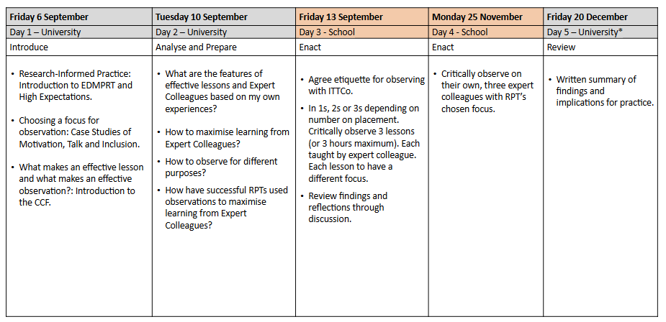
ITAPs (Intensive Training and Practice)
ITAP1 Observing Expert Colleagues
Notes:
RPTs will be responsible for completing a booklet. Ensure you are aware of when ITAPs are and refer to these in mentor meetings.

Slide 23
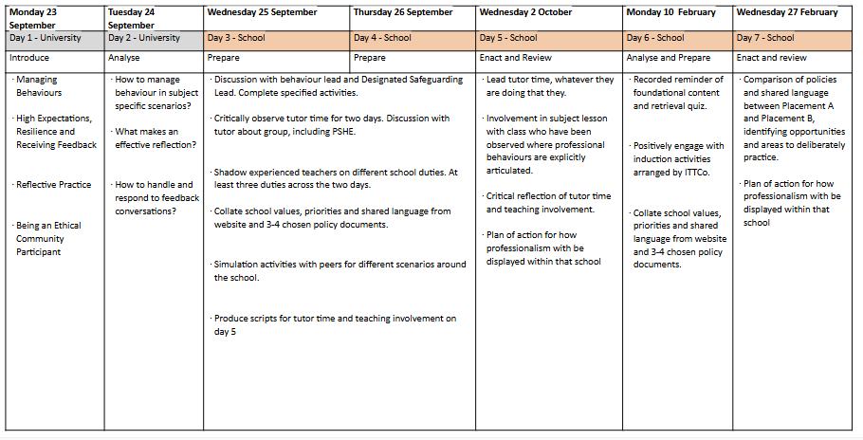
ITAP2: Professional Behaviours
Notes:
Depending on how you're organising the school-based aspects of the ITAPs, please do share your expectations of mentor involvement in these activities.

Slide 24
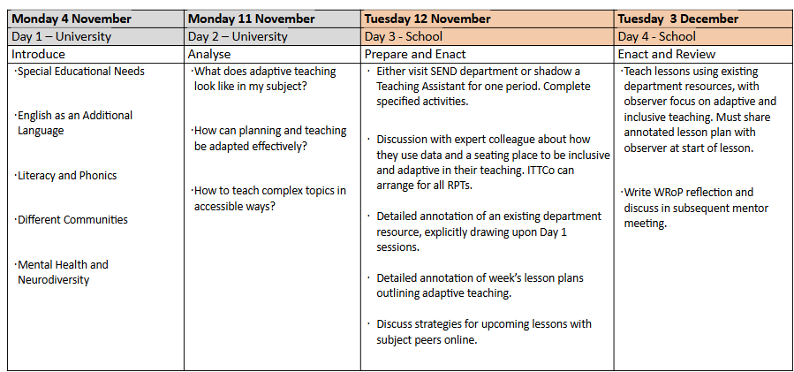
ITAP3: Being an Adaptive & Inclusive Teacher

Slide 25
Scenarios
Your RPT repeatedly misses deadlines, doesn't appear to read emails and is frequently late for meetings.
What do you do?
When in front of a class, your RPT appears very nervous and seems to be avoiding getting involved in teaching.
What do you do?
A colleague has requested that your RPT no longer observe them teach, as the RPT did not appear to be engaged in their lesson (they just sat at the back of the classroom typing on their laptop) or show any interest in talking about it with the teacher afterward.
What do you do?
Notes:
Use these scenarios to discuss how mentors might handle potentially difficult situations with their RPT. If you have experienced mentors, they will be able to share their experiences with new mentors.

