Slide 1
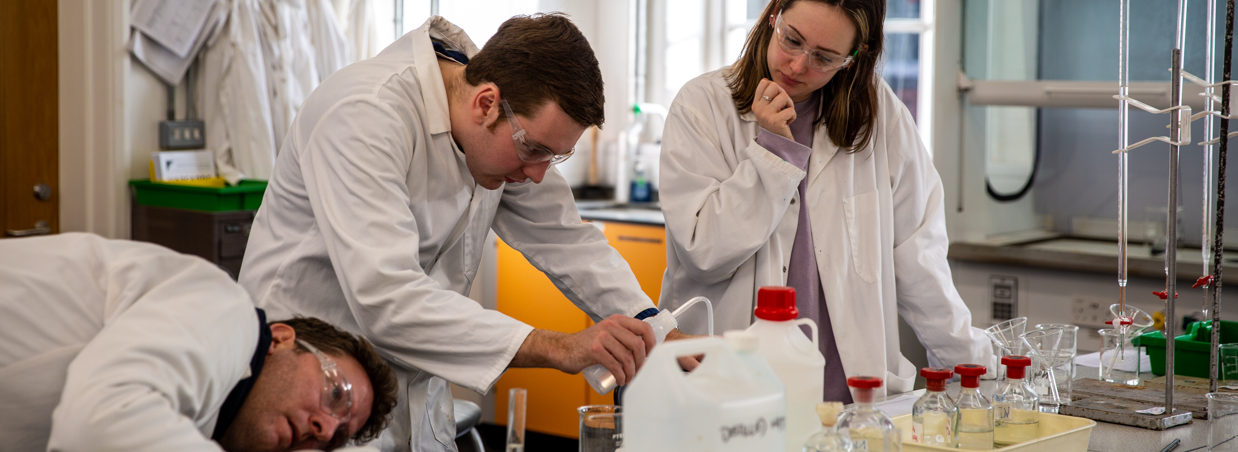
PGCE Secondary Science Professional Development Mentor Meeting
PGCE Secondary Science
2024-25
11/03/25

Slide 2
Agenda
Welcome and programme update ​
Key messages from School B Mentor training & being a Science mentor ​
Starting from where they are: key strengths and areas for development from PPR2 visits and Report 2 ​
Assessment ITAP
Supporting Science RPTs in the independent stage: ​
Looking towards Report 3 and the Teachers’ Standards
Opportunities at School B​
Making the most of observation and feedback​
Supporting planning
Thinking about Science pedagogy and taking risks​
AOB ​
Notes:
Welcome and programme update (5mins)
Key messages from School B Mentor training & being a SUBJECT mentor (15mins)
Starting from where they are: key strengths and areas for development from PPR2 visits and Report 2 (15mins)
Supporting SUBJECT RPTs in the independent stage:
Opportunities at School B
Making the most of observation and feedback
Supporting planning
Thinking about SUBJECT pedagogy and taking risks
Using the mentor bulletins and conversation prompts
Looking towards Report 3 and the Teachers’ Standards (40mins)
AOB

Slide 3
Welcome & Programme Updates
Staffing
Margie Choi - administrator
pgcesecondary@reading.ac.uk
Head of School: Dr Sarah Marston
Director of Teaching and Learning: Dr Jo Anna Reed-Johnson
Head of ITT: Dr Catherine Foley
Director of Secondary: Will Bailey-Watson
Secondary Science Co-Lead : Andrew Happle and Caroline Foulkes.
Science Academic Tutor – Will Prowse
Science Technician – Carolyn Fox
pgcescience@reading.ac.uk (shared inbox for Caroline, Andrew and Will)

Slide 4
Welcome and programme update
Key messages from School B Mentor training & being a Science mentor
Starting from where they are: key strengths and areas for development from PPR2 visits and Report 2
Supporting Science RPTs in the independent stage:
Looking towards Report 3 and the Teachers’ Standards
Opportunities at School B
Making the most of observation and feedback
Using the mentor bulletins and conversation prompts
Supporting planning/EDMPIP
Thinking about Science pedagogy and taking risks
Assessment ITAP
AOB

Slide 5
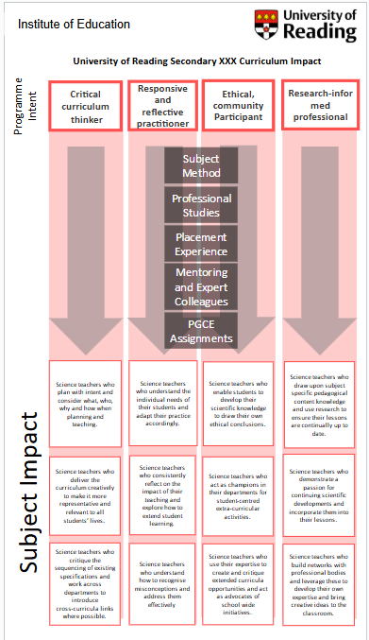
Understanding the UoR ITE Programme
Link to googledrive 'dropbox' for these documents
Manual of Guidance
Secondary Science Handbook
Professional Studies Handbook
Assignment Handbook (EDMPIP)
Link to Mentor Hub
Mentor Curriculum
Curriculum conversations
Mentor training and meeting slides
Notes:
An introduction to mentoring a placement B RPT [20mins]
An overview of UoR’s ITE curriculum for placement B [20mins]
https://drive.google.com/drive/folders/1CSBA7YOx_fc3yi5-LTQfmzz99BNgbRij

Slide 6
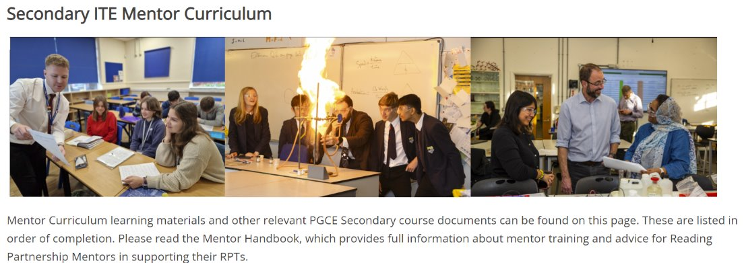
https://sitesb.reading.ac.uk/ioe-mentoring/
Notes:
Reminder!
https://sitesb.reading.ac.uk/ioe-mentoring/

Slide 7
Being a School B Mentor
Early idealism
Personal survival
Dealing with difficulties
Hitting a plateau
Moving on (Furlong & Maynard ,1995; Burn et al, 2015)​
Mentor role: range of support
Stages of development:
SUGGESTIONS:
Establish a positive relationship from the outset, showing that you believe they are significant, competent, and likeable.
Use the reflective cycle questions to help structure your conversations.
Be explicit about what you do, how you do it and why you do it.
Plan topics to cover at different stages of the course.
Highlight praise and make it specific.
Notes:
Range of aspects of the mentor role:
Professional support (such as showing the trainee how to put ‘praise points’ onto the database and discussing when this would be appropriate)​
Pedagogic support (such as demonstrating how to ‘model’ some writing during a lesson and discussing how it worked afterwards)​
Academic support (such as suggesting a book on basic grammar knowledge that you’ve read) ​
Emotional support (such as comforting them if they have a difficult lesson) (Roberts, 2020)
Be aware of the stages of development (and where your RPT is in this journey):
Early idealism: ‘in which trainees tend to identify quite closely with the pupils and seek inspiration in the example of significant teachers recalled from their own schooldays. Their analysis of these teachers... Tends to be framed in terms of the teachers’ personality and the relationships that they established, rather than reference to the planning and structure of their lessons or their pedagogical strategies.’ ​
Personal survival: ‘in which trainees tend to feel vulnerable and crave the assurance of being seen as a teachers. They are therefore keen to fit in and become anxious ab out securing effective control of their classes.​
Dealing with difficulties: ‘in which the emphasis is on establishing themselves as a teacher by implementing specific policies (particularly in relation to managing pupils’ behaviour) and demonstrating their ability to organise and execute different kinds of learning activities.​
Hitting a plateau: in which progress my stall as the trainees demonstrate their competence and confidence in running a classroom, and implementing different kinds of activity. Only if they are sufficiently challenged and encouraged to look more closely at the pupils’ experience and the evidence of their learning will they move on.​
Moving on: the final phase in which they are able and willing to adapt their teaching in response to critical evaluation of the pupils’ needs and their ongoing learning.​ (Furlong & Maynard, 1995; Burn et al, 2015)
Suggestions:
Conversation questions for initial/first meetings/’contract’ and reflective cycle questions: see Mentor Handbook: Section 4 ‘Guidance for Mentors’ and you could make use of a mentoring expectations ‘contract’ (see Appendix 16). Also ‘needs analysis’, this will have been established from the mentor handover meetings and the RPTs’ self-audit document, linked to interim Report 2.

Slide 8
Step in Gibbs’ reflective cycle | Example questions/prompts
Description | - Tell me what happened in your lesson on Tuesday. - Can you describe the incident with Joanna in more detail? - What were you thinking/feeling at that point?
Evaluation | - Thinking about what you wanted the pupils to learn, how effective did you think that activity was? - What did you find easy/difficult?
Analysis | - Why do you think your lesson on reproduction with Yr7 was difficult? How was it different to the previous lesson with that class?
Conclusions | - If you were to teach that lesson again, what would you change?
Action plan | - As you’ve suggested that most of the class found the first activity too easy, let’s think about pitch and pace at the beginning of lessons…
Notes:
Part of reflective cycle, not dissimilar to the Impact Cycle from Instructional Coaching (Knight, 2022): IDENTIFY, LEARN, IMPROVE
See also: REVIEW module in MoG

Slide 10
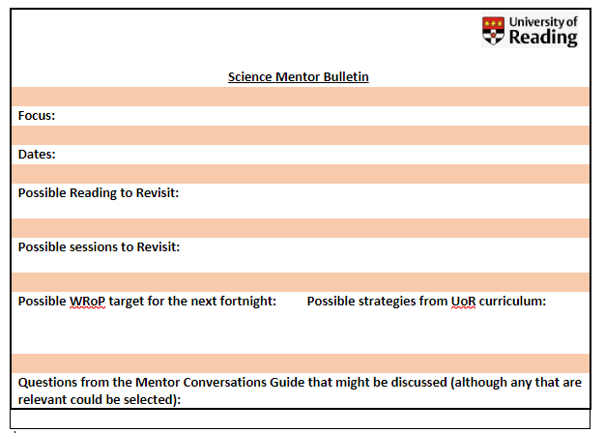
Using the Mentor Bulletins & Conversation Prompts
Fortnightly from March
Connected to a curriculum strand

Slide 11
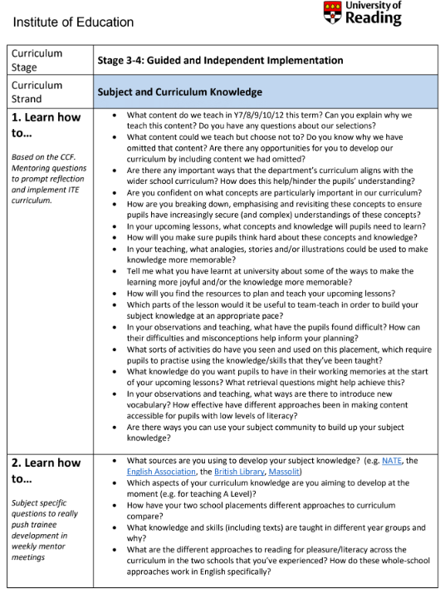
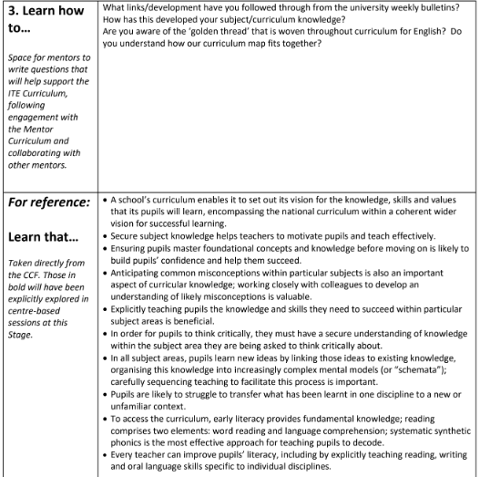
Personalised
Generic
CCF
Subject-specific
Notes:
Ask if anyone has used any so far this year (or from last y
How and when could you use these prompt questions with your RPT? What might your follow up guidance be in response to their answers?
ear) and how they used them.

Slide 12
Welcome and programme update
Key messages from School B Mentor training & being a Science mentor
Starting from where they are: key strengths and areas for development from PPR2 visits and Report 2
Supporting Science RPTs in the independent stage:
Looking towards Report 3 and the Teachers’ Standards
Opportunities at School B
Making the most of observation and feedback
Using the mentor bulletins and conversation prompts
Supporting planning/EDMPIP
Thinking about Science pedagogy and taking risks
Assessment ITAP
AOB

Slide 13
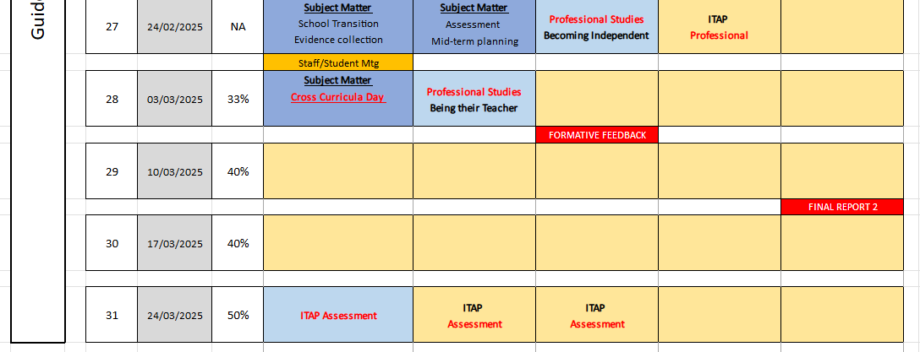
End of Guided Implementation – settle in, report 2, ITAP Assessment
Mentor Meeting

Slide 14
ITAP Focus 4: Assessing and Providing Feedback for Progress Over Time
CCF Focus: Planning and Teaching, and Assessment
Desired outcomes: RPTs demonstrate curriculum intent over sequences of lessons, use a variety of assessment methods throughout sequences, and critically engage with what learning has taken place over time and how they continue to support pupil progress through feedback.
Monday 24 March | Tuesday 25 March | Wednesday 26 March | Friday 20 June
Day 1 – University | Day 2 – School | Day 3 - School | Day 4 - School
Introduce | Analyse | Prepare and Enact | Enact and Review
Using the CCF as a basis for improving assessment practice. Making feedback meaningful and lasting. Planning, teaching and assessing for progress over time as an independent RPT. | Choose two year groups to focus on for the remainder of the ITAP, ideally from two Key Stages. Complete an upcoming assessment that will be set for each of the two chosen Key Stage classes in the conditions they will be completing it under, and reflect on the how this affects teacher knowledge and understanding of the support they will need in order to complete the assessment well. Discuss a mark scheme for each of the two chosen Key Stage classes with an experienced colleague. Choose two pupil outcomes to discuss and decide what their responses reveal about the pupils’ understanding of their learning. | Discussion with expert colleague about what data they use to meaningfully assess pupils in this school(e.g. progress reviews, end of year exams, daily retrieval quizzes, online systems, etc). (Day 2/3) Make detailed annotations of a medium term plan for each of the two chosen Key Stage classes plans. Identify what knowledge pupils are to draw upon in each lesson, how that knowledge will help the pupils make progress in the lesson, and what learning will look like at the end. (Day 2/3) Detailed annotation of a lesson plan (or resource if using the medium term plan) for a lesson to be taught on Day 3. Must explicitly draw upon Day 1 sessions. Teach one lesson with observer focus on questioning and formative assessment. | Collect sample of pupil work from each of the two chosen Key Stage classes. There must be at least two contrasting pupils from each of the two classes. Use appropriate assessment methods (marking, observing, reading, listening) to assess what each pupil has learnt, how this is known, and what feedback each pupil requires to move forward. Review what pupils in the two chosen Key Stage classes have learnt and the implications for future practice.

Slide 15
Starting from where they are
What have you learnt about your RPT in terms of their strengths and areas for development?
Strengths
Routines and rapport
Ensuring silence and attention
Understanding adaptive practice and needs in room
Knowledge of range of assessment strategies
Development ​
​Effective implementation of new Behaviour policy
Subject knowledge
Opportunities for practical work
Formative assessment
Implementing adaptive practice effectively
Demonstrating progress over time
Notes:
What have you learnt about your RPT in terms of their strengths and areas for development? – ideas in the chat. Are there commonalities? What is very specific to your RPT?
This is the WCF we’ve collated from our PPR2 visits. How might we address some of the areas for development? Ideas in the chat.

Slide 16
Welcome and programme update
Key messages from School B Mentor training & being a Science mentor
Starting from where they are: key strengths and areas for development from PPR2 visits and Report 2
Supporting Science RPTs in the independent stage:
Looking towards Report 3 and the Teachers’ Standards
Opportunities at School B
Making the most of observation and feedback
Using the mentor bulletins and conversation prompts
Supporting planning/EDMPIP
Thinking about Science pedagogy and taking risks
Assessment ITAP
AOB

Slide 17
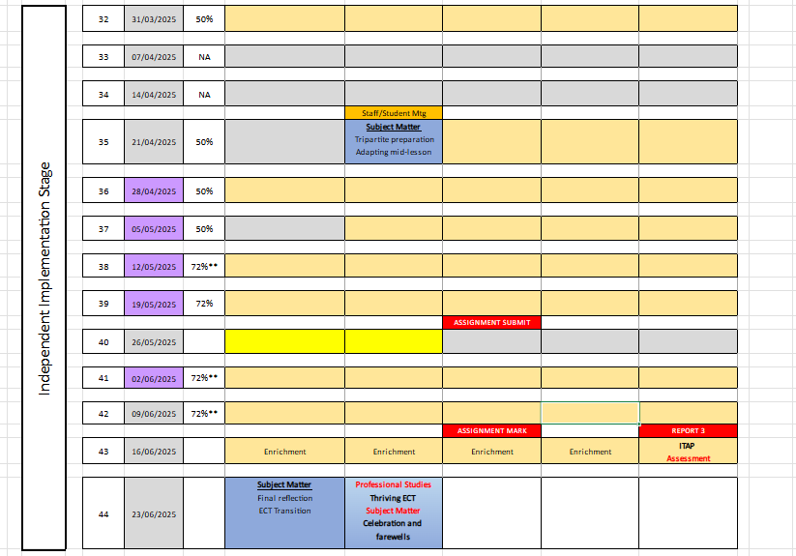
EDMPIP – intervention to support learning
Identify focus
Pre-test/establish baseline
2-4 lessons including intervention
Post-test/Assess impact
Report 3
Tripartite Visits
Lesson observation
Discuss Best evidence guide (BEG)
Set targets to meet TS by report 3

Slide 18
TEACHER STANDARDs
https://assets.publishing.service.gov.uk/government/uploads/system/uploads/attachment_data/file/974307/ITT_core_content_framework_.pdf
https://www.gov.uk/government/publications/teachers-standards
CCF /TS
High Expectations
How Pupils learn
Subject and Curriculum
Classroom Practice
Adaptive Teaching
Assessment
Managing Behaviour
Professional Behaviours
Institute of Education, University of Reading Curriculum
a) Showing professional behaviours and becoming an ethical community participant
b) Building knowledge of their subject and curricula choices
c) Showing high expectations and getting to know pupils
d) Planning and teaching appropriate, ambitious lessons
e) Taking responsibility for behaviour management
f) Adapting practice in response to learners’ needs
g) Demonstrating pupil progress on different time scales
h) Using assessment for formative and summative purposes

Slide 19
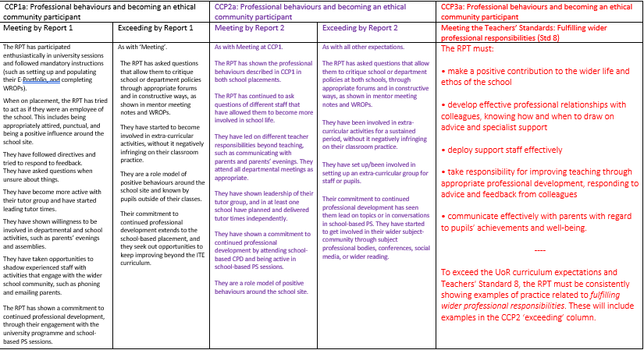
Notes:
How the CCPs map onto the TS for R3

Slide 20
Three teaching modules:
Shared
Guided
Independent
Teaching 50% of a school timetable for a sustained period; opportunity of rising to 72% for Wks 38,39 & 41, 49
Assessment – Report 2 on 21st March (same Excel spreadsheet)
Collecting ‘evidence’ against the Teachers’ Standards – making use of the e-Portfolio
Writing a Best Evidence Guide
Evidence includes:
A WROP
A lesson plan
A sequence of lessons
A resource you produced
Pupil work
Examples of your marking
Feedback from observers
Emails from parents/colleagues/pupils
Notes:
Timetable – 50% by Easter. Of the WHOLE timetable. 60% for final two weeks of teaching.

Slide 21
Discussion
Please add tips on mentoring to the chat
How to stretch an RPT who is coping well
How to support an RPT who is finding it hard
Supporting their transition

Slide 22
Making the most of the opportunities Sch B can afford
How is your school context different to School A?
What opportunities will this provide for your RPT and how can they capitalise on this?

Slide 23
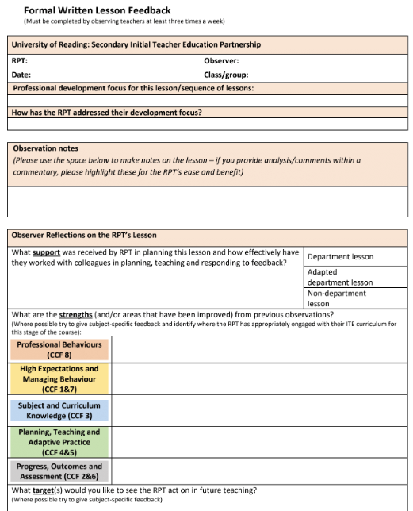
Observation & Feedback
What is your current practice?
Do you provide a live ‘account’ of lesson? How do you frame/word what you see?
When you give verbal feedback, how do you structure this?
Utilise Reflective Practice
Instead of asking ‘How do you think that went?’
Ask: ‘What did you want the pupils to learn?’
Ensuring other colleagues who will provide feedback are aware of how to do this – trickle down of mentor training!
Notes:
What is your current practice? Take points in the chat.
Emphasise that this practice is what would be great to see when we do our PPR visits!

Slide 24
Course Expectations for Planning
Shared Implementation stage (Oct-Dec) | RPTs complete a full lesson planning pro-forma designed by their Subject Lead for every lesson. When teaching parts of lessons, RPTs still must follow this process.
Guided Implementation stage (Jan-March) | RPTs can: Plan using a medium-term plan designed by their Subject Lead to cover every lesson. Plan using a simplified ‘non-negotiables’ lesson pro-forma designed by their Subject Lead. In science this is the same full planning proforma but the level of detail might reduce or be specific to targets or class for every lesson. Whether RPTs choose to use the medium-term plan or the simplified lesson pro-forma, all RPTs must complete a full lesson planning pro-forma for 1 in 3 lessons.
Independent Implementation stage (March-June) | RPTs can: Plan using a medium-term plan designed by their Subject Lead to cover every lesson. Plan using a simplified ‘non-negotiables’ lesson pro-forma designed by their Subject Lead. In science this is the same full pro-forma with specific details to evidence thinking towards targets. Whether RPTs choose to use the medium-term plan or the simplified lesson pro-forma, all RPTs must complete a full lesson planning pro-form for 1 in 5 lessons.
(MoG, Appendix 20 ‘Principles of Planning’)
Notes:
Discuss support for planning that RPTs have had. Any issues arisen from those who were Sch A mentors?
Note that the forthcoming ITAP4 (18th -20th March) will focus on planning for progress and use of assessment.

Slide 25
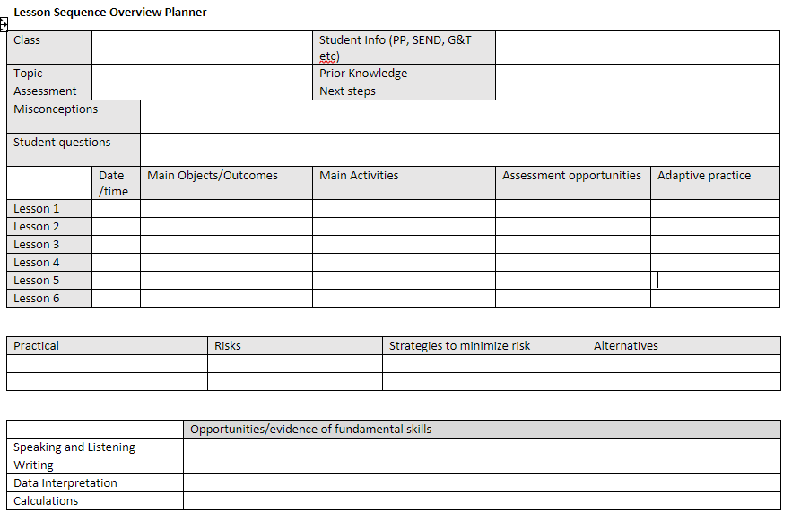
Science medium term plan
Could add ‘evaluation’ column
Can form rich evidence of RPT planning but only if intent is made explicit for each section so they can explain why they are using each resource or activity
Populate from SoW/dept resources
Include as much detail as possible
Students to unpick and adapt for each class
Will need to be a ‘working document’

Slide 26
Using departmental resources
Dept SoW
Dept PP and workbooks
Used consistently
Dept shared drive
Bank of resources
Dept SoW
Where is your dept on this continuum?
How will you ensure your RPT can articulate their planning and collect evidence of TS?
Minimal opportunity to modify but adaptable to specific class
RPT MUST be able to create a written plan that explains how they will deliver that lesson to that class using ideas from CCF
Staff have autonomy to create own lessons.
RPT have opportunity to plan from LO on SoW drawing on ‘tried and tested’ resources.
Lesson plan must draw on ideas from CCF

Slide 27
Discussion
Please consider what the resources are like in your school and add to chat box (it helps us to be aware of how each school differs)
How can you support the RPT with planning and reflecting and lead them to become independent? Ideas in the chat?

Slide 28
WROP Targets and record of mentor meeting
WROPS should 'tell the story' and clearly identify what the student is working on
Well thought out WROPS provide good evidence of progress for BEG.
Mentor and Class teachers should be able to write directly into the e-portfolio.
Reflections and progress towards previous week’s targets should be done by RPT in advance of mentor meeting
New targets/strategies and record of meeting should be added at or just after the meeting
Some are missing specific weekly targets and strategies to achieve these targets.
Some are missing the records of topics discussed at mentor meetings
Some are missing the box checked that RPT is engaging appropriately

Slide 29
To summarise
Please communicate with us if you have any concerns – we can pop in to see teach and help with setting targets before Easter. pgcescience@reading.ac.uk
Several students are on Additional Support or haven't quite got up to the 60% teaching – mainly but not exclusively, those who were educated overseas. We will contact you to check how they have coped with transition.
New guidance from DfE for increased timetable – we are happy with slow and steady. Long game.
Please nag RPTs as needed and ensure their organisation is good and there is time allocated for regular updates to e-portfolio
Encourage recognition that planning doesn't stop, but the focus can change, and the notes can be abbreviated – permission needs to be sought if moving from uni template
Competency in standards over time is essential not just one incident.
Encourage participation in CPD/science meetings
Remind students to relate practice back to core content framework, subject sessions PS and reading.

Slide 30
Questions?

