Slide 1
PE Professional Development Mentor Meeting (Mentor Curriculum 4.1)
PGCE Secondary PE
2024-25
11.3.25
Harvey Grout
Notes:
Say hello and school in the chat

Slide 2
Agenda
Welcome and programme overview
Being School B PE mentor: sharing good practice
Starting from where they are: common strengths and areas for development from PPR2 visits
Supporting PE RPTs in the independent stage:
Opportunities at School B
Using the mentor bulletins, conversation prompts & setting targets
Looking towards Report 3 and the Teachers’ Standards
Questions/AOB
Supporting planning
Thinking about PE pedagogy and taking risks

Slide 3
Being a School B Mentor

Slide 4
Timetable
Notes:
Ask any Sch A mentors how they managed the move up to 72% teaching timetable
See Appendix 20

Slide 5
What have you learnt about your RPT in terms of their strengths and areas for development?
Some Whole Class Feedback from PPR2:
Strengths ​
Behaviour Management​
Subject Knowledge​
LOs and sequencing of tasks​
Relationships with classes​
Positive and friendly ​
Knowledge of pupils (and how to support them)
Development ​
AfL/checking for understanding and progress​
Ensuring key learning is 'front and centre’ (​plan backwards from an intended outcome and think about timing of activities so things don’t run over)
Adapted practice
Peer Assessment

Slide 6
Report 2
Notes:
Any questions regarding completing R2?
Reminder that it is on the same Excel spreadsheet. Should be a copy in the RPTs' ePortfolio

Slide 7
Supporting PE RPTs in the Independent Stage

Slide 8
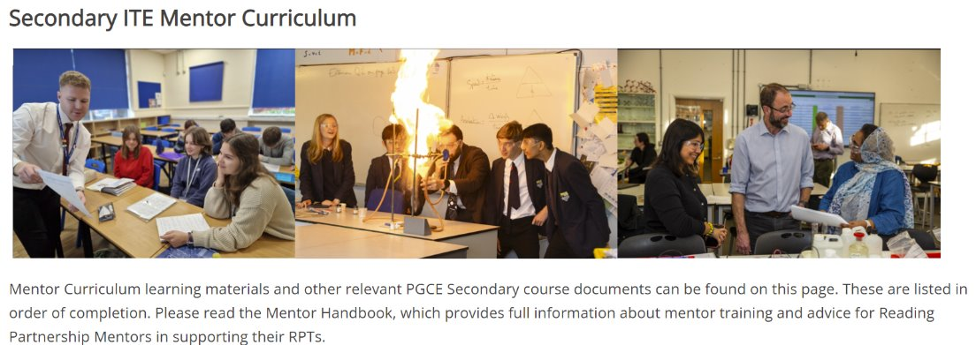
https://sitesb.reading.ac.uk/ioe-mentoring/
Notes:
Reminder!
https://sitesb.reading.ac.uk/ioe-mentoring/

Slide 9
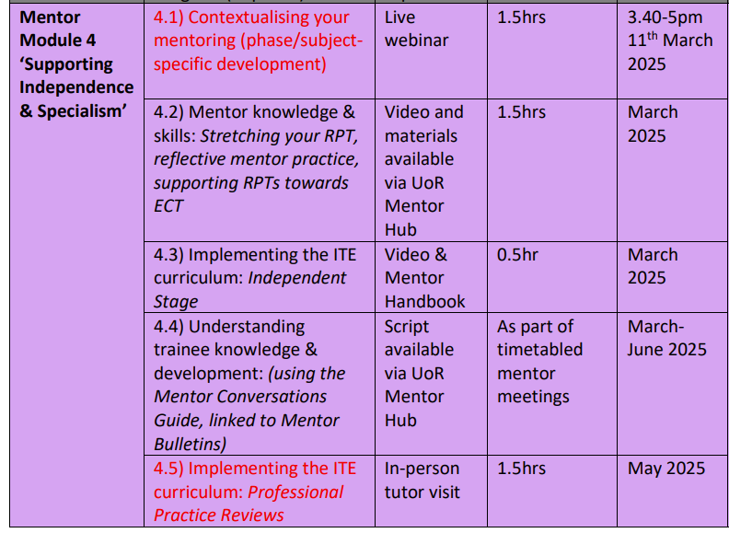
Mentor Curriculum
Notes:
Completion of this training, including the mentor reflection, will result in UoR mentor certification. Module 4 ‘Supporting Independence & Specialism’ has started. As you can see the mentor modules are aligned to the RPTs’ developmental stages.
Any questions at this point about mentor training?

Slide 10
Making the most of the opportunities Sch B can afford
How is your school context different to School A?
What opportunities will this provide for your RPT and how can they capitalise on this?

Slide 11
Course Expectations for Planning
Shared Implementation stage (Oct-Dec) | RPTs complete a full lesson planning pro-forma designed by their Subject Lead for every lesson. When teaching parts of lessons, RPTs still must follow this process.
Guided Implementation stage (Jan-March) | RPTs can: Plan using a medium-term plan designed by their Subject Lead to cover every lesson. Plan using a simplified ‘non-negotiables’ lesson pro-forma designed by their Subject Lead. Whether RPTs choose to use the medium-term plan or the simplified lesson pro-forma, all RPTs must complete a full lesson planning pro-forma for 1 in 3 lessons.
Independent Implementation stage (March-June) | RPTs can: Plan using a medium-term plan designed by their Subject Lead to cover every lesson. Plan using a simplified ‘non-negotiables’ lesson pro-forma designed by their Subject Lead. Whether RPTs choose to use the medium-term plan or the simplified lesson pro-forma, all RPTs must complete a full lesson planning pro-form for 1 in 5 lessons.
(MoG, Appendix 19 ‘Principles of Planning’)
Notes:
Discuss support for planning that RPTs have had. Any issues arisen from those who were Sch A mentors?
Note that the forthcoming ITAP4 (18th -20th March) will focus on planning for progress and use of assessment.

Slide 12
Using the Mentor Bulletins & Conversation Prompts
Fortnightly in the Independent Phase
Connected to a curriculum strand
PE Mentor Bulletin
Focus: Subject and Curriculum Knowledge
Dates: 03/03/25
Possible Reading to Revisit:
Sullivan, L. (2021) ‘Changing our Curriculum Offer: From Traditional to a Concept Driven Approach’ RPTs could be asked to revisit Sullivan’s article on designing a concept driven curriculum. You could ask the RPTs to summarise the article and give two ways this article could influence your PE practice
OR Beckley, A. (2023) ‘4Ms of transformative PE curricula’
RPTs could be asked to read Beckley’s article and consider how they may consider the 4Ms and look to deliberately plan and make time for them within their PE lessons.

Slide 13
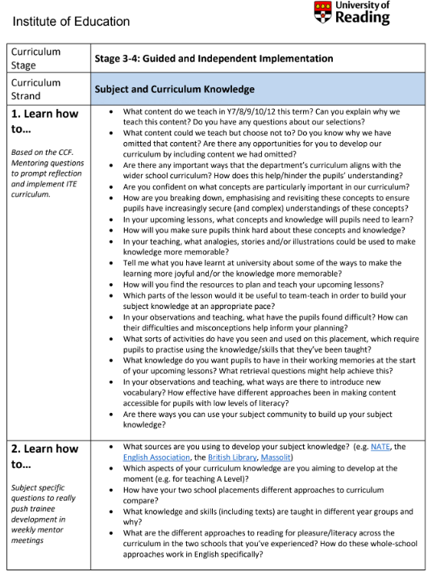
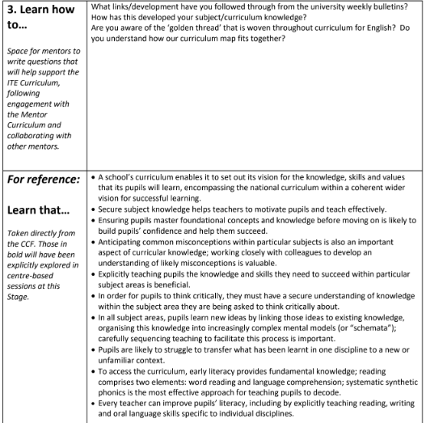
Personalised
Generic
CCF
Subject-specific
Notes:
Ask if anyone has used any so far this year (or from last year) and how they used them.

Slide 14
Target Setting

Slide 15
ITE Curriculum Strand | Target (What is the intended learning? What kind of target is it? How long will the target last?) | Strategy (What actions/tasks will enable them to achieve the target?) | Progress towards target (Have they achieved the target? What are the next steps?)
Professional Behaviours & Teacher Wellbeing | Build your presence as a teacher around the school [SKILL; medium-term) | Read the school policies on behaviour moving around the school site; shadow a teacher on duty; talk to students outside of the classroom SO THAT the trainee builds their teacher presence beyond the c/room. | Trainee regularly shadows a duty; they feel more confident in their role; they've started to build relationships outside of the c/room
High Expectations & Managing Behaviours | Develop a range of strategies in the classroom to engage and motivate students [SKILL; long-term] | Observe teacher X and note how they use non-verbal cues and waiting for silence. Practice different ways of doing this (e.g. hand up/counting down) SO THAT...
Subject & Curriculum Knowledge | Build subject knowledge of topic X [KNOWLEDGE; short-term] | Attend subject association CPD on topic X SO THAT...
Planning, Teaching & Adapting Practice | Refine use of model answers [SKILL; short-term] | Practice writing model answers for an exam question (Grade 9, Grade 7, Grade 5), using exam board training materials SO THAT...
Progress, Outcomes & Assessment | Understand how the mark scheme is applied for an exam. [KNOWLEDGE & SKILL; short-term] | Co-mark a set of mock exam responses, using the exam mark scheme SO THAT...
Verbs for targets:
Learn
Establish
Maintain
Develop
Adapt
Refine
Embed
Respond
Ensure
Understand
Notes:
To have a really tight learning cycle for RPTs, targets do need careful crafting and thinking about.
It is helpful to first consider which curriculum strand it might fall under, then determine what kind of target it is (skill or knowledge), and its timeframe (this will help avoid vague or wooly targets that are much harder to measure). Beginning the target with a verb (again, with thought) can also make clear the intended learning, as in these examples.
The next stage is to consider what strategies might be employed to help the RPT meet their target (this would be an action or task). It can be helpful to use the phrase 'so that', as this will indicate what the RPT will learn from engaging with the suggested actions or strategies (this should link to the target!).
Finally, you should have a good idea of how you and your RPT will be able to measure or evaluate their progress towards the target – what evidence would demonstrate that they have achieved it?
Effective target-setting and review does take time and, ideally, should form a key part of your weekly mentor meeting with your trainee.

Slide 16
Setting Weekly Targets
How might these example targets be improved?
Targets should address the intended learning of the RPT.
Pitching of work for year 7 - clear instructions and chunking of instructions for low-ability class.
B. Assign approximate timings to each lesson activity, so that things don't over run. Use a timer to help.
Notes:
Targets should address intended learning of the RPT e.g. tighter/clearer use of time in lessons. Using 'so that' can help clarify the purpose of the target.
Should be able to demonstrate they've addressed the targets each week.
Reminder that this is covered in mentor curriculum video 3.2 available in the Mentor Hub: https://sitesb.reading.ac.uk/ioe-mentoring/sample-page/pgce-secondary/ https://www.youtube.com/watch?v=qlzDVGn4KrM

Slide 17
Notes:
Example B from previous slide: Assign approximate timings to each lesson activity, so that things don't over run. Use a timer to help.
What to do when targets are carried over.
Strategies to meet the target.

Slide 18
Questions?

