Slide 1
Being a School B Art/D&T mentor: sharing practice from 2023-4
Welcome Art and D&T mentors – 11/03/25

Slide 2
Being a School B Mentor
Early idealism
Personal survival
Dealing with difficulties
Hitting a plateau
Moving on (Furlong & Maynard ,1995; Burn et al, 2015)​
Mentor role: range of support
Stages of development:
SUGGESTIONS:
Establish a positive relationship from the outset, showing that you believe they are significant, competent, and likeable.
Use the reflective cycle questions to help structure your conversations.
Be explicit about what you do, how you do it and why you do it.
Plan topics to cover at different stages of the course.
Highlight praise and make it specific.
Notes:
Be aware of the stages of development (and where your RPT is in this journey):
Early idealism: ‘in which trainees tend to identify quite closely with the pupils and seek inspiration in the example of significant teachers recalled from their own schooldays. Their analysis of these teachers... Tends to be framed in terms of the teachers’ personality and the relationships that they established, rather than reference to the planning and structure of their lessons or their pedagogical strategies.’ ​
Personal survival: ‘in which trainees tend to feel vulnerable and crave the assurance of being seen as a teachers. They are therefore keen to fit in and become anxious ab out securing effective control of their classes.​
Dealing with difficulties: ‘in which the emphasis is on establishing themselves as a teacher by implementing specific policies (particularly in relation to managing pupils’ behaviour) and demonstrating their ability to organise and execute different kinds of learning activities.​
Hitting a plateau: in which progress my stall as the trainees demonstrate their competence and confidence in running a classroom, and implementing different kinds of activity. Only if they are sufficiently challenged and encouraged to look more closely at the pupils’ experience and the evidence of their learning will they move on.​
Moving on: the final phase in which they are able and willing to adapt their teaching in response to critical evaluation of the pupils’ needs and their ongoing learning.​ (Furlong & Maynard, 1995; Burn et al, 2015)
Suggestions:
Conversation questions for initial/first meetings/’contract’ and reflective cycle questions: see Mentor Handbook: Section 4 ‘Guidance for Mentors’ and you could make use of a mentoring expectations ‘contract’ (see Appendix 16). Also ‘needs analysis’, this will have been established from the mentor handover meetings and the RPTs’ self-audit document, linked to interim Report 2.
Not novices but also still require support! How are they getting on so far?

Slide 3
Being an Art/D&T Mentor
‘Mentors who have volunteered for their role, and those who are within the same key stage and/or subject area specialties as their mentees, are more likely to develop effective relationships’ (NIoT, 2023, p4)
Notes:
Any reflections on your experiences so far as a mentor?

Slide 4
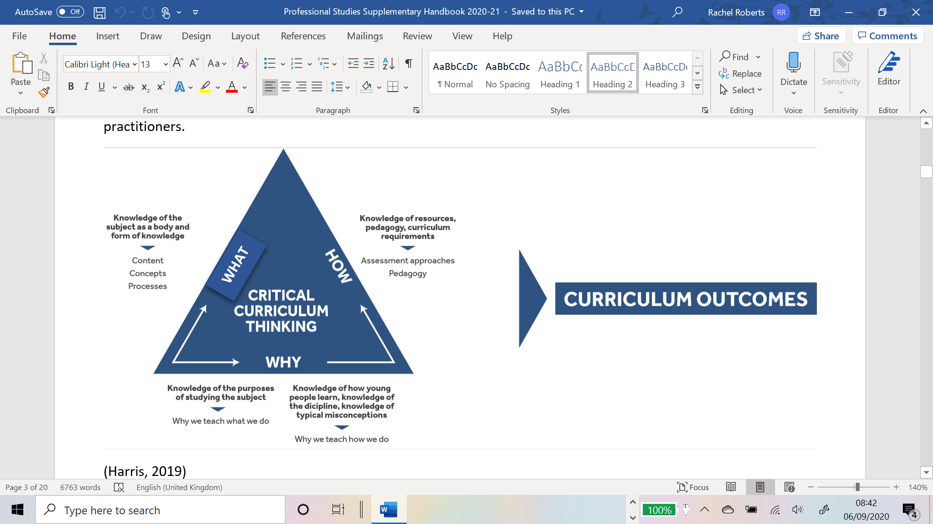
‘Initial teacher education (ITE) and continuing professional development (CPD) should reflect the fact that knowing a discipline is not simply knowing its content, but involves understanding the wider concepts that frame the discipline itself.’ (Eaglestone, 2021, p35)​
Notes:
PGCE students’ responses to substantive knowledge (difficulty in this): ‘are there facts in English?’; ‘systems that underlie communication’; ‘seminal authors’; ‘history of the English language’; ‘quotes’; ‘knowledge of terminology’ (Feb 2020)​
Even if we were to agree that knowledge of a text equates to substantive knowledge, what it means to know a text is subject to levels of familiarity. I could say that I know my Shakespeare because I can, with some accuracy, recount the plot of a number of his plays. I can also quote quite a lot of Shakespeare and can mutter with an air of superiority when I hear mis-quotations (all that glistens instead of glisters). Substantive knowledge, in this instance, is reduced to Mastermind-style question and recall. My point is not that substantive and disciplinary knowledge in English could not be established or agreed upon, rather that it is difficult and there is, thanks to the combination of techne and phronesis that exists in English, less of a clear demarcation between them. ​

Slide 5
Starting from where they are- find this out through discussion and reading the WRoPs.

Slide 6
What have you learnt about your RPT in terms of their strengths and areas for development?
Some Whole Class Feedback from PPR2:
Strengths ​
Behaviour Management​
Subject Knowledge​​
Relationships with classes​
Positive and friendly ​
Knowledge of pupils (and how to support them)
Development ​
AfL/checking for understanding and progress​
Consequences/following through (e.g. Waiting for silence)​
Make the main activity of the lesson more meaningful in order to keep pupils engaged
Use of a visualiser! ​(For modelling/sharing pupils’ work etc.)
Build up confidence when doing demo’s
Don’t allow under current of chat if you are talking or a student is talking to the class.
Notes:
What have you learnt about your RPT in terms of their strengths and areas for development? – ideas in the chat. Are there commonalities? What is very specific to your RPT?
WCF from PPR2 visits
This is the WCF we’ve collated from our PPR2 visits. How might we address some of the areas for development? Ideas in the chat.
General advice for ‘starting from where there are’:
Linking to targets so that training is a spiral
Making use of Interim R2 targets
New environment
Medium Term Planning
Opportunities afforded in Sch B placement
Working with TAs, EAL, adaptive teaching, 6th Form, assessment…

Slide 7
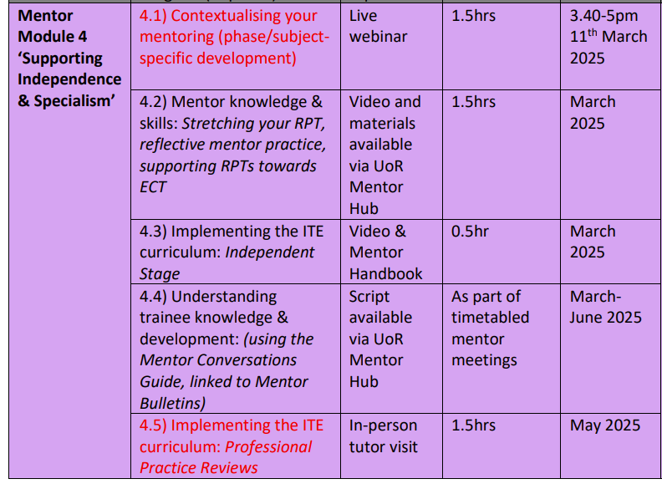
Mentor Curriculum
Notes:
Completion of this training, including the mentor reflection, will result in UoR mentor certification. Module 4 ‘Supporting Independence & Specialism’ has started. As you can see the mentor modules are aligned to the RPTs’ developmental stages.
Any questions at this point about mentor training?

Slide 8
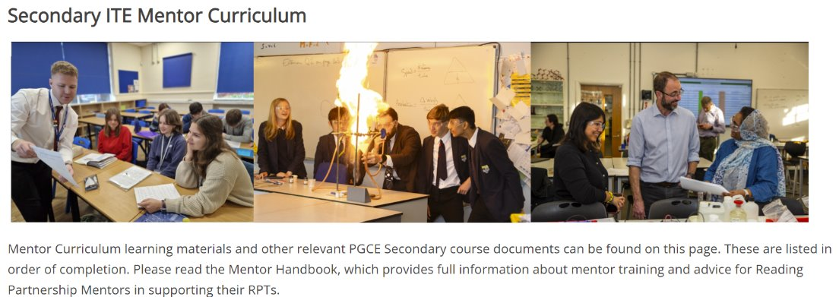
https://sitesb.reading.ac.uk/ioe-mentoring/
Notes:
Reminder!
https://sitesb.reading.ac.uk/ioe-mentoring/

Slide 9
Course Expectations for Planning
Shared Implementation stage (Oct-Dec) | RPTs complete a full lesson planning pro-forma designed by their Subject Lead for every lesson. When teaching parts of lessons, RPTs still must follow this process.
Guided Implementation stage (Jan-March) | RPTs can: Plan using a medium-term plan designed by their Subject Lead to cover every lesson. Plan using a simplified ‘non-negotiables’ lesson pro-forma designed by their Subject Lead. Whether RPTs choose to use the medium-term plan or the simplified lesson pro-forma, all RPTs must complete a full lesson planning pro-forma for 1 in 3 lessons.
Independent Implementation stage (March-June) | RPTs can: Plan using a medium-term plan designed by their Subject Lead to cover every lesson. Plan using a simplified ‘non-negotiables’ lesson pro-forma designed by their Subject Lead. Whether RPTs choose to use the medium-term plan or the simplified lesson pro-forma, all RPTs must complete a full lesson planning pro-form for 1 in 5 lessons.
(MoG, Appendix 19 ‘Principles of Planning’)
Notes:
Discuss support for planning that RPTs have had. Any issues arisen from those who were Sch A mentors?
Note that the forthcoming ITAP4 (18th -20th March) will focus on planning for progress and use of assessment.

Slide 10
Using the Mentor Bulletins & Conversation Prompts
Art and D&T Mentor Bulletin: Subject and Curriculum Knowledge
Focus: Subject and Curriculum Knowledge
Possible Reading to Revisit (available through the University Library):
( both of these sources are available through the University Library- In the International Encyclopedia of Art and Design- Volume 2 Curriculum. General editor Richard Hickman, John Wiley & Sons, inc.): Granville, G. (2019) Design in the Secondary Curriculum Steers, J. (2019) National Curricula in the Visual Arts
Possible WRoP target for the next fortnight: | Possible strategies from UoR curriculum:
To revisit an area of the Reading curriculum that relates to the importance of teachers building and implementing rich and vibrant subject and curriculum knowledge | Just some of the strategies might include: Design an activity within a lesson that supports children to think about the subject within the wider world Make a resource based on an artist, designer or technologist not currently covered in the curriculum Discuss a contemporary artist, designer, architect, engineer, (as relevant) in one of your lessons
Questions from the Mentor Conversations Guide that might be discussed (although any that are relevant could be selected):
How have you developed your subject knowledge through the projects that you have taught? In what areas of the curriculum are children particularly challenged in? How have you planned for progression in your schemes of work/schemes of learning?
Fortnightly in the Independent Phase
Connected to a curriculum strand

Slide 11
Curriculum Stage Stage 3-4: Guided and Independent Implementation Curriculum Strand Subject and Curriculum Knowledge 1. Learn how to… Based on the CCF. Mentoring questions to prompt reflection and implement ITE curriculum.
2. Learn how to… Subject specific questions to really push trainee development in weekly mentor meetings • How have you developed your subject knowledge through the projects that you have taught the pupils? • Have you developed your subject knowledge through other means, such as subject association, Youtube videos, visits to museums/galleries? • In what areas of the curriculum in art or D&T do you think that pupils are challenged or stretched? • How have you planned for progression in the schemes of work that you have written? • How have you developed your questioning skills for pupils in different key stages? • What pupil examples have you got that reflect excellence in lessons you have taught. • How well are the pupils working in your after school club? Institute of Education • How are you contributing to a love of learning outside the classroom and the wider community? • What knowledge is embedded at KS3 and how does it support learning in KS4?
Notes:
Ask if anyone has used any so far this year (or from last year) and how they used them.

Slide 12
Target Setting

Slide 13
ITE Curriculum Strand | Target (What is the intended learning? What kind of target is it? How long will the target last?) | Strategy (What actions/tasks will enable them to achieve the target?) | Progress towards target (Have they achieved the target? What are the next steps?)
Professional Behaviours & Teacher Wellbeing | Build your presence as a teacher around the school [SKILL; medium-term) | Read the school policies on behaviour moving around the school site; shadow a teacher on duty; talk to students outside of the classroom SO THAT the trainee builds their teacher presence beyond the c/room. | Trainee regularly shadows a duty; they feel more confident in their role; they've started to build relationships outside of the c/room
High Expectations & Managing Behaviours | Develop a range of strategies in the classroom to engage and motivate students [SKILL; long-term] | Observe teacher X and note how they use non-verbal cues and waiting for silence. Practice different ways of doing this (e.g. hand up/counting down) SO THAT...
Subject & Curriculum Knowledge | Build subject knowledge of topic X [KNOWLEDGE; short-term] | Attend subject association CPD on topic X SO THAT... Practise drawing the figure in a foreshortened position, so that you can teach it to year 9 with confidence.
Planning, Teaching & Adapting Practice | Break your lesson into chunks, and manage the movement of pupils when collecting materials and clearing up [SKILL; short-term] | Plan for several activities to happen during the main part of the lesson. Be prepared to adapt activities based on how far the pupils have progressed with their work. Plan carefully for organising pupils at the sink.
Progress, Outcomes & Assessment | Understand how the mark scheme is applied for marking GCSE projects. [KNOWLEDGE & SKILL; short-term] | Co-mark a set of mock exams, using the exam mark scheme in order to fully understand what is needed to meet the AOs.
Verbs for targets:
Learn
Establish
Maintain
Develop
Adapt
Refine
Embed
Respond
Ensure
Understand
Notes:
To have a really tight learning cycle for RPTs, targets do need careful crafting and thinking about.
It is helpful to first consider which curriculum strand it might fall under, then determine what kind of target it is (skill or knowledge), and its timeframe (this will help avoid vague or wooly targets that are much harder to measure). Beginning the target with a verb (again, with thought) can also make clear the intended learning, as in these examples.
The next stage is to consider what strategies might be employed to help the RPT meet their target (this would be an action or task). It can be helpful to use the phrase 'so that', as this will indicate what the RPT will learn from engaging with the suggested actions or strategies (this should link to the target!).
Finally, you should have a good idea of how you and your RPT will be able to measure or evaluate their progress towards the target – what evidence would demonstrate that they have achieved it?
Effective target-setting and review does take time and, ideally, should form a key part of your weekly mentor meeting with your trainee.

Slide 14
Setting Weekly Targets
Targets should address the intended learning of the RPT. They should not be jobs, such as ‘mark a set of sketchbooks’ or ‘do a lunch time duty’.
Mark a set of sketchbooks in order to…
Notes:
Targets should address intended learning of the RPT e.g. tighter/clearer use of time in lessons. Using 'so that' can help clarify the purpose of the target.
Should be able to demonstrate they've addressed the targets each week.
Reminder that this is covered in mentor curriculum video 3.2 available in the Mentor Hub: https://sitesb.reading.ac.uk/ioe-mentoring/sample-page/pgce-secondary/ https://www.youtube.com/watch?v=qlzDVGn4KrM

Slide 15
Notes:
Example B from previous slide: Assign approximate timings to each lesson activity, so that things don't over run. Use a timer to help.
What to do when targets are carried over.
Strategies to meet the target.

Slide 16
Assessment for QTS
RPTs will be asked to produce a Best evidence guide (BEG)
RPTs will be assessed against the Teachers’ Standards
Start to make note of which TS they are showing evidence of in order to help them with their BEG

Slide 17
Reading Guild of Artists (RGA)
Summer exhibition
13th June 2025
Please do consider entering a piece of art/artefact alongside thatof your RPT
It was FAB last year!

Slide 18
Questions?

