Slide 1
PGCE Secondary MFL Professional Development Mentor Meeting
Mentor Curriculum 4.1
11 March 2025

Slide 2
Agenda
Welcome and programme update
Key messages from School B Mentor training & being an MFL mentor
Starting from where they are: key strengths and areas for development
Supporting MFL RPTs in the independent stage:
ITAP 4 Assessment, feedback and progress
AOB
Targets and strategies for WRoPs
Using the mentor bulletins and conversation prompts
Observation and feedback
Supporting planning
Looking towards Report 3 and the Teachers’ Standards
Making the most of opportunities at School B

Slide 3
Welcome & Programme Updates
Staffing
Margie Choi - administrator
  pgcesecondary@reading.ac.uk
Head of School: Dr Sarah Marston
Director of Teaching and Learning: Dr Jo Anna Reed-Johnson
Head of ITT: Dr Catherine Foley
Director of Secondary: Will Bailey-Watson
Secondary MFL team: Barbara King, Prof Suzanne Graham, Sarah Rae

Slide 4

School B Mentor Training
-
Key Messages

Slide 5



Understanding the UoR ITE Programme

Slide 6

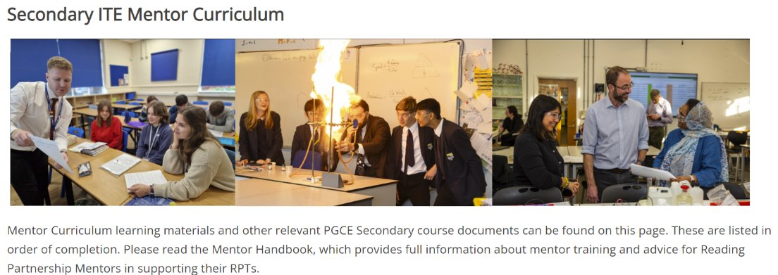
https://sitesb.reading.ac.uk/ioe-mentoring/
Notes:
Reminder!
https://sitesb.reading.ac.uk/ioe-mentoring/

Slide 7
Being a School B Mentor
Early idealism
Personal survival
Dealing with difficulties
Hitting a plateau
Moving on (Furlong & Maynard ,1995; Burn et al, 2015)​
Mentor role: range of support
Stages of development:
SUGGESTIONS:
Establish a positive relationship from the outset, showing that you believe they are significant, competent, and likeable.
Use the reflective cycle questions* to help structure your conversations.
Be explicit about what you do, how you do it and why you do it.
Plan topics to cover at different stages of the course.
Highlight praise and make it specific.
*See later slide
Notes:
Range of aspects of the mentor role:
Professional support (such as showing the trainee how to put ‘praise points’ onto the database and discussing when this would be appropriate)​
Pedagogic support (such as demonstrating how to ‘model’ some writing during a lesson and discussing how it worked afterwards)​
Academic support (such as suggesting a book on basic grammar knowledge that you’ve read) ​
Emotional support (such as comforting them if they have a difficult lesson) (Roberts, 2020)
Be aware of the stages of development (and where your RPT is in this journey):
Early idealism: ‘in which trainees tend to identify quite closely with the pupils and seek inspiration in the example of significant teachers recalled from their own schooldays. Their analysis of these teachers... Tends to be framed in terms of the teachers’ personality and the relationships that they established, rather than reference to the planning and structure of their lessons or their pedagogical strategies.’ ​
Personal survival: ‘in which trainees tend to feel vulnerable and crave the assurance of being seen as a teachers. They are therefore keen to fit in and become anxious ab out securing effective control of their classes.​
Dealing with difficulties: ‘in which the emphasis is on establishing themselves as a teacher by implementing specific policies (particularly in relation to managing pupils’ behaviour) and demonstrating their ability to organise and execute different kinds of learning activities.​
Hitting a plateau: in which progress my stall as the trainees demonstrate their competence and confidence in running a classroom, and implementing different kinds of activity. Only if they are sufficiently challenged and encouraged to look more closely at the pupils’ experience and the evidence of their learning will they move on.​
Moving on: the final phase in which they are able and willing to adapt their teaching in response to critical evaluation of the pupils’ needs and their ongoing learning.​ (Furlong & Maynard, 1995; Burn et al, 2015)
Suggestions:
Conversation questions for initial/first meetings/’contract’ and reflective cycle questions: see Mentor Handbook: Section 4 ‘Guidance for Mentors’ and you could make use of a mentoring expectations ‘contract’ (see Appendix 16). Also ‘needs analysis’, this will have been established from the mentor handover meetings and the RPTs’ self-audit document, linked to interim Report 2.

Slide 8
Range of support mentors provide
Professional support (such as showing the trainee how to put ‘praise points’ onto the database and discussing when this would be appropriate)​
Pedagogic support (such as demonstrating how to ‘model’ some writing during a lesson and discussing how it worked afterwards)​
Academic support (such as suggesting a book on basic grammar knowledge that you’ve read) ​
Emotional support (such as comforting them if they have a difficult lesson) (Roberts, 2020)
Any other examples for the four above?
Any other kinds of support?

Slide 9
Being an MFL Mentor
‘Mentors who have volunteered for their role, and those who are within the same key stage and/or subject area specialties as their mentees, are more likely to develop effective relationships’ (NIoT, 2023, p4)
As an MFL mentor - what can you offer an RPT that no one else can?

Slide 10

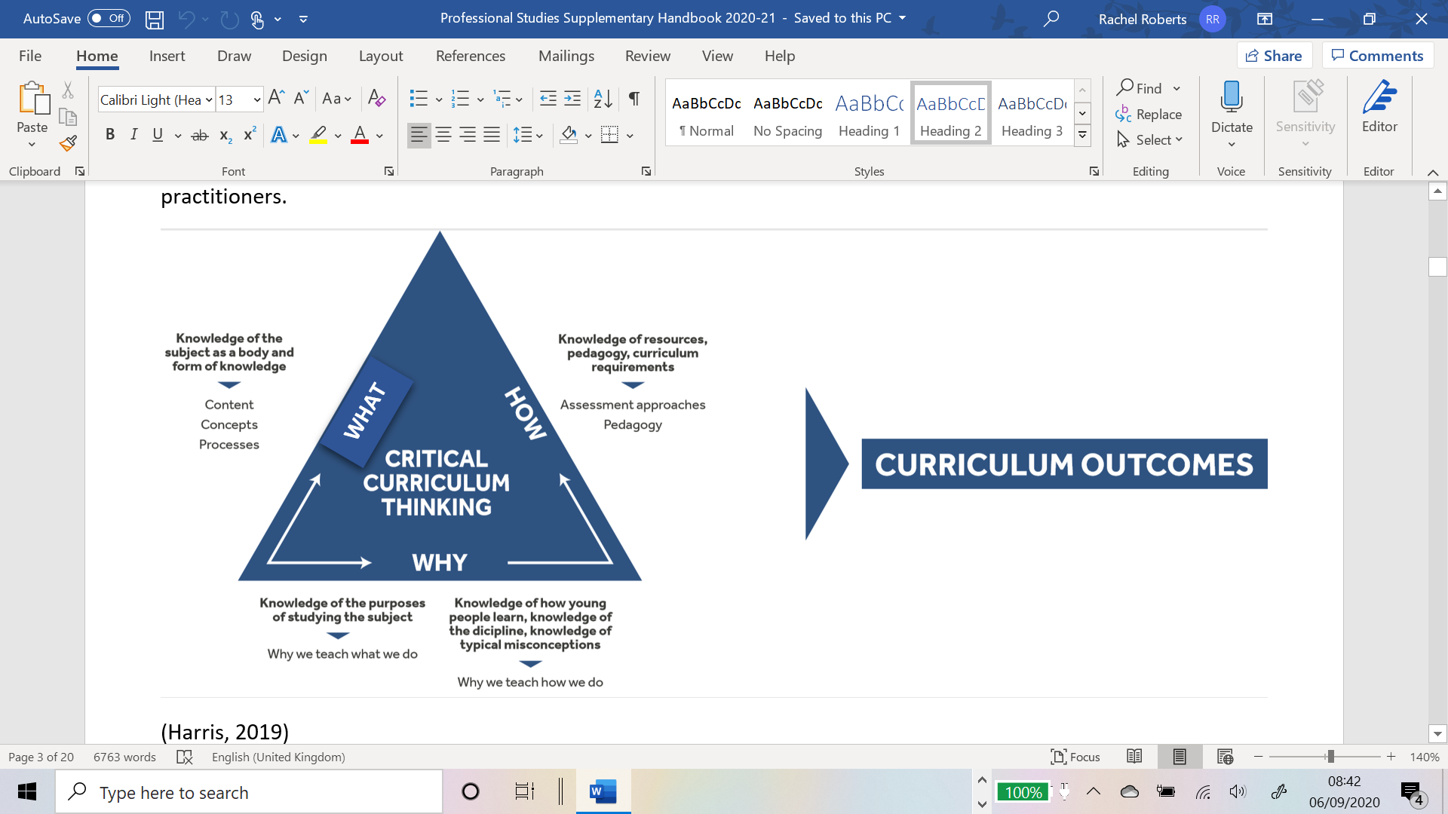

‘Initial teacher education (ITE) and continuing professional development (CPD) should reflect the fact that knowing a discipline is not simply knowing its content, but involves understanding the wider concepts that frame the discipline itself.’ (Eaglestone, 2021, p35)​
Notes:
Language learning a complex process and for different purposes.
It is easy to reduce it to learning content for GCSE.

Slide 11
The ugly truth… https://gianfrancoconti.com/category/general-pedagogy/
(with Steve Smith) Nov 2016
I was recently criticised by some of Stephen Krashen’s fans for something that to me and many other teachers is a sad given : MFL teachers operating in secondary schools have simply no time to teach languages the way they should ideally be taught. Time and syllabus constraints force teachers to extremely tight schedules which do not allow for the extensive listening and reading practice that it is evident from much research that every language learner benefits from before engaging in real-life-like speaking.

Slide 12
Continued…
If I had five hours contact time a week I would teach entirely differently from the way I teach now. This would be my recipe: lots of daily receptive exposure to compelling aural and written input ; plenty of oral interaction through fun and challenging communicative activities (even more than the 30 minutes per lesson I do now); engaging multimedia project-based learning ; drama and art activities ; cultural awareness-raising through videos and realia ; exciting enquiry-based grammar learning.

Slide 13
Continued…
The problem is, for teachers working in England to effectively prepare their students for GCSE and A-Level examinations, all of the very desirable above simply cannot be done as often as one would like. We all know that. Hence, effective teaching in our context is not merely about applying what we know best benefits language acquisition ; but it is first and foremost how to make the most of the time we have available to build our students’ linguistic competence, self-confidence and motivation adapting what we know about human language acquisition to the context we operate in. (blog continues)

Slide 14
Thoughts and comments?
In the chat please
How do we keep the ideal in mind?
How do we keep up with good practice?
Work hard to set good habits with KS3 classes?
Encourage RPTs to keep looking for opportunities?

Slide 15

Thinking about your RPT…

Slide 16

Starting from where they are

Slide 17
Starting from where they are
What have you learnt about your RPT …
in terms of their strengths and areas for development?
Strengths
For development
Notes:
What have you learnt about your RPT in terms of their strengths and areas for development? – ideas in the chat. Are there commonalities? What is very specific to your RPT?

Slide 18

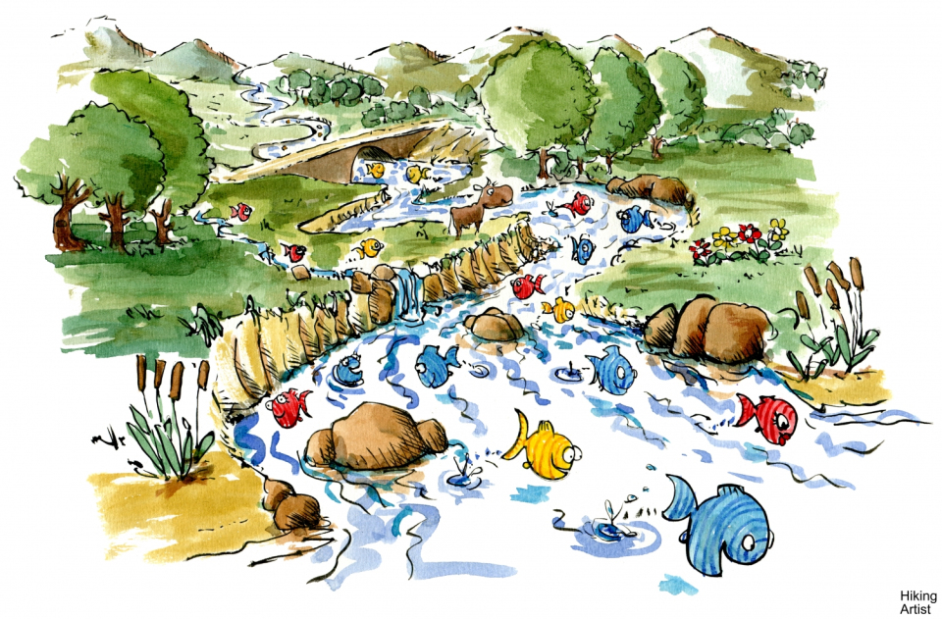

Highs and lows
Drawing a chart, river, journey…
Drawing on experience to plan ahead
What was it like in School A?
What might it be like in School B?
This Photo by Unknown Author is licensed under CC BY-SA
This Photo by Unknown Author is licensed under CC BY-NC

Slide 19
Key dates coming up can you predict the ups and downs?

Slide 20
Current worry
Results for Literature Review assignment come out tomorrow 12 noon
RPTs then have two weeks to produce Proposal and Action Plan for next assignment – a classroom project over a small number of lessons.
Aim: to try something out and evaluate it.
Mentors (and ITTCos) to check and agree Action Plan
Please check for practicalities (does it clash with a trip?) and cast a professional eye over their plans. Improvement suggestions are welcome.
The project should be ‘normal practice’ so no extra interviews, videos or recordings, UNLESS recordings are a normal part of assessment.
Deadline to send Proposal and Action Plan to Barbara – 28 March.
RPTs cannot start project until Barbara has signed it off.

Slide 21
Important dates and processes
Please continue to refer to ‘phases of the course’ pages in MoG
Report 2 by 21 March
PPR 3 visits after Easter – ensure timetables in EPortfolios please
Increase timetable to 72% from 5 May
Assignment due in H-T Thursday 29 May
Report 3 by 20 June
Remaining university days:
  Monday 24 March – ITAP on Assessment
  Tuesday 22 April - just after the Easter break
  Enrichment 16-19 June-probably in school –details to follow
  Monday 23 June, Tuesday 24 June – end of course

Slide 22
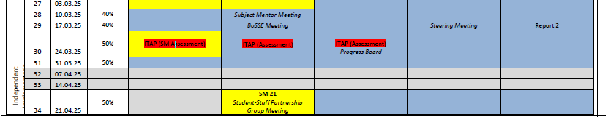
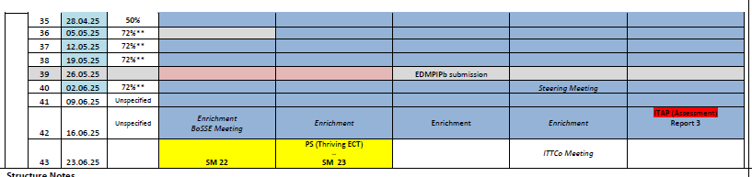
Timetable
School A mentors - did you manage to buld up to 72% How did it go?

Slide 23
Report 2 is coming
Due to IoE 21/03/25 from ITTCo email
Check with your ITTCo when they need report from you and RPT
Use the same Excel document as for all reports
RPTs should have this in their EPortfolios

Slide 24

Supporting MFL RPTs in the Independent Stage

Slide 25
ITAP 4 Assessing and Providing
Feedback for Progress Over Time
Monday 24th March Day 1 - University | Tuesday 25th March Day 2 - School | Wednesday 26th March Day 3 - School | Friday 20th June Day 4 - School
Introduce | Analysis | Prepare and Enact | Enact and Review
Assessing and Providing Feedback for Progress Over Time | Whole Cohort Lectures and Workshops: Using the CCF as a basis for improving assessment practice. (Day 1) Making feedback meaningful and lasting. (Day 1) Planning, teaching and assessing for progress over time as an independent RPT. (Day 1) | School Based Critique and Analysis: Choose two year groups to focus on for the remainder of the ITAP, ideally from two Key Stages. (Day 2) Complete an upcoming assessment that will be set for the two chosen Key Stage classes in the conditions they will be completing it under, and reflect on the how this affects teacher knowledge and understanding of the support they will need in order to complete the assessment well. (Day 2) Discuss a mark scheme for the two chosen Key Stage classes with an experienced colleague. Choose two pupil outcomes to discuss and decide what their responses reveal about the pupils’ understanding of their learning. (Day 2) | School Based Activities: Discussion with expert colleague about what data they use to meaningfully assess pupils in this school(e.g. progress reviews, end of year exams, daily retrieval quizzes, online systems, etc). (Day 2/3) Make detailed annotations of a medium term plan for each of the two chosen Key Stage classes plans. Identify what knowledge pupils are to draw upon in each lesson, how that knowledge will help the pupils make progress in the lesson, and what learning will look like at the end. (Day 2/3) Detailed annotation of an lesson plan (or resource if using the medium term plan) for a lesson to be taught on Day 3. Must explicitly draw upon Day 1 sessions. (Day 3) | School Based Activities: Teach one lesson with observer focus on questioning and formative assessment. (Day 3) Collect sample of pupil work from each of the two chosen Key Stage classes. There must be at least two contrasting pupils from each of the two classes. Use appropriate assessment methods (marking, observing, reading, listening) to assess what each pupil has learnt, how this is known, and what feedback each pupil requires to move forward. (Day 4) | Review of what pupils in the two chosen Key Stage classes have learnt and the implications for future practice. (Day 4)

Slide 26
Making the most of the opportunities in School B
How is your school context different from School A?
What opportunities will this provide for your RPT and how can they capitalise on this?
What opportunities are particularly important for them?
Is there anything they did not see or do in School A that they need from School B?
How can you ensure this need is met?

Slide 27
WRoPs
RPTs SHOULD come to mentor meeting with their parts of the WRoP Already prepared
In shared stage, some MFL RPTs fell behind in WRoP writing
In guided phase this has been focus for MFL
Some still not uploading to EPortfolio, so I can’t check
Please make this a focus.
You should see the WRoP in weekly mentor meetings

Slide 28
Setting Weekly Targets
Targets should address the intended learning of the RPT.
How might these example targets be improved?
Can you suggest strategies to achieve the new targets?
Pitching of work for year 7 - clear instructions and chunking of instructions for low-ability class.
B. Assign approximate timings to each lesson activity, so that things don't over run. Use a timer to help.
Notes:
Targets should address intended learning of the RPT e.g. tighter/clearer use of time in lessons. Using 'so that' can help clarify the purpose of the target.
Should be able to demonstrate they've addressed the targets each week.
Reminder that this is covered in mentor curriculum video 3.2 available in the Mentor Hub: https://sitesb.reading.ac.uk/ioe-mentoring/sample-page/pgce-secondary/ https://www.youtube.com/watch?v=qlzDVGn4KrM

Slide 29
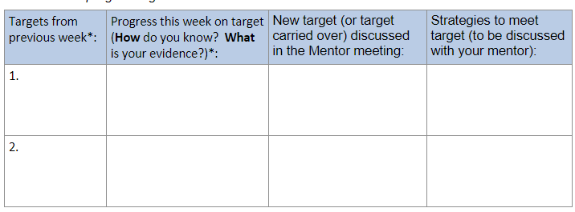
Notes:
Example B from previous slide: Assign approximate timings to each lesson activity, so that things don't over run. Use a timer to help.
What to do when targets are carried over.
Strategies to meet the target.

Slide 30
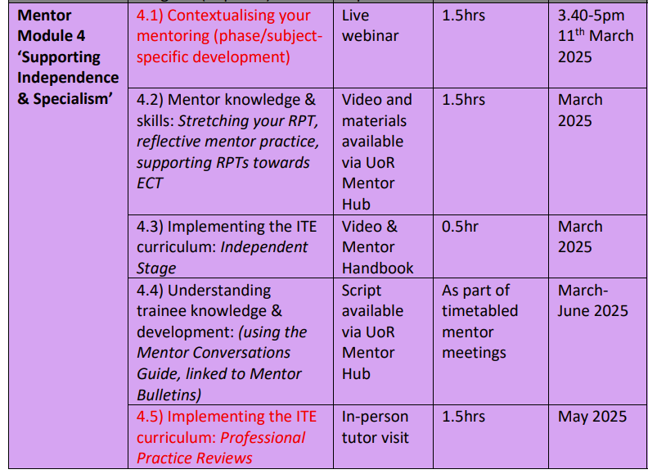

Mentor
Curriculum
Notes:
Completion of this training, including the mentor reflection, will result in UoR mentor certification. Module 4 ‘Supporting Independence & Specialism’ has started. As you can see the mentor modules are aligned to the RPTs’ developmental stages.
Any questions at this point about mentor training?

Slide 31
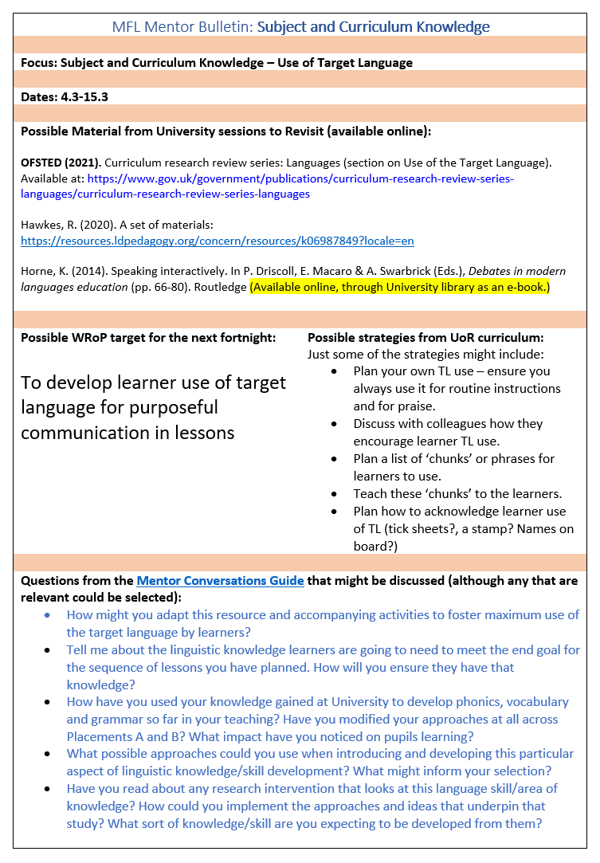
Using the Mentor Bulletins & Conversation Prompts
Fortnightly from March
Connected to a curriculum strand

Slide 32
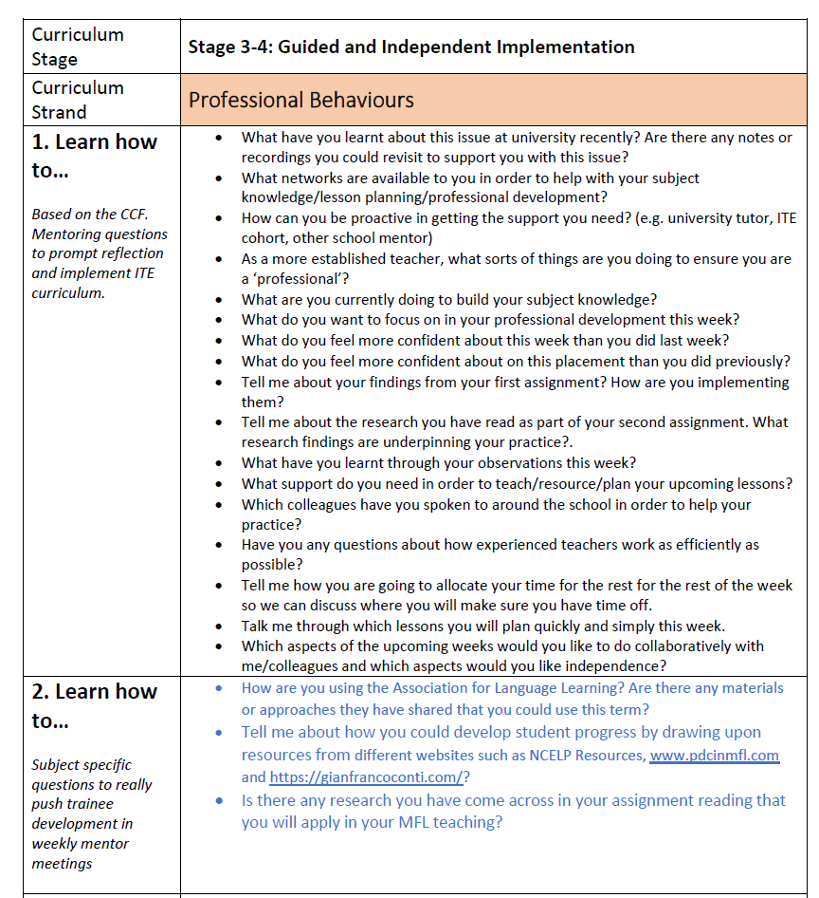
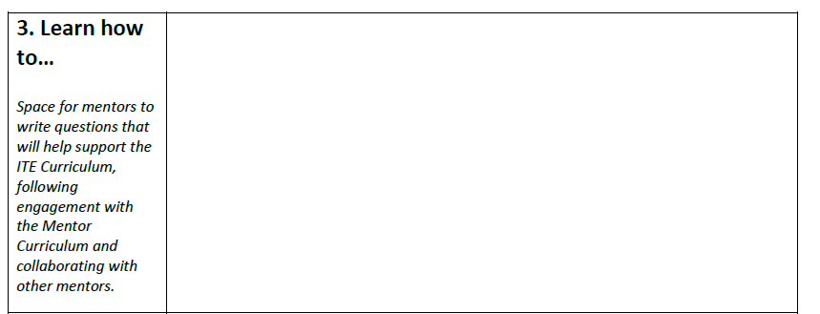
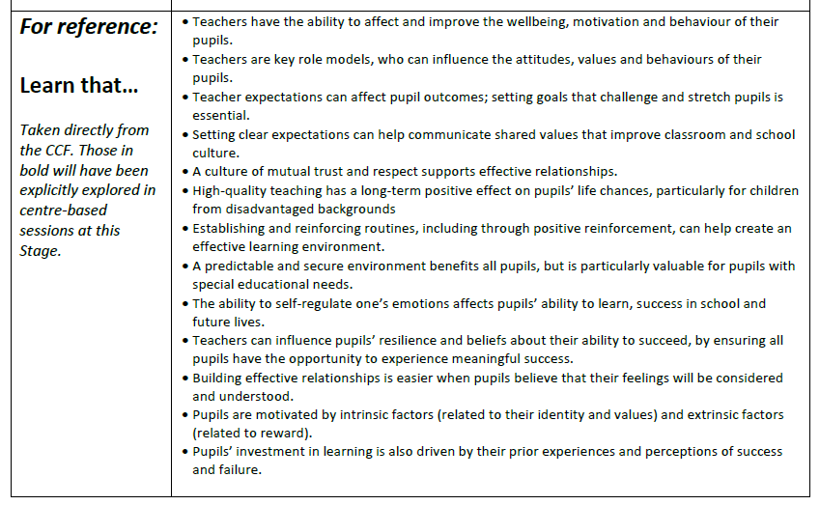
Personalised
Generic
CCF
Subject-specific
Notes:
Ask if anyone has used any so far this year (or from last y
How and when could you use these prompt questions with your RPT? What might your follow up guidance be in response to their answers?
ear) and how they used them.

Slide 33
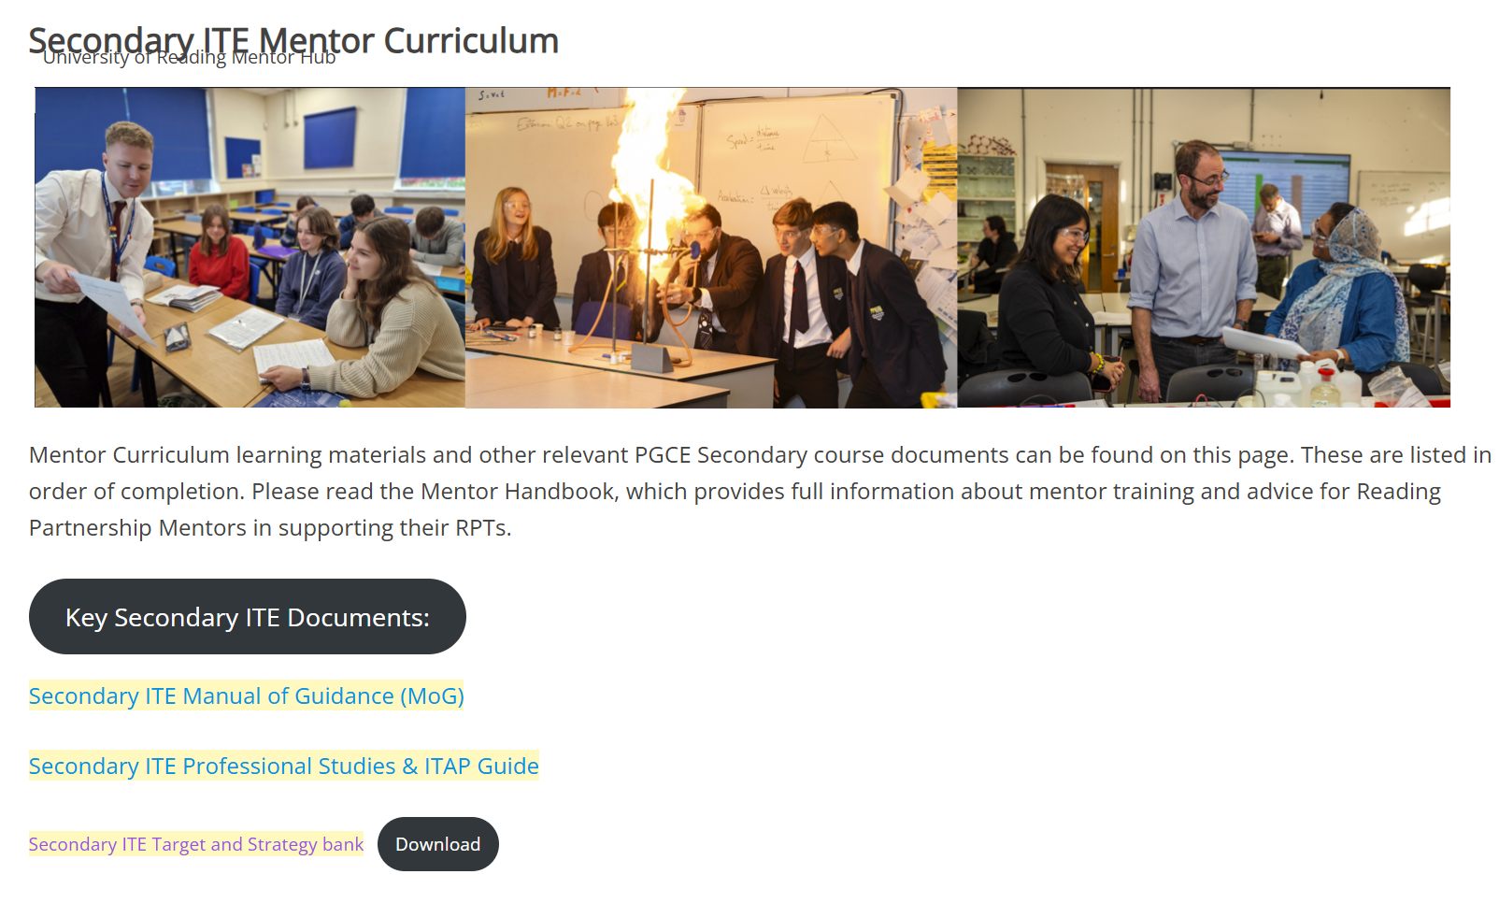
New element

Slide 34
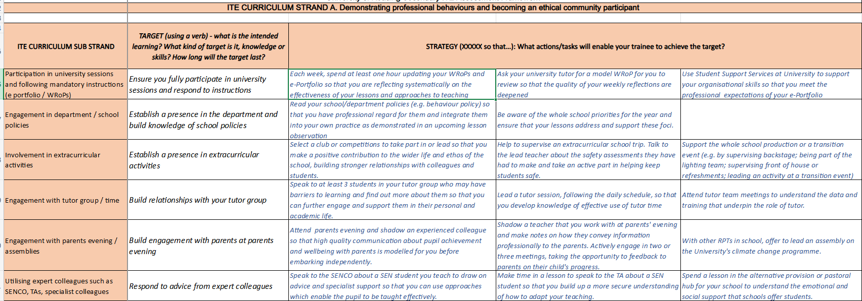
Using the ITE Target and Strategy Bank

Slide 35
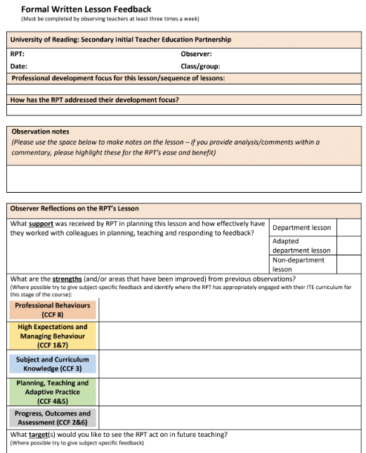
Professional development focus for this lesson or sequence of lessons
Please make sure this is completed on all observation forms

Slide 36
Observation & Feedback
What is your current practice?
  Do you provide a live ‘account’ of the lesson? How do you frame/word what you see?
  When you give verbal feedback, how do you structure this?
Utilise Reflective Practice
Instead of asking ‘How do you think that went?’
Ask: ‘What did you want the pupils to learn?’
Ensuring other colleagues who will provide feedback are aware of how to do this – trickle down of mentor training!
Notes:
What is your current practice? Take points in the chat.
Emphasise that this practice is what would be great to see when we do our PPR visits!

Slide 37
Step in Gibbs’ reflective cycle | Example questions/prompts
Description | - Tell me what happened in your lesson on Tuesday. - Can you describe the incident with Joanna in more detail? - What were you thinking/feeling at that point?
Evaluation | - Thinking about what you wanted the pupils to learn, how effective did you think that activity was? - What did you find easy/difficult?
Analysis | - Why do you think your lesson on families with Y7 was difficult? - How was it different to the previous lesson with that class?
Conclusions | - If you were to teach that lesson again, what would you change?
Action plan | - As you’ve suggested that most of the class found the first activity too easy, let’s think about pitch and pace at the beginning of lessons…
Notes:
Part of reflective cycle, not dissimilar to the Impact Cycle from Instructional Coaching (Knight, 2022): IDENTIFY, LEARN, IMPROVE
See also: REVIEW module in MoG

Slide 38
Course Expectations for Planning
Shared Implementation stage (Oct-Dec) | RPTs complete a full lesson planning pro-forma designed by their Subject Lead for every lesson. When teaching parts of lessons, RPTs still must follow this process.
Guided Implementation stage (Jan-March) | RPTs can: Plan using a medium-term plan designed by their Subject Lead to cover every lesson. Plan using a simplified ‘non-negotiables’ lesson pro-forma designed by their Subject Lead. Whether RPTs choose to use the medium-term plan or the simplified lesson pro-forma, all RPTs must complete a full lesson planning pro-forma for 1 in 3 lessons.
Independent Implementation stage (March-June) | RPTs can: Plan using a medium-term plan designed by their Subject Lead to cover every lesson. Plan using a simplified ‘non-negotiables’ lesson pro-forma designed by their Subject Lead. Whether RPTs choose to use the medium-term plan or the simplified lesson pro-forma, all RPTs must complete a full lesson planning pro-forma for 1 in 5 lessons.
(MoG, Appendix 19 ‘Principles of Planning’)
Notes:
Discuss support for planning that RPTs have had. Any issues arisen from those who were Sch A mentors?
Note that the forthcoming ITAP4 (18th -20th March) will focus on planning for progress and use of assessment.

Slide 39
Medium-term Planning in MFL
Three-part template
Part 1 for all classes taught
Parts 1 and 3 for at least one class per Key Stage taught
  KS3 Y7, 8, 9
  KS4 Y10, 11
  KS5 Y12, 13

Slide 40
MFL PGCE Lesson Plan Template
Both pages must be completed for all teaching episodes in the Shared and Guided Teaching phases. In the Independent Teaching phase, if your mentor and University tutor both agree, you can move to just completing the second sheet plus the ‘Key Information’ and ‘What’? sections of the first sheet.
KEY INFORMATION | RPT: School: Date: Class: Time/Period: Room: REQUESTED FOCUS FOR OBSERVATION:
WHAT (topic/language/skills/objectives and intended learning outcomes) | Topic New language (specify): New skills: Learning objectives: What will learners learn/know how to do that they did not know before the lesson? Learning outcomes (the ‘so that’):
REFLECTION/ EVALUATION: This section should be completed for all lessons during the Shared and Guided Teaching phases. For the Independent Teaching phase, please complete one self-evaluation for each class taught each week. Complete sentences are not necessary!
Notes:
More in depth planning of some parts of a lesson which is connected to what they are working on as targets? Working more efficiently with planning so they complete lessons plans in a row. The RPTs who struggle seem to be planning in isolation.

Slide 41
The Teachers’ Standards & the ITE curriculum
Showing professional behaviours and becoming an ethical community participant (Standard 8: Fulfil wider professional responsibilities)
Building knowledge of their subject and critiquing curricula choices (Standard 3: Demonstrate good subject and curriculum knowledge)
Showing high expectations and getting to know pupils (Standard 1: Set high expectations which inspire, motivate and challenge pupils)
Planning and teaching appropriate, ambitious lessons (Standard 4: Plan and teach well well-structured lessons)
Taking responsibility for behaviour management (Standard 7: Manage behaviour effectively to ensure a good and safe learning environment)
Adapting practice in response to learners’ needs (Standard 5: Adapt teaching to respond to the strengths and needs of all pupils)
Demonstrating pupil progress on different time scales (Standard 2: Promote good progress and outcomes by pupils)
Using assessment for formative and summative purposes (Standard 6: Make accurate and productive use of assessment)

Slide 42
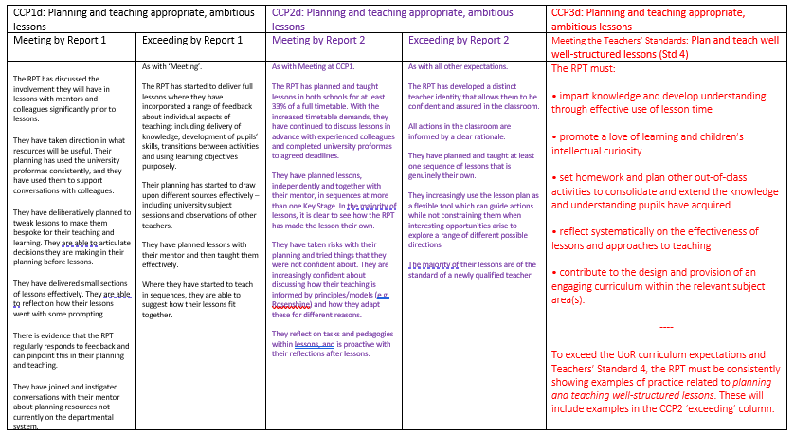
TS 4

Slide 43
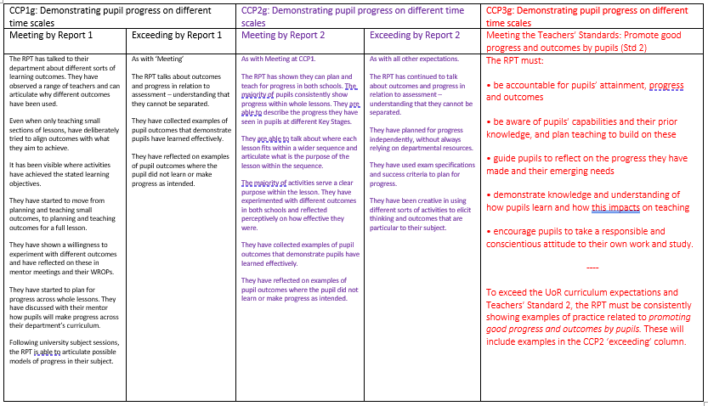
TS 2

Slide 44
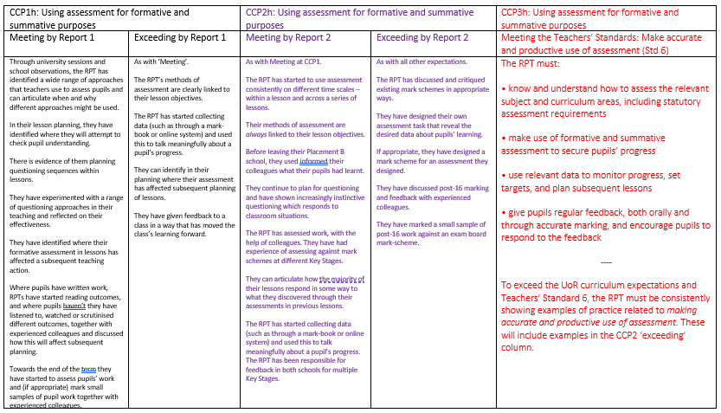
TS 6

Slide 45
Questions +AoB

Slide 46
References
Eaglestone, R. (2021). 'Powerful knowledge', 'cultural literacy' and the study of literature in schools.’ Impact: Philosophical Perspectives on Education Policy(No. 26), 1-40.
Furlong, J. and Maynard, T. (1995). Mentoring Student Teachers: The Growth of Professional Knowledge. London: Routledge. ​
Hagger, H., Burn, K., Mutton, T. & Brindley, S. (2008). Practice makes perfect? Learning to learn as a teacher, Oxford Review of Education, 34:2, 159-178. ​
Harris, R. & Graham, S. (2019) 'Engaging with curriculum reform: insights from English history teachers’ willingness to support curriculum change', Journal of Curriculum Studies, 51:1, 43-61 ​
Knight, J. (2022). The Definitive Guide to Instructional Coaching: Seven Factors for Success. ASCD. ​
National Institute of Teaching (2023) ‘Mentoring and Coaching of Teachers: What does the research tell us?’ https://niot.org.uk/teacher-mentoring-research
Rosenshine, B. & Stevens, R. (1986). 'Teaching Functions'. Handbook of Research on Teaching. 376-391.​

