Slide 1
Mathematics Professional Development Mentor Meeting (Mentor Curriculum 4.1)
PGCE Secondary Mathematics
Tuesday 11th March 2025 PM
Fiona Curtis

Slide 2
Agenda
Welcome and programme overview
School B mentor expectations
Starting from where they are
Supporting Mathematics RPTs in the independent stage:
* Developing curriculum knowledge
* Target setting
Questions/AOB

Slide 3
Welcome & Programme Updates
Staffing
Margie Choi - administrator
pgcesecondary@reading.ac.uk
Head of School: Dr Sarah Marston
Director of Teaching and Learning: Dr Jo Anna Reed-Johnson
Head of ITT: Dr Catherine Foley
Director of Secondary: Will Bailey-Watson

Slide 4
Report 2
Notes:
Any questions regarding completing R2?
Reminder that it is on the same Excel spreadsheet. Should be a copy in the RPTs' ePortfolio

Slide 5
Timetable
50 teaching days left
Notes:
Ask any Sch A mentors how they managed the move up to 72% teaching timetable
See Appendix 20

Slide 6
Timetable
How easy was it to move the RPT up to 72% timetable?
Notes:
Ask any Sch A mentors how they managed the move up to 72% teaching timetable
See Appendix 20

Slide 7
ITAP – Assessing and providing feedback for progress over time 25th and 26th March
RPT to choose two classes (one from each KS)
RPT to complete upcoming assessment for each class, and reflect on what teaching input would be helpful
RPT and mentor to discuss a mark scheme
RPT and mentor to select two pupils in each class, anticipate what their outcomes will be
RPT and expert colleague to discuss data used to assess pupils

Slide 8
ITAP – Assessing and providing feedback for progress over time 25th and 26th March
RPT to annotate medium term plan for each class identifying prior knowledge needed and where, what learning will look like
RPT to create detailed annotation of lesson plan to be taught, building on university ITAP input
Lesson taught, observer to focus on questioning and AfL
Pupil work collected, marked and given feedback
Review of what has been learned and implications

Slide 9
Course expectations for planning
Shared Implementation stage (Oct-Dec) | RPTs complete a full lesson planning pro-forma designed by their Subject Lead for every lesson. When teaching parts of lessons, RPTs still must follow this process.
Guided Implementation stage (Jan-March) | RPTs can: Plan using a medium-term plan designed by their Subject Lead to cover every lesson. Plan using a simplified ‘non-negotiables’ lesson pro-forma designed by their Subject Lead. Whether RPTs choose to use the medium-term plan or the simplified lesson pro-forma, all RPTs must complete a full lesson planning pro-forma for 1 in 3 lessons.
Independent Implementation stage (March-June) | RPTs can: Plan using a medium-term plan designed by their Subject Lead to cover every lesson. Plan using a simplified ‘non-negotiables’ lesson pro-forma designed by their Subject Lead. Whether RPTs choose to use the medium-term plan or the simplified lesson pro-forma, all RPTs must complete a full lesson planning pro-form for 1 in 5 lessons.
(MoG, Appendix 19 ‘Principles of Planning’)
Notes:
Discuss support for planning that RPTs have had. Any issues arisen from those who were Sch A mentors?
Note that the forthcoming ITAP4 (18th -20th March) will focus on planning for progress and use of assessment.

Slide 10
Course expectations for written feedback
Still give written feedback at least three times a week – could be shared between other teachers or all from mentor
(Expectation of spoken feedback after every lesson)
Notes:
Discuss support for planning that RPTs have had. Any issues arisen from those who were Sch A mentors?
Note that the forthcoming ITAP4 (18th -20th March) will focus on planning for progress and use of assessment.

Slide 11
Developing RPTs – sharing good practice
PPR2 visits:
Good modelling, good use of AfL, good presence and rapport with pupils, thorough planning, few problems with subject knowledge
Adequate questioning and attention to student learning, behaviour management reliant on mentor presence and praise/rewards but reluctance to use sanctions
Over-reliance on slides, weak focus on making content interesting/relevant/memorable, limited promotion of motivation and self-efficacy, weak contingent action
Notes:
Opportunity to talk here about the nature of our cohort and how we want to now develop them into the teachers we would like. This relates to our mathematics curriculum impact statement.

Slide 12
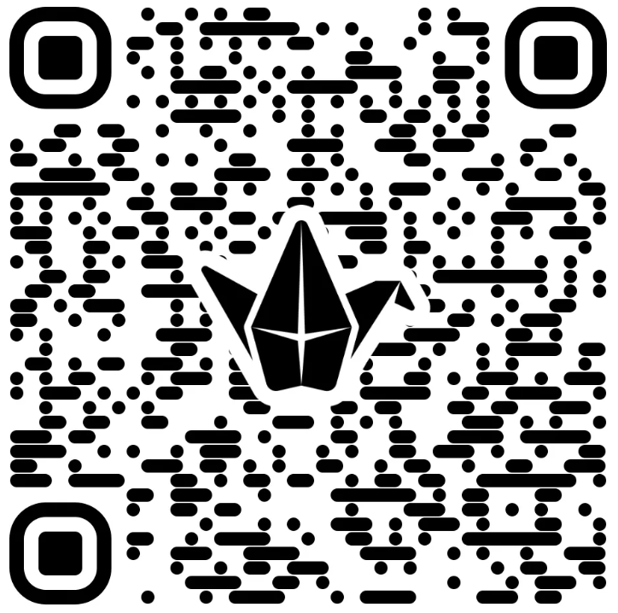
Developing RPTs – sharing good practice
What can we do to support RPTs:
Reducing over-reliance on slides?
Making lessons interesting/ relevant/memorable?
Engaging students’ motivation and self-efficacy
Being able to take contingent action (dump the lesson plan if necessary)?
https://padlet.com/universityofreading/how-can-we-support-our-rpts-to-g73ini6lu66fyyou
Notes:
Opportunity to talk here about the nature of our cohort and how we want to now develop them into the teachers we would like. This relates to our mathematics curriculum impact statement.

Slide 13
Starting from where they are

Slide 14
Being a School B Mentor
Mentor role: range of support
Stages of development:
Early idealism – identify with pupils and own experience
Personal survival – feeling vulnerable, focus on control
Dealing with difficulties – implementing policies, procedural
Hitting a plateau – progress can stall, procedural limitations
Moving on – focus on pupil learning rather than self
How can we tell what stage our RPT is at?
(Furlong & Maynard ,1995; Burn et al, 2015)​

Slide 15
How can we tell where our RPTs are?
Talk about beliefs, values and identity, why they want to be a teacher, why do they think maths should be taught in schools
Look at their planning approach, confidence with curriculum content, mathematical knowledge and resource access
Talk with them about their vision for the lesson, where their vision might depart from reality, why it might depart from reality, what they will do about it
Observe them teach, reflecting on how focused they are on children’s learning rather than their own performance
Engage them in a reflective cycle

Slide 16
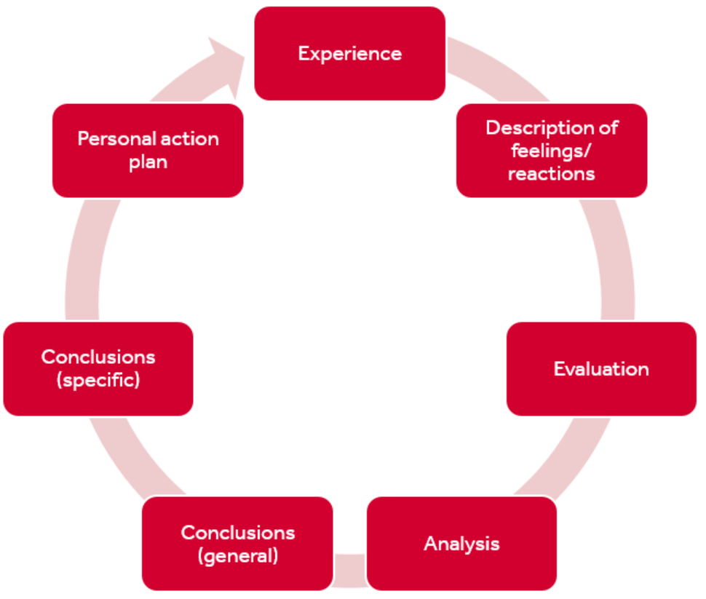
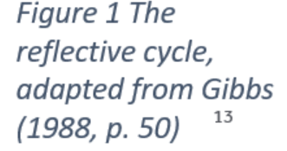
How can we tell where our RPTs are?

Slide 17
How can we tell where our RPTs are?
Take a minute to think about what stage you think your RPT is at
Early idealism
Personal survival
Dealing with difficulties
Hitting a plateau
Moving on

Slide 18
Top tips!
SUGGESTIONS:
Establish a positive relationship from the outset, showing that you believe they are significant, competent, and likeable.
Use the reflective cycle questions to help structure your conversations.
Be explicit about what you do, how you do it and why you do it.
Plan topics to cover at different stages of the course.
Highlight praise and make it specific.

Slide 19
Making the most of School B opportunities
How is your school context different to School A?
What opportunities will this provide for your RPT and how can they capitalise on this?
What might be challenging for your RPT and how can you support them with this?

Slide 20
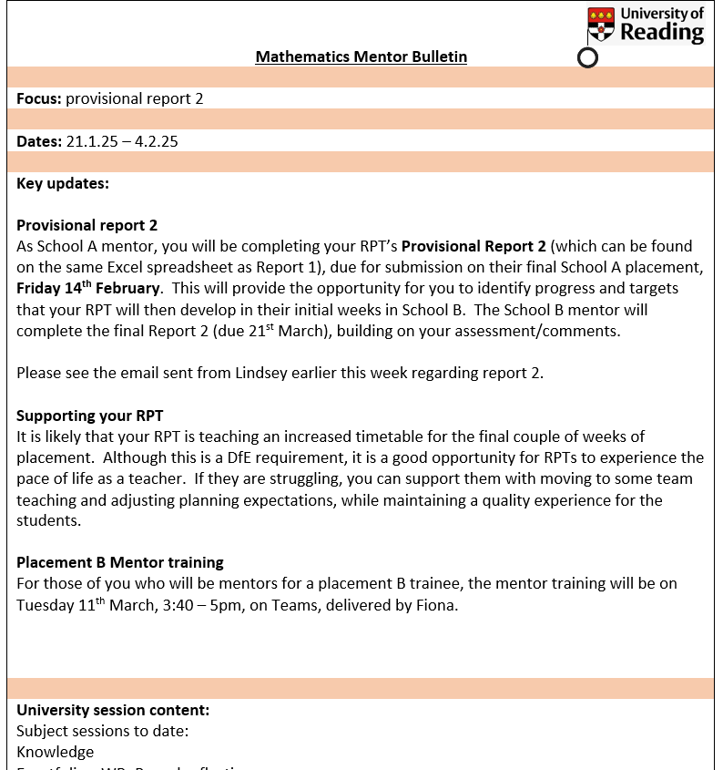
Using the Mentor Bulletins & Conversation Prompts
Fortnightly in the Independent Phase
Connected to a curriculum strand

Slide 21
Supporting Maths RPTs in the Independent Stage

Slide 22
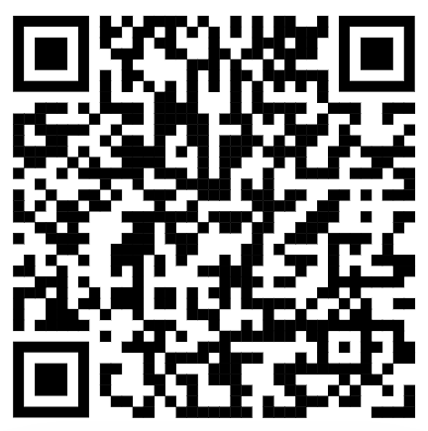
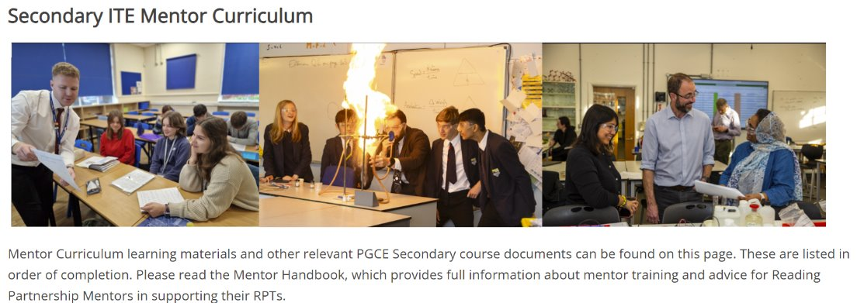
https://sitesb.reading.ac.uk/ioe-mentoring/
Notes:
Reminder!
https://sitesb.reading.ac.uk/ioe-mentoring/

Slide 23
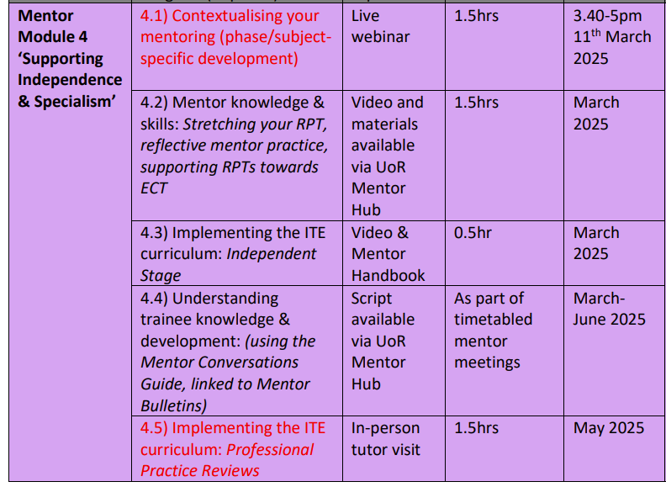
Mentor Curriculum
Notes:
Completion of this training, including the mentor reflection, will result in UoR mentor certification. Module 4 ‘Supporting Independence & Specialism’ has started. As you can see the mentor modules are aligned to the RPTs’ developmental stages.
Any questions at this point about mentor training?

Slide 24
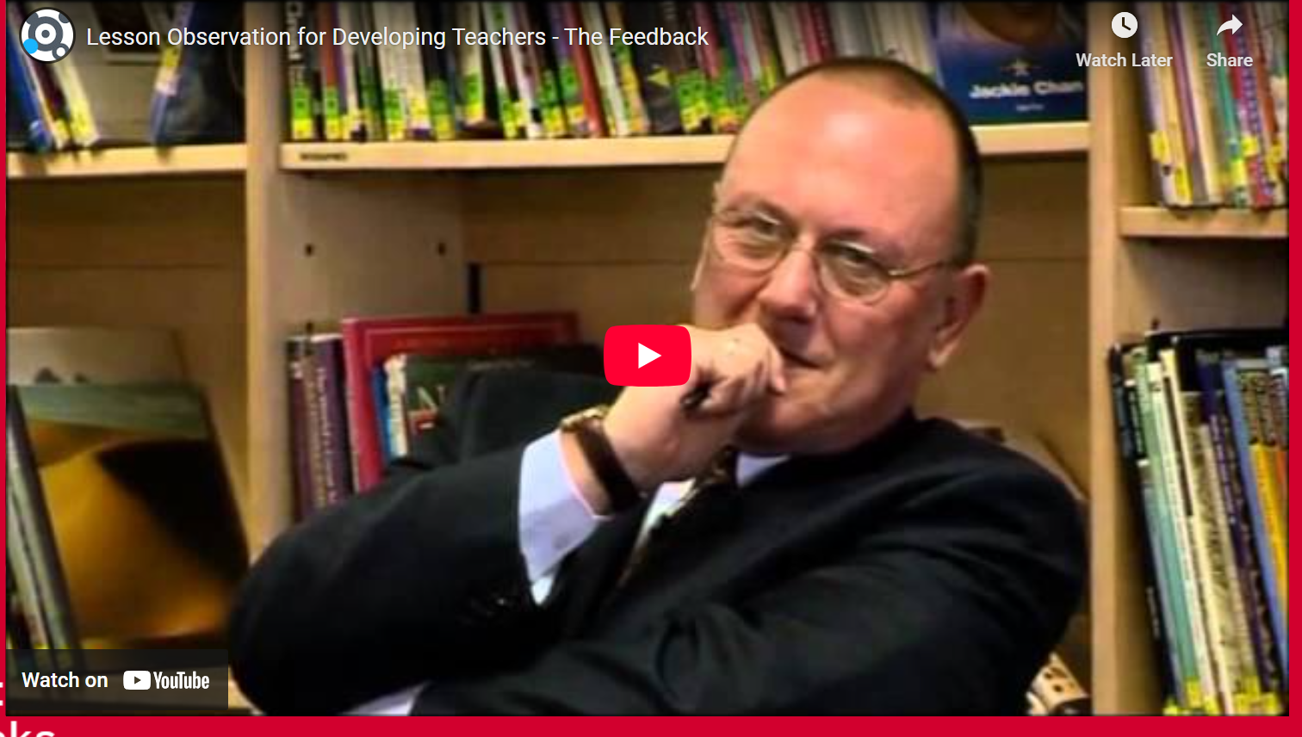
Example of material
https://tinyurl.com/5yybckk3 (slide 16)

Slide 25
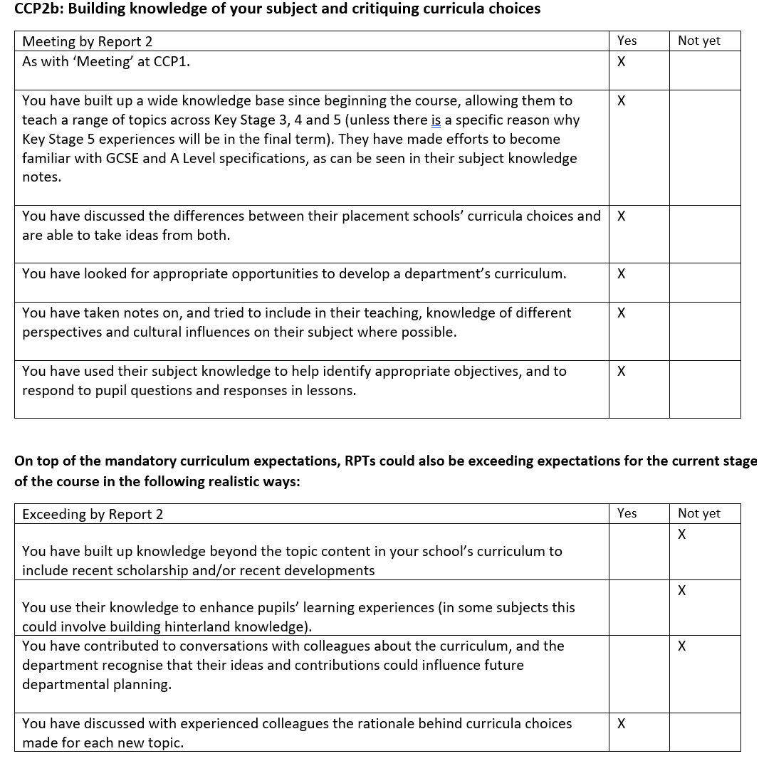
Discussing the
curriculum
Most RPTs could not yet state that they had built up knowledge beyond topic content, built hinterland knowledge or contributed to conversations about the curriculum

Slide 26
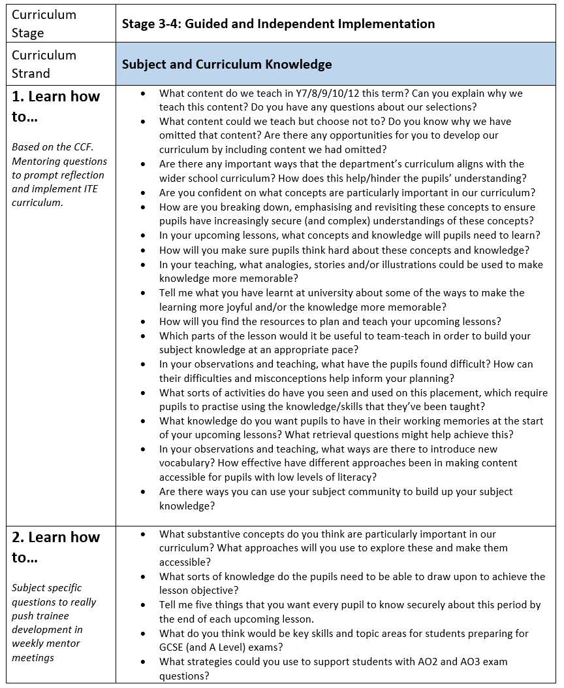
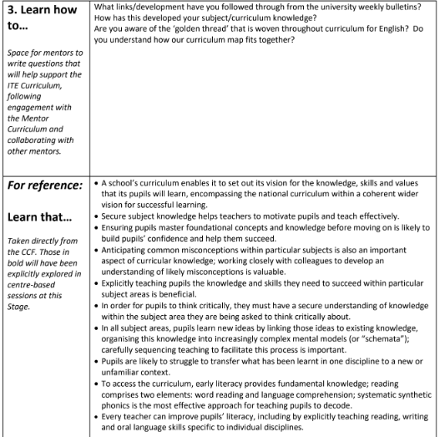
Personalised
Generic
CCF
Subject-
specific

Slide 27
Look at the questions in the generic and subject-specific sections (in the chat) – identify one that you could imagine using in a conversation with your RPT
Generic
Subject-
specific

Slide 28
Target Setting

Slide 29
Setting targets and strategies
Target-setting recognises behaviour is the result of conscious intention, not trained responses (cf behaviourism)
Targets give a sense of purpose, challenge and accomplishment
Clarity of action
Challenge (just out of reach)
Commitment (mentee’s values)
Feedback-able
Complexity (one thing at a time)
Mentor curriculum video 3.2 https://www.youtube.com/watch?v=qlzDVGn4KrM
(Locke & Latham, 2019)

Slide 30
Setting targets and strategies
How do these goals align with Locke’s principles?
“become confident with the year 13 curriculum”
“develop your self-efficacy with SEN students”
“improve your presence in the room”
“use online homework so you don’t have to mark”
“ensure all lessons engage all students”
Commitment
Feedback
Task complexity
Clarity
Challenge

Slide 31
Setting targets and strategies
Set targets for knowledge (know that) and skills (know how)
Think of short-, medium- or long-term
What are the following targets designed to develop?
What strategies might follow these targets?

Slide 32
Setting targets and strategies
ITE Curriculum Strand | Target (What is the intended learning? What kind of target is it? How long will the target last?) | Strategy (What actions/tasks will enable them to achieve the target?) | Progress towards target (Have they achieved the target? What are the next steps?)
Professional Behaviours & Teacher Wellbeing | Build your presence as a teacher around the school | Read the school policies on behaviour moving around the school site; shadow a teacher on duty; talk to students outside of the classroom SO THAT the trainee builds their teacher presence beyond the c/room. | Trainee regularly shadows a duty; they feel more confident in their role; they've started to build relationships outside of the c/room
[SKILL; medium-term)

Slide 33
Setting targets and strategies
ITE Curriculum Strand | Target (What is the intended learning? What kind of target is it? How long will the target last?) | Strategy (What actions/tasks will enable them to achieve the target?) | Progress towards target (Have they achieved the target? What are the next steps?)
High Expectations & Managing Behaviours | Develop a range of strategies in the classroom to engage and motivate students | Observe teacher X and note how they use non-verbal cues and waiting for silence. Practice different ways of doing this (e.g. hand up/counting down) SO THAT...
[SKILL; long-term)

Slide 34
Setting targets and strategies
ITE Curriculum Strand | Target (What is the intended learning? What kind of target is it? How long will the target last?) | Strategy (What actions/tasks will enable them to achieve the target?) | Progress towards target (Have they achieved the target? What are the next steps?)
Subject & Curriculum Knowledge | Build subject knowledge of topic X | Read “Yes, but why” by Ed Southall SO THAT...
[KNOWLEDGE; short-term)

Slide 35
Setting targets and strategies
Verbs for targets:
Learn
Establish
Maintain
Develop
Adapt
Refine
Embed
Respond
Ensure
Understand

Slide 36
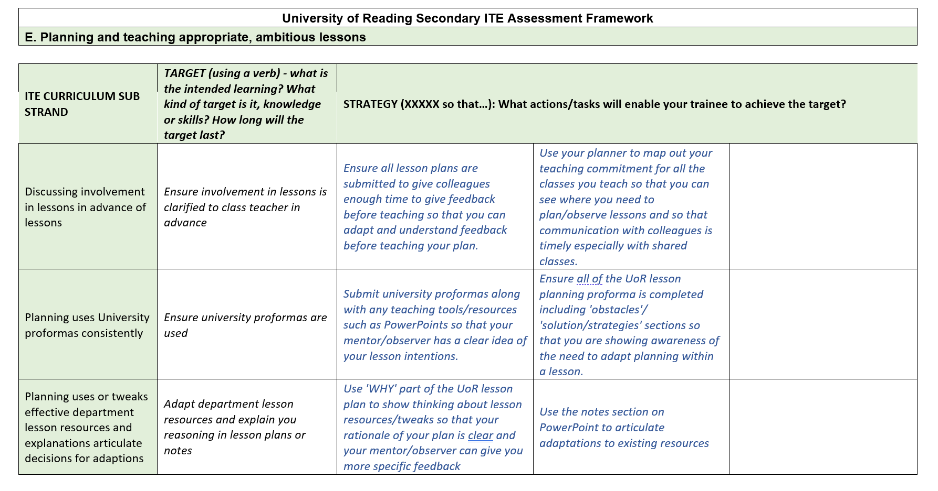
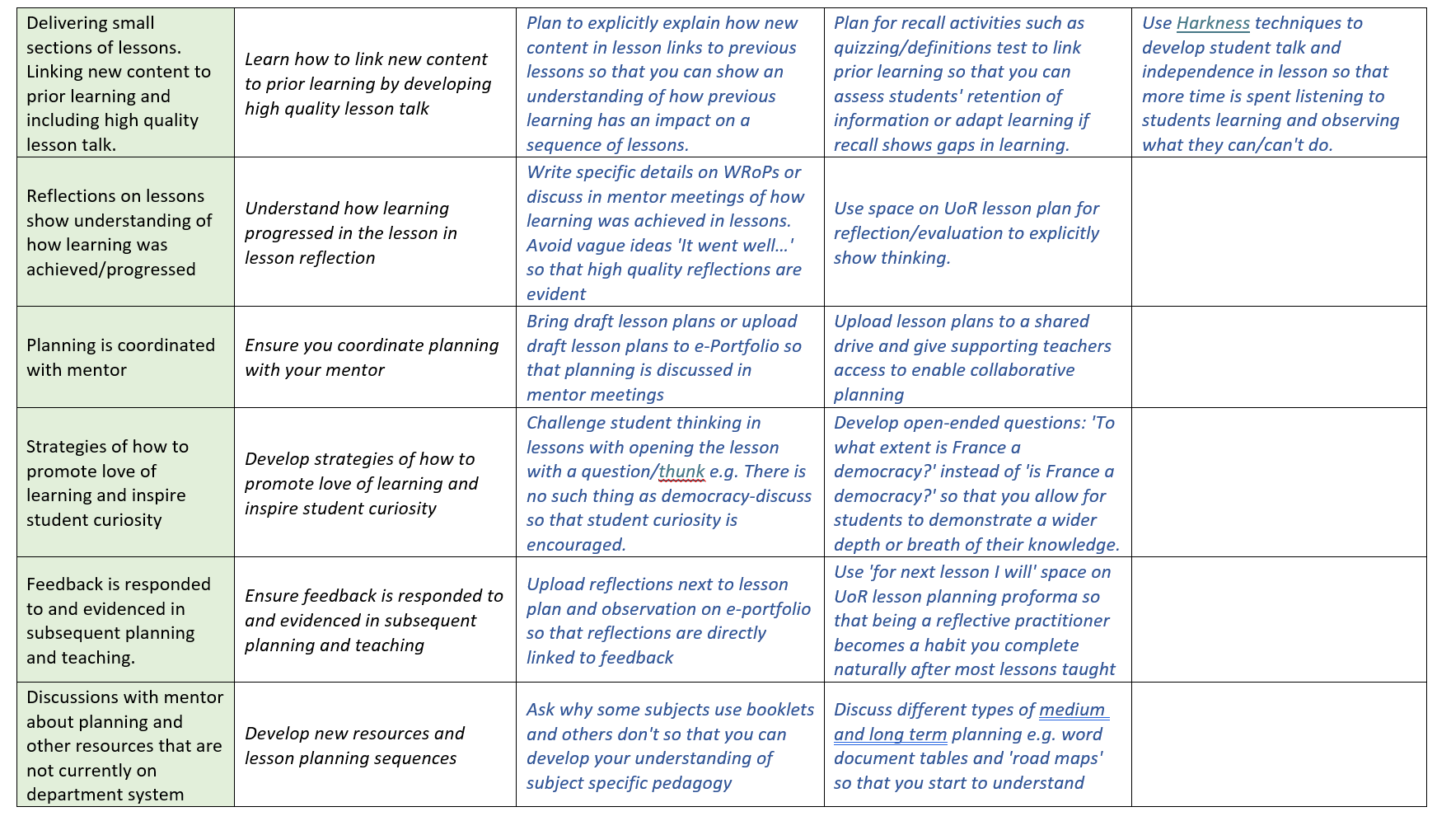
Setting targets and strategies
Look at the target and strategy bank, written by Lead Mentors
p.13

Slide 37
Setting targets and strategies
Identify one that you think you should set for your RPT
Can you make the strategy more specific to mathematics learning?

Slide 38
Sharing Good Practice
In the chat, write one thing that you do with someone who is not making the progress you would like, other than discussing in the mentor meeting/post lesson feedback
In the chat, write one thing that you do with someone who is not behaving as professionally as you would like, other than discussing in the mentor meeting/post lesson feedback

Slide 39
Questions?

Slide 40
References
Furlong, J. and Maynard, T. (1995). Mentoring Student Teachers: The Growth of Professional Knowledge. London: Routledge.
Hagger, H., Burn, K., Mutton, T. & Brindley, S. (2008). Practice makes perfect? Learning to learn as a teacher, Oxford Review of Education, 34:2, 159-178.
Harris, R. & Graham, S. (2019) 'Engaging with curriculum reform: insights from English history teachers’ willingness to support curriculum change', Journal of Curriculum Studies, 51:1, 43-61
Locke, E., & Latham, G. (2019). The development of goal-setting theory: A half century retrospective. Motivation Science, 5(2), 93-105.
Knight, J. (2022). The Definitive Guide to Instructional Coaching: Seven Factors for Success. ASCD.
National Institute of Teaching (2023) ‘Mentoring and Coaching of Teachers: What does the research tell us?’ https://niot.org.uk/teacher-mentoring-research
Rosenshine, B. & Stevens, R. (1986). 'Teaching Functions'. Handbook of Research on Teaching. 376-391.
Sherrington, T. & Caviglioli, O. (2020) Teaching Walkthrus. John Catt Ltd. https://walkthrus.co.uk/

