Slide 1
PGCE Secondary Geography Professional Development Mentor Meeting
PGCE Secondary Geography
March 2025 Martin Sutton

Slide 2
Welcome & Programme Updates
Staffing
Margie Choi - administrator
pgcesecondary@reading.ac.uk
Head of School: Dr Sarah Marston
Director of Teaching and Learning: Dr Jo Anna Reed-Johnson
Head of ITT: Dr Catherine Foley
Director of Secondary: Will Bailey-Watson

Slide 3
Agenda
Welcome and programme updates.
Key messages from School B Mentor training & being a Geography mentor.
Key strengths and areas for development, from Place A.
Supporting Geography RPTs in the independent stage, after R2.
AOB

Slide 4
School B Mentor Training Key Messages
www.tinyurl.com/geogmentors

Slide 5
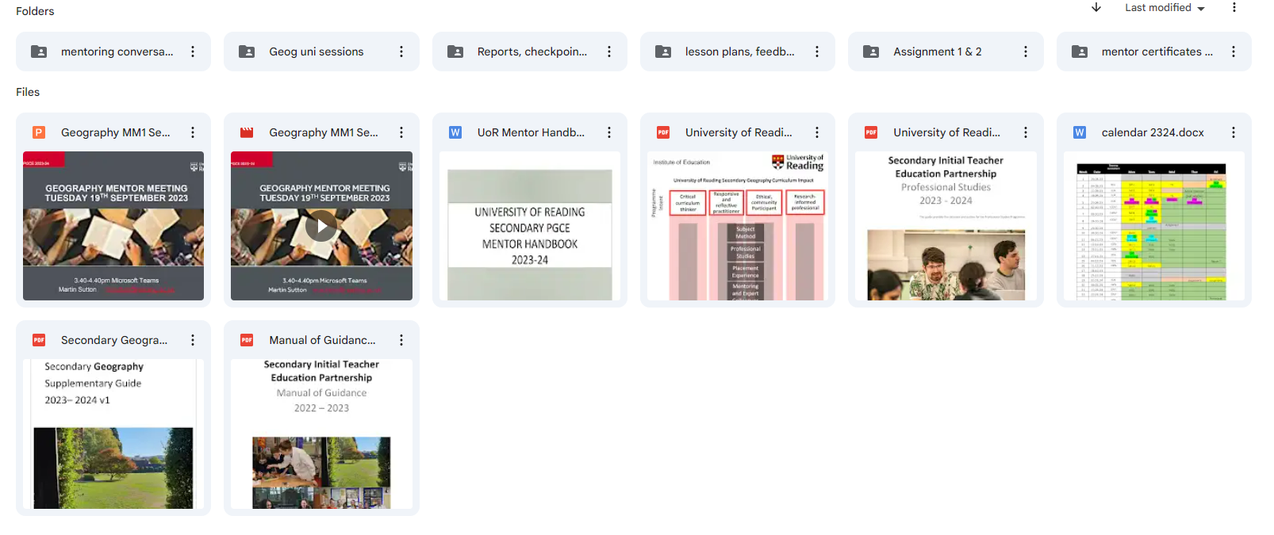
www.tinyurl.com/geogmentors

Slide 6
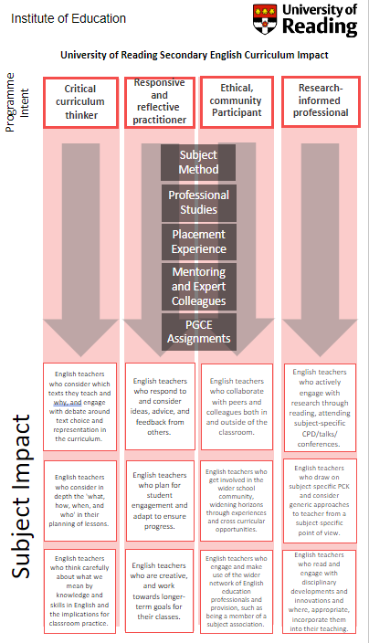
Understanding the UoR ITE Programme
Notes:
An introduction to mentoring a placement B RPT [20mins]
An overview of UoR’s ITE curriculum for placement B [20mins]

Slide 7
Mentor Hub https://sitesb.reading.ac.uk/ioe-mentoring/sample-page/pgce-secondary/

Slide 8
Being a School B Mentor
Early idealism
Personal survival
Dealing with difficulties
Hitting a plateau
Moving on (Furlong & Maynard ,1995; Burn et al, 2015)​
Mentor role: range of support
Stages of development:
SUGGESTIONS:
Establish a positive relationship from the outset, showing that you believe they are significant, competent, and likeable.
Use the reflective cycle questions to help structure your conversations.
Be explicit about what you do, how you do it and why you do it.
Highlight praise and make it specific.
What sort of difficulties and plateaux have your RPTs encountered?
How did you (try to) overcome them?
Notes:
Range of aspects of the mentor role:
Professional support (such as showing the trainee how to put ‘praise points’ onto the database and discussing when this would be appropriate)​
Pedagogic support (such as demonstrating how to ‘model’ some writing during a lesson and discussing how it worked afterwards)​
Academic support (such as suggesting a book on basic grammar knowledge that you’ve read) ​
Emotional support (such as comforting them if they have a difficult lesson) (Roberts, 2020)
Be aware of the stages of development (and where your RPT is in this journey):
Early idealism: ‘in which trainees tend to identify quite closely with the pupils and seek inspiration in the example of significant teachers recalled from their own schooldays. Their analysis of these teachers... Tends to be framed in terms of the teachers’ personality and the relationships that they established, rather than reference to the planning and structure of their lessons or their pedagogical strategies.’ ​
Personal survival: ‘in which trainees tend to feel vulnerable and crave the assurance of being seen as a teachers. They are therefore keen to fit in and become anxious ab out securing effective control of their classes.​
Dealing with difficulties: ‘in which the emphasis is on establishing themselves as a teacher by implementing specific policies (particularly in relation to managing pupils’ behaviour) and demonstrating their ability to organise and execute different kinds of learning activities.​
Hitting a plateau: in which progress my stall as the trainees demonstrate their competence and confidence in running a classroom, and implementing different kinds of activity. Only if they are sufficiently challenged and encouraged to look more closely at the pupils’ experience and the evidence of their learning will they move on.​
Moving on: the final phase in which they are able and willing to adapt their teaching in response to critical evaluation of the pupils’ needs and their ongoing learning.​ (Furlong & Maynard, 1995; Burn et al, 2015)
Suggestions:
Conversation questions for initial/first meetings/’contract’ and reflective cycle questions: see Mentor Handbook: Section 4 ‘Guidance for Mentors’ and you could make use of a mentoring expectations ‘contract’ (see Appendix 16). Also ‘needs analysis’, this will have been established from the mentor handover meetings and the RPTs’ self-audit document, linked to interim Report 2.

Slide 10
Starting from where they are
What have you learnt about your RPT in terms of their strengths and areas for development?
Strengths ​
Development ​
​
Notes:
What have you learnt about your RPT in terms of their strengths and areas for development? – ideas in the chat. Are there commonalities? What is very specific to your RPT?
This is the WCF we’ve collated from our PPR2 visits. How might we address some of the areas for development? Ideas in the chat.

Slide 11
Starting from where they are
What have I learnt about the current RPTs, based on the visits, their e-ps and their work at London Road campus?
Strengths ​
Development ​​
Behaviour Management
Subject Knowledge (generally)
LOs and sequencing of tasks
Relationships with classes
Knowledge of pupils (and how to support them)
Subject knowledge gaps / KS5
Lesson narrative, transitions
Medium term lesson plan proformas
Upload to e-p : plans, feedback
Sixth Form experience
Visualisers
GIS
Group work / collaborations
Notes:
What have you learnt about your RPT in terms of their strengths and areas for development? – ideas in the chat. Are there commonalities? What is very specific to your RPT?
This is the WCF we’ve collated from our PPR2 visits. How might we address some of the areas for development? Ideas in the chat.

Slide 12
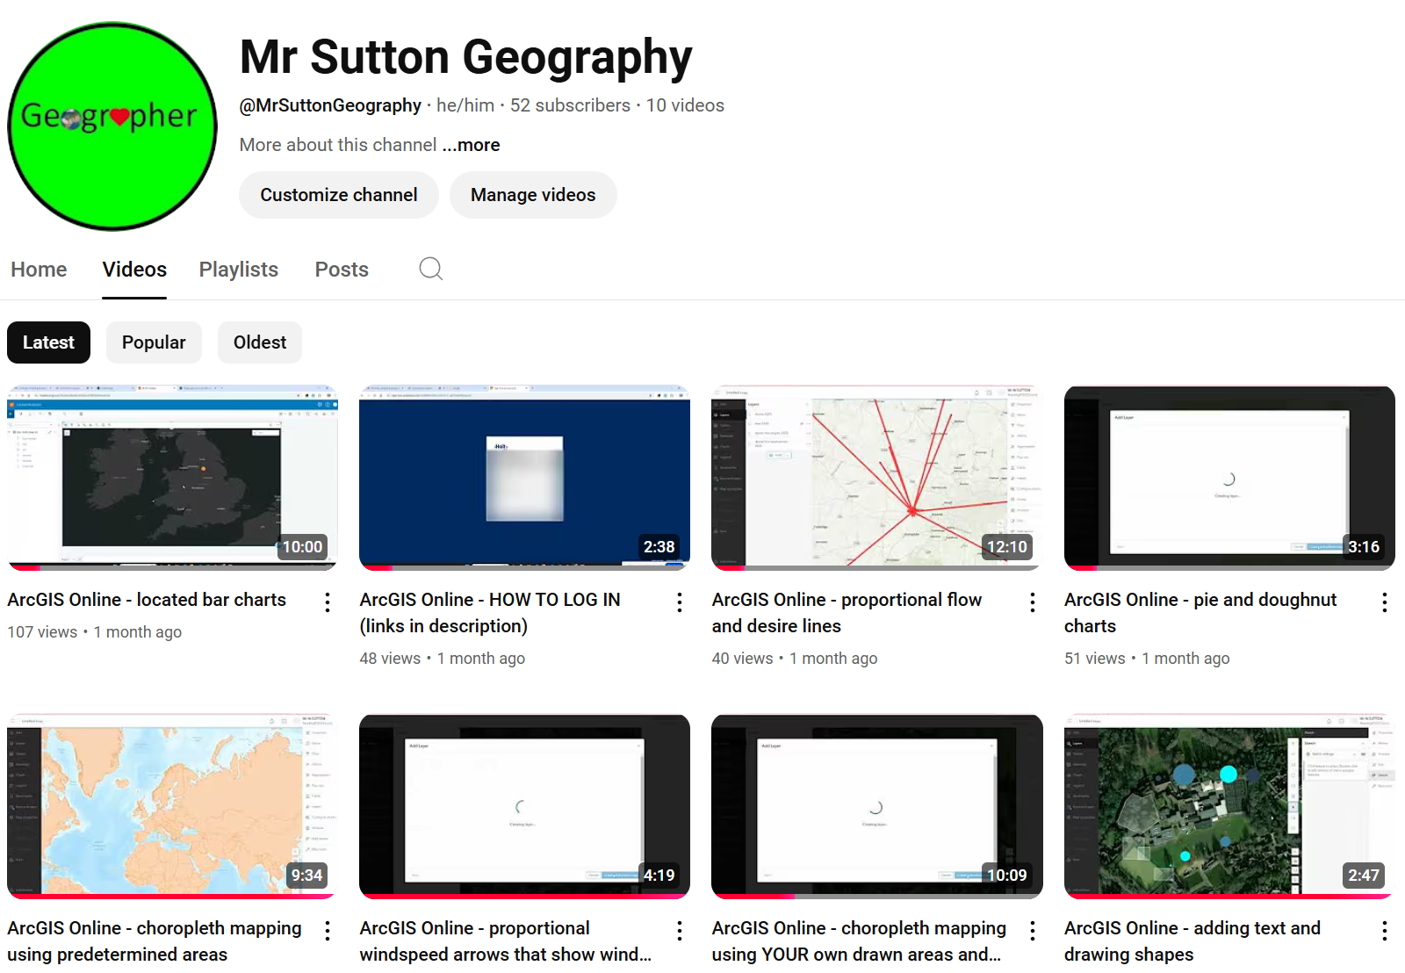
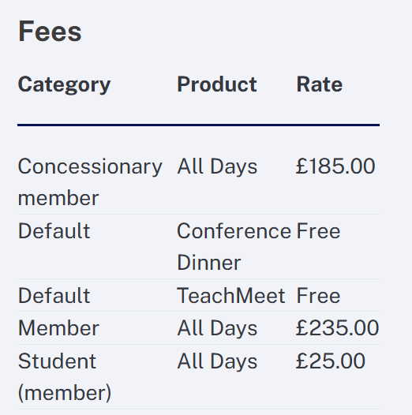
Two opportunities
GA Annual Conference and Exhibition 2025 will be held from 15–17 April 2025 at the new and exciting venue of Oxford Brookes University.
Teach Meet @ Holt
https://www.youtube.com/@MrSuttonGeography

Slide 13
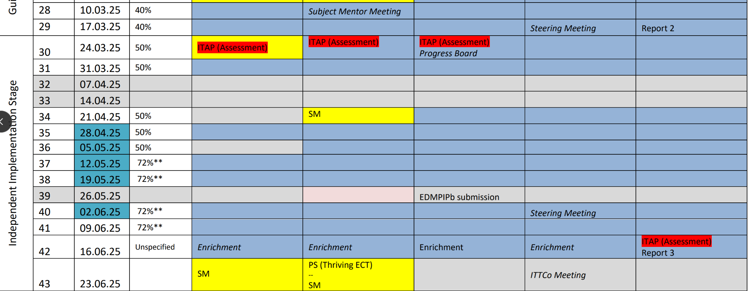
Notes:
Any questions regarding completing R2?
Reminder that it is on the same Excel spreadsheet. Should be a copy in the RPTs' ePortfolio

Slide 14
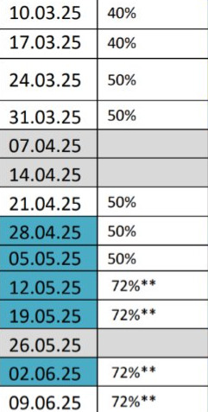
Timetable weightings
40% teaching
30% PPA
30% mentor meet, PS, obs
50% teaching 25% PPA
25% mentor meet, PS, obs
72%
Easter
May HT

Slide 15
Making the most of the opportunities Sch B can afford
How is your school context different to School A?
What opportunities will this provide for your RPT and how can they capitalise on this?

Slide 16
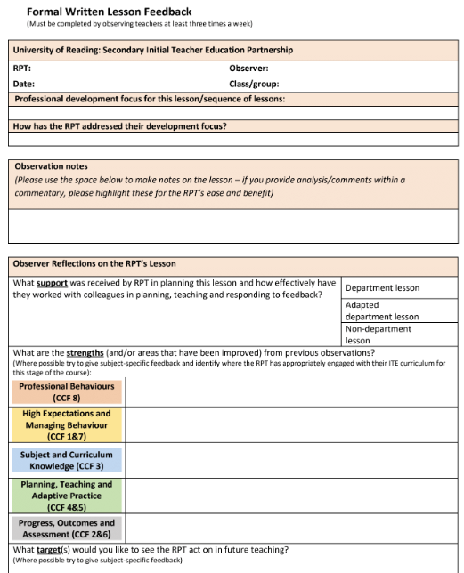
Observation & Feedback
Utilise Reflective Practice
Instead of asking ‘How do you think that went?’
Ask: ‘What did you want the pupils to learn?’
Ensuring other colleagues who will provide feedback are aware of how to do this – trickle down of mentor training!
Notes:
What is your current practice? Take points in the chat.
Emphasise that this practice is what would be great to see when we do our PPR visits!

Slide 17
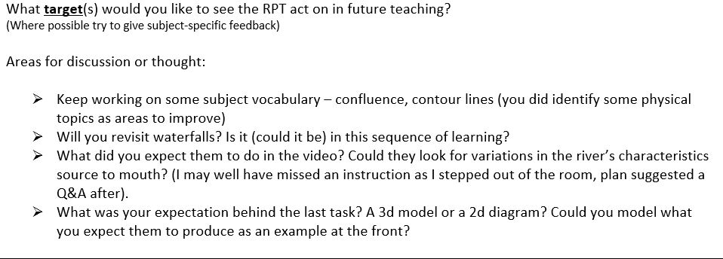

Slide 18
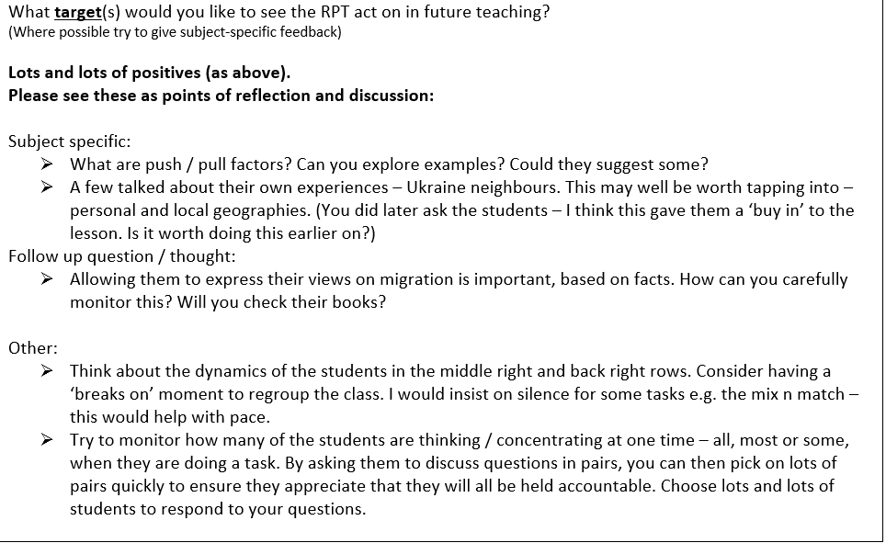

Slide 19
Course Expectations for Planning
Guided stage (up to R2) | Plan using a medium-term plan Plan using a simplified ‘non-negotiables’ lesson pro-forma Whether RPTs choose to use the medium-term plan or the simplified lesson pro-forma, all RPTs must complete a full lesson planning pro-forma for 1 in 3 lessons.
Independent stage (after R2) | Plan using a medium-term plan Plan using a simplified ‘non-negotiables’ lesson pro-forma Whether RPTs choose to use the medium-term plan or the simplified lesson pro-forma, all RPTs must complete a full lesson planning pro-form for 1 in 5 lessons.
(MoG, Appendix 19 ‘Principles of Planning’)
Notes:
Discuss support for planning that RPTs have had. Any issues arisen from those who were Sch A mentors?
Note that the forthcoming ITAP4 (18th -20th March) will focus on planning for progress and use of assessment.

Slide 20
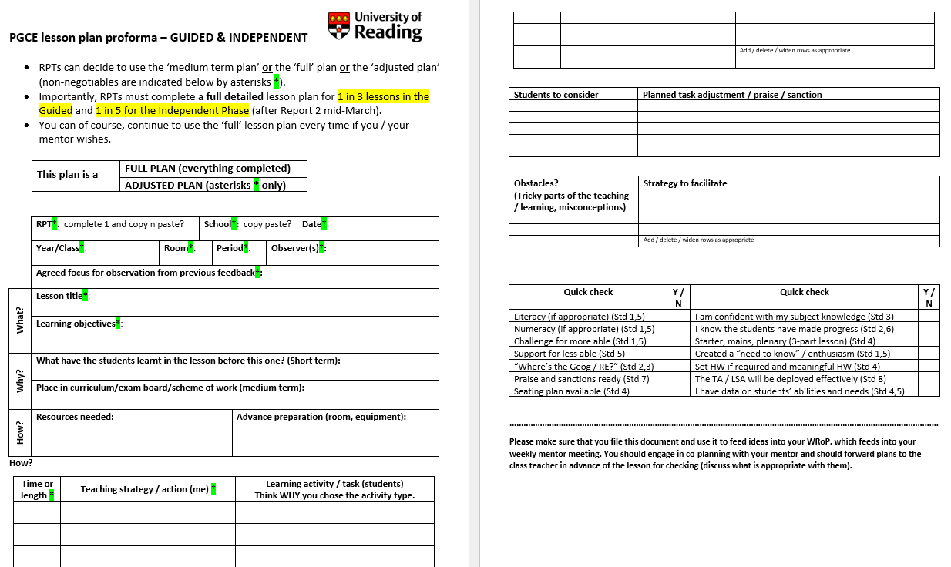
Short version =
2 in 3 before R2
4 in 5 after R2

Slide 21
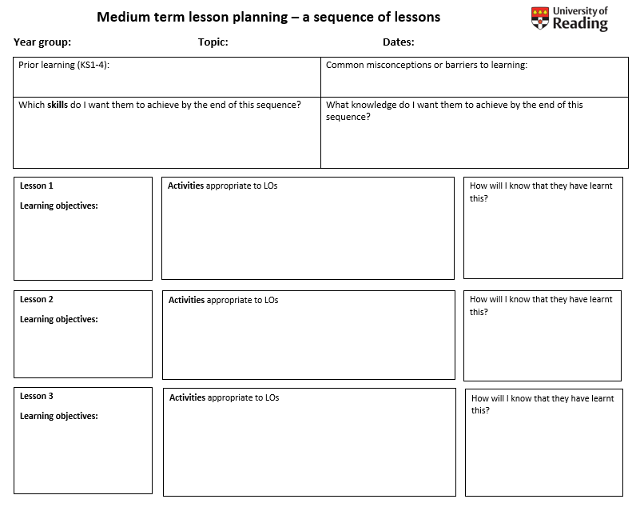
2 in 3 before R2
4 in 5 after R2

Slide 22
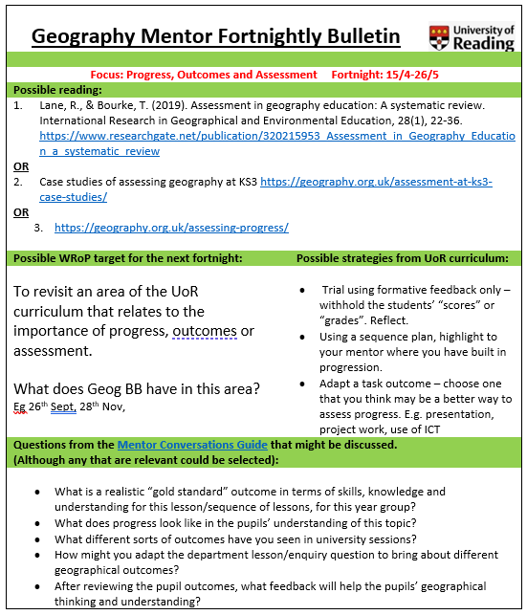
Using the Mentor Bulletins
Fortnightly from March / April
Connected to a curriculum strand

Slide 23
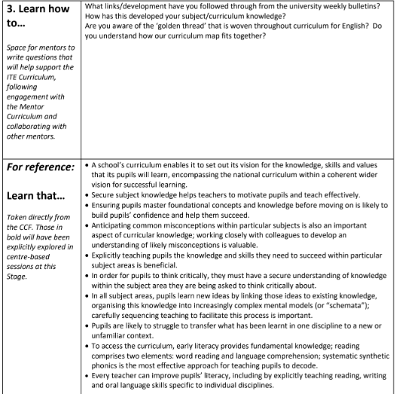
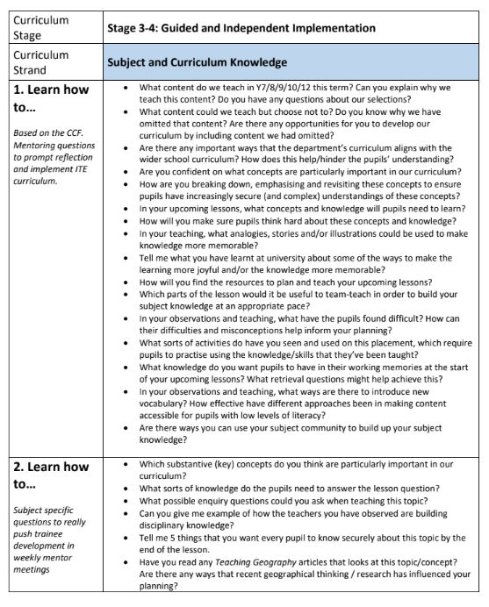
Conversation Prompts – in tinyurl
Personalised
Generic
CCF
Subject-specific
Notes:
Ask if anyone has used any so far this year (or from last y
How and when could you use these prompt questions with your RPT? What might your follow up guidance be in response to their answers?
ear) and how they used them.

Slide 24
Towards R3
Teaching 50% of a school timetable for a sustained period; rising to 72% from 12th May. SUSTAINABLE.
Collecting ORGANIC ‘evidence’ against the Teachers’ Standards – making use of the e-Portfolio
Writing a Best Evidence Guide (BEG) which outlines and helps to explain / justify evidence for each TS.
Evidence includes:
A WROP
A lesson plan
A sequence of lessons
A resource you produced
Pupil work
Examples of your marking
Feedback from observers
Emails from parents/colleagues/pupils
Notes:
Timetable – 50% by Easter. Of the WHOLE timetable. 60% for final two weeks of teaching.

Slide 25
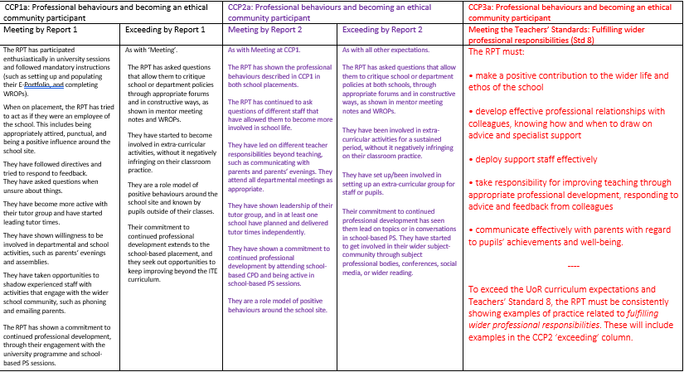
Notes:
How the CCPs map onto the TS for R3

Slide 26
Questions? AOB

