Slide 1
Summer School Experience 2025
Reading Partnership Teachers:
Excellent practitioners who have a positive impact on their pupils
Primary PG ITE
Mentor Training
Welcome Reading Partnership Mentors!

Slide 2
Contacts:
Scarlett Murphy, Programme Director:
s.l.e.murphy@reading.ac.uk
Georgia Aspinox, Assistant Director
g.aspinox@reading.ac.uk
Phil Smith-Stevenson, Assistant Director
p.smith-stevenson@reading.ac.uk
Programme Email: primarypgite@reading.ac.uk

Slide 3
Agenda:
The Primary PGCE Curriculum
Placement timetable
Your role as a mentor
Designing the learning timetable and making progress
Co planning with your RPT
Lesson observations, post lesson discussion and the Good Practice Guide
The weekly meeting
Assessment of the placement – more details in separate screencast

Slide 4
Primary Priorities for 24-25
Establish mechanisms for educating RPTs about their use of GenAI as teaching professionals.​
Embed subject monitoring of placement performance to establish a strong feedback loop.​
To strengthen the Primary ITE partnership through providing induction and support for ITTCos.​
To evaluate SEND provision across the programmes
Primary PG specific:
To bring the outcomes of BAME students in line with their peers​
To effectively work with Lead Partners in the delivery of the new programme​
To implement ITaPs on the programme
Notes:
H&S

Slide 5
Reading Partnership Teacher
Evidence-informed teachers
Pedagogically-skilled practitioners
Creative critical thinkers
Ethical community participants
Compassionate professionals
Our Primary ITE Curriculum Intent: Attributes

Slide 6
Our Curriculum intent
RPTs should be able to articulate:
Why we teach what we do, in the way that we teach it
What they are teaching, with deep and confident subject knowledge
How they are teaching it, and the reasons for the decisions they make
Who they are teaching, and what they bring to their learning

Slide 7
Initial Teacher Training Early Career Framework (ITTECF) entitlement for all trainees:
Access to expert colleagues: professional colleagues, including experienced and effective teachers, subject specialists, mentors, lecturers and tutors
Practise: opportunities to use approaches defined in the ‘learn how to’ column of the ITT Core Content Framework
Discussing and analysing with expert colleagues: interrogating and reflecting on practice, using the best available evidence
Observing how expert colleagues… and deconstructing this approach
Receiving clear, consistent and effective mentoring

Slide 8
RPTs should:
“Learn that…” (informed by the best available educational research)
“Learn how to…” (drawn from wider evidence base including both academic research and additional guidance form expert practitioners)

Slide 9
Mentor Curriculum 2024-2025
Mentor hub: Primary Post Graduate Initial Teacher Education (Primary PG ITE) – University of Reading Mentor Hub
Mentor Placement Materials: Primary PG ITE Placement Documentation – University of Reading Mentor Hub
Mentor handbook (supports the curriculum and mentor certification)
Optional modules
Lead Mentors role: Gill Martin and Fiona Ludlow

Slide 10
Placement Handbook
Please read through this carefully, especially the appendices. Includes:
First meeting checklist
Mentor expectations
Assessment of RPT and learning timetable
Lesson Planning Staged Flowchart
Review Point Checklist (supports visits)
Giving Feedback and Setting targets (supports lesson observations and weekly targets), especially the example
Curriculum Overview

Slide 11
Summer Placement

Slide 12
Aims of the final School Experience:
“To meet the TS at an appropriate level for a trainee at the end of their training programme”
Notes:
Defined by the Standards grading statements

Slide 13
Our RPTs
Pathways
Variety of backgrounds – from University/mature career changers
FTN- we may share with you a specific need if the RPT requires medication on site or reasonable adjustments have been suggested by our Disability Advisory Service (e.g. written feedback, access to resources etc.)
Overseas
Extra Support Forms
Previous placements

Slide 14
How we support you:
Resources on the Mentor Hub
The Placement Handbook
Phone/email support from your tutor / Programme Director
Your tutor:
Will make contact during week 1 or 2 for a brief catch up online
Will arrange an online tutorial in week 3 and visit week 9/10
Will support you in assessing your RPT
Is available for on-going support
If you have any concerns, PLEASE discuss with the RPT first and let us know.

Slide 15
Your role as a mentor
First meeting checklist
Supporting your RPTs:
Formally (weekly meetings recorded on Weekly Planner in portfolio)
Informally
Support them to plan, teach and assess – being mindful of the Staged Planning Support
Observe lessons / activities once a week and complete post lesson discussion with written observation form
Support them in meeting the Teachers’ Standards and completing their progress reviews
Support with completing and checking School-Based tasks

Slide 16
Stage 4: Independent Implementation | 28.04 | Induction
 | 5.05 | 50% | BH
 | 12.05 | 60% | SATS?
 | 19.05 |  | ITAP Theme 1 - Sch | ITAP Theme 1 - Uni | ITAP Theme 3 - Uni | ITAP Theme 3 - Sch
 | 26.05 | Half Term | BH
 | 2.06 |  | ITAP Theme 5 - Uni | ITAP Theme 5 - Sch | ITAP Theme 5 - Sch
 | 9.06 | 80%
 | 16.06 | 80%
 | 23.06 | 80%
 | 30.06 | 80%
 | 7.07 | 80%
 | 14.07
Placement Timetable
Stage 4: Independent Implementation | 28.04 | Induction
 | 5.05 | 50% | BH |  |  | Externals | Externals
 | 12.05 | 60% | Placement Tutorial
 | 19.05 |  | ITaP 1 - SCH | ITaP 1 - UNI | ITaP 3 - UNI | ITaP 3 - SCH
 | 26.05 | Half Term | BH
 | 2.06 |  | ITaP 5 - UNI | ITaP 5 - SCH | ITaP 5 - SCH
 | 9.06 | 80% | Moderation
 | 16.06 | 80%
 | 23.06 | 80%
 | 30.06 | 80% | Final Progress Review
 | 7.07 | 80% | Final Progress Review
 | 14.07 |  | University | University
PS - Working with TAs / specialists
PS - Workload and wellbeing
PS - Working with parents / carers
Behaviour
PS -SALTs?
PS -EAL
PS - Equality and race
PS - Prepare classroom / workload, celebration

Slide 17
ITaPs – Intensive Training and Practice
ITaP 1: Professional identity and behaviours
ITaP3: Anticipating, pre-empting and responding to disruption in the classroom to maximise the opportunity to learn
ITaP 5: Teaching for diversity

Slide 18
Week 10:
Ideally your progress review will happen in week 9
If you have an ESF, you may have this in week 10
Week 10: Continue teaching at 80% but you may spend time in another year group if needed for compliance.

Slide 19
80% in the role of the teacher
Administering SATs / being a reader
Sports Day
School play rehearsals
Interventions
School trips
Phonics screening etc.
All of these count as ‘being in the role of the teacher’.

Slide 20
Key documents
Observation Summary Form (you will use this to observe the RPTs)
UoR lesson design coversheet (what the RPTs will use to support school plans)
The Assessment of Progress (AoP) – managed and shared by your RPT
Assessment Descriptors – support assessment
Weekly Planner (in the ePortfolio)
RPT reflection
A record of your weekly meeting
RPT targets
(More later)

Slide 21
Planning and Learning Timetable
The RPT builds up to teaching around the equivalent of four days per week by the end of term, taking on the role of a teacher.
All school-based tasks* are completed as these form an essential part of the programme’s curriculum and support the Teachers’ Standards
The main focus of the placement is to take on the full role of a teacher, including managing behaviour, planning, teaching, assessing and all transitions and responsibilities that come with the role.
Planning – for the entire placement, RPTs should co-plan alongside their mentor/class teacher, drawing upon existing school schemes and proformas. RPTs should continue to check planning with their mentor and are not required to use the UoR Lesson Design sheet unless agreed by tutor and mentor.

Slide 22
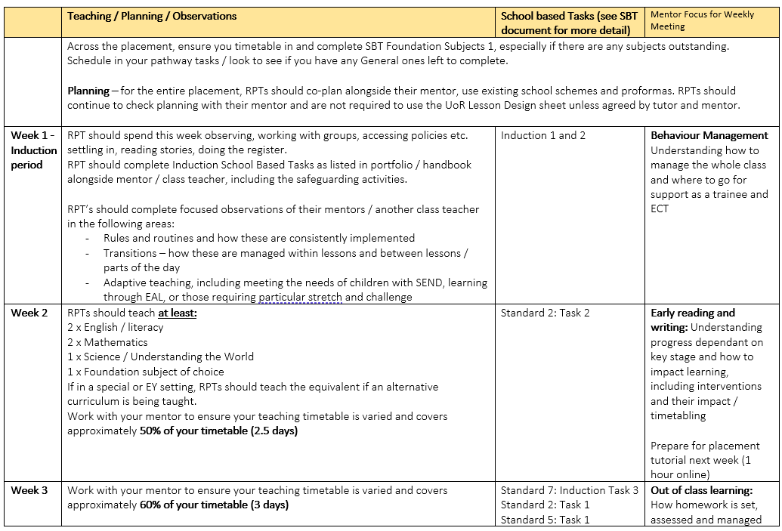

Slide 23
Online Eportfolios
A key part of supporting the RPT in their progress
Includes all the tasks that the RPT needs to complete
Are not easily shared, so RPT will open this for you to work on together
This is an online portfolio through OneNote
Supports our aim of being a Green University
Tutors will send / add feedback – checked weekly

Slide 24
Teaching Files (from handbook)
Teaching Files The RPTs are advised to set up a Teaching File for each experience. They should be organised and be made available for you when you visit and can be used as examples of how they have met certain Strands / Standards in their claims. If these files are kept carefully and thoroughly there will be no need for a separate ‘evidence’ file – all the evidence required to demonstrate the Standards have been met will be contained in their files and e-portfolio and there is no need for replication.
Files should be monitored to ensure they provide evidence of impact on children’s learning. The ITTCo, mentor and you should access the files on your visits, so RPTs must ensure that they are accessible to another reader. Teaching files are not expected to contain a large number of teaching resources.
Notes:
Please make sure these are looked at during your weekly meeting

Slide 25
The weekly meeting
It MUST be timetabled and protected, if you are absent, we ask another qualified teacher to support this:
Reviewing and reflecting upon their progress over the week, with particular focus on elements of the Teachers’ Standards
Having a focused developmental dialogue on an agreed area of practice supported by evidence and development
Plan the next steps in their training (identifying up to three areas to focus on in their practice).
Check on school-based task progress and make notes on what they have completed

Slide 26
The weekly meeting
In discussion with the RPT, please also complete their Overview Timetable, where you will note that they have:
Taught the necessary subjects / proportion of the timetable (with PPA time protected – 20% of the timetable)
Is making good progress with their school-based tasks
Has been observed by you / another experienced colleague and has observed other teachers

Slide 27
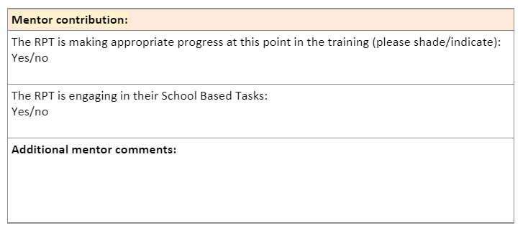
Notes:
School Based Task – add detail

Slide 28
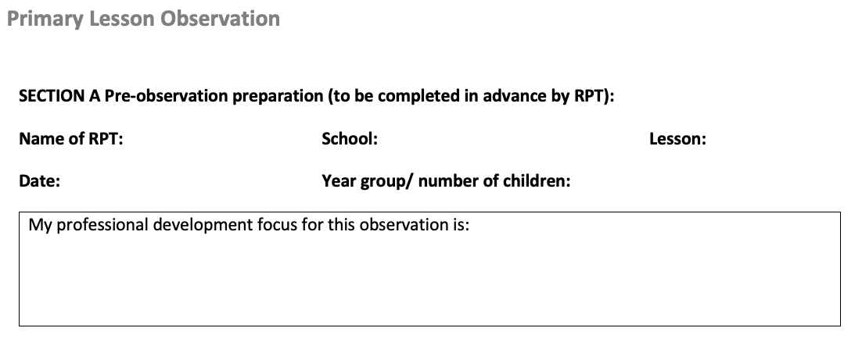
Observing your RPT – once a week
The RPT should provide:
A copy of their planning and/ or slides
The lesson observation feedback document with the focus completed:

Slide 29
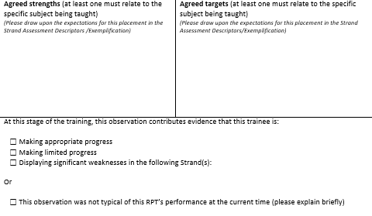
Observation summary form – discussion not ‘feedback’

Slide 30
Instructional Coaching – Post Lesson Discussion NOT feedback
It is key that the RPT is given the opportunity following each lesson to reflect
Ask the RPT to share their reflection based on what the children learnt and how they felt they met their chosen foci
RPTs should be regularly reflecting during this placement on the progress of the children and the impact they are having
It is important for you to offer your observations after this, in relation to their reflection and based on their chosen foci rather than identifying everything that went wrong

Slide 31
Questions to facilitate reflection
Step in Gibbs’ reflective cycle | Example questions/prompts
Description | Tell me what your key aim was for the lesson? What did you want the pupils to learn?
Evaluation | How effective did you that that activity was? What did you find easy/difficult? How do you know the class learned X?
Analysis | Why do you think your lesson with X was difficult? How was it different from the previous lesson with that class?
Conclusions | If you were to teach that lesson again, what would you change?
Action plan | As you’ve suggested that most of the class found the first activity too easy, let’s think about pitch and pace at the beginning of lessons…
Post lesson discussion should take place on the same day as the lesson.
(Roberts, 2020, p128)

Slide 32
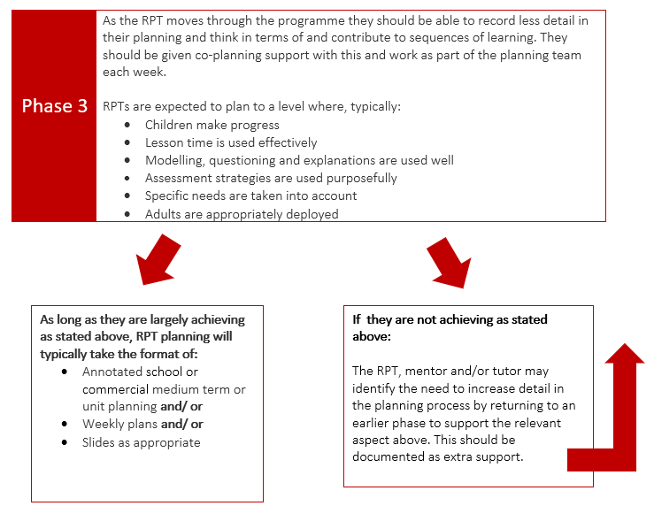
Planning flowchart

Slide 33
An example of focused support: co-planning
Planning can be difficult for beginning teachers, even highly skilled ones!
In particular, they can need help in deconstructing the decisions you regularly make during your planning
Showing RPTs your own plans and verbally feeding back on planning that the RPT has done are both useful strategies, but these should be supplementary and not instead of co-planning, in particular if the RPT is needing more support

Slide 34
Features of successful co-planning
Build on the positive relationship you have with your RPT – make it clear that co-planning support is normal and not a sign that you think they are doing poorly. Thank the RPT for their ideas.
Set up the parameters – who is going to type/write each time? How long can you both allocate to this? Decide out loud what RPT contribution is expected.
Consider who is present – is it just you and the RPT? Are there other dominant team members present?
Model how you go about your planning - literally as you would model for your pupils! Do you have any tips? What are the non-negotiables for you/your school?

Slide 35
Features of successful co-planning
Explain your additions/choices – what are you thinking when you decide to do something in a particular way? Why will that learning make more sense at that stage? Why do you group the chln like that?
Note what aspects the RPT is less confident with - which bits of the process do they never contribute to? Think about making that a focus for next time and plan support for that.
Use questions to draw the RPT in – they might need some encouragement. What forms of question are least threatening? (e.g. ‘How would you teach that learning objective?’ is much less scaffolded than, ‘Given how we taught last week’s main learning, do you think this learning would lend itself to that approach as well?’) Include some questions that you don’t know the answer to yet, so you can work out the answer together.
Ask the RPT to do a section – they should be able to build on your modelling of a different section or a previous lesson’s section to have a go themselves.

Slide 36
School Based Tasks (see Team)
The SBTs are designed to:
• Support the taught modules
• Provide further opportunities for Standards’ evidence
• Provide explicit opportunities to explore aspects of practice
• Provide opportunities to make links between theory and practice
• Provide opportunities for reflection, both individually and collaboratively
• Support the development of banks of resources for RPTs to draw on during
the PGCE and beyond
• Model assessment techniques and methods
• Ensure the Fundamental Skills as outlined by the DfE are met
Please be aware of your role in completing the SBTs

Slide 37
Review and Reflect
TS
Notes:
Encourage the RPT and mentor to use the Target Setting support – this should not be a checklist / to do list but focus on the actual learning – RPT’s could use the Strands / TS / CCF to identify a target and word it correctly.

Slide 38
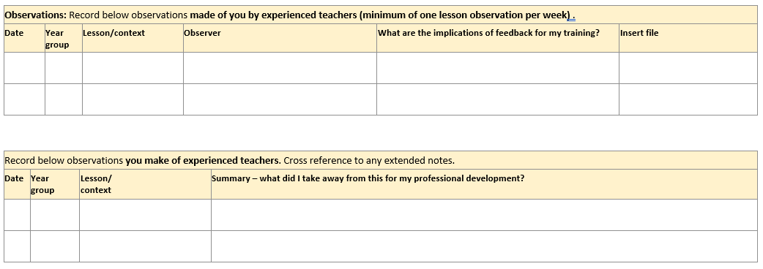
Observations of others only needed until RPT is in the role of the teacher for 80%
Observations of them once a week should continue for the whole placement

Slide 39
Must be completed
Notes:
Mentors need to fill this in and must contact us if they tick ‘no’.
Encouraged to check the SBTs weekly and make notes here on what has been completed and anything else…

Slide 40
Targets for the following week
One target must be subject knowledge specific, using the Good Practice Guide as a support
Must be linked to a Teachers’ Standard
See Module 2.1 of the mentor curriculum – strongly recommended
Teacher Standard

Slide 41
Assessment of the placement

Slide 42
Placement Tutorial – Week 3
Online
Approximately 1 hour with RPT and mentor
RPT will write Progress Review against all strands
Mentor and RPT will write Spring Interim AoP tab
You will agree assessment against each strand and if on track to meet
Any genuine ‘Not Met’s will require an ESF
Review any current ESFs
Check SBTs
Agree timetable for reminder of placement building up role and teaching
Complete post visit form (coming soon) ready for Summer board

Slide 43
Progress Review
Face to face
Approximately 2 hours – lesson observation with mentor leading post lesson discussion
RPT will complete Progress Review
Mentor and RPT complete AoP
Agree assessment against each standard in visit and observe teach / post lesson discussion
Review ESFs, SBTs and portfolio complete
Complete references post visit
Agree targets for ECT form
Screen cast regarding process coming soon!

Slide 44
Extra Support (ESF) (RPT slide)
Used if an RPT is not making expected progress
There are many, many reasons why RPTs make slower progress than expected
ESF forms detail targets and the support that will be put in place to enable the RPT to make progress
They may come to the summer placement already on one
The ESF will be reviewed after an appropriate time frame
If the targets have not been achieved then:
Targets will be rolled over
A new ESF will be issued
‘Cause for Concern’ will be put in place’

Slide 45
From the SE file:
“Please note that should concerns be raised from the school or the University around children’s academic progress or wellbeing as a consequence of the RPTs timetabled teaching, then the teaching timetable will be reconsidered, and additional support will be put in place, normally a reduction in the percentage of required teaching. In this case, it is unlikely that the RPT will be able to gain the evidence required to pass the placement, unless you are able to show improvement and assume full requirements.”

Slide 46
PPA/non-contact time (RPT slide)
RPTs should aim to be in your class for 4 days a week, however, if not teaching, they may complete SBTs / observe others in agreement with you.
The 5th day:
For half that day RPTs should aim to be in a class (not necessarily your own, use the time to identify opportunities for gaining experience in other classes, completing SBTs)
The other half should be used for PPA time – ‘planning, preparation and assessment’ – with you. If you do this at home, please enable the RPT to join you somehow.
RPTs should be in school unless agreed by you or their tutor / Academic Tutor

Slide 47
P.E
The guidelines on ‘Safe Practice in Physical Education and Sport’ state that "Trainee teachers are placed in schools as a fundamental part of their professional training and are not signed off as competent to teach until the end of the training period. As such, however capable they are in a particular activity, they should not be given full responsibility for any group. They should be supervised, managed and monitored throughout their training programme."
(3.4.45) In view of this, RPTs must always ensure that a qualified teacher is present whenever they teach a Physical Education lesson or run a sports club whilst on placement. This is irrespective of any sports qualification the RPT may already have.

Slide 48
Attendance
Absences are only authorised for the following reasons:
Illness
Family emergency
Graduation
Interviews (NOT for ‘visits’ prior to applications)
Religious holidays / celebrations
RPTs have been informed that they must notify their tutor, university and also follow your school’s absence policy, regardless of whether they are teaching
They are allowed one day for visiting their employing school /transition day

Slide 49
Mentor email
Share Initial Needs / Personal by email and any disclosures, some may come from us if the RPT has specific medical needs
Time of arrival
Dress code
Parking
Meeting days
Time they should leave
Please let them know if they should contact your ITTCO too

Slide 50
Common Q&A:
What if my RPT arrives already on an ESF? Does this mean they are failing?
No. IT means there may be a specific area they need to work on following spring assessments. This may be because of absence (mentor or RPT), staffing, or just an additional target. Your tutor will discuss this will you with the RPT in their week 1 check in.
Do I have to have PPA with my RPT? I usually do mine at home.
Yes. The RPT needs to be with you for PPA. Please make arrangements so they can join you and ensure they have access to all schemes, shared areas, planning and printers. Remind them that the RPT is not supply and must have support nearby
What should I do if I am absent or needed to cover?
Your RPT must still have their weekly meetings and observations, so another teacher / ITTCO will need to support them. They must also have support nearby from a qualified teacher at all times.

Slide 51
Any questions?
Screencasts will be recorded to support the reviews
All will be saved on the hub – please check your spam folder!
Regular mentor bulletins will be sent out to support
RPTs have access to all forms and screencasts too as do your tutors so please do ask them if you are worried you are missing anything

