Slide 1
Mentor curriculum 4.2
ITE Mentor Curriculum
Mentor Knowledge & Skills: Supporting your RPT Towards Independence
Dr Rachel Roberts
Notes:
Hello and welcome to the final general mentor knowledge and skills training video. The focus of this session is on supporting your RPT towards independence

Slide 2
Content
The development of training and mentoring
Stretching your RPT
Supporting beyond the first year
Successful mentoring
Notes:
This session will cover the following:

Slide 3
1. The development of training and mentoring

Slide 4
The stages of beginning teachers’ development
Early idealism
Personal survival
Dealing with difficulties
Hitting a plateau
Moving on
(Furlong & Maynard,1995)
Notes:
You may remember that I shared Furlong & Maynard's research in an earlier session, which identifies the different stages of beginning teachers' development:
Early idealism: ‘in which trainees tend to identify quite closely with the pupils and seek inspiration in the example of significant teachers recalled from their own schooldays. Their analysis of these teachers... Tends to be framed in terms of the teachers’ personality and the relationships that they established, rather than reference to the planning and structure of their lessons or their pedagogical strategies.’
Personal survival: ‘in which trainees tend to feel vulnerable and crave the assurance of being seen as a teachers. They are therefore keen to fit in and become anxious ab out securing effective control of their classes.
Dealing with difficulties: ‘in which the emphasis is on establishing themselves as a teacher by implementing specific policies (particularly in relation to managing pupils’ behaviour) and demonstrating their ability to organise and execute different kinds of learning activities.
Hitting a plateau: in which progress my stall as the trainees demonstrate their competence and confidence in running a classroom, and implementing different kinds of activity. Only if they are sufficiently challenged and encouraged to look more closely at the pupils’ experience and the evidence of their learning will they move on.
Moving on: the final phase in which they are able and willing to adapt their teaching in response to critical evaluation of the pupils’ needs and their ongoing learning.
Burn et al (2015), p36
Expertise development – difference between novice and expert. Opportunity to reflect on your own development – remembering what you found difficult/didn’t know when you started training.
Note here about where RPTs are now in their development – not complete novices but also

Slide 5
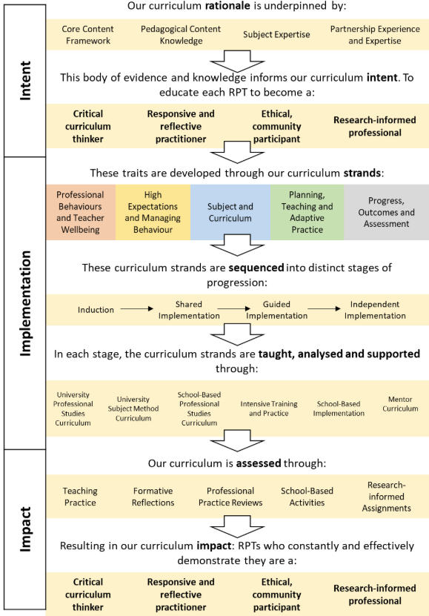
UoR ITE Curriculum Vision
Notes:
These stages of development are reflected in how we designed and sequenced the ITE curriculum

Slide 6
Notes:
Link between the curriculum strands and how development is sequenced – as we move into the independent phase. This is supported through this training, as well as the other aspected of the course (university sessions and the RPTs' school experience)

Slide 7
Critical Curriculum Thinking (Harris, 2021)
Notes:
A key trait that we aim for RPTs to develop is that of being a CCT...
As mentors, we do ask that you continue to foster these thoughts and discussions with your RPT throughout their placement.

Slide 8
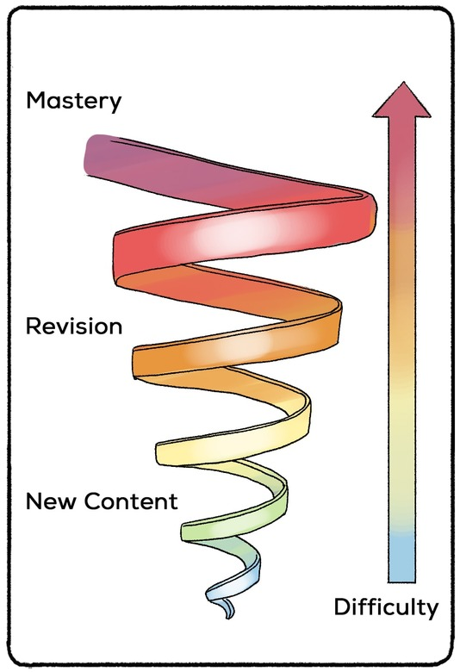
Spiral curriculum for ITE?
(Bruner, 1926)
Notes:
Bruner's concept of a spiral curriculum can be helpful in examining the design, structure and implementation of an ITE curriculum, and the mentor's role as part of this.
The spiral currriculum is:
(1) Cyclical Learning, (2) Increasing Depth on each Iteration, and (3) Learning by building on prior knowledge. (Bruner, 1960)
This is very difficult to achieve in learning to be a teacher, because of the complexity and contextual nature of teaching. However, as a mentor it is possible for you to structure your RPTs' learning through the weekly meetings and targets/strategies set (you can make use of the mentor prompts and target/strategy bank to help – more on this later).
This revisiting of key learning, practicing and refining is built into the curriculum strands and the ITE assessment, where at each reporting point, the expectations of what the RPTs can do/should know develops in depth and sophistication.

Slide 9
Challenging the beginning teacher’s assumptions, being a critical friend and demonstrating how to do something they are having difficulties with.
Coaching
Acting as a sounding-board, being there to listen and offer support.
Counselling
Helping a beginning teacher develop resourcefulness, make them aware of the information, resources, people, organisations and more formal repositories of knowledge.
Networking
Giving advice – a balance between giving a beginning teacher the answer and encouraging them to find their own solutions to problems through reflective thinking.
Guiding
Developmental Mentoring Model
(Adapted from Cluttterbuck in Golder et al, 2020, p13)
Notes:
As previously covered, the mentor model that we advocate is a developmental one: drawing on aspects of coaching when appropriate (less of a stark difference between being a 'directive' mentor and non-directive coach - so more of a continuum
By aiming to be ‘Empowering – progressively non-directive to support mentees to become more autonomous and agentic’ will foster independence (Hobson, 2016, p101)

Slide 10
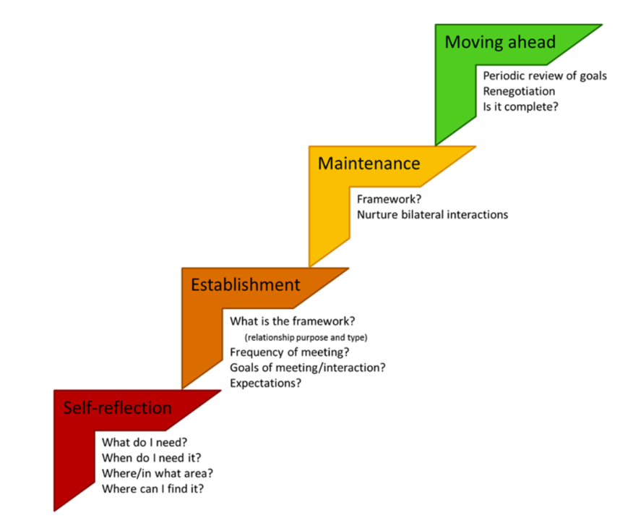
Mentoring Roadmap
(Montgomery, 2017, p4)
Notes:
You could take a moment now to consider your own learning journey as a mentor, whether this is the first time you have mentored a beginning teacher, or whether you've been a mentor for many years. Motgomery provides a 'roadmap' to think about the different stages of mentoring: ‘This figure illustrates the stages or stations included in a mentoring roadmap, including self-reflection, establishment, maintenance, and moving ahead. Pertinent guiding questions or considerations for each stage are represented below each major area. Although depicted in a linear progression, the roadmap is not unidirectional and revisiting steps such as self-reflection should occur periodically.’ (Montgomery, 2017, p4). Where are you now?

Slide 11
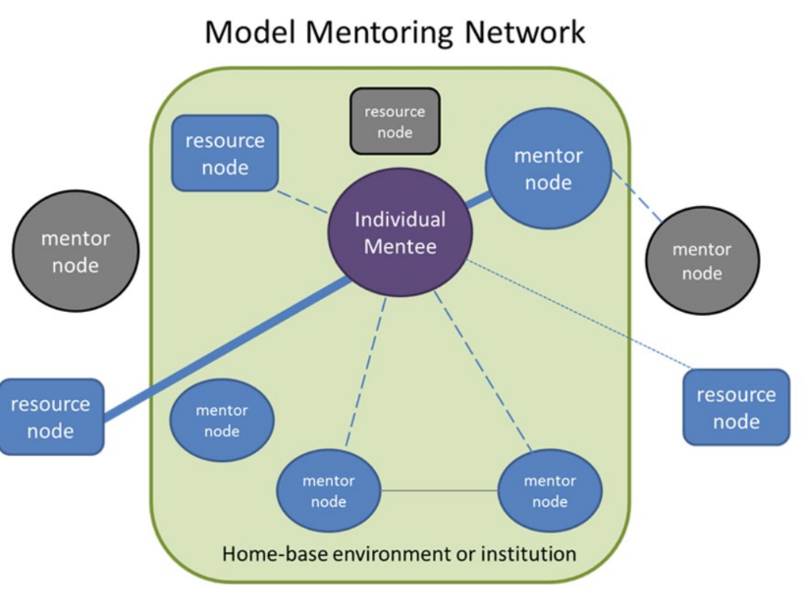
(Montgomery, 2017, p9)
Notes:
Montgomery also suggests a way of thinking about a mentoring network: ‘Shown is an example of an egocentric or mentee-centered mentoring network including mentor (represented as circles) or nonhuman mentoring resources (represented as rectangles) nodes. Nonhuman resources include books, Internet resources, online courses, or other resources which provide insights into mentoring but are not direct relationships with another person. Blue nodes represent mentoring resources already known to the mentor, gray nodes are needed or unknown mentoring resources. The nodes are connected by ties or edges, which represent the relationships or interactions between mentee and mentor or engagement of mentee with a particular resource, with thinner dotted lines (weaker) to thicker solid lines (stronger) representing the strength of the relationship; and the length of the edges represent relative distance (professional, physical, or emotional). Nodes without edges are those that are identified as known nodes which will be needed at a later time or unknown or needed nodes that have not yet been identified and/or connected. The light green box represents the boundaries of the home-base environment or institution, whereas the space outside the box is external to one’s home environment.’ (Montgomery, 2017, p9)
Take a moment to consider what resources you have used (or might need), including drawing on others' experience/knowledge.
Informal mentoring support
‘In some teacher induction programmes, the emphasis on appointed mentors does not recognise the reality that new teachers approach many people for support – for example, their subject colleagues, the teacher next door, the teacher who shares the same year group and so on... Rather than leaving everything to the official mentor and the informal support of other colleagues, other support mechanisms for new teachers would be useful... This could include formal structures to facilitate peer support, whole-school support and the creation of networks for teachers who work in smaller schools.’ (Shanks, 2023,p 448) Who else can you drawn on to support your RPT?
‘Actively teaching mentors how to identify opportunities for their mentees to network and collaborate with peers, as well as how to find external professional development to participate in, would also be valuable.’ NIoT 2023 p5

Slide 12
2. Stretching your RPT

Slide 13
Recognising the successful RPT
What are the signs that you are working with a mentee who will need stretching?
What potential difficulties might you or your colleagues face in doing so?
lessons are solid very quickly
lessons might sometimes be as good as more experienced teachers
pupils are really positive about them
their planning and teaching often achieves the things that they set out to achieve
they have been able to draw links between university/best practice and the classroom
Lack of subject/year group expertise
Time to support them
Complacency of the mentee
Complacency of teachers

Slide 14
Two interlinked focuses
Risk-taking
Target-setting

Slide 15
Risk-taking
What are two most commonly seen interpretations of ‘risk-taking’ when dealing with mentors and their successful mentees?
Huge, creative, student-led.
Being left alone.
This is not necessarily what we mean at all.

Slide 16
Risk-taking
Support in teaching involves creating a culture where everyone feels that taking risks is part of their everyday profession.
By risk-taking in this context, we mean: ‘taking a chance on something where success is not guaranteed and, indeed, something that might not work’.
Rationalised risk-taking is a crucial part of learning to teach, because it provides the most fertile opportunities to actually learn. (Wiliam, 2016)

Slide 17
Risk-taking
Lower the stakes
What constitutes lower stakes in your context?

Slide 18
Risk-taking
2. Normalise risk-taking as part of practice
For instance, include in each mentor meeting a section to ask:
Tell me one thing you did this week that you were worried wouldn’t work?
What did you learn from taking that risk?
Help scaffold, and secure justifications/rationale in advance.
Praise RPTs for the things they want to encourage.

Slide 19
Risk-taking
3. Experienced teachers working with the RPT should consider the role they play in normalising risk-taking.

Slide 20
Risk-taking
What might risk-taking look like in your context?
Managing new technologies?
Allowing for independent learning?
Less control over a class?
Trying ideas from other trainees? (Wright, 2017)
Notes:
Bringing their academic passions and interests into the classroom
Being bold with curriculum choices
Expecting every pupil to contribute and succeed
Going beyond a specification/resource
Opening themselves up to questioning
Being innovative with school policies
Giving a sanction
Link to target setting (see video 3.2)

Slide 21
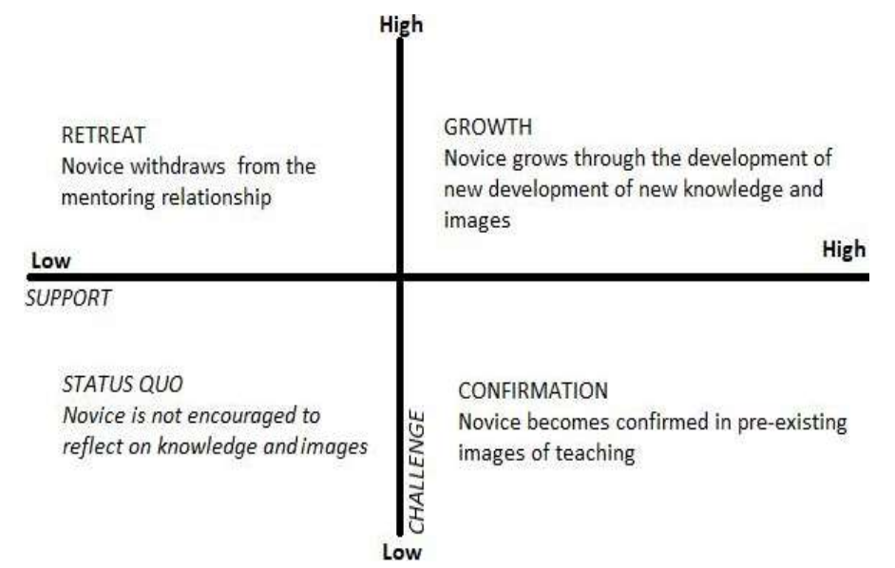
Notes:
Striking a balance between support and challenge (adapted from Daloz, 1986, cited in Schofield, 2019:21)
Mentors can foster a growth mindset (Dweck, 2006) in their RPTs

Slide 22
RPTs with growth mindset:
They take responsibility for improving their practice.
They see setbacks and feedback as an opportunity to learn and grow their skills.
They actively seek learning opportunities and new challenges.
They have positive and high expectations of their students.
They use growth mindset language when teaching and with themselves.

Slide 23
I cannot teach without a PowerPoint.
I must stick to the lesson plan that I spent all weekend crafting.
They make it look so easy; I’ll never be able to teach like them.
I’m not a shouty teacher; I’ll never get the students to behave like they do.

Slide 24
The Reflective Cycle adapted from Gibbs (1988, p. 50)
Experience
Description of feelings/ reactions
Evaluation
Analysis
Personal action plan
Conclusions (general)
Conclusions (specific)
Notes:
Should be seen as a spiral, not a repeated cycle

Slide 25
Step in Gibbs’ reflective cycle | Example questions/prompts
Description | Tell me what happened in your lesson on Tuesday. Can you describe the incident with Joanna in more detail? What were you thinking/feeling at that point?
Evaluation | Thinking about what you wanted the pupils to learn, how effective did you think that activity was? What did you find easy/difficult?
Analysis | Why do you think your lesson on photosynthesis with Yr7 was difficult? How was it different to the previous lesson with that class?
Conclusions | If you were to teach that lesson again, what would you change?
Action plan | As you’ve suggested that most of the class found the first activity too easy, let’s think about pitch and pace at the beginning of lessons…
Notes:
Using questions/prompts to stretch/grow

Slide 26
Using the Supporting Mentoring Conversations Documents
Questions and prompts provided for each curriculum strand, for each of the four stages of trainee development
Based on the CCF 'Learn how to...' statements allocated to the trainee stage
Generic questions
Subject/phase-specific questions
Personalised by mentors
To be used weekly
Notes:
Please use the UoR Supporting Mentoring Conversations documents, which provide further prompts for questions/discussions for you to have with your trainee. Each Supporting Mentoring Conversation document contains generic questions/prompts, based on the CCF's 'Learn how to...' statements, followed by subject/phase-specific prompts. There is space for you to add your own questions, so that it is personalised to your trainee, their specialism, and their stage of progress. Please use these as part of your weekly meetings with your trainee, selecting the most appropriate/relevant question for the stage of their development.

Slide 27
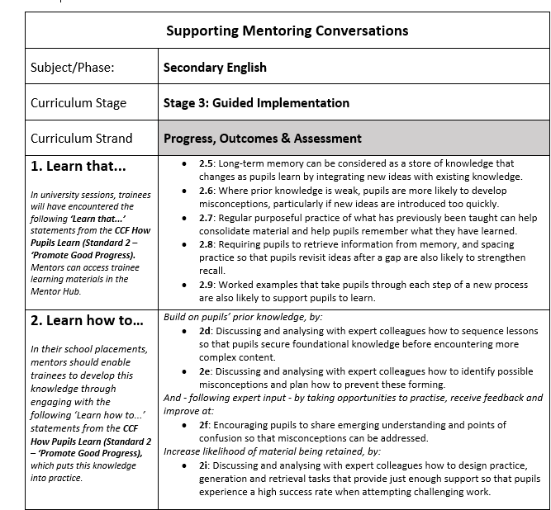
Supporting Mentoring Conversations
Notes:
This is a detailed example screenshot of relevant subject-specific mentor conversation questions for this Curriculum Strand. This is from Secondary English.

Slide 28
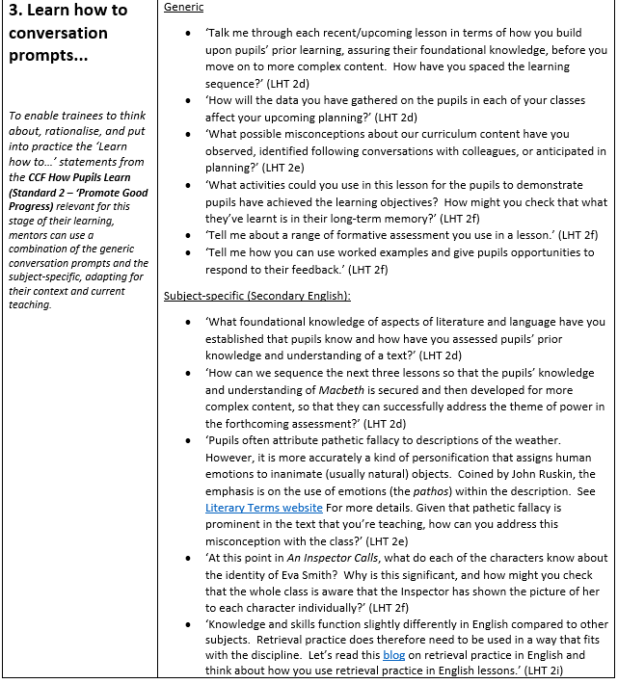
Notes:
Notice how the prompts are tailored to the subject and designed to stretch trainees' thinking towards independence.

Slide 29
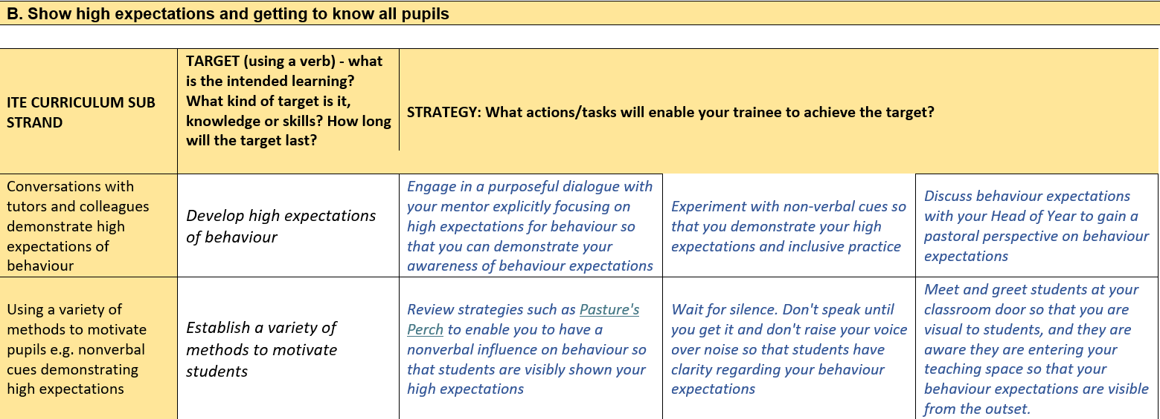
Secondary ITE Target and Strategy Bank
Notes:
We have also developed an ITE Target and Strategy bank, which includes targets linked directly to the curriculum strands and a series of suggested strategies that RPTs can use to address the target – see Mentor Hub, and user guide.

Slide 30
Unseen Observations
(O'Leary, 2020, p148)
Notes:
To facilitate moving towards independence, mentors do not need to observe every lesson in this sequence: instead, use an 'unseen observation'* approach (O'Leary, 2020).
'Unseen observations are quite similar to other models of observation, but the main difference is that there is no observed lesson. Instead of the observer visiting the class to carry out a ‘live observation’, the stimulus for the professional dialogue between the observer and the observee is based on the latter’s self-analysis and recounting of the lesson itself, as well as a pre-lesson meeting between the two in which the proposed lesson plan is discussed' (O'Leary, 2020, p147).
This process can serve to facilitate independence of self-evaluation and reflective practice, as the trainees' teaching experience progresses.

Slide 31
3. Supporting beyond the first year

Slide 32
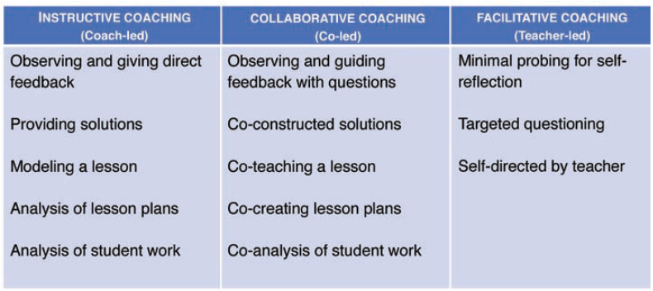
Beyond the first year
Notes:
Although it is unlikely that you will mentor your RPT as an ECT, it is worth thinking about this continued developmental phase, particularly if you are going to be a mentor to an ECT.
Utilising aspects of instructive coaching (which we covered in Module 3) can be helpful. This table identifies the possible different approaches that, again, take into account the increasing experience of the ECT.
‘Instructive coaching is direct, where the coach provides support for specific situations, offers solutions to problems, and leads conversations with the teacher.
Collaborative coaching is less direct, where the coach and teacher share stake in the conversations, and solutions are co-constructed. Facilitative coaching is where the teacher leads the conversations and the coach may probe for problem-solving. While the goal for all teachers is that coaching becomes facilitative, some teachers may need more instructive coaching for certain dimensions of teaching and facilitative coaching for others.
An instructional coach may need to adjust his or her approach based on what a teacher needs at any given point in time. The art of coaching requires understanding when a teacher needs to be the co-constructor of learning and when a teacher needs to lead the self-discovery and analysis of learning.’ (Zugelder, 2019, p182);
Workload and wellbeing initiatives

Slide 33
4. Successful mentoring

Slide 34
Is mentoring successful?
Mentor’s success might judged by mentee’s performance as viewed through the Teachers’ Standards.
Success in NQT mentoring judged by retention (Totterdell et al, 2008)
Critically important to NQTs in induction year (Totterdell et al, 2008)
Student teachers view practicum as most important part of training, influencing teacher identity, and without a mentor were overwhelmed (Bradbury & Koballa, 2008; Clarke, Triggs & Nielsen, 2014)
Trained subject mentors produced teachers that scored more highly on all measures than untrained, non-subject mentors (Stanulis & Floden, 2009)
School benefits of retention, job satisfaction, mentoring capacity (Allan, 2007; Hobson et al, 2009)
Trained mentors are more inclined to using developmental approaches to mentoring than mentors without any formal education in mentoring… Reflective mentoring models aiming to promote critical reflection have to be based on a developmental approach towards mentoring, rather than a judgemental one. ’ (Tonna et al, 2017, p222)
Notes:
How can a mentor’s success be evaluated?

Slide 35
Conditions for success
Matching personalities, either similar types or opposites
Accepting and involving, feeling prioritised, buying in
Being prepared and organised
Being open minded
Sharing philosophy of teaching, making decisions explicit
Trust and communication
Time
Training
Network of support
How would you evaluate your mentoring this year?
What influenced it and what might you do differently next time?
(Allan, 2007; Jones, Kelsey & Brown, 2017; Lee et al, 2006)
Notes:
Which of these conditions have you had 'control' over?

Slide 36
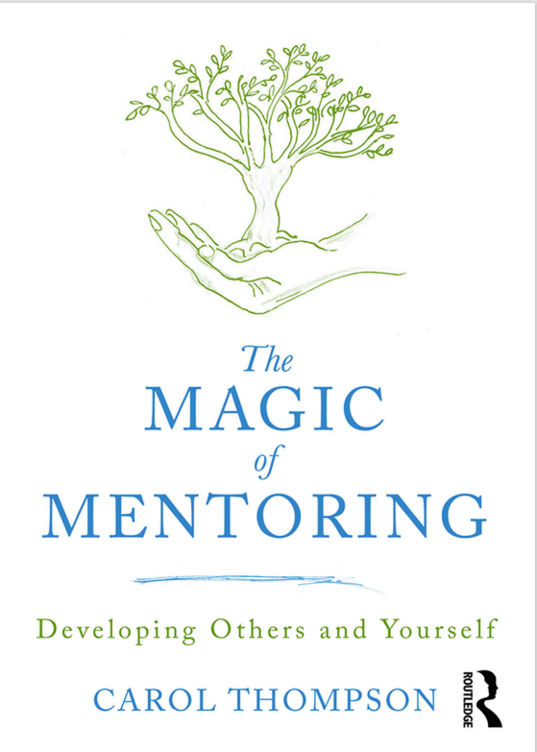
‘Reflective practice could be described as the process of learning from experiences in ways that develop new insights about ourselves and how we work. Through structured reflection we develop self-awareness and critically examine our assumptions and responses to events. The purpose is to recapture experiences and think about them objectively in order to gain new understandings. For anyone in a professional context this is an important activity because the very nature of professionalism is embodied in characteristics such as honesty, integrity and self-regulation.’ (Thompson, 2019, p136)
Notes:
The reflective cycle is, as discussed, essential for teachers to embed in their practice and this is the same for mentors.
‘According to Bolton (2001), reflective practice may be enhanced by becoming as reflexively aware as possible. This means reflecting on yourself as well as a given incident in order to establish the impact your patterns of thought and behaviour have on the incident, as well as your response to it. In a way it is about ‘looping back’ in order to establish potential actions that are rooted in deeper understanding. This can be done by developing a mindful approach, giving careful consideration to the complexity of situations, rather than simply recording objective observations.’ (Thompson, 2019, p139)

Slide 37
‘We distinguish the process of “constructing practice”, in order to identify some further features of critical reflective practice. “Constructing practice” is not only about planning but is also about “anticipatory reflection” (Loughran, 1996). This is the deliberating about possible alternatives, and involves not only the planning but also the anticipating of the experiences that may happen as a result of the planning.’ (Harrison et al, 2005, pp423-4)
Notes:
‘Evaluation is often seen as the core ability for critical thinking (Kennedy et al., 1991). Associated abilities include:
identifying a problem and its associated assumptions;
clarifying and focusing the problem;
analysing, understanding and making use of inferences, inductive and deductive logic, as well as judging the validity and reliability of the assumptions, sources of data or information.
Pithers and Soden (2000) also summarize the necessary dispositions: these include being ‘open-minded’, drawing assumptions cautiously, weighing the credibility of evidence. For beginning teachers and their mentors, ‘deconstructing practice’ is an important part of the process of critical reflection-on-practice. It involves ‘retrospective reflection’ (Loughran, 1996) …

Slide 38
Teachers of Teaching
‘As “teachers of teaching”, mentor teachers created relationships that repositioned themselves as supporters of pre-service teachers’ learning.’ (Grimmett et al, 2018, p347)
Notes:
As I shared in the first training session, mentors need to see themselves as ‘School-based teacher educators’, recognising the importance of their role in a beginning teacher's journey.
Writing a critical reflection of your mentoring experience this year – final part of the mentor training. More information to follow.

Slide 39
References
Allan, P. (2007). The benefits and impacts of a coaching and mentoring programme for teaching staff in secondary school. International Journal of Evidence Based Coaching and Mentoring, 5 (2), 12-22.
Bradbury, L., & Koballa Jr., T. (2008). ‘Borders to cross: Identifying sources of tension in mentor-intern relationships.’ Teaching and Teacher Education, 24(8), 2132-2145.
Bruner, J. (1960). The Process of Education. Cambridge, MA: Harvard University Press.
Burn, K., Hagger, H., Mutton, T. (2015). Beginning Teachers’ Learning. St Albans: Critical Publishing Limited
Clarke, A., Triggs, V., & Nielsen, W. (2014). ‘Cooperating teacher participation in teacher education: A review of the literature.’ Review of Educational Research, 84(2), 163-202.
DfE (2019). ITT Core Content Framework.
Dweck, C. (2006). Mindset: the new psychology of success. New York: Random House.
Gibbs, G. (1988). Learning by Doing: A guide to teaching and learning methods. Oxford: Oxford Further Education Unit.
Golder, G., Keyworth, A., & Shaw, C. (2020). Ch 1: Models of mentoring. In D. H. (ed.), Mentoring English Teachers in the Secondary School (pp. 5-16). Abingdon: Routledge.
Grimmett, H., Forgasz, R., Williams, J., & White, S. (2018). ‘Reimagining the role of mentor teachers in professional experience: moving to I as fellow teacher educator’, Asia-Pacific Journal of Teacher Education, 46:4, 340-353.
Harris, R. (2021). ‘Where are we and where are we going?’ Teaching History, 185(December), 60-67.
Harrison, J., Lawson, T., Wortley, A. (2005) ‘Mentoring the beginning teacher: developing professional autonomy through critical reflection on practice.’ Reflective Practice 6(3), 419–441.
Hobson, A. (2016). Judgementoring and how to avert it: introducing ONSIDE Mentoring for beginning teachers. International Journal of Mentoring and Coaching in Education, 87-110.
Hobson, A., Ashby, P., Malderez, A., & Tomlinson, P. (2009). ‘Mentoring beginning teachers: What we know and what we don't.’ Teaching and Teacher Education, 207-216.

Slide 40
Jones, Kelsey, & Brown (2014). ‘Climbing the steps toward a successful cooperating teacher/student teacher mentoring relationship’, Journal of Agricultural Education, 55 (2), 33-47.
Lee, S., Theoharis, R., Fitzpatrick, M., Kim, K., Liss, J., Nix-Williams, T., Griswold, D., & Walther-Thomas, C. (2006). ‘Create effective mentoring relationships: Strategies for mentor and mentee success.’ Intervention in School and Clinic, 41(4), 233-240.
Maynard, T., & Furlong, J. (1995). ‘Learning to teach and models of mentoring’. In T. K. Mayes, Issues in Mentoring (pp. 10-24). London: Routledge.
Montgomery (2017) ‘Mapping a Mentoring Roadmap and Developing a Supportive Network for Strategic Career Advancement’. SAGE Open April-June: 1–13
National Institute of Teaching. (2023) ‘Mentoring and Coaching of Teachers: What can the research tell us?’ [Retrieved from: https://niot.org.uk/teacher-mentoring-research]
O’Leary, M. (2020). Classroom Observation: A Guide to the Effective Observation of Teaching and Learning. Abingdon: Routledge.
Pithers, R. T. & Soden, R. (2000) ‘Critical thinking in education: a review,’ Educational Research, 42(3), 237–249.
Roberts, R. (2020). Ch 10: ‘Holding weekly debriefs.’ In D. Hickman, A Practical Guide to Mentoring English Teachers. Abingdon: Routledge.
Schofield, M. (2019). ‘Why have mentoring in universities? Reflections and justifications.’ In M Snowden & JP Halsall (eds). Mentorship, leadership, and research: Their place within the social science curriculum. Cham, Switzerland: Springer.
Shanks, R. (2023) ‘Informal coaching and mentoring and an “informal turn” in teacher professional learning’. International Journal of Mentoring and Coaching in Education 12(4), pp. 440-452
Stanulis, R., & Floden, R. (2009). ‘Intensive mentoring as a way to help beginning teachers develop balanced instruction.’ Journal of Teacher Education, 60 (2), 112-122.
Thompson, C. (2019) The Magic of Mentoring, Abingdon: Routledge
Tonna, M., Bjerholt, E., ‘Teacher mentoring and the reflective practitioner approach’, International Journal of Mentoring and Coaching in Education Vol. 6 No. 3, 2017 pp. 210-227
Totterdell, M., Woodroffe, L., Bubb, S., Daly, C., Smart, T., & Arrowsmith, J. (2008). ‘What are the effects of the roles of mentors or inductors using induction programmes for newly qualified teachers (NQTs) on their professional practice, with special reference to teacher performance, professional learning and retention rates?’ In: Research Evidence in Education Library. London: EPPI-Centre, Social Science Research Unit.
Wiliam, D. (2016). Leadership for Teacher Learning: Creating a Culture Where All Teachers Improve So That All Students Succeed. Blairsville: Learning Sciences International
Wright, T. (2017). How to be a Brilliant Mentor. Abingdon: Routledge
Zugelder, B. (2019) ‘Beyond New Teacher Mentoring: The Role of Instructional Coaching,’ Kappa Delta Pi Record, 55:4, 181-183.

Slide 41
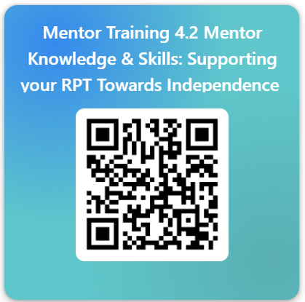
Please take two minutes to fill out the completion form: ​https://forms.office.com/e/awxsaPgbGc
Notes:
I hope that you have found the mentor training materials helpful.
Please take two minutes to complete this form, to register your engagement.
And thank you; mentors are the backbone of successful ITE for everyone!

