Slide 1
English Professional Development Mentor Meeting (Mentor Curriculum 4.1)
PGCE Secondary English
2024-25
11.3.25
Dr Rachel Roberts

Slide 2
Agenda
Welcome and programme overview
Being School B English mentor: sharing good practice
Starting from where they are: common strengths and areas for development from PPR2 visits
Supporting English RPTs in the independent stage:
Opportunities at School B
Using the mentor bulletins, conversation prompts & setting targets
Questions/AOB
Supporting planning
Thinking about English pedagogy and taking risks
Notes:
Welcome and programme update (5mins)
Key messages from School B Mentor training & being an English mentor (15mins)
Starting from where they are: key strengths and areas for development from PPR2 visits and Report 2 (15mins)
Supporting English RPTs in the independent stage:
Opportunities at School B
Making the most of observation and feedback
Supporting planning
Thinking about English pedagogy and taking risks
Using the mentor bulletins and conversation prompts
Looking towards Report 3 and the Teachers’ Standards (40mins)
AOB

Slide 3
Welcome & Programme Updates
Staffing
Margie Choi - administrator
pgcesecondary@reading.ac.uk
Head of School: Dr Sarah Marston
Director of Teaching and Learning: Dr Jo Anna Reed-Johnson
Head of ITT: Dr Catherine Foley
Director of Secondary: Will Bailey-Watson

Slide 4
Being a School B English mentor: sharing good practice

Slide 5
Being a School B Mentor
Early idealism
Personal survival
Dealing with difficulties
Hitting a plateau
Moving on (Furlong & Maynard ,1995; Burn et al, 2015)​
Mentor role: range of support
Stages of development:
SUGGESTIONS:
Establish a positive relationship from the outset, showing that you believe they are significant, competent, and likeable.
Use the reflective cycle questions to help structure your conversations.
Be explicit about what you do, how you do it and why you do it.
Plan topics to cover at different stages of the course.
Highlight praise and make it specific.
Notes:
Be aware of the stages of development (and where your RPT is in this journey):
Early idealism: ‘in which trainees tend to identify quite closely with the pupils and seek inspiration in the example of significant teachers recalled from their own schooldays. Their analysis of these teachers... Tends to be framed in terms of the teachers’ personality and the relationships that they established, rather than reference to the planning and structure of their lessons or their pedagogical strategies.’ ​
Personal survival: ‘in which trainees tend to feel vulnerable and crave the assurance of being seen as a teachers. They are therefore keen to fit in and become anxious ab out securing effective control of their classes.​
Dealing with difficulties: ‘in which the emphasis is on establishing themselves as a teacher by implementing specific policies (particularly in relation to managing pupils’ behaviour) and demonstrating their ability to organise and execute different kinds of learning activities.​
Hitting a plateau: in which progress my stall as the trainees demonstrate their competence and confidence in running a classroom, and implementing different kinds of activity. Only if they are sufficiently challenged and encouraged to look more closely at the pupils’ experience and the evidence of their learning will they move on.​
Moving on: the final phase in which they are able and willing to adapt their teaching in response to critical evaluation of the pupils’ needs and their ongoing learning.​ (Furlong & Maynard, 1995; Burn et al, 2015)
Suggestions:
Conversation questions for initial/first meetings/’contract’ and reflective cycle questions: see Mentor Handbook: Section 4 ‘Guidance for Mentors’ and you could make use of a mentoring expectations ‘contract’ (see Appendix 16). Also ‘needs analysis’, this will have been established from the mentor handover meetings and the RPTs’ self-audit document, linked to interim Report 2.
Not novices but also still require support! How are they getting on so far?

Slide 6
Being an English Mentor
‘Mentors who have volunteered for their role, and those who are within the same key stage and/or subject area specialties as their mentees, are more likely to develop effective relationships’ (NIoT, 2023, p4)
Notes:
Any reflections on your experiences so far as a mentor?

Slide 7
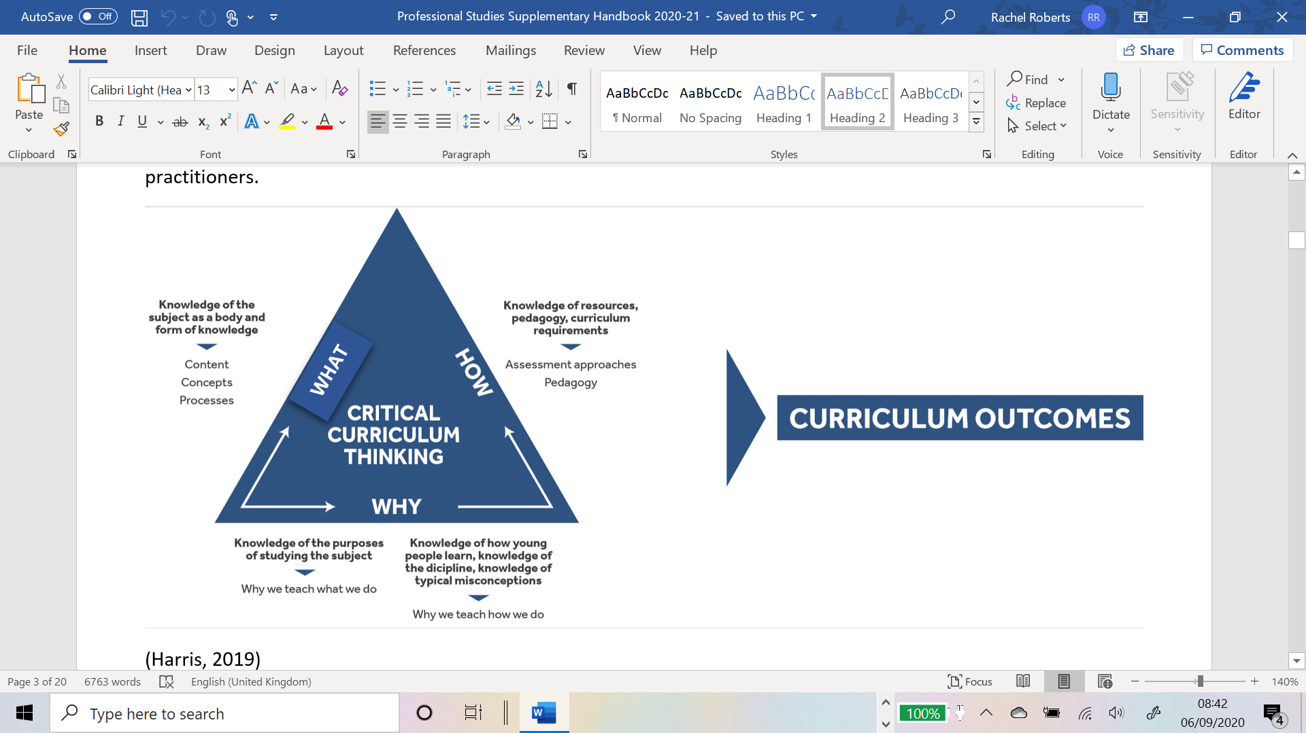
‘Initial teacher education (ITE) and continuing professional development (CPD) should reflect the fact that knowing a discipline is not simply knowing its content, but involves understanding the wider concepts that frame the discipline itself.’ (Eaglestone, 2021, p35)​
Notes:
PGCE students’ responses to substantive knowledge (difficulty in this): ‘are there facts in English?’; ‘systems that underlie communication’; ‘seminal authors’; ‘history of the English language’; ‘quotes’; ‘knowledge of terminology’ (Feb 2020)​
Even if we were to agree that knowledge of a text equates to substantive knowledge, what it means to know a text is subject to levels of familiarity. I could say that I know my Shakespeare because I can, with some accuracy, recount the plot of a number of his plays. I can also quote quite a lot of Shakespeare and can mutter with an air of superiority when I hear mis-quotations (all that glistens instead of glisters). Substantive knowledge, in this instance, is reduced to Mastermind-style question and recall. My point is not that substantive and disciplinary knowledge in English could not be established or agreed upon, rather that it is difficult and there is, thanks to the combination of techne and phronesis that exists in English, less of a clear demarcation between them. ​

Slide 8
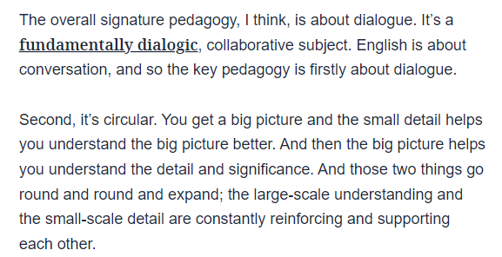
‘Different disciplines grow from these different kinds of knowledge… We calculate the solution to an equation but we deliberate together the meaning of a poem; a physicist discovers an answer but a literary critic persuades of an opinion.’ (Eaglestone, 2021, p11)
(Eaglestone, 2023)
Notes:
‘Knowledge in English is contextual and dynamic: “the process of meaning-making is summoned into being in conversation . . . between readers or between students and their teachers” (Knights 2018). It is more than being able to recount the narrative of a novel or identify and define poetic devices; it may be more accurate to consider this “process of meaning-making” as employing lots of different “knowledges” (such as cultural or historical context) which are brought to bear when engaging with texts (Roberts 2019a), linked to personal experience (Eaglestone 2019)…
Intrinsic approach to literature (‘formalism’ – the words on the page matter)​
Extrinsic approach to literature (‘historicism’ – the world outside/around the text matters)​
https://www.tes.com/magazine/teaching-learning/general/how-one-view-knowledge-came-dominate-learning 28th June 2023

Slide 9
Timetable
Notes:
72% teaching timetable
See Appendix 20

Slide 10
Sharing Good Practice

Slide 11
Mentoring Top Tips
Listen to them
Give guidance
Set goals and create accountability
Notes:
Listen to them
They would have learnt a great deal from placement A. setbacks we need to create a safe space where they feels comfortable sharing the ups and the downs from their last placement. Actively listen without judgment, ask open-ended questions, and provide honest, constructive feedback.
Guidance
Easy to tell them the answers-get into teaching quicker, but instead keep encouraging mentees to think critically and develop their own solutions. Share experiences and insights of classes, teaching staff and set texts/resources, but we need them to take ownership of their learning and decisions.
Goals and Accountability
They will have setbacks early on. They may try to replicate something they did in Placement A and it fails! So, we need to help them reflect then define specific, achievable goals where we check in regularly on progress. We need to cheerlead-Offer support, celebrate wins, but also challenge them to push beyond what they achieved previously.

Slide 12
Starting from where they are

Slide 13
What have you learnt about your RPT in terms of their strengths and areas for development?
Some Whole Class Feedback from PPR2:
Strengths ​
Behaviour Management​
Subject Knowledge​
LOs and sequencing of tasks​
Relationships with classes​
Positive and friendly ​
Knowledge of pupils (and how to support them)
Development ​
AfL/checking for understanding and progress​
Consequences/following through (e.g. Waiting for silence)​
Ensuring key learning is 'front and centre’ (​plan backwards from an intended outcome and think about timing of activities so things don’t run over)
Use of a visualiser! ​(For modelling/sharing pupils’ work etc.)
Notes:
What have you learnt about your RPT in terms of their strengths and areas for development? – ideas in the chat. Are there commonalities? What is very specific to your RPT?
WCF from PPR2 visits
This is the WCF we’ve collated from our PPR2 visits. How might we address some of the areas for development?
General advice for ‘starting from where there are’:
Linking to targets so that training is a spiral
Making use of Interim R2 targets
New environment
Medium Term Planning
Opportunities afforded in Sch B placement
Working with TAs, EAL, adaptive teaching, 6th Form, assessment…

Slide 14
Report 2
Notes:
Any questions regarding completing R2?
Reminder that it is on the same Excel spreadsheet. Should be a copy in the RPTs' ePortfolio

Slide 15
Supporting English RPTs in the Independent Stage

Slide 16
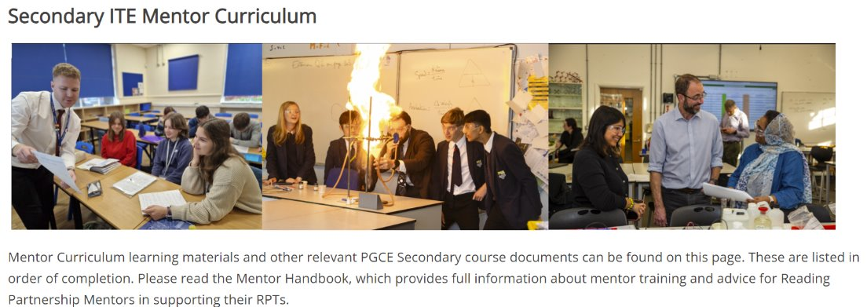
https://sitesb.reading.ac.uk/ioe-mentoring/
Notes:
Reminder!
https://sitesb.reading.ac.uk/ioe-mentoring/

Slide 17
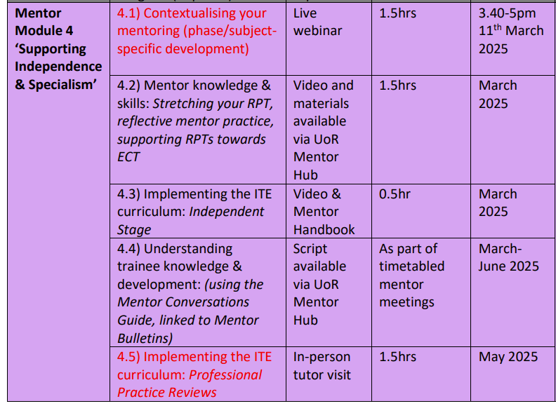
Mentor Curriculum
Notes:
Completion of this training, including the mentor reflection, will result in UoR mentor certification. Module 4 ‘Supporting Independence & Specialism’ has started. As you can see the mentor modules are aligned to the RPTs’ developmental stages.

Slide 18
Making the most of the opportunities Sch B can afford
How is your school context different to School A?
What opportunities will this provide for your RPT and how can they capitalise on this?

Slide 19
Course Expectations for Planning
Shared Implementation stage (Oct-Dec) | RPTs complete a full lesson planning pro-forma designed by their Subject Lead for every lesson. When teaching parts of lessons, RPTs still must follow this process.
Guided Implementation stage (Jan-March) | RPTs can: Plan using a medium-term plan designed by their Subject Lead to cover every lesson. Plan using a simplified ‘non-negotiables’ lesson pro-forma designed by their Subject Lead. Whether RPTs choose to use the medium-term plan or the simplified lesson pro-forma, all RPTs must complete a full lesson planning pro-forma for 1 in 3 lessons.
Independent Implementation stage (March-June) | RPTs can: Plan using a medium-term plan designed by their Subject Lead to cover every lesson. Plan using a simplified ‘non-negotiables’ lesson pro-forma designed by their Subject Lead. Whether RPTs choose to use the medium-term plan or the simplified lesson pro-forma, all RPTs must complete a full lesson planning pro-form for 1 in 5 lessons.
(MoG, Appendix 19 ‘Principles of Planning’)
Notes:
Discuss support for planning that RPTs have had. Any issues arisen from those who were Sch A mentors?
Note that the forthcoming ITAP4 will focus on planning for progress and use of assessment.

Slide 20
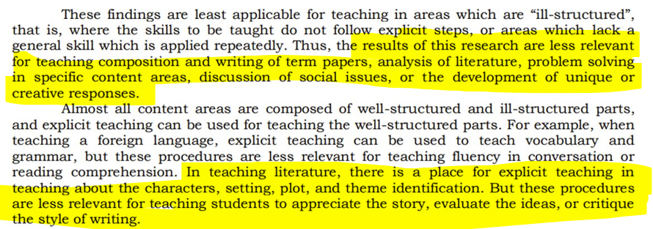
Making Generic Pedagogy English-y
(Rosenshine & Stevens, 1986, p379)
Notes:
Taking risks and thinking about English pedagogy

Slide 21
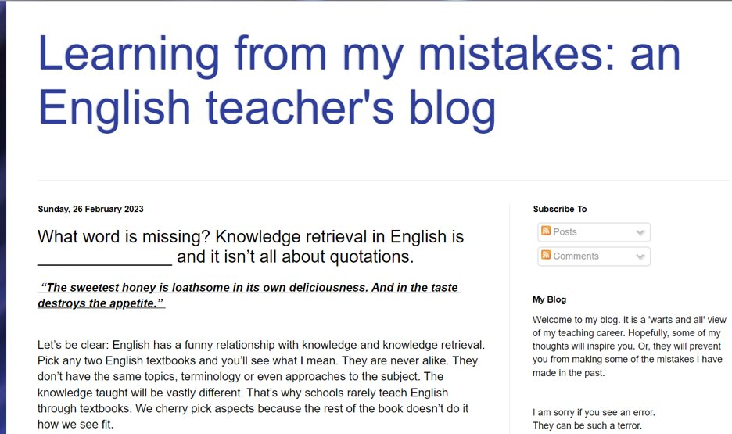
https://learningfrommymistakesenglish.blogspot.com/
https://codexterous.home.blog/2021/08/08/literary-puzzles-using-the-do-now-in-english/

Slide 22
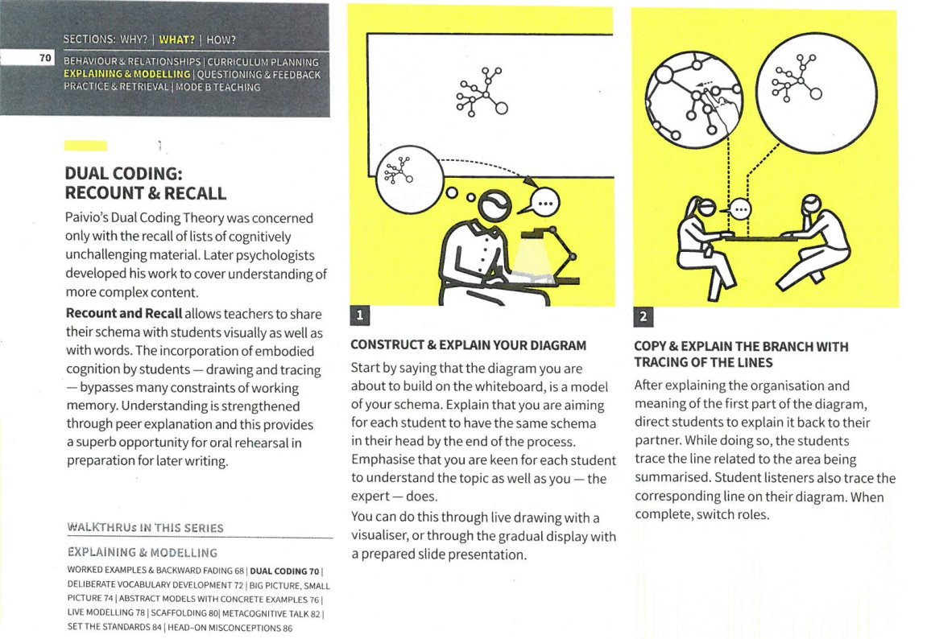
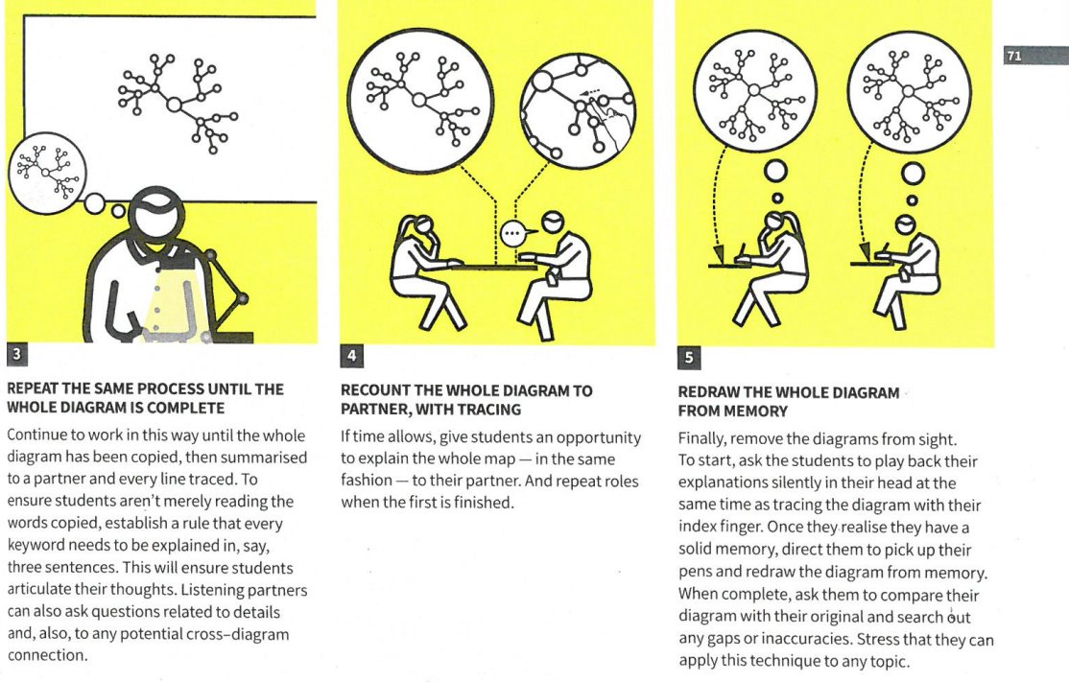
Memory & Poetry
Revisited aspects of cognitive science
Looked at research on memorising poetry
Used Walkthus to focus on specific techniques
Notes:
Session on Monday 3rd March

Slide 23
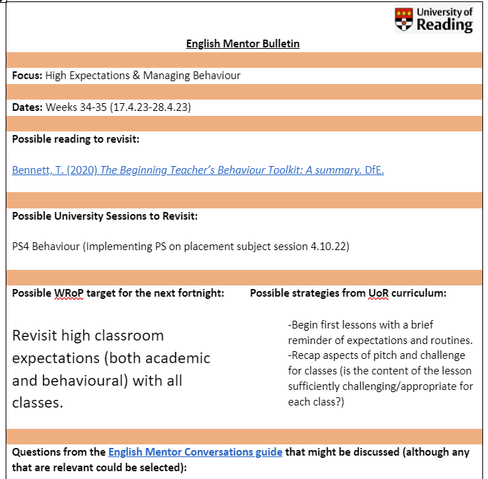
Using the Mentor Bulletins & Conversation Prompts
Fortnightly in the Independent Phase
Connected to a curriculum strand

Slide 24
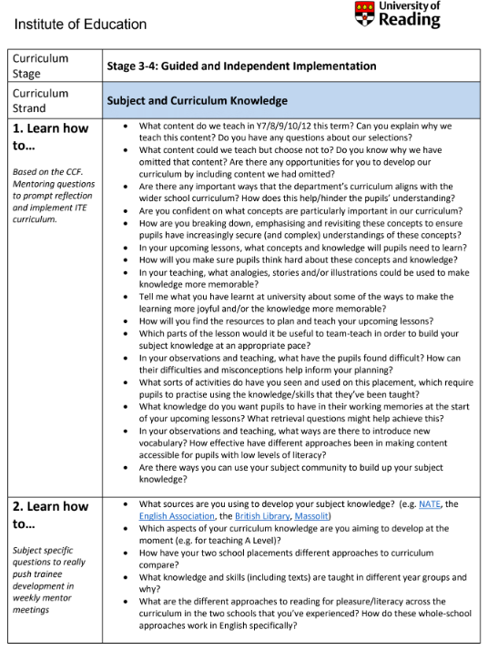
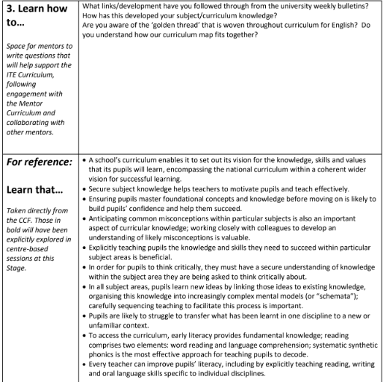
Personalised
Generic
CCF
Subject-specific

Slide 26
Target Setting

Slide 27
ITE Curriculum Strand | Target (What is the intended learning? What kind of target is it? How long will the target last?) | Strategy (What actions/tasks will enable them to achieve the target?) | Progress towards target (Have they achieved the target? What are the next steps?)
Professional Behaviours & Teacher Wellbeing | Build your presence as a teacher around the school [SKILL; medium-term) | Read the school policies on behaviour moving around the school site; shadow a teacher on duty; talk to students outside of the classroom SO THAT the trainee builds their teacher presence beyond the c/room. | Trainee regularly shadows a duty; they feel more confident in their role; they've started to build relationships outside of the c/room
High Expectations & Managing Behaviours | Develop a range of strategies in the classroom to engage and motivate students [SKILL; long-term] | Observe teacher X and note how they use non-verbal cues and waiting for silence. Practice different ways of doing this (e.g. hand up/counting down) SO THAT...
Subject & Curriculum Knowledge | Build subject knowledge of topic X [KNOWLEDGE; short-term] | Attend subject association CPD on topic X SO THAT...
Planning, Teaching & Adapting Practice | Refine use of model answers [SKILL; short-term] | Practice writing model answers for an exam question (Grade 9, Grade 7, Grade 5), using exam board training materials SO THAT...
Progress, Outcomes & Assessment | Understand how the mark scheme is applied for an exam. [KNOWLEDGE & SKILL; short-term] | Co-mark a set of mock exam responses, using the exam mark scheme SO THAT...
Verbs for targets:
Learn
Establish
Maintain
Develop
Adapt
Refine
Embed
Respond
Ensure
Understand
Notes:
To have a really tight learning cycle for RPTs, targets do need careful crafting and thinking about.
It is helpful to first consider which curriculum strand it might fall under, then determine what kind of target it is (skill or knowledge), and its timeframe (this will help avoid vague or wooly targets that are much harder to measure). Beginning the target with a verb (again, with thought) can also make clear the intended learning, as in these examples.
The next stage is to consider what strategies might be employed to help the RPT meet their target (this would be an action or task). It can be helpful to use the phrase 'so that', as this will indicate what the RPT will learn from engaging with the suggested actions or strategies (this should link to the target!).
Finally, you should have a good idea of how you and your RPT will be able to measure or evaluate their progress towards the target – what evidence would demonstrate that they have achieved it?
Effective target-setting and review does take time and, ideally, should form a key part of your weekly mentor meeting with your trainee.

Slide 28
Setting Weekly Targets
How might these example targets be improved?
Targets should address the intended learning of the RPT.
Pitching of work for year 7 - clear instructions and chunking of instructions for low-ability class.
B. Assign approximate timings to each lesson activity, so that things don't over run. Use a timer to help.
Notes:
Targets should address intended learning of the RPT e.g. tighter/clearer use of time in lessons. Using 'so that' can help clarify the purpose of the target.
Should be able to demonstrate they've addressed the targets each week.
Reminder that this is covered in mentor curriculum video 3.2 available in the Mentor Hub: https://sitesb.reading.ac.uk/ioe-mentoring/sample-page/pgce-secondary/ https://www.youtube.com/watch?v=qlzDVGn4KrM

Slide 29
Notes:
Example B from previous slide: Assign approximate timings to each lesson activity, so that things don't over run. Use a timer to help.
What to do when targets are carried over.
Strategies to meet the target.

Slide 30
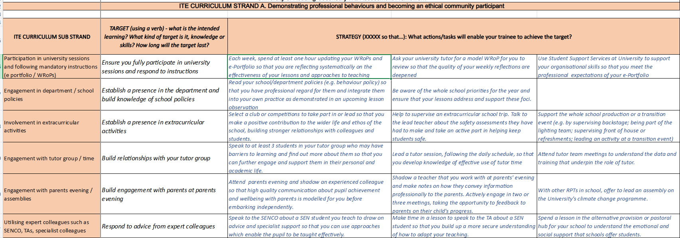
Using the Curriculum Check Point Strategy Bank

Slide 31
Questions?

Slide 32
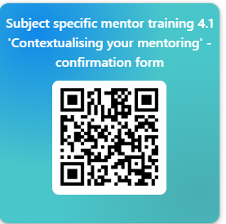
Questions?
https://forms.office.com/e/sMS54PpKv6

Slide 33
References
Eaglestone, R. (2021). 'Powerful knowledge', 'cultural literacy' and the study of literature in schools.’ Impact: Philosophical Perspectives on Education Policy(No. 26), 1-40.
Furlong, J. and Maynard, T. (1995). Mentoring Student Teachers: The Growth of Professional Knowledge. London: Routledge.
Hagger, H., Burn, K., Mutton, T. & Brindley, S. (2008). Practice makes perfect? Learning to learn as a teacher, Oxford Review of Education, 34:2, 159-178.
Harris, R. & Graham, S. (2019) 'Engaging with curriculum reform: insights from English history teachers’ willingness to support curriculum change', Journal of Curriculum Studies, 51:1, 43-61
Knight, J. (2022). The Definitive Guide to Instructional Coaching: Seven Factors for Success. ASCD.
National Institute of Teaching (2023) ‘Mentoring and Coaching of Teachers: What does the research tell us?’ https://niot.org.uk/teacher-mentoring-research
Rosenshine, B. & Stevens, R. (1986). 'Teaching Functions'. Handbook of Research on Teaching. 376-391.
Sherrington, T. & Caviglioli, O. (2020) Teaching Walkthrus. John Catt Ltd. https://walkthrus.co.uk/

