Slide 1
School B New Mentor Training
Institute of Education
Mentor Curriculum
6.2.25
Dr Rachel Roberts
We will be starting at 3.30pm and will be recording.
Please mute your microphone and turn off your camera (but do say hello in the chat!)

Slide 2
Welcome & Introductions
Name | Role | Email
Dr Rachel Roberts | Principle Lead Mentor, Deputy Programme Director Secondary PGCE & English Subject Lead | r.l.roberts@reading.ac.uk
Dr Catherine Foley | Head of ITE | c.m.foley@reading.ac.uk
Will Bailey-Watson | Secondary PGCE Programme Director | w.baileywatson@reading.ac.uk
Dolly Churchill Jonathan Newton Kerri Steedman Emma Walters Annemarie Zalaki | Secondary Lead Mentors | d.churchill@reading.ac.uk jonathan.newton@reading.ac.uk k.steedman@reading.ac.uk emma.walters@reading.ac.uk a.zalaki@reading.ac.uk
Secondary PGCE administrator | Admin | pgcesecondary@reading.ac.uk
Notes:
Hello! I’m Rachel Roberts, Principle LM at the IoE
Colleague Barbara King, SL for MFL monitoring the chat
Please say hello in the chat, which school and subject and whether or not you’ve been a mentor before
Explain role of Lead Mentor
https://sitesb.reading.ac.uk/ioe-mentoring/wp-content/uploads/sites/41/2025/01/Secondary-LM-School-Allocation-List-Jan25.docx
3.30pm: Welcome to the UoR ITE Partnership & Mentor Training Overview
3.40pm: Introduction to the UoR ITE Curriculum
3.55pm: Key principles of mentoring, including:
The mentor’s professional identity and values;
Building a positive relationship with your RPT;
Utilising observation and feedback.
4.50pm: Developing your RPT in their second placement and implementing the ITE curriculum in the Guided and Independent Phases.
4.55pm: Any questions

Slide 3
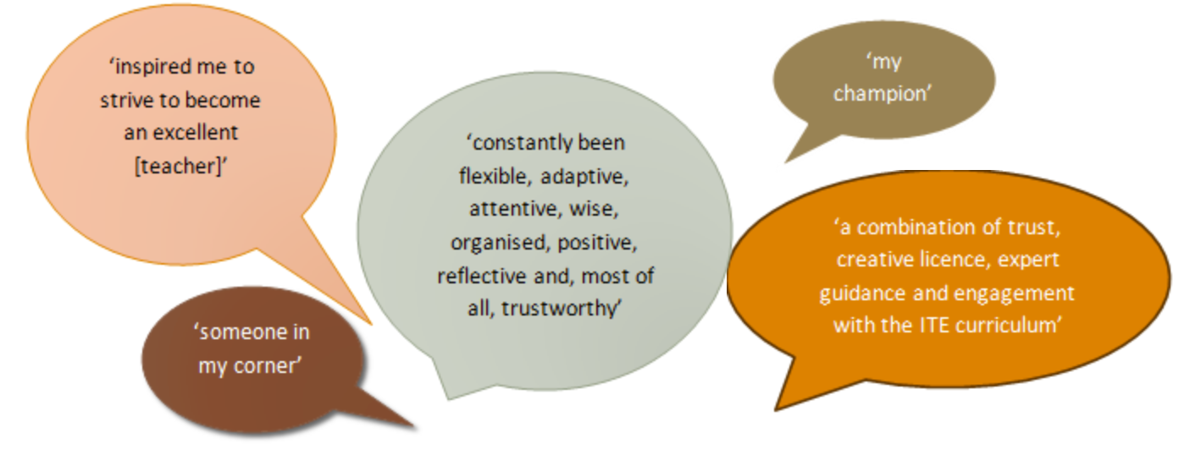
Notes:
Importance of the mentor

Slide 4
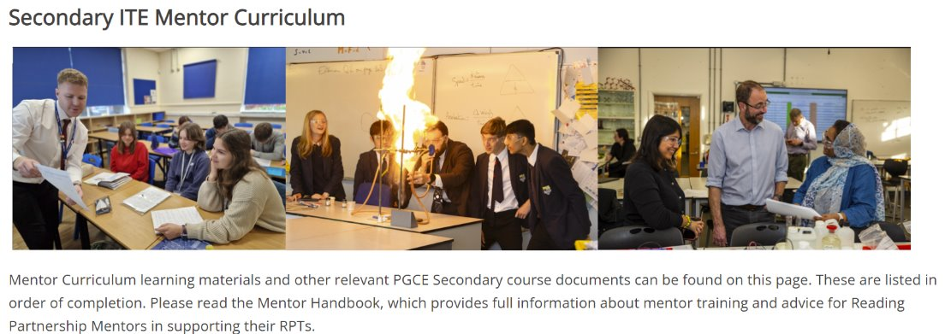
https://sitesb.reading.ac.uk/ioe-mentoring/
Notes:
https://sitesb.reading.ac.uk/ioe-mentoring/

Slide 6
RPT Curriculum:
Mentor Curriculum:
Notes:
Designed to map against the RPT curriculum & therefore development.
Successful completion of the Mentor Curriculum modules results in Certification of Mentoring, in recognition of RPMs’ efforts and their ongoing professional development.

Slide 7
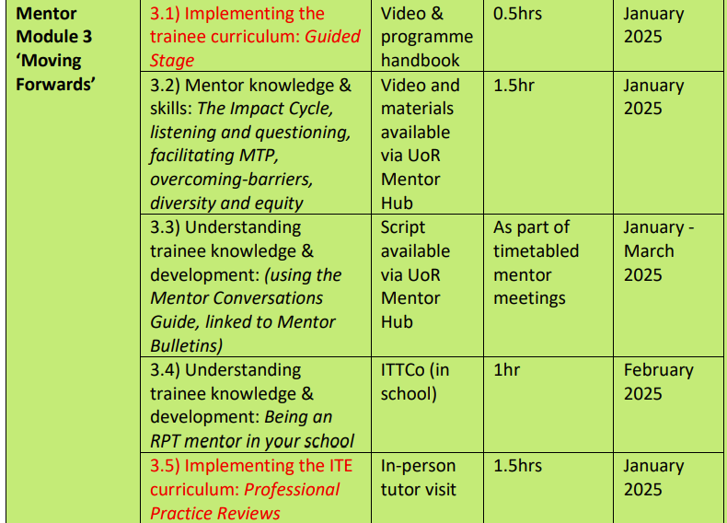
PLUS for Sch B Mentors:
Today’s session
Joint mentor meeting
Notes:
Note that you can access all previous training materials, if you would like to, on the Mentor Hub and that your school will be able to claim funding for your time at the end of the academic year.

Slide 8
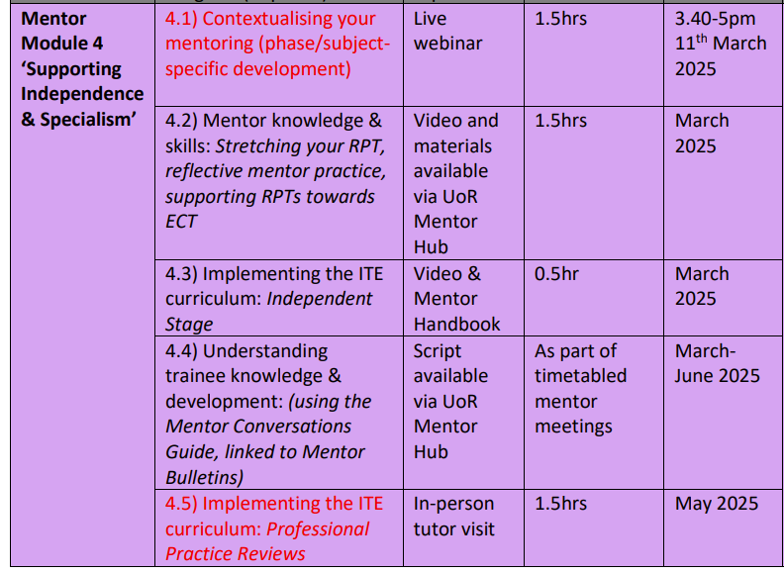
Notes:
Completion of this training, including the mentor reflection, will result in UoR mentor certification.
Any questions at this point about mentor training?

Slide 9
Introduction to the UoR ITE Curriculum

Slide 10
Manual of Guidance Professional Studies Guide Subject Guide
Notes:
Our partnership covers a wide area across Berkshire, Hampshire, Oxfordshire and Buckinghamshire. We are supported through our 10 Lead Partners and their school alliances. You may be receiving either a university-recruit or a Lead Partner-recruit but it doesn’t make any difference to the curriculum or assessment.
Now it is important to emphasise that everything I say today can be found in three documents. The most important one for any process information (e.g. timetables, assessment) is in the Manual of Guidance. Any information about what the RPTs are learning at university, and which they should therefore be discussing and implementing in schools, can be found in the PS Guide and the relevant Subject Guide.
All of this is stored in a Key Documents folder that we have shared with ITTCos and in the Mentor Hub. Of particular note to you is the section on mentor support which includes our mentor conversation guides, our Intent to Impact statements, and our training videos.

Slide 11
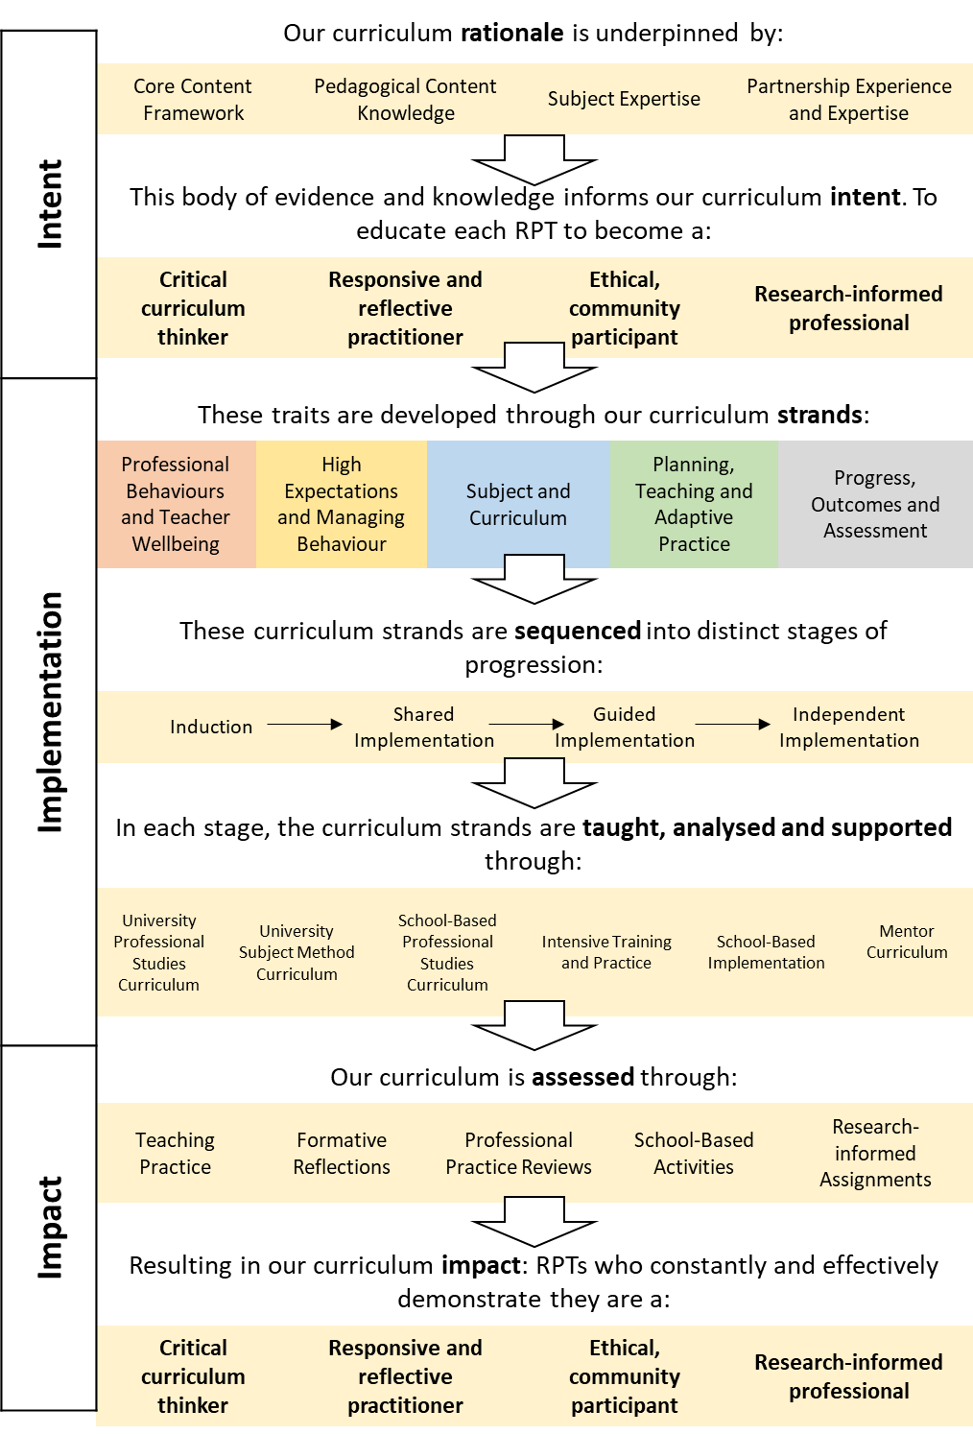
University of Reading Secondary ITE Curriculum Vision
Page 6 of the Manual of Guidance
Notes:
As a structure for this session, we will refer to the UoR ITE Curriculum Vision, used across all programmes. As you can see we divide it into intent, implementation and impact.
Hopefully this is a clear and useful document that can give all new mentors confidence in how everything fits together and what we are seeking to achieve.

Slide 12
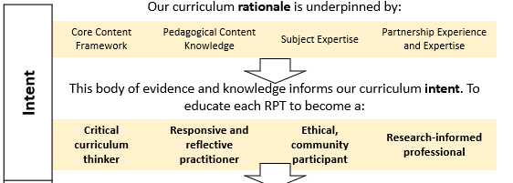
Curriculum Intent
Notes:
We begin with a distinct intent. Our starting point is an aspiration that every single RPT will develop four distinct traits that define a Reading educated teacher. There are…
Of course, what these traits will look like does differ from subject to subject. Therefore all mentors will be sent an Intent to Impact poster to stick on your wall and refer to throughout the year and which specifies exactly what this high-level intent looks like in practice.

Slide 13
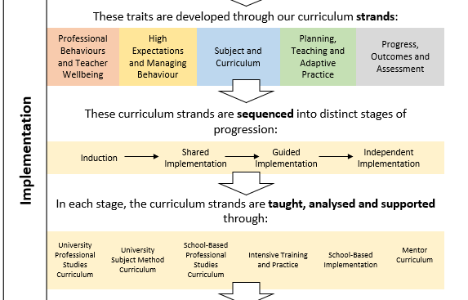
Curriculum Implementation
Notes:
Obviously intent is nothing without implementation,
As you can see we break our content and feedback into five curriculum strands, which we sequence through four stages. Please note that as a Placement B mentor, you will be responsible for the second half of the Guided Implementation. This stage lasts until Friday 21st March, and then the RPTs enter the final Independent Implementation stage which lasts until mid-June.
SO these are the five curriculum strands. You will see these in our curriculum documents, your observation forms and in the end of module reports.

Slide 14
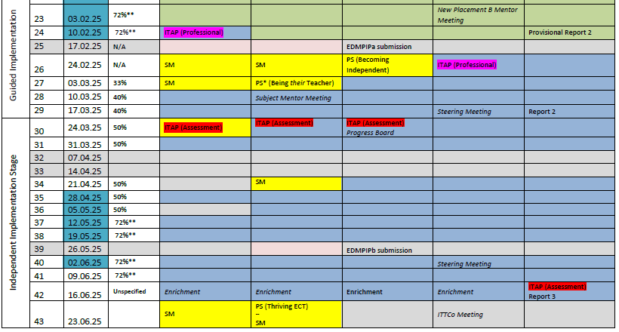
Notes:
And so you can see what this all looks like in the programme structure, you can see the Blue Days where they are in school with you.
You can see on the left is a clear week-by-week expectation of their teaching involvement. This does not have to be solely taught by them.
highlighted in blue are the windows when the RPT’s tutor will carry out a Professional Practice Review, where they will meet with the RPT and yourself.
In red you can see the three days when the RPTs will be off timetable completing their ITAPs.
Finally, making sure they are highlighted in your diaries, we have Report 2 on Friday 21 March and Report 3 on 20 June.

Slide 15
Curriculum Impact
May: Professional Practice Review
Three written observations each week, on the University of Reading observation template.
EDMPIP: Designing an Intervention in their Own Practice
Teaching Practice | Formative Reflections | Professional Practice Reviews | School-Based Activities | Research-informed Assignments
WRoPs discussed each week in mentor meetings. Focusing on discussion points from the Fortnightly Mentor Bulletin.
Mentor Conversations Guide
Subject Handbook
Notes:
The impact will be seen:
Through your written observations – they need 3 a week from the department.
Through their weekly reflections – which are discussed in the mentor meeting
Through the Professional Practice Reviews. The one in May is an on-site school visit to observe a lesson.
Through school based activities set by Subject Leads
Through their assignment – where they will be planning a series of lessons in your school to address an issue that they have identified previously.
The most important thing of all though is each week, you need to tick yes or no at the bottom of their Weekly Reflection to say whether they have engaged with all this appropriately

Slide 16
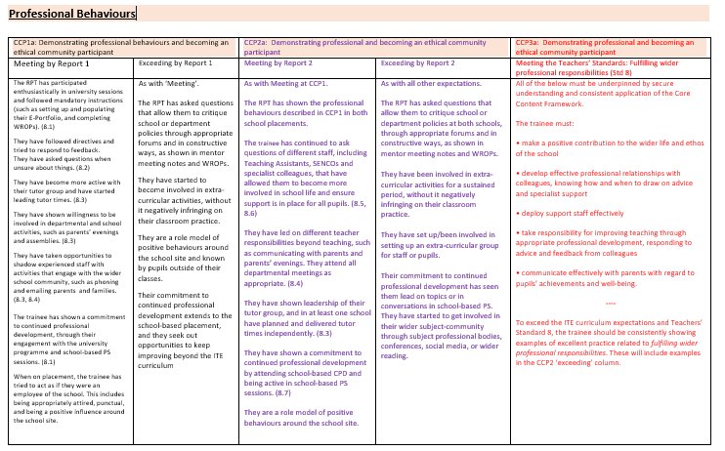
Notes:
With each having very clear guidance on the actions, behaviours and expectations of the RPT at this point in the year. You can see here the criteria for the Guided stage in blue and the final summative assessment against the Teachers’ Standards in orange.

Slide 17
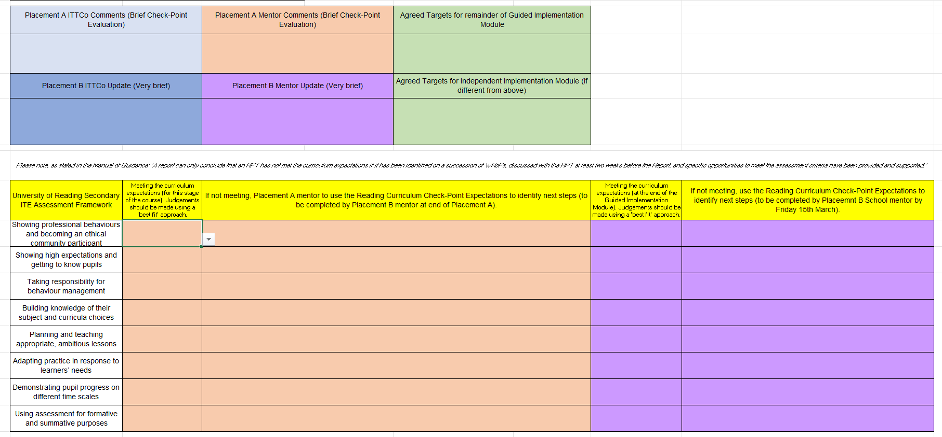
Notes:
Which feeds into the end of module reports. Your RPT will share this with you.
You can see here that the Placement A mentor will already have completed a Provisional Report 2 and you will only have to add to this if necessary following your three weeks. You will note that all the sections have a drop-down menu to make it as quick as possible.

Slide 18
Any questions?
Notes:
And there we have it. Hopefully that makes sense and you can see how this Curriculum Vision works in practice. I’ll give you a moment to revisit this diagram now and see if you have any questions at all.

Slide 19
Key Principles of Mentoring
Notes:
The mentor’s professional identity and values; Building a positive relationship with your RPT; Utilising observation and feedback.

Slide 20
What is a mentor?
… ‘off-line help from one person to another in making significant transitions in knowledge, work or thinking’ (Megginson & Clutterbuck, 1995, p. 12).
The mentor’s role is part of a significant professional transition (i.e. from trainee to qualified teacher) and emphasise the importance of a positive interpersonal relationship between mentor and trainee (NFER, 2008; CUREE, 2005)
Which can be problematic…
‘teachers of teaching’ (Grimmett et al, 2018, p. 341)
Notes:
why did you go into teaching? What motivated you to be a teacher? [take suggestions].
Most likely not the huge bonuses or the automatic and undisputed professional respect from the rest of society. Most people who enter the teaching profession are motivated with a desire to help others; to pass on their passion for their subject and to make a difference to children’s lives; these are quite altruistic motivations (Lortie, 1975; Nias, 1996).
In ITT mentors have a somewhat liminal role: they are employed by their schools to teach, yet are required by ITT programmes to induct beginning teachers into the profession. Tensions may arise from conflicting demands of either party. Mentors need to conceive of themselves as ‘teachers of teaching’ (Grimmett et al, 2018, p. 341); Gimmett et al’s work with mentors in Australia found this conception led to more productive mentor-trainee relationships and mentors moved away from a view of teaching purely as a skill and focused more on care for the trainee, rather than assessment of them. In time-constrained and workload-heavy environments, the focus of mentoring can easily fall upon the latter.
If you had to describe in one word your most recent lesson, what would it be? Exciting? Difficult? Tiring? Teaching is emotional!

Slide 21
Emotional Labour & Your Identity
Teaching involves emotional labour (Hochschild, 2012)
Training to teach is itself emotional (Yuan & Lee, 2016) - and is intertwined with formation of teacher identity (Nicols, Schutz, Rodger, & Bilica, 2017; Zembylas, 2005).
Notes:
Emotional labour (Hochschild, 2012)
Training is emotional (Yuan & Lee, 2016) and – intertwined with formation of teacher identity (Nicols, Schutz, Rodger, & Bilica, 2017; Zembylas, 2005)
Importance of recognising this – both for the RPT but also for the mentor. (anecdote of Dan S storming out of my lesson whilst I was being observed by my trainee)

Slide 22
Mentoring and support
Professional support
Pedagogic support
Academic support
Emotional support (Roberts, 2019)
Notes:
‘Mentors can fill many roles, including the provision of practical advice about careers or a course of study, contributions to professional development, or dissemination of political guidance and strategies’ (Montgomery et al., 2014).
role-model (Anderson & Shannon in Kerry & Mayes, 1995),
guide (Izadinia, 2017),
provider of assistance (Tomlinson, 1995),
developer of reflective practice (Ballantyne, Packer, & Hansford, 1995),
emotional supporter (Marable & Raimondi, 2007).
Professional support (such as showing the trainee how to put ‘praise points’ onto the database and discussing when this would be appropriate)
Pedagogic support (such as demonstrating how to ‘model’ some writing during a lesson and discussing how it worked afterwards)
Academic support (such as suggesting a book on basic grammar knowledge that you’ve read)
Emotional support (such as comforting them if they have a difficult lesson)

Slide 23
Effective mentoring
Knowledge and expertise
Time
Structure
Relationship
Dialogue
Effective mentoring engages with values (Montgomery, 2017)
Notes:
Discuss shared values…
Who are they and what do they know?
Two-way relationship
Take a moment to reflect on what your values are as a teacher and what you hope to achieve through being a mentor.

Slide 24
Pedagogical Content Knowledge (PCK)
‘The most regularly taught topics in one’s subject area, the most useful forms of representation of those ideas, the most powerful analogies, illustrations, examples, explanations, and demonstrations – in a word, the ways of representing and formulating the subject that make it comprehensible to others’ (Shulman, 1986, p9)

Slide 25
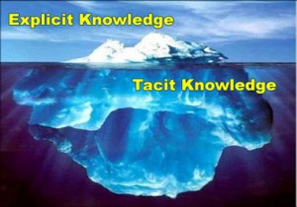
Mentor knowledge
 | Teaching context | Mentoring context
Content knowledge | Maths/English etc | Planning, behaviour management, AfL, differentiation, etc
Pedagogical knowledge | How to teach children – behaviour management, differentiation etc | How to teach mentees – collaboration, reflection, guidance
Pedagogical content knowledge | Ways of representing knowledge, common errors, misconceptions | Ways of understanding what goes on in the classroom, how to observe, judging an appropriate tone for relationships, how to tell if pace is right
Contextual knowledge | Curriculum, policy, school environment | Standards, policy, school and university environment
(Jones & Straker, 2006: Shulman, 1986)
Notes:
Problem: practical knowledge of mentors = tacit (Zanting et al, 2003)
‘practical knowledge is developed or adjusted by teaching experience and integrates content knowledge, knowledge about students, the curriculum, the specific teaching situation, and pedagogy’ (p196)

Slide 26
The stages of beginning teachers’ development
Early idealism
Personal survival
Dealing with difficulties
Hitting a plateau
Moving on
(Furlong & Maynard,1995)
Notes:
Early idealism: ‘in which trainees tend to identify quite closely with the pupils and seek inspiration in the example of significant teachers recalled from their own schooldays. Their analysis of these teachers... Tends to be framed in terms of the teachers’ personality and the relationships that they established, rather than reference to the planning and structure of their lessons or their pedagogical strategies.’
Personal survival: ‘in which trainees tend to feel vulnerable and crave the assurance of being seen as a teachers. They are therefore keen to fit in and become anxious ab out securing effective control of their classes.
Dealing with difficulties: ‘in which the emphasis is on establishing themselves as a teacher by implementing specific policies (particularly in relation to managing pupils’ behaviour) and demonstrating their ability to organise and execute different kinds of learning activities.
Hitting a plateau: in which progress my stall as the trainees demonstrate their competence and confidence in running a classroom, and implementing different kinds of activity. Only if they are sufficiently challenged and encouraged to look more closely at the pupils’ experience and the evidence of their learning will they move on.
Moving on: the final phase in which they are able and willing to adapt their teaching in response to critical evaluation of the pupils’ needs and their ongoing learning.
Burn et al (2015), p36
Hagger et al 2008 intentionality
Expertise development – difference between novice and expert. Opportunity to reflect on your own development – remembering what you found difficult/didn’t know when you started training.
Note here about where RPTs are now in their development – not complete novices but also

Slide 27
Notes:
BUT

Slide 28
Notes:
Mentor-mentee relationship central to the mentee’s progress

Slide 29
Challenging the beginning teacher’s assumptions, being a critical friend and demonstrating how to do something they are having difficulties with.
Coaching
Acting as a sounding-board, being there to listen and offer support.
Counselling
Helping a beginning teacher develop resourcefulness, make them aware of the information, resources, people, organisations and more formal repositories of knowledge.
Networking
Giving advice – a balance between giving a beginning teacher the answer and encouraging them to find their own solutions to problems through reflective thinking.
Guiding
Developmental Mentoring Model
(Adapted from Cluttterbuck in Golder et al, 2020, p13)
Notes:
So, to return to the notion of mentors thinking of themselves as ‘teachers of teaching’
How do you teach teaching – it’s not a straightforward case of trainees copying what their mentors do…
Consider:
How you might draw on research?
How you might deconstruct your classroom practice? (modelling)
How you might provoke/scaffold reflection in your RPT’s practice?
What do you need to think about/make explicit about your context (school, subject, cohort etc.)?
The mentor model that we advocate is a developmental one.

Slide 30
(Schutz,1994)

Slide 31
The mentor-mentee relationship
Central to the development of the trainee (Hawkey, 1998)
Provision of developmental feedback is pivotal (Hobson, Ashby, Malderez & Tomlinson, 2009; Hudson & Hudson, 2014; Mercardo & Mann, 2015)
Notes:
Take a minute to reflect on the relationships that you had with your mentor(s). What made them function/work?
Back to the red umbrella!

Slide 32
ESTABLISHING A POSITIVE RELATIONSHIP
Acknowledge the power dynamic
Begin with core values, passions and interests
Subject/topic/phase-specific support (put a list of useful resources together e.g. subject organisations/useful websites/books)
Make use of the interim Report 2/Joint mentor meeting – enabling starting points to be specific for needs of your RPT
Demonstrate that you think they are significant, competent and likeable (Schutz, 1994)
Set boundaries and expectations – write a mentoring agreement (see Mentor Handbook)
Notes:
There are suggested first mentor meeting prompts and a mentor agreement in the Mentor HB that might be helpful

Slide 33
The Reflective Cycle adapted from Gibbs (1988, p. 50)
Experience
Description of feelings/ reactions
Evaluation
Analysis
Personal action plan
Conclusions (general)
Conclusions (specific)

Slide 34
KNOWING HOW TO HELP
Plan
Teach
Assess
Much of ‘teacher knowledge’ is tacit, so you need to try to be really explicit about what you do and why…
Notes:
Trainees can struggle to see the direct connection between assessment and planning at first.

Slide 35
For example…
Why can planning be difficult for a beginning teacher?
You can help them by:
Discussing the relationship between the ‘big picture’ of National Curriculum requirements or exam board specifications and the ‘little picture’ of individual lessons
Explicit demonstration of the difference between objectives and outcomes
Deconstructing the decisions you have made in planning and how this worked in practice; discussing your own teaching after your trainee observes you is helpful
Joint planning (this might include you planning and the trainee teaching or vice versa)
Notes:
Expertise and tacit knowledge – the need to be explicit about what you do and why
What other things do you expect your RPT might find difficult initially?
How might you support them in these areas?
How might this look different at this point in their training compared to September?

Slide 36
Teaching as 'an apprenticeship of observation' (Lortie, 1975, p61)
Notes:
Observation of your trainee should not be used as a means of control; all teachers have their preferred ways of doing things, their own teaching style, but when working with a beginning teacher it is important to be aware of your own bias (O’Leary, 2014). It is instinctive when watching a novice to think: ‘I wouldn’t have done it like that.’ Whilst this may be intuitive, it wouldn’t be very helpful to fill your feedback notes with what you would have done; this is about their development and practice, after all. It is more helpful to be open-minded about different approaches, so that your beginning teacher can have the freedom to experiment.
Focus on mentor​
Seen as 'transmission' model​
Differences in perception​
Not having a shared meaning​
Impact on learning​
Burdensomeness​
Being judged ​
Not all feedback is good (can do harm)​
More feedback is not helpful (Molloy & Boud, 2013)

Slide 37
Feedback
‘she’ll just hit me with [it]’ (Dan, Redwood TI3).
‘if they’re a bit too cutting… you don’t learn anything from it’ (Saffron, Oakbank TI1).
‘positive [feedback] … made me feel more positive about my teaching’ (Charlotte, Ferndean TI2)
Notes:
The pivotal nature of developmental feedback recurs in the literature and research around mentoring (Hobson, Ashby, Malderez & Tomlinson, 2009; Hudson & Hudson, 2014; Mercado & Mann, 2015). And there are lots of ways in which feedback can be problematic, including:​
​
​
Mentors who focus solely on what needs to be improved (which is likely to be a lot at the beginning of anyone’s professional career) are in danger of ‘Judgementoring’ (Hobson & Malderez, 2013), which can be a highly negative experience for a novice. ​
​
The trainees in my research study from 2019 made a link between the use of specific vocabulary, how they felt and how this affected their learning: Violent imagery was used to describe negative feedback:
​
The impact of the evaluative language used is affective.​
​
Teachers, and beginning teachers especially, are vulnerable to criticism because they want to do their best for the children that they are teaching (Kelchtermans, 2009); they can therefore perceive criticism as an attack on their ethical intentions. ​

Slide 38
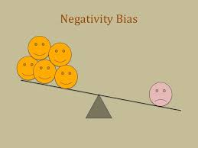
Affective language
People use more positive than negative language (Dodds et al, 2015)
BUT
Negativity bias = bad is stronger than good (Baumeister et al., 2001; Jing-Schmidt, 2007)
Notes:
Studies have shown that people tend to use more positive than negative language in general conversation, commonly known as the Pollyanna principle (Dodds et al., 2015). Negative language, however, has a stronger effect. This means that, even if feedback consists of more positive than negative comments, the negative comments will have greater impact on the recipient. Jing-Schmidt (2007) argues that the negativity bias operates on a biological level (therefore negative language invokes a kind of ‘fight-or-flight’ response), rather than a linguistic level. This could impact on learning (Nicols, Schutz, Rodgers & Bilica, 2017) and could be detrimental to the progress of a trainee. Beginning teachers sometimes have a tendency to be over-critical of themselves and may internalise negative judgements, affecting their self-efficacy (Roberts, 2019). In the heightened situation of a feedback conversation, consideration of the evaluative language used is therefore important. You could consider your choice of words, particularly vocabulary that is directly associated with grading, for example for the PGCE. You could also consider the amount and type of praise that you use; think about how you might use it to reward and motivate. (Roberts, 2020, p123)
Effective feedback Should '…answer three major questions asked by a teacher and/or by a student: ​
Where am I going? (What are the goals?), ​
How am I going? (What progress is being made toward the goal?), ​
Where to next? (What activities need to be undertaken to make better progress?)' (Hattie & Timperley, 2007, p. 86) ​

Slide 39
What is the first question an observer asks when starting the feedback conversation?
Notes:
What is the first question an observer asks when starting the feedback conversation?

Slide 40
‘How do you think that went?’

Slide 41
Ask instead: ‘What did you want the pupils to learn?’
Notes:
An alternative starting point would be to ask: what did you want the pupils to learn?
The pivotal nature of developmental feedback recurs in the literature and research around mentoring (Hobson, Ashby, Malderez, & Tomlinson, 2009; Hudson & Hudson, 2014; Mercado & Mann, 2015). Mentors who focus solely on what needs to be improved (which is likely to be a lot at the beginning of anyone’s professional career) are in danger of ‘Judgementoring’ (Hobson & Malderez, 2013), which can be a highly negative experience for a trainee.
There are a number of ways in which you can structure the feedback conversation that should be of benefit to your trainee and lessen any awkwardness you might feel in taking on the role of arbiter of teaching quality. First, try to avoid beginning the conversation with an emotional response (either yours or theirs!). It is common for those giving feedback to begin by asking ‘How do you think/feel it went?’ (Iyer-O'Sullivan, 2015); whilst starting this question is less immediately judgemental or evaluative than ‘I thought that lesson was good/great/messy etc.’ and is intended to provoke reflection in the trainee, it can lead to quite limited responses. Trainees may fall back on saying something like: ‘Well, it was ok’ and then begin to list all of the elements of the lesson they felt were ‘wrong’ or things that they didn’t do very well. A better starting point would be to move away from a generic ‘what went well’ question, to a more focused ‘What did you want the pupils to learn?’
Immediately, this question will mean that your trainee’s reflection focuses on the learning of the pupils, rather than their own performance. This has two benefits: it means that they are less likely to fall into a cycle of self-flagellation by criticising their own capabilities and it will open up a deeper conversation about the strategies and decisions that took place in the lesson and their impact on pupils’ learning. Your following discussion is therefore less likely to feel judgemental, as you are both critiquing the dynamic interaction between learning activities and pupils’ engagement and reaction to them.
Should you find yourself in the position of a mismatch of praise (either you feel you are not providing enough/the right kind or your trainee not ‘hearing’ it) then you could try recording your conversations and playing them back. Criticism that ‘hurts’ is likely to be that which is most judgemental: this kind of evaluative language appraises the person, rather than their performance (Martin & White, 2005) .
Updated feedback form offers a structured procedure to follow.

Slide 42
Step in Gibbs’ reflective cycle | Example questions/prompts
Description | - Tell me what happened in your lesson on Tuesday. - Can you describe the incident with Joanna in more detail? - What were you thinking/feeling at that point?
Evaluation | - Thinking about what you wanted the pupils to learn, how effective did you think that activity was? - What did you find easy/difficult?
Analysis | - Why do you think your lesson on photosynthesis with Yr7 was difficult? How was it different to the previous lesson with that class?
Conclusions | - If you were to teach that lesson again, what would you change?
Action plan | - As you’ve suggested that most of the class found the first activity too easy, let’s think about pitch and pace at the beginning of lessons…
Notes:
GTT4: present content, activities and interactions that activate their students’ thinking
Part of reflective cycle, not dissimilar to the Impact Cycle from Instructional Coaching (Knight, 2022): IDENTIFY, LEARN, IMPROVE
See also: REVIEW module in MoG

Slide 43
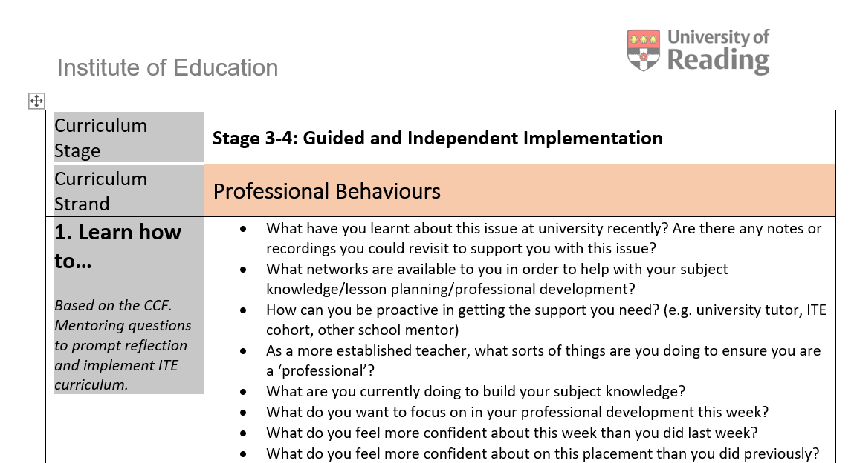
Mentor Conversation Prompts

Slide 44
Starting from where they are…
Linking to targets so that training is a spiral
Making use of R1 targets
New environment
Medium Term Planning
Opportunities afforded in Sch B placement
Working with TAs, EAL, adaptive teaching, 6th Form, assessment…
Notes:
GTT1: understand the content they are teaching and how it is learnt
Trainees can struggle to see the direct connection between assessment and planning at first.
GTT3: manage the classroom to maximise the opportunities to learn
Target setting – see 3.2 training video
Have they had their joint mentor meetings? What were key priorities for your RPT? Put one in the chat – how will you address this/build into their training?

Slide 45
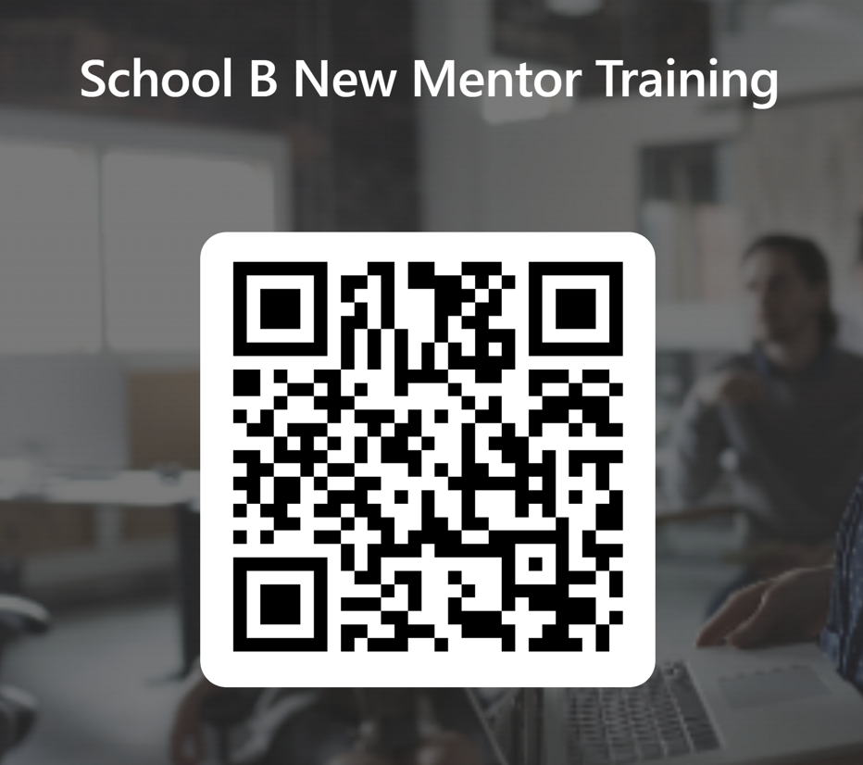
To Do:
School B New Mentor training completion form
Mentor Audit (online form)
Mentor Hub & Mentor Handbook
Subject mentor training: live webinar Tuesday 11th March 3.40-5pm
Notes:
Put links into the chat:
School B New Mentor training confirmation form: https://forms.office.com/e/tiJ6M1pz2N (2mins)
Mentor Audit: https://forms.office.com/e/VinZ69MgVR Please take some time to complete the audit (approx.15mins)
Mentor Hub: https://sitesb.reading.ac.uk/ioe-mentoring/sample-page/pgce-secondary/

Slide 46
Any questions?

Slide 47
References
Allan, P. (2007). The benefits and impacts of a coaching and mentoring programme for teaching staff in secondary school. International Journal of Evidence Based Coaching and Mentoring, 5 (2), 12-22.​
Ballantyne, R., Packer, J., & Hansford, B. (1995). The crisis in teacher education: A European concern? London: Falmer Press.
Burn, K. H. (2015). Beginning Teachers' Learning. St Alban's: Critical Publishing Ltd.
Centre for the Use of Research and Evidence in Education. [CUREE]. (2005). National Framework for Mentoring and Coaching. Retrieved from http://www.curee.co.uk/resources/publications/national-framework-mentoring-and-coaching
Clutterbuck in Golder, Keyworth & Shaw (2020), Ch1 in Mentoring English Teachers in the Secondary School. Ed. D. Hickman. Abingdon: Routledge.
CUREE (2005). Mentoring and coaching CPD capacity building project – National framework for mentoring and coaching. Retrieved from: http://www.curee.co.uk/resources/publications/national-framework-mentoring-and-coaching
Day, C., & Leitch, R. (2001). Teachers' and teacher educators' lives: the role of emotion. Teaching and Teacher Education, 12, 403-415.
Gibbs, G. (1986). Learning by Doing: A guide to teaching and learning methods. Oxford: Oxford Further Education Unit.
Hargreaves, A. (1998). The emotional politics of teaching and teacher development: with implications for educational leadership. International Journal of Leadership in Education, 1(4), 315-336.

Slide 48
Hawkey, K. (2006). Emotional intelligence and mentoring in pre-service teacher education: a literature review. Mentoring & Tutoring, 14(2), 137-147.
Hobson, A., & Malderez, A. (2013). Judgementoring and other threats to realizing the potential of school-based mentoring in teacher education. International Journal of Mentoring and Coaching, 2(2), 89-108.
Hochschild, A. (2012). The Managed Heart: commercialization of human feeling (3rd ed.). Palo Alto, California: University of California Press.
Hudson, P. (2007). Examining mentors’ practices for enhancing preservice teachers’ pedagogical development in mathematics and science. Mentoring and Tutoring, 15 (2), 201-217.
Hudson, P. (2013). Mentoring as professional development: ‘growth for both’ mentor and mentee. Professional Development in Education, 39(5), 771-783.
Izadinia, M. (2017). Pre-services teachers’ use of metaphors for mentoring relationships. Journal of Education for Teaching, 43(5), 506-519.
Jones, Kelsey, & Brown (2014). ‘Climbing the steps toward a successful cooperating teacher/student teacher mentoring relationship’, Journal of Agricultural Education, 55 (2), 33-47. ​
Jones, M., & Straker, K. (2006). What informs mentors’ practice when working with trainees and newly qualified teachers? An investigation into mentors’ professional knowledge base. Journal of Education for Teaching, 32 (2), 165-184.
Kelchtermans, G. (2009). Who I am in how I teach is the message: self-understanding, vulnerability and reflection. Teachers and Teaching: theory and practice, 15(2), 257-272.
Lee, S., Theoharis, R., Fitzpatrick, M., Kim, K., Liss, J., Nix-Williams, T., Griswold, D., & Walther-Thomas, C. (2006). Create effective mentoring relationships: Strategies for mentor and mentee success. Intervention in School and Clinic, 41(4), 233-240.​
Maynard, T., & Furlong, J. (1995). Learning to teach and models of mentoring. In T. Kerry & A. Mayes (Eds.) Issues in mentoring (pp.10-24). London: Routledge. ​
Roberts, R. (2020). Chapter 4: Developing a mentor-mentee relationship. In D. Hickman, Mentoring English Teachers in the Secondary School (pp. 36-50). Abingdon: Routledge. ​

