Slide 1
Mentor Curriculum 3.2
ITE Mentor Curriculum
Mentor Knowledge & Skills: The Impact Cycle & Supporting Trainees
Dr Rachel Roberts

Slide 2
Contents
Using the Impact Cycle
Target setting
Supporting struggling trainees

Slide 3
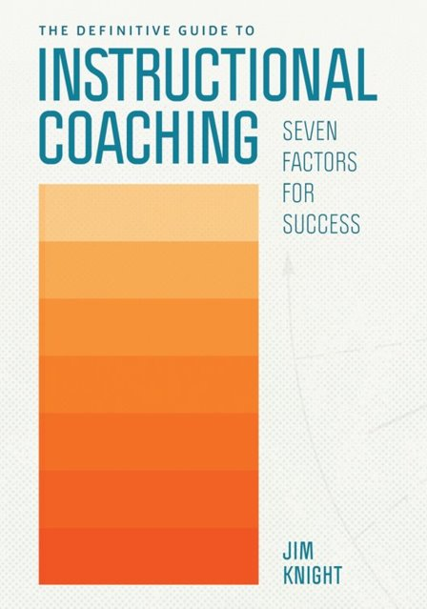
1. Using the Impact cycle
https://resources.corwin.com/impactcycle
Notes:
This comes from Instructional Coaching and, whilst it wouldn't be appropriate to adopt whole-sale the IC approach, there are aspects that you may find helpful in mentoring your RPT, particularly as we move towards more independence of practice in the Guided Stage

Slide 4
Mentoring & Coaching
Mentoring
‘A one-to-one relationship between a relatively inexperienced teacher (the mentee) and a
relatively experienced teacher (the mentor), which aims to support the mentee’s learning,
development and well-being, and their integration into the cultures of both the organisation in
which they are employed and the wider profession.’ (Hobson, 2016, p88)
Mentoring is a holistic role, likely to incorporate counsellor, guide, coach (Clutterbuck, 2004).
Can be more or less directive.
Coaching
Focus on someone who already has expertise being enabled to draw out their own thinking and reflection and decide on their own actions. In some cases, coaching is seen as requiring less context-specific expertise and is more about asking effective questions.
Notes:
To understand the IC, we do need to consider briefly how this sits in relation to mentoring.

Slide 5
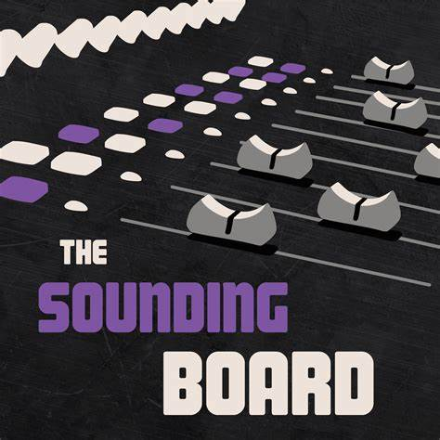
Coaching Models
Coaching
Facilitative Coaching
Coaches work from the assumption that the teacher already knows what to do.
Decision-maker is the teacher
Directive Coaching
Coaches work from the assumption that teachers don’t know what to do.
Decision-maker is the coach
Notes:
Facilitative: The Sounding Board
“I don’t share ideas, I don’t share expertise, I don’t share knowledge, but I do facilitate your thinking through the way I ask questions and listen and work with you.” ( Works from the premise that the coachee already knows what to do but through the coaching process (questioning, mediating thinking) “ (Knight, 2018). Coaches who take a facilitative approach encourage teachers to share openly. They refrain from sharing their own expertise or suggestions with respect to what a teacher can do to get better and instead maintain an approach that is keen to ask questions in probing ways. The relationship here is very much based on equality. The coach is more of a sounding board than someone who might give advice; the decision-maker is the teacher. ALSO: Growth coaching, cognitive coaching.
Directive: The Master and the Apprentice
The directive coach has special knowledge and his or her job is to transfer that knowledge to the teacher. The directive coach works from the assumption that the teachers they are coaching do not know how to use best practices and they can support them to improve what they do in the classroom. The relationship is respectful, but not equal. The decision-maker is the coach.
https://www.headteacher-update.com/best-practice-article/instructional-coaching-what-it-is-how-it-works-and-why-it-matters/244188/

Slide 6
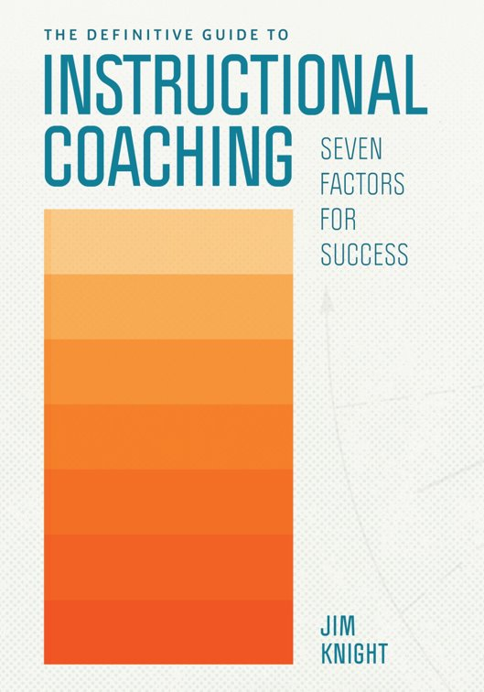
Instructional* (dialogical) coaching
Instructional (dialogical) Coaching
Assumption that often teachers do know what they want to work on
Helpful to work with an expert in instructional practices to help learn new things to meet their goal
Teachers & coaches work together as partners
Teacher remains the decision-maker
The coach isn’t the “expert” but has expertise to share.
*To do with instruction in the classroom i.e. pedagogy
Notes:
Dialogical: The Partner
Dialogical coaches share strategies and options for improvements provisionally and help teachers describe precisely what it is they want to achieve and how to get there. They go beyond mere conversation to dialogue, where thinking is done together and neither the teacher nor the coach is expected to withhold their ideas. The relationship is equal.
“I don’t give advice, I don’t show up like an expert, but I have expertise to share with my partner, the professional”
*could call this pedagogical coaching
As you can see, a coach is not the same as being a mentor, as the relationship is necessarily less hierarchical in terms of expertise in teaching with the coach-coachee relationship
However, there are points at which, as a mentor, you may want to use techniques of the coach and this is where the Impact Cycle can be useful

Slide 7
The Impact Cycle
A process for helping teachers set and hit powerful goals.
Identify
Learn
Improve
Notes:
The IC is a Step-by-step process that helps teachers (and in our case, trainees) reach specific teaching goals

Slide 8
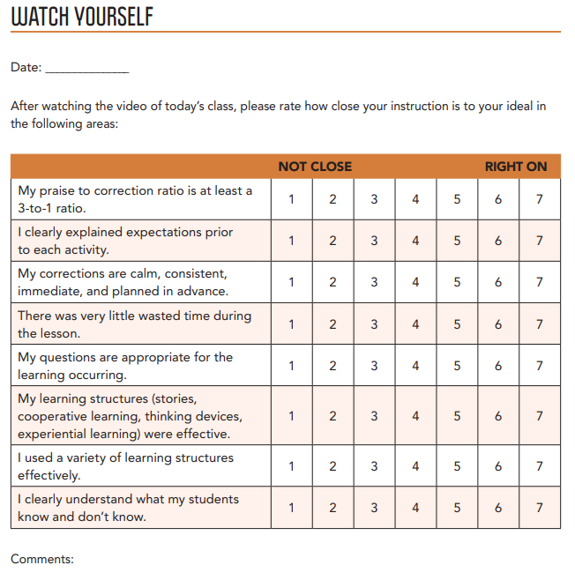
Impact Cycle Stage 1: Identify
Teacher gets a clear picture of current reality
Through: observation, video, interviewing learners, looking at pupils’ work, sharing data
Teacher works with coach to answer the identify questions and identify a student-focused goal (PEERS goal)
Teacher identifies a teaching strategy to use to hit the goal.
Notes:
For the purposes of this presentation, we can replace ‘coach’ with mentor and ‘teacher’ with trainee
PEERS = powerful, emotionally compelling, easy, reachable, student-focused)

Slide 9
Impact Cycle Stage 2: Learn
Coach shares a checklist for the chosen teaching strategy.
Coach prompts teacher to modify the practice if teacher wishes.
Teacher chooses an approach to modelling that they would like to observe and identifies a time to watch modelling.
Coach provides modelling in one or more formats.
Teacher sets a time to implement the practice.

Slide 10
Video 4.4 Jim Models Using Open, Opinion Questions
https://resources.corwin.com/impactcycle/student-resources/videos
Notes:
For example

Slide 11
Impact Cycle Stage 3: Improve
Teacher implements the practice.
Teacher or coach gathers data on student progress towards the goal.
Teacher or coach gathers data on teacher’s implementation of the practice.
Teacher and coach meet to confirm direction and monitor progress.
Teacher and coach make adaptations and plan next actions until the goal is met.

Slide 12
Reflective cycle
Experience
Description of feelings/ reactions
Evaluation
Analysis
Personal action plan
Conclusions (general)
Conclusions (specific)
The reflective cycle, adapted from Gibbs (1988, p. 50)
Notes:
How using the Impact Cycle can work as part of the reflective cycle, on which our programme is based.
The IC might be seen as a smaller wheel within this cycle, that is carefully planned and has a very specific learning goal for the RPT to achieve

Slide 13
2. Target setting

Slide 14
How do we deconstruct practice to form targets?
When deconstructing or clarifying learning targets we take a broad and/or unclear standard or objective and break it into smaller more explicit learning targets and component parts.
The deconstructing process:
What does the trainee need to be able to do? (identifying the action)
What does the trainee need to know? (identifying the content)
What will success look like? (identifying the outcome)
What steps will the trainee take to be able to do this? (identifying the journey)

Slide 15
What do mentees need to know, understand or be able to do, to demonstrate mastery of the goal?
Types of Targets
KNOWLEDGE targets:
What knowledge or thinking will they need to demonstrate the intended learning?
SKILLS targets:
What skills or capabilities must be developed/demonstrated?

Slide 16
Target types
Knowledge or thinking targets: Facts and concepts we want the trainee to know.
Knowledge targets represent the factual underpinnings in each discipline.
Often stated using verbs such as knows, lists, names, identifies and recalls.
Thinking targets represent mental processes such as predicts, infers, classifies, hypothesises, compares, concludes, summarises, analyses, evaluates and generalises.
Skill targets: Trainees use their knowledge and reasoning to act skillfully.
Refers to performances which must be demonstrated and observed, heard or seen.
(Knowledge targets tend to precede skill targets.)

Slide 17
What kinds of targets are these? How effective/useful are they?
Experiment with using mini-whiteboard as an AfL tool
B. Learn how progress is tracked for one class
C. Mark a set of books
D. Research and practice a range of questioning strategies which
engage students who tend not to offer an answer
Notes:
A - skill; practicing AfL tool. 'experiment' is perhaps a bit vague
B – knowledge. Clear, although how will success be obvious?
C – not really a target: this is an action or task. Implied learning might be 'to understand how to apply a mark scheme or assessment criteria' or to practice accuracy in summative assessment (it isn't clear what is being mark or for what purpose – formative or summative?)
D – knowledge and skill. Clear learning intended around developing use of questioning and this is nicely specific related to inclusion. Also indicates actions/strategies that they will need to do to address this target and what success is likely to look like
‘To Do’ list statements masquerade as targets but they are not. Targets should express how an RPT’s teaching and practice needs to develop, and not be things that need doing or are in the handbook/manual anyway.
There is a difference between stating the target (the destination) and strategies that may help achieve it (the journey). Some targets skilfully interweave both by including examples. Targets are still effective without examples as long as some oral guidance is given to support development.
The best targets are plausibly achievable within the review timeframe. They should also be expressed in a way that will allow success to be measured, i.e. they should be specific.
It is always best to question whether you mean ‘continue’ or is a refined (better) version of the target actually needed?

Slide 18
Target Duration
Long, medium, short-term
SMART targets (Specific, Measurable, Achievable, Relevant, Timebound)
WEEKLY targets, reviewed in mentor meeting

Slide 19
ITE Curriculum Strand | Target (What is the intended learning? What kind of target is it? How long will the target last?) | Strategy (What actions/tasks will enable them to achieve the target?) | Progress towards target (Have they achieved the target? What are the next steps?)
Professional Behaviours & Teacher Wellbeing | Build your presence as a teacher around the school [SKILL; medium-term) | Read the school policies on behaviour moving around the school site; shadow a teacher on duty; talk to students outside of the classroom SO THAT the trainee builds their teacher presence beyond the c/room. | Trainee regularly shadows a duty; they feel more confident in their role; they've started to build relationships outside of the c/room
High Expectations & Managing Behaviours | Develop a range of strategies in the classroom to engage and motivate students [SKILL; long-term] | Observe teacher X and note how they use non-verbal cues and waiting for silence. Practice different ways of doing this (e.g. hand up/counting down) SO THAT...
Subject & Curriculum Knowledge | Build subject knowledge of topic X [KNOWLEDGE; short-term] | Attend subject association CPD on topic X SO THAT...
Planning, Teaching & Adapting Practice | Refine use of model answers [SKILL; short-term] | Practice writing model answers for an exam question (Grade 9, Grade 7, Grade 5), using exam board training materials SO THAT...
Progress, Outcomes & Assessment | Understand how the mark scheme is applied for an exam. [KNOWLEDGE & SKILL; short-term] | Co-mark a set of mock exam responses, using the exam mark scheme SO THAT...
Verbs for targets:
Learn
Establish
Maintain
Develop
Adapt
Refine
Embed
Respond
Ensure
Understand
Notes:
To have a really tight learning cycle for RPTs, targets do need careful crafting and thinking about.
It is helpful to first consider which curriculum strand it might fall under, then determine what kind of target it is (skill or knowledge), and its timeframe (this will help avoid vague or woolly targets that are much harder to measure). Beginning the target with a verb (again, with thought) can also make clear the intended learning, as in these examples.
The next stage is to consider what strategies might be employed to help the RPT meet their target (this would be an action or task). It can be helpful to use the phrase 'so that', as this will indicate what the RPT will learn from engaging with the suggested actions or strategies (this should link to the target!).
Finally, you should have a good idea of how you and your RPT will be able to measure or evaluate their progress towards the target – what evidence would demonstrate that they have achieved it?
Effective target-setting and review does take time and, ideally, should form a key part of your weekly mentor meeting with your trainee.

Slide 20
Medium Term Planning
Understanding the bigger picture
Discuss rational and sharing curriculum map
Thinking about pupils’ progress
Notes:
As RPTs have now completed their first practical teaching module and their teaching involvement increases, they should be moving to MTP as they can start to see the bigger picture in terms of pupils' learning and progression.
To support this, do talk through longer-term curriculum plans or maps (across KS and year groups). Explain the rationale behind SoW/MTP (where have cues for specific learning objectives been taken from? How does the SoW fit with other things that are studied across the year? How is learning sequenced across a series of lessons? How do you plan for pupils' progress?)

Slide 21
Questions to facilitate discussions about MTP
Where are the aims and objectives taken from?
How is the Scheme of Work tailored to a specific group of pupils (if at all)? How is it designed to be flexible, so that it could be adapted to suit a specific class?
What does the SoW assume about the pupils’ prior learning?
How has the lesson outline section been organised? What does it include?
Is the structure logical, building learning as the scheme progresses?
Are the resources used specific and easy to obtain?
How are lesson objectives connected with outcomes?
Are opportunities for assessment built into the scheme, not just left to the end?
If you had to teach this, what would you need to read up on/prepare in advance? What might you change?

Slide 22
3. Supporting struggling trainees

Slide 23
Struggling trainees
In what ways do trainees struggle?
Are they struggling?
Expectations
Why do trainees struggle?
Physical health
Mental health
Personal reasons/circumstances
Mismatch between expectation and reality
How can you help?
Talk
Use of language
Support plans (specific, clear, revisited)

Slide 24
Using aspects of CBT
TRIGGER
Thoughts
Feelings
Behaviours
Notes:
Cognitive Behaviour Therapy (CBT) offers some useful techniques that you might use with a trainee who is experiencing mild anxiety, for example. Essentially, CBT focuses on changing the relationship between an event and its result through a person’s perceptions. A good way of thinking about this is as follows:
A = an event
B = one’s perception of the event
C = one’s emotional or behavioural reaction
Events trigger thoughts, which provoke feelings, that generate actions that influence aspects of one’s life. CBT challenges the assumption that A leads directly to C (Lam & Gale, 2000); it is one’s perception of events that will affect feelings. Imagine your trainee teaches a lesson in which she has to send a pupil out of the classroom for refusing to comply with a request (A). She thinks she has failed because she has had to remove the pupil and feels that she is not able to fully control the class (B). She becomes uncertain in her authority in the classroom and she is less decisive in her behaviour management in the following lesson (C). This could easily become a downward spiral in her self-efficacy (that is: her belief in her own ability to be successful in a particular capacity) and progress.

Slide 25
Steps for using CBT strategies
Identify triggers
Identify feelings
Identify distorted thoughts
Identify unhealthy coping mechanisms
Recognise consequences
Identify core beliefs
Identify healthy beliefs
Think of evidence of unhealthy beliefs
Think of evidence of healthy beliefs
Face your fears
Use your resources (Adapted from Riggenbach, 2013, in Roberts, 2020)

Slide 26
What is a difficult conversation?
A difficult conversation can be defined as ‘anything you find it hard to talk about’​ (Stone, Patton & Heen, 2011, p.xxvii)

Slide 27
What difficult conversations might occur?
What might a mentor want to discuss with a trainee that could be difficult?
What might a trainee want to discuss with a mentor that could be difficult?

Slide 28
What makes a conversation difficult?
You are unhappy about causing someone else distress
You are embarrassed
You are fearful of an emotional reaction
You lack confidence that you will handle it well
You feel the conversation will be frustrating or futile
You are worried about consequences to friendships or relationships
You are worried that you will be criticised

Slide 29
From your experience of teaching and being a mentor, reflect on a difficult conversation you had to conduct
Why was it difficult, what negative feelings did it create in you in advance?
What might the mentee have felt in advance? Was it more difficult for you or the mentee?
How did you prepare for it?
Did you put off or avoid having the conversation?
Did the conversation go in the way you wanted?
How did the mentee react?
How would you do it differently another time?

Slide 30
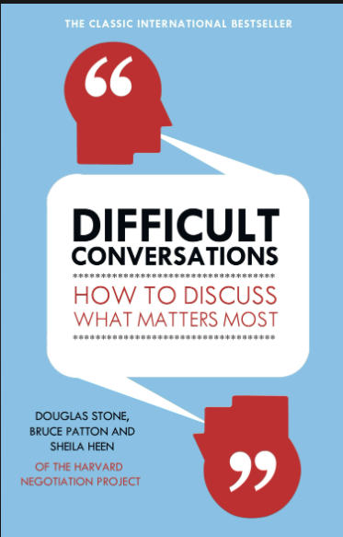
Prepare by walking through the three conversations (sort out what happened; understand feelings; ground your identity).
Check your purposes and decide whether to raise the issue (consider what you would like to achieve, emphasising problem- solving; consider if this is the right time/ way to raise the issue).
Start from the third story (describe the difference between your two stories; share your purposes; invite them to participate in resolving the situation).
Explore their story and yours (listen to understand their perspective, acknowledging feelings behind the issues; paraphrase to check that you’ve understood; try to work out how the circumstance came about; share your point of view; reframe – move away from judgement and blame to understanding).
Problem- solving (Agree on options on which both parties can agree; consider standards or expectations of what should happen; discuss how to keep open communication in the future) (Stone et al., 2010, pp. 233– 234)
Notes:
As mentor, you may find yourself as the broker between colleagues if there are issues
between your trainee and another member of staff, and you may feel torn between
supporting your mentee and showing solidarity with your colleague. It is important, in these
instances, to see the situation from all points of view. Stone, Patton and Heen’s (2010) book
Difficult Conversations suggests that there are actually three conversations going on in a
difficult conversation: what happened, feelings and identity. They argue that both parties will
have their own perspective of events, so unpicking what happened can be challenging. Those
in a difficult conversation will have individual feelings and responses to what happened,
which can make the conversation difficult because they may feel angry or hurt and this may
threaten their sense of self, their identity. Stone et al. recommend the following step- by- step
process for having a difficult conversation with a positive outcome:
…
Essentially, you need to ‘have a dialogue about the dialogue’ (Wright, 2018, p. 20), being
direct but understanding. In her TedX talk (link at the end of this chapter), Joy Baldridge
(2018) suggests some useful ‘ways in’ to starting difficult conversations, such as using the
words ‘noticed’ and ‘wondering’: ‘I noticed that … and I was wondering …’. These can be used
to structure feedback (both positive and negative) and then followed up with ‘likelihood’
and ‘when’ to close the conversation: ‘What’s the likelihood that you can … and when might
that be?’

Slide 31
1. Prepare 2. Select a suitable time and place 3. Start positively 4. Get to the point 5. Use “I” not “you” 6. Include other person’s response 7. Listen don’t interrupt 8. Take personal responsibility 9. Solve and summarise 10. Reflect and improve
Difficult Conversation Short-hand

Slide 32
Potential difficult conversations...
The trainee is struggling to act on feedback and advice
The trainee has behaved in an unprofessional way

Slide 33
Ways in
Joy Baldridge (2018) suggests some useful ‘ways in’ to starting difficult conversations, such as using the words ‘noticed’ and ‘wondering’: ‘I noticed that… and I was wondering…’. These can be used to structure feedback (both positive and negative) and then followed up with ‘likelihood’ and ‘when’ to close the conversation: ‘What’s the likelihood that you can… and when might that be?’
Joy Baldridge’s TedX Talk ‘Difficult Conversations Made Easy’: https://youtu.be/4TkbHLD5Mnw [15mins]

Slide 34
An example
Samina, a mentor, knows that she will have to have a difficult conversation with her trainee, Harriet, as she did not attend a lesson that Samina had arranged especially for her to observe. This lesson observation was tied to a specific target that Harriet had (the managing of transition points in a lesson) and had asked a favour of a colleague who had re-arranged their planning to accommodate this request. Samina’s colleague, a very experienced teacher, remonstrated with her at the end of the day, commenting on Harriet’s unprofessional behaviour and mentioned that he had sent an email to Harriet with words to that effect. Although Samina has not yet seen Harriet, she knows that she is upset as she was reportedly in tears in the staffroom.
Notes:
Read the following conversation and identify where Samina structures the conversation so that she is able to communicate why her colleague was annoyed, her expectations of professionalism and identify steps to repair the relationship with her colleague and prevent the same situation reoccurring.

Slide 35
Samina: Harriet, I noticed that there has been some friction between you and Jonathan and wondered how I could help?
Harriet: I’m not sure; I don’t think he likes me much.
Samina: Well, why don’t you tell me what happened, then I’ll share his perspective.
Harriet: Ok. I knew that I was supposed to observe him at some point on Tuesday, I definitely wrote it down but I left my planner at home so I thought I’d check with him. But when I came in I remembered that I was supposed to take part in rolling tutor period and I had to go and prepare for that cos I was teaching it. I wasn’t confident about this at all, as it was on voting rights so that took up period 2. And I was over the other side of the school, so I didn’t see Jonathan at all and by the time I got back here I realised that I had missed the lesson completely. I’d thought it was period 3, but I was wrong.
Samina: Ok; thanks. So, you had a busy morning and were feeling anxious about teaching your tutor group a topic that you weren’t confident in and you thought you had the right lesson, but by the time you realised, it was too late?

Slide 36
Harriet: Yes, that’s right.
Samina: Ok, let’s think about Jonathan’s point of view. He was going to be doing an assessment with Year 7 on Tuesday, but was happy to reorganise things so that you could see him and his way of managing the class transitioning between activities. This was a favour for me, really. He said that he even wrote out a lesson plan for you. This made him feel put out, as he had gone out of his way to be helpful. He said that he would have expected at least an email to say you weren’t going to be there or an apology for not showing up.
Harriet: I did try! But I was teaching period 4 and then had our training meeting, so I didn’t have time.
Samina: Let’s summarise the two perspectives of what happened: Jonathan changed his lesson so that you could observed, he expected you to show up, but you didn’t and didn’t let him know why or apologise. You were fully intending to observe but had to change your morning plans because you were asked to teach your tutor group and you had to prepare for that. You sound like you were quite anxious about the whole thing – is that right?
Harriet: Yes, I didn’t want to let the tutor down and I was also worried about my lesson in the afternoon. I’m sorry I didn’t get around to emailing Jonathan.

Slide 37
Samina: Let’s think about how we can resolve the situation with Jonathan and prevent this kind of thing from happening again. Would you like to speak to Jonathan?
Harriet: Yes, I think I need to explain why I didn’t show up and apologise – I realise that he changed his lesson for me.
Samina: When would you like to speak to him?
Harriet: Can I email him?
Samina: You can, but it might be better to do it in person – perhaps first thing tomorrow.
Harriet: Ok.
Samina: What about the future; how can we prevent this from happening again?
Harriet: I’ll try to be more organised (and not forget my planner!) and speak to people as soon as I can if I have missed something.
Samina: Ok, that’s great.
(Roberts, 2020)

Slide 38
Summary
Using aspects of the Impact Cycle can be helpful in its specificity and focus
Target-setting needs careful thought; it needs to link clearly to a curriculum strand and focus on the intended learning; the RPT will need guidance in terms of strategies/actions to address the target; progress towards the target will need to be reviewed (SMART targets)
You can use aspects of CBT to support struggling trainees and be prepared for difficult conversations.

Slide 39
References
Clutterbuck, D. (2004). Everyone Needs a Mentor: Fostering Talent in Your Organisation (4th ed.). London: CIPD.
Ericsson, A. & Pool, R. (2016). Peak: Secrets from the new science of expertise. London: The Bodley Head.
Ferrier- Kerr, J. (2009). ‘Establishing professional relationships in practicum settings.’ Teaching and Teacher Education, 25, 790– 797.
Gibbs, G. (1988). Learning by Doing: A guide to teaching and learning methods. Oxford: Oxford Further Education Unit.
Hobson, J. (2016). ‘Judgementoring and how to avert it: introducing ONSIDE Mentoring for beginning teachers’. International Journal of Mentoring and Coaching in Education, 5(2), 87-110.
Hochschild, A. (2012). The Managed Heart: Commercialization of human feeling (3rd ed.). Palo Alto, CA: University of California Press.
Instructional Coaches’ Toolkit
Knight et al. (2022). Curious Convos Webinar.
Knight, J. (2017). The Impact Cycle: What instructional coaches should do to foster powerful improvements in teaching, Corwin Press.
Knight, J. (2018). Instructional Coaching. Brief guide video.
Knight, J. (2022). The Definitive Guide to Instructional Coaching: Seven Factors for Success. ASCD.
Lam, D. & Gale, J. (2000). ‘Cognitive behaviour therapy: Teaching a client the ABC model – the first step towards the process of change.’ Journal of Advanced Nursing, 31(2), 444– 451.
Riggenbach, J. (2013). The CBT Toolbox: A workbook for clients and clinicians. Eau Claire, WI: Premier Publishing and Media.
Roberts, R. (2020). ‘Holding weekly debriefs.’ In D. Hickman, A Practical Guide to Mentoring English Teachers. Abingdon: Routledge.
Stone, D., Patton, B., & Heen, S. (2011). Difficult conversations: How to discuss what matters most. Penguin.

Slide 40
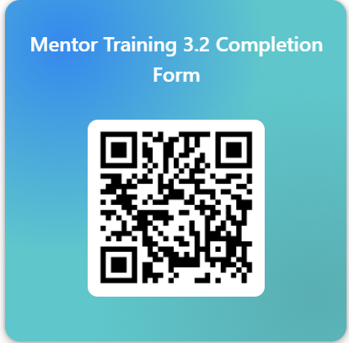
Please take two minutes to fill out the completion form: https://forms.office.com/e/G1cpXEFSyB

