Slide 1

Mentor Curriculum 2.3
ITE Mentor Curriculum
Mentor Knowledge & Skills: Observation & Feedback
Dr Rachel Roberts r.l.roberts@reading.ac.uk
Notes:
Welcome to the second mentor curriculum module, developing your mentor knowledge and skills. I’m Rachel Roberts, Principle Lead Mentor here at the University of Reading.

Slide 2
Content
Observation
Feedback
Constructive conversations
Notes:
This session will focus on three key areas of mentor practice: observation (including being observed), feedback, and enabling constructive conversations between mentors and RPTs.

Slide 3

1 Observation

Slide 4
Developmental Mentoring Model
Challenging the beginning teacher’s assumptions, being a critical friend and demonstrating how to do something they are having difficulties with.
Coaching
Acting as a sounding-board, being there to listen and offer support.
Counselling
Helping a beginning teacher develop resourcefulness, make them aware of the information, resources, people, organisations and more formal repositories of knowledge.
Networking
Giving advice – a balance between giving a beginning teacher the answer and encouraging them to find their own solutions to problems through reflective thinking.
Guiding
(Adapted from Cluttterbuck in Golder et al, 2020, p13)
Notes:
As you know from mentor training 1.1, we adopt the Developmental Mentoring Model, with its four constituent parts: coaching, counselling, guiding, networking. The process of observation and feedback is fundamental to a beginning teacher’s learning, and is filtered through each of these dimensions.

Slide 5

Teaching as 'an apprenticeship of observation' (Lortie, 1975, p61)
Notes:
Lortie’s (1975, p. 61) seminal sociological study of the schoolteacher described teaching as an ‘apprenticeship of observation’; observation is conceived as a vital way to learn. This suggests that, as a mentor, you should be able to organise opportunities for your trainee to observe some excellent teaching and that they’ll learn directly from it: teacher see, teacher do. Unfortunately, it isn’t quite as straightforward as it might appear. Of course, it is likely that a novice will learn something by observing some lessons, but without structure it may not be very effective. This is partly because teaching itself is highly complex and, because of the familiarity of the classroom environment, teaching well can appear easy to the untrained eye. Teaching’s complexity is partly to do with its contextual nature; it is helpful to think of teaching as being ‘dilemma based’ (Loughran, 2010, p. 13). Consider the number of decisions that you make (many of them unconsciously) within a ten-minute segment of a lesson. This could range from reinforcing your classroom routines (reminding pupils to line up outside the classroom), to the type of question you ask an individual pupil during whole-class discussion, to dropping an activity that you had planned.

Slide 6

Seeing and Noticing
Notes:
Because everyone has been a student in a classroom, there is an assumption that an observer will understand everything that they see. Classrooms are complex, dynamic places and even experienced observers are likely to notice different things in the same lesson. It is not surprising, therefore, that Jegede, Taplin and Chan’s (2000) research found that trainees are less able to see the moment-by-moment decisions made by the teacher who they are observing.
There is also a problem with what might be termed ‘teacher knowledge’, much of which is tacit. Polanyi's (1958) concept of tacit knowledge, like an iceberg – as we covered in mentor module 1 - is the stuff that the teacher is doing that can’t be easily seen on the surface.
There is something of a double-bind to the development of expertise in teaching, as more experienced or expert teachers may be better at noticing (Mason, 2002) and recognising the tacit knowledge of person they are observing, but they may find it difficult in explaining their own decision making; they have become ‘unconsciously competent’ (Howell, 1982).

Slide 7
Enabling Learning from Observing
You can:
Articulate expertise for your trainee (Goodwyn, 1997);
Use modelling (i.e. demonstrate for your student teacher in a lesson that they observe), but ensure it is analysed as part of a process of your mentee’s learning (Hattie & Yates, 2014);
Help your mentee shift their perspective from that of a pupil to that of a teacher (Walker & Adelman, 1975);
Enable discussion between your student teacher and others that they observe, to potentially allow access to otherwise tacit knowledge (Roberts, 2014).
'Joint' observations
Notes:
It is here that you, as mentor, can make a real impact on deconstructing the process of your student teacher learning from observing. You can:
• Articulate expertise for your trainee (Goodwyn, 1997);
• Use modelling (i.e. demonstrate for your student teacher in a lesson that they observe), but ensure it is analysed as part of a process of your mentee’s learning (Hattie & Yates, 2014);
• Help your mentee shift their perspective from that of a pupil to that of a teacher (Walker & Adelman, 1975);
• Enable discussion between your student teacher and others that they observe, to potentially allow access to otherwise tacit knowledge (Roberts, 2014).
In effect, this means that you will need to think carefully about how you: set up observations for your student teacher; discuss with them what they have observed; identify and agree areas of focus; and consider what has been learnt.
Set up a joint observation, so that you can observe alongside your mentee. As you are observing the lesson, talk about what you ‘notice’ and what your student teacher can see. This will unlock some of the ‘tacit knowledge’ that may be otherwise hidden from them. If you can, schedule some time for you both to talk to the class teacher.

Slide 8

Being Observed
How do you feel about being observed?
Notes:
Being observed
How do you feel about being observed? Consider the reason for your feelings. Are you worried about being judged or making a mistake in front of your trainee? If you’re worried about being judged, think about the purpose and nature of the observations: they are for your trainee to learn and for you to demonstrate aspects of teaching that you can discuss with your trainee. That doesn’t mean that your lessons all have to be perfect! It would actually be beneficial to discuss with your trainee things that you might change for the next lesson; you are then modelling some of the process of reflection for your trainee.

Slide 9


Organising Lesson Observations
Range
Focus
Pre and post-observation discussions
Notes:
It is worth thinking about how to organise the lessons that your mentee will observe. Consider the range of different classes you teach (it is helpful for them to see your most challenging classes as well as your most productive!) and the conversations that you are going to have pre- and post-observation. If you provide a focus, it will stimulate discussion after the lesson; it will allow your trainee to consider the decisions you’ve made in planning and execution. For example in English, you might ask your trainee to observe your Year 11 lesson revising poetry, focusing on lesson structure. Your intention for the lesson is for pupils to recall their knowledge of the poems, reactivate connections between them and revisit some of their interpretations. In your discussion after the lesson, you can then deconstruct the sequence of activities, their purpose and how successful you felt they were in enabling the class to revise. (Roberts, 2020, p115)

Slide 10
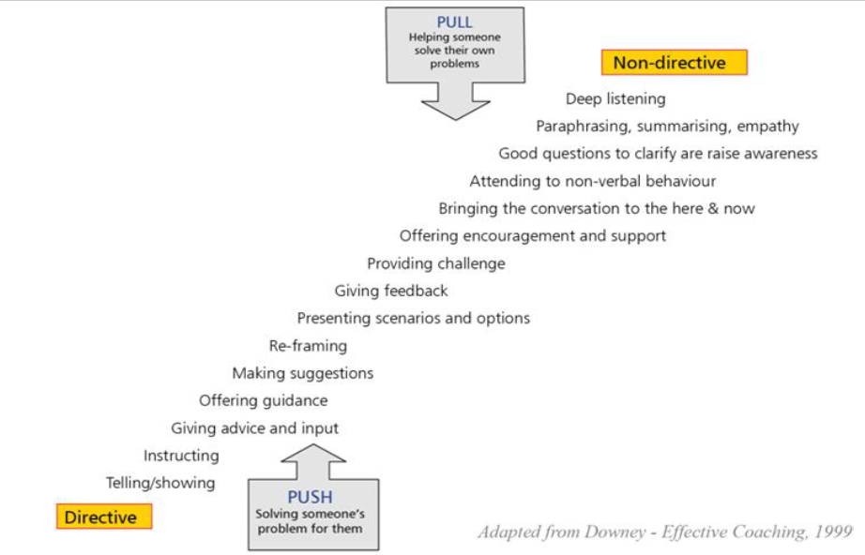
Notes:
Continuum of mentors' skills (see also Hughes, 2010 From How to be a brilliant mentor)

Slide 11
Observing your trainee
Questioning
Body language and use of voice
Subject knowledge
Whole-class management
Managing discussion
Transitions between activities
Starting and finishing a lesson
Timing and pace
Quality of explanations
Relationships with pupils (including use of language and tone of voice)
The engagement/progress of individual pupils
Checking for understanding
Adaptive teaching (Roberts, 2020, p116)
Notes:
Observation of your trainee should not be used as a means of control; all teachers have their preferred ways of doing things, their own teaching style, but when working with a beginning teacher it is important to be aware of your own bias (O’Leary, 2014). It is instinctive when watching a novice to think: ‘I wouldn’t have done it like that.’ Whilst this may be intuitive, it wouldn’t be very helpful to fill your feedback notes with what you would have done; this is about their development and practice, after all. It is more helpful to be open-minded about different approaches, so that your beginning teacher can have the freedom to experiment. As noted earlier, lessons are dynamic, changing environments and it is impossible to see everything that is going on. When you are observing, consider the focus. There are lots of different things you can focus on whilst observing, such as…
In the same way that you plan for your pupils’ progression, you will want to plan observations in such a way that they support your mentee’s progress. A suitable focus could be identified in consultation with your mentee as part of their weekly training. For instance, if a target from the previous week was to develop a greater range of questioning strategies, this should form one of your focuses.

Slide 12

Feedback
Notes:
We will now think about the next part of the process: the role of feedback.

Slide 13
Reflective cycle
Experience
Description of feelings/ reactions
Evaluation
Analysis
Personal action plan
Conclusions (general)
Conclusions (specific)
Figure 1 The reflective cycle, adapted from Gibbs (1988, p. 50)
Notes:
Where does feedback occur in the reflective cycle?

Slide 14
What is feedback?
‘information about the gap between the actual level and the reference level of a system parameter which is used to alter the gap in some way’ (Ramaprasad, 1983)
A form of formative assessment (Sadler, 1989; Hattie & Gan, 2011; Taras, 2013; McArthur and Huxham, 2013)

Slide 15
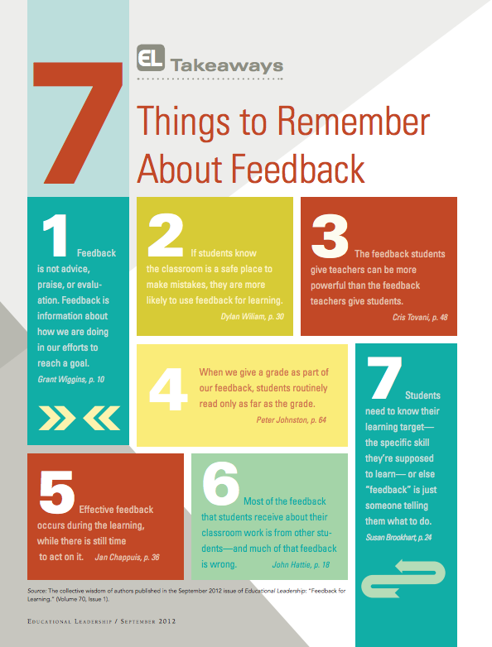
7 Things to Remember About Feedback
(Visible Learning, 2015)
Notes:
https://visible-learning.org/2015/02/infographic-feedback-for-learning/
There are some general good principles to remember about feedback in general… and these similarly apply to conversations that you will have with your trainee.

Slide 16

Consider:
Who speaks
Language
Body language
Notes:
https://www.youtube.com/watch?v=G9YHAnHCHLg&feature=emb_logo
Watch the following 3min clip of a feedback conversation and note:
Who speaks (when and how much)
Language used (where is it evaluative?)
Body language
You may have noticed that the observer does most of the talking at least initially and this is includes stating the things that she felt went well in the lesson. For example, she says his ‘energy in the lesson was pretty amazing’. She uses the phrase ‘I thought that..’ several times and the language she uses is clearly evaluative ‘tailoring your questions was done particularly well’. Here we can see a statement that is evaluative: she is effectively praising him here.
When she does move on to areas for improvement, this is phrased as ‘One thing that you need to take care about is…’.
The trainee doesn’t really speak until a minute and a half into the conversation and this is prompted by the observer asking ‘how did you feel about the lesson as a whole?’ This then becomes more of a dialogue, further prompted by her asking what he’d like to work on.
Although the set up here is necessarily a bit awkward (they are being filmed after all!), a quiet location has been found for the feedback conversation. The desk/paper could be seen as something of a barrier and I wonder how much the conversation is driven by what the observer feels she needs to say (as suggested by her frequent reference to her notes) and slightly less by properly listening to his thoughts/responses.
The body language of both during the first half of the conversation also suggests a passivity on the part of the trainee and he does look slightly terrified! As mentors providing feedback, it is worth remembering that feedback conversations can feel very high stakes for trainees (they do need to know where they’ve been successful and that they’ve been successful, as well as identifying areas for development).

Slide 17
Problems with Feedback
‘she’ll just hit me with [it]’ (Dan, Redwood TI3).
Focus on mentor
Seen as 'transmission' model
Differences in perception
Not having a shared meaning
Impact on learning
Burdensomeness
Being judged
Not all feedback is good (can do harm)
More feedback is not helpful (Molloy & Boud, 2013)
‘if they’re a bit too cutting… you don’t learn anything from it’ (Saffron, Oakbank TI1).
‘positive [feedback] … made me feel more positive about my teaching’ (Charlotte, Ferndean TI2)
Notes:
The pivotal nature of developmental feedback recurs in the literature and research around mentoring (Hobson, Ashby, Malderez & Tomlinson, 2009; Hudson & Hudson, 2014; Mercado & Mann, 2015). And there are lots of ways in which feedback can be problematic, including:
Mentors who focus solely on what needs to be improved (which is likely to be a lot at the beginning of anyone’s professional career) are in danger of ‘Judgementoring’ (Hobson & Malderez, 2013), which can be a highly negative experience for a novice.
The trainees in my research study from 2019 made a link between the use of specific vocabulary, how they felt and how this affected their learning: Violent imagery was used to describe negative feedback: ‘she’ll just hit me with [it]’ (Dan, Redwood TI3).
‘if they’re a bit too cutting… you don’t learn anything from it’ (Saffron, Oakbank TI1).
‘positive [feedback] … made me feel more positive about my teaching’ (Charlotte, Ferndean TI2);
The impact of the evaluative language used is affective.
Teachers, and beginning teachers especially, are vulnerable to criticism because they want to do their best for the children that they are teaching (Kelchtermans, 2009); they can therefore perceive criticism as an attack on their ethical intentions.

Slide 18
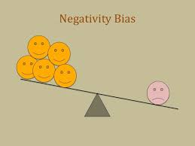
Affective language
People use more positive than negative language (Dodds et al, 2015)
BUT
Negativity bias = bad is stronger than good (Baumeister et al., 2001; Jing-Schmidt, 2007)
Notes:
Studies have shown that people tend to use more positive than negative language in general conversation, commonly known as the Pollyanna principle (Dodds et al., 2015). Negative language, however, has a stronger effect. This means that, even if feedback consists of more positive than negative comments, the negative comments will have greater impact on the recipient. Jing-Schmidt (2007) argues that the negativity bias operates on a biological level (therefore negative language invokes a kind of ‘fight-or-flight’ response), rather than a linguistic level. This could impact on learning (Nicols, Schutz, Rodgers & Bilica, 2017) and could be detrimental to the progress of a trainee. Beginning teachers sometimes have a tendency to be over-critical of themselves and may internalise negative judgements, affecting their self-efficacy (Roberts, 2019). In the heightened situation of a feedback conversation, consideration of the evaluative language used is therefore important. You could consider your choice of words, particularly vocabulary that is directly associated with grading, for example for the PGCE. You could also consider the amount and type of praise that you use; think about how you might use it to reward and motivate. (Roberts, 2020, p123)

Slide 19
Effective feedback
Should '…answer three major questions asked by a teacher and/or by a student:
  Where am I going? (What are the goals?),
  How am I going? (What progress is being made toward the goal?),
  Where to next? (What activities need to be undertaken to make better progress?)' (Hattie & Timperley, 2007, p. 86)
Notes:
Similar to a reflective cycle, effective feedback needs to address three key questions:

Slide 20
  Being supportive (Martinez Agudo, 2016) and showing empathy (Akcan & Tatar, 2010);
  Being sensitive and balanced (Parsloe & Wray, 2000);
  Being goal-oriented (Brandt, 2008);
  Using praise to encourage and recognising their efforts to keep trainees motivated (Rhodes, Stokes, & Hampton, 2004);
  Recognising potential emotional consequence of receiving feedback (Hyland & Lo, 2006);
  Steering the conversation, using ‘reframing’ (Roberts, 2019)
Notes:
As a mentor, you can provide effective feedback by

Slide 21
What is the first question an observer asks when starting the feedback conversation?
Notes:
What is the first question an observer asks when starting the feedback conversation?

Slide 22
‘How do you think that went?’

Slide 23
Ask instead: ‘What did you want the pupils to learn?’
Notes:
An alternative starting point would be to ask: what did you want the pupils to learn?
The pivotal nature of developmental feedback recurs in the literature and research around mentoring (Hobson, Ashby, Malderez, & Tomlinson, 2009; Hudson & Hudson, 2014; Mercado & Mann, 2015). Mentors who focus solely on what needs to be improved (which is likely to be a lot at the beginning of anyone’s professional career) are in danger of ‘Judgementoring’ (Hobson & Malderez, 2013), which can be a highly negative experience for a trainee.
There are a number of ways in which you can structure the feedback conversation that should be of benefit to your trainee and lessen any awkwardness you might feel in taking on the role of arbiter of teaching quality. First, try to avoid beginning the conversation with an emotional response (either yours or theirs!). It is common for those giving feedback to begin by asking ‘How do you think/feel it went?’ (Iyer-O'Sullivan, 2015); whilst starting this question is less immediately judgemental or evaluative than ‘I thought that lesson was good/great/messy etc.’ and is intended to provoke reflection in the trainee, it can lead to quite limited responses. Trainees may fall back on saying something like: ‘Well, it was ok’ and then begin to list all of the elements of the lesson they felt were ‘wrong’ or things that they didn’t do very well. A better starting point would be to move away from a generic ‘what went well’ question, to a more focused ‘What did you want the pupils to learn?’
Immediately, this question will mean that your trainee’s reflection focuses on the learning of the pupils, rather than their own performance. This has two benefits: it means that they are less likely to fall into a cycle of self-flagellation by criticising their own capabilities and it will open up a deeper conversation about the strategies and decisions that took place in the lesson and their impact on pupils’ learning. Your following discussion is therefore less likely to feel judgemental, as you are both critiquing the dynamic interaction between learning activities and pupils’ engagement and reaction to them.
Should you find yourself in the position of a mismatch of praise (either you feel you are not providing enough/the right kind or your trainee not ‘hearing’ it) then you could try recording your conversations and playing them back. Criticism that ‘hurts’ is likely to be that which is most judgemental: this kind of evaluative language appraises the person, rather than their performance (Martin & White, 2005) .

Slide 24
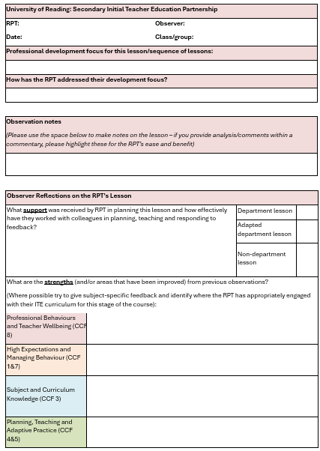
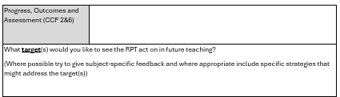
Written
Feedback
Notes:
Writing feedback for your beginning teacher can feel like an additional burden, particularly if you have spent some time discussing the lesson with them already. However, written feedback is an important form of evidence and it can be done with minimal additional work for yourself. Take time to familiarise yourself with the lesson observation feedback form. It is helpful to have a specific focus of the observation, one that should be agreed beforehand with the RPT.
You can use the expandable ‘observation notes’ box to write a running commentary of the lesson as you go (personally, I type it directly onto the observation form on my laptop, as this saves the job of translating scribbled notes onto a computer screen at a later point), making notes as to particularly effective aspects of the lesson (e.g. ‘Effective use of questioning to draw out Abigail’s answer’) or questions to draw attention to elements you want the student teacher to reflect on (e.g. ‘How might you change the order of the group activities, so that they all have a clear understanding of the events of this scene?’).
As the lesson nears its end, you are likely to have a clear idea of the key elements that you felt were effective and areas for development (try to keep the latter to two or three targets at the most). If you aren’t going to have your feedback conversation immediately after the lesson, you can take some time to consider the evidence towards our curriculum strands demonstrated in the lesson, although, try not to use it as a ‘checklist’: if they haven't covered everything it doesn’t mean the lesson wasn’t any good! Framing your feedback as comments in answer to pre-agreed questions is a good way of developing a reflective cycle in training.

Slide 25
Think about feedback that you have received following a lesson observation.
What can you remember about it?
Were there particular words or phrases that stick in your mind?
How did they make you feel?
Did you feel that you learned from the conversation? What enabled or prevented you learning from it?
Notes:
Take a moment to think about feedback that you have received following a lesson observation:
Teachers, and beginning teachers especially, are vulnerable to criticism because they want to do their best for the children that they are teaching (Kelchtermans, 2009); they can therefore perceive criticism as an attack on their ethical intentions. When you’re discussing a lesson with your beginning teacher, you do need to be aware of their affective or emotional response: receiving feedback can be painful (Roberts, 2019), particularly if mentees feel that it is being ‘done’ to them.

Slide 26
Responding to Feedback
What do I think I achieved during the lesson?
What am I most proud of?
Did my learners learn what I intended?
Were my learners productively engaged in the activities?
Was I satisfied with my planning, selection of resources, teaching and assessment?
What have I learnt about the learners and my chosen teaching and assessment strategies?
What worked/didn’t work? Why? Why not?
What have I discovered about myself as a teacher?
What happened that I didn’t expect to happen?
If I could teach this lesson again, what would I do differently and why?
What is the key thing that I want to improve in my next lesson/when I next teach this class?
What do I need to do to enable this to happen?
(Adapted from O’Leary, 2014, p. 87.)
Notes:
The other, perhaps more significant, half of the equation in feedback conversations is your mentee’s response. It is helpful to put yourself in their shoes: you are an experienced, qualified teacher and will ultimately be assessing them. This makes you quite a powerful figure and your student teacher may be especially nervous in hearing your opinion of their teaching; they will want to make you proud, after all. O’Leary (2014) suggest a series of prompts that would be useful for trainees to use when reflecting on their teaching:
What do I think I achieved during the lesson? 2. What am I most proud of? 3. Did my learners learn what I intended? 4. Were my learners productively engaged in the activities? 5. Was I satisfied with my planning, selection of resources, teaching and assessment? 6. What have I learnt about the learners and my chosen teaching and assessment strategies? 7. What worked/didn’t work? Why? Why not? 8. What have I discovered about myself as a teacher? 9. What happened that I didn’t expect to happen? 10. If I could teach this lesson again, what would I do differently and why? 11. What is the key thing that I want to improve in my next lesson/when I next teach this class? 12. What do I need to do to enable this to happen? (Adapted from O’Leary, 2014, p. 87.)
These could be useful to stimulate independent reflection in your student teacher before discussing the lesson with an observer.
Occasionally, you may encounter resistance to feedback. This can be difficult to address. It is worth trying to identify what trainees are resisting: is it linked to a fear of failure or another insecurity? If they are having trouble recognising where things are going wrong in their lessons, then using video clips of their teaching as part of their regular training conversations can help them to see elements of their practice that they find difficult to pinpoint. It may be the case that they become defensive, which could be linked to prior experiences; early conversations about the nature of the training course and how your relationship with them functions are helpful at this point. Discuss with them how they have dealt with criticism or points for development in their past professional roles or academic courses. Do they have difficulty accepting criticism from other members of staff? Is it connected to the way in which feedback is conveyed? Again, if feedback is a conversation, rather than something imposed upon them, it is more likely to be accepted by the trainee as they will have some ownership of it. If you find that there are ongoing issues around listening to feedback, enlist the help of ITTCo or university tutor, who may be able to offer a fresh perspective. (Roberts, 2020, pp123-4)
In written feedback, your trainee could highlight the praise – this may physically represent how well they’re doing and counterbalance their tendency to focus on criticism.

Slide 27
Providing Feedback
Structure – how to begin the conversation; how to move things on; how to conclude
Specific language use – what kind of language is used, particularly evaluative language
Tone – how the language is spoken
Body language – what is being communicated non-verbally
Watch a colleague giving feedback. Consider how effective the discussion is and the impact, or otherwise, of the above.
Notes:
Things to think about when providing feedback

Slide 28
Framing Feedback
Read the following pen portraits of trainee teachers. Decide how you would frame feedback on a lesson to each of them:
Mindy is disorganised, which means that she often misses deadlines and the beginning of lessons can be messy. She is passionate about her subject and is proud of her good subject knowledge. Her self- confidence is low and she has a tendency to ‘put her head in the sand’ when things become difficult; she doesn’t readily ask for help. You suspect that her home- life is troubled in some way.
Jamilla is keen to get everything right. She is very hardworking, although she doesn’t always work ‘smartly’ and can get quite stressed if she feels she hasn’t done the right thing and feels under pressure. When asked how she feels about her progress, she will automatically list all of the things she can’t do or hasn’t done very well.
Omar is a confident young man and really enjoys being in the classroom. He has been praised for his positive relationships with students, particularly those seen as challenging. His planning can be minimal, although his classroom presence is strong.. You have mentioned to him before about the importance of planning, and he agreed, but his practice did not seem to change in light of your comments.
Notes:
Read the following pen portraits of trainee teachers. Decide how you would frame feedback on a lesson to each of them:
Jamilla
Jamilla is keen to get everything right. She is very hardworking, although she doesn’t always work ‘smartly’ and can get quite stressed if she feels she hasn’t done the right thing and feels under pressure. When asked how she feels about her progress, she will automatically list all of the things she can’t do or hasn’t done very well.
Mindy
Mindy is disorganised, which means that she often misses deadlines and the beginning of lessons can be messy. She is passionate about English and is proud of her good subject knowledge. Her self- confidence is low and she has a tendency to ‘put her head in the sand’ when things become difficult; she doesn’t readily ask for help. You suspect that her home- life is troubled in some way.
Omar
Omar is a confident young man and really enjoys being in the classroom. He has been praised for his positive relationships with students, particularly those seen as challenging. His planning can be minimal, although his classroom presence is strong. You have mentioned to him before about the importance of planning, and he agreed, but his practice did not seem to change in light of your comments.
You may need to tailor feedback to the individual, particularly if you are aware of wider issues/circumstances.

Slide 29
Observation & Feedback Procedure
Lesson Observation Feedback Guidance for Observers
Prior to the observation: ensure that you and the RPT have identified an appropriate professional development focus and that the RPT has shared their lesson plan with you.
During the observation: write down what happens when in the ‘observation notes’ section. It may be useful to annotate their lesson plan in relation to their identified focus and impact on children’s learning. Consider your use of evaluative language in this section – all observers must identify aspects of effective and well-intentioned practice and record in the ‘strengths’ section, connected to the curriculum strands.
During the observation: try to record constructive comments as questions that might prompt reflection (e.g. ‘what conditions would have allowed the pupils to focus on the activity?’, ‘how far did the starter achieve the intended aim?’, ‘how might the instructions for the first activity be restructured to ensure all pupils understood?’)
After the observation: if time allows, ask the RPT to reflect privately on the lesson. One effective method is to give them time to annotate their copy of the lesson plan before your discussion.
Begin the post-lesson discussion with a question such as ‘What did you want the children to learn?’ Discuss the RPT’s reflections, contributing your own where appropriate (see further guidance for structuring lesson observation feedback conversations in the Mentor Handbook). Agree developmental targets and suggest some strategies that they can use to address them.
After the discussion: check that the RPT has saved a copy of this completed form.
Notes:
Lesson observation feedback appendix 6 in the MoG
Especially useful for members of staff, other than their mentors, who observe and give feedback to RPTs
Prior
During
After:
When and how you conduct the feedback conversation is important. If it is done in the corridor hurriedly, before racing off to the next lesson, it diminishes the learning opportunity the conversation would afford. Arrange a time to sit down, at a point in the day where you are less likely to be interrupted, so that you can properly talk through the lesson with your mentee. Try to do it as soon as you can following the lesson (if it is more than a day or so later, then the immediacy of being able to reflect fully is likely to be lost). Allow sufficient time, at least 20 minutes, for the conversation; this will enable you to talk it through properly. Don’t wait until you have your designated meeting to do lesson observation feedback, particularly as this will then take up most of your session (especially if trainees are teaching more than one lesson a week!).

Slide 30

3 Constructive conversations

Slide 31

Learning Through Conversations
Conversational learning (Gray et al, 2016): a dialogic process that is rooted in experience and affect.
Reflected in the way in which ITT courses are structured (Hobson, 2002): mentor meetings are designated conversations that form part of the learning process for the trainee.
The dialogue between mentor and mentee in ITT allows space for the discussion of concepts in teaching that are vital to the development of a trainee’s understanding (Aderibigbe, Colucci-Gray, & Gray, 2016).
‘Dialogue can be seen as an internal dialogue where an individual engages in personal reflection to achieve an insight (Clutterbuck 1998); however, the most relevant dialogic process within a mentoring and coaching relationship takes place in collaboration. As Brockbank and McGill state, it adds ‘external dialogue to the inner dialogue by providing another perspective, asking questions not previously considered and drawing on other experience …Transformative learning according to Brockbank and McGill is more likely to occur as a result of collaborative dialogue.’’’ (Burley & Pomphrey, 2011, p23)
Notes:
Mentor-trainee conversations (and mentor meetings) are not (and should not) just be feedback from lesson observations.
Conversations that you have with your RPT are a key aspect of their learning - it is the process of conversation between mentor and trainee that facilitates the development of the trainee. The social construction of knowledge through dialogue is linked to the process of reflection (Schon, 1987) and analysis of experience.

Slide 32
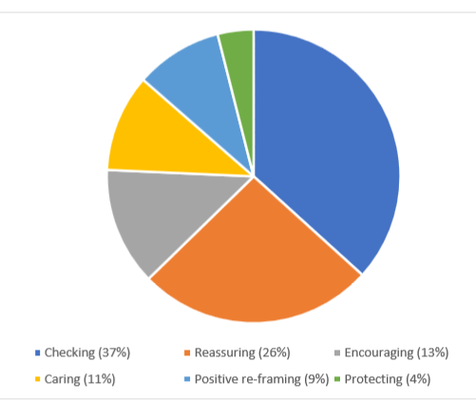
Mentoring Conversations’ Content
(Roberts, 2019)
Notes:
In my research, I analysed the content of mentor meeting conversations, which included a significant amount of ‘support’.
‘Support’ further broke down into:
Checking – showing concern, generic or specific, regarding trainee’s wellbeing or progress. Usually in the form of a question.
Reassuring – comments that ‘things will be fine’; that what the trainee is experiencing is normal. Empathetic in tone.
Encouraging – comments that suggest the mentor has confidence or faith in the trainee’s ability; to bolster the trainee’s confidence.
Caring – showing concern, often through using a question and related to trainee’s wellbeing.
Positive re-framing – the mentor re-positions a negative self-evaluation that the trainee has into a positive.
Protecting – the mentors’ suggestions protects the trainee from possible threats.
All of these features work along some kind of display of emotion: we might say that emotions are productive, they do things in social relations through discourse (Wetherell, McCreanor, McConville, Moewaka Barnes, & le Grice, 2015; Zembylas, 2005).

Slide 33
Some Issues with Mentoring Conversations
Power and dominance
Personality, agenda, time (Hyland & Lo, 2006)
Focus on performance in conversations between mentors and trainees (Timperly, 2001; Orland-Barak & Klein, 2005);
Disparity between the mentors’ stated preference for dialogic talk and the more directive reality in their conversations with their trainees (Orland-Barak & Klein, 2005).
Accountability measures and teacher evaluation (Goodwyn, 2011; Donaghue and Howard, 2015; Randall, 2015; Lofthouse and Thomas, 2014). Lofthouse and Thomas (2014) found that some mentors found that performativity (in the form of box ticking or completion of forms) could dominate conversations with trainees.

Slide 34


Facilitating a Reflective Conversation
Content
Structure

Slide 35
Content: Topics for mentor meetings
Mentor bulletins and conversation prompts support you here
Curriculum threads:
  Professional Behaviours & Teacher Wellbeing
  High Expectations & Managing Behaviour
  Subject & Curriculum
  Planning, Teaching & Adapting Practice
  Progress, Outcomes & Assessment
Use the weekly targets to guide your conversations (and therefore their learning), but don’t be afraid to change/add to these!

Slide 36
Using Coaching
Less directive
Enable the other person to have ownership of their challenges and take responsibility for their actions.
Achieved through listening and asking questions to enable the coachee to find their own solutions.
There are times to direct or give answers, but coaching conversations are about the other person’s learning – not your opinion or expertise. (NHS, 2019, p3)
Notes:
Key coaching skills:
Listening
Reflecting
Clarifying
Questioning

Slide 37
Questioning
Open questions
Clarifying questions
Tell me more about…
What aspect of this do you want to discuss today?
Reflective questions
What would you have to change in order for…?
What’s another way you might look at this?
Summarisng questions
So to summarize… is that right?
So, in order to achieve this, you say you are going to…?
Outcome questions
What is your first step to achieve this?
What will you do next?
What support do you need?
Notes:
Mentoring conversations are characterised by use of questions as a kind of scaffolding (Engin, 2013; Olsher & Kantor, 2012)

Slide 38
Step in Gibbs’ reflective cycle | Example questions/prompts
Description | Tell me what happened in your lesson on Tuesday. Can you describe the incident with Joanna in more detail? What were you thinking/feeling at that point?
Evaluation | Thinking about what you wanted the pupils to learn, how effective did you think that activity was? What did you find easy/difficult?
Analysis | Why do you think your lesson on photosynthesis with Yr7 was difficult? How was it different to the previous lesson with that class?
Conclusions | If you were to teach that lesson again, what would you change?
Action plan | As you’ve suggested that most of the class found the first activity too easy, let’s think about pitch and pace at the beginning of lessons…
Notes:
Structuring your conversation

Slide 39

Reappraisal
'Reappraisal is the process of “modifying one’s appraisal of a situation… to alter its emotional impact” (Gross, 2015, p. 9)… Mentors can help trainees reappraise, or re-frame, experiences they feel to be very negative so that they are able to take some positives from it.’ (Roberts, 2019, p134)
Notes:
‘Sometimes your trainee will need to have the space to vent their emotional reaction to experience before you’re able to discuss what might be done differently next time. You can help this process by using ‘reappraisal’. Reappraisal is the process of “modifying one’s appraisal of a situation… to alter its emotional impact” (Gross, 2015, p. 9)… Mentors can help trainees reappraise, or re-frame, experiences they feel to be very negative so that they are able to take some positives from it.’ (Roberts, 2019, p134)

Slide 40

Using reappraisal
Let them lead and talk through their emotional reaction
Begin the discussion by asking about their planning/intentions for learning
Use active listening
Use a blend of open and closed questioning
Acknowledge their feelings
Avoid judgement
Give options
Draw out the positives.
Refocus their attention; come back to the positives
Show that they are significant.

Slide 41
Read the conversation between mentor and trainee and identify how the trainee (Steven) is feeling, why he may be feeling this way and how the mentor (Maggie) re-frames his negative experience.
What specific techniques does the mentor use to re-frame the trainee’s experience?

Slide 42
Maggie: Do you want to continue to talk about it now?
Steve: Um, I might need some more time.
Maggie: Ok, we can discuss it tomorrow. You see them again on Wednesday I think?
Steve: Yeah.
Maggie: Alright. Although you said they all started mucking about – was it all of them?
Steve: Well, no, but a few.
Maggie: And they must have got something from the lesson?
Steve: I think Alice and her group did – they actually made some really insightful connections between the poems.
Maggie: So it wasn’t a complete disaster!
Steve: I guess not.
Maggie: But I understand why you feel annoyed; we’ll think about how we can deal with this behaviour issue together – remember that you’re not on your own. Let’s talk again tomorrow.
Steve: Ok, thanks.
(Roberts, 2020, p135)

Slide 43

Talking about the learning
Watch the video clip of the feedback conversation between the mentor and mentee available here: https://www.scienceoflearning-ebc.org/
How does the conversation between the mentor and mentee enable the mentee to reflect and how is this connected to the impact on pupils’ learning?
Notes:
https://www.scienceoflearning-ebc.org/

Slide 44
Listening Skills
1. Listening rather than ‘gap’ listening
2. Keeping quiet – active listening
3. Making use of non-verbal signs
4. Using continuation responses
Notes:
Avoid: Avoid reassuring, Avoid advising, Avoid switching it to you, Avoid changing the subject
Do use: Continuation responses, Reflective statements, In frequent and tentative questions

Slide 45
The Reflective Cycle adapted from Gibbs (1988, p. 50)
Experience
Description of feelings/ reactions
Evaluation
Analysis
Personal action plan
Conclusions (general)
Conclusions (specific)

Slide 46
Key Take Aways
Observation is a key part of trainees' learning, but is not straightforward
Mentors can support learning from observing through specific focuses and deconstruction
Feedback needs to be descriptive, specific and not just evaluative
Structure conversations, and use reflective questions such as 'what did you want the children to learn?'
Using reappraisal can help positively re-frame trainees' perspectives

Slide 47
References
Aderibigbe, S., Colucci-Gray, L., & Gray, D. (2016). Conceptions and Expectations of Mentoring Relationships in a Teacher Education Reform Context. Mentoring & Tutoring: Partnership in Learning, 24(1), 8-29. ​
Akcan, S., & Tatar, S. (2010). An investigation of the nature of feedback given to pre-service English teachers during their practice teaching experience. Teacher Development, 14(2), 153-172. ​
Baumeister, R., Bratslavsky, E., Finkenauer, C., & Vohs, K. (2001). Bad Is Stronger Than Good. Review of General Psychology, 5(4), 323-370. ​
Boud, D., & Molloy, E. (2013). What is the problem with feedback? In D. Boud & E. Molloy (Eds.), Feedback in High and Professional Education: Understanding it and doing it well. Abingdon: Routledge.​
Brandt, C. (2008). Integrating feedback and reﬂection in teacher preparation. ELT Journal, 62(1), 37-46. ​
Burley, S & Pomphrey, C. Mentoring and Coaching in Schools : Professional Learning Through Collaborative Inquiry, Taylor & Francis Group, 2011.​
Dodds, P., Clark, E., Desu, S., Frank, M., Reagan, A., Williams, J., Danforth, C. (2015). Human language reveals a universal positivity bias. Proceedings of the National Academy of Science, 112(8), 2389-2394
Donaghue, H., & Howard, A. (2015). Introduction. In A. Howard & H. Donaghue (Eds.), Teacher Evaluation in Second Language Education London: Bloomsbury.​
Engin, M. (2013). Questioning to scaffold: an exploration of questions in preservice teacher training feedback sessions. European Journal of Teacher Education, 36(1), 39-54. ​
Gibbs, G. (1988). Learning by Doing: A guide to teaching and learning methods. Oxford: Oxford Further Education Unit.​
Golder, G., Keyworth, A., & Shaw, C. (2020). Ch 1: Models of mentoring. In D. H. (ed.), Mentoring English Teachers in the Secondary School (pp. 5-16). Abingdon: Routledge.
Goodwyn, A. (1997). Developing English Teachers. Buckingham: Open University Press.
Goodwyn, A. (2011). The Expert Teacher of English. Abingdon: Routledge.​
Gray, D., Garvey, B., & Lane, D. (2016). A Critical Introduction to Coaching and Mentoring. London: Sage.​
Hattie, J., & Gan, M. (2011). Instruction Based on Feedback Handbook of Research on Learning and Instruction. Abingdon: Routledge.​
Hattie, J., & Timperley, H. (2007). The Power of Feedback. Review of Educational Research, 77(1), 81-112. ​
Hobson, A. (2002). Student Teachers' Perceptions of School-based Mentoring in Initial Teacher Training. Mentoring & Tutoring: Partnership in Learning, 10(1), 5-20. ​
Hobson, A. (2016). Judgementoring and how to avert it: introducing ONSIDE Mentoring for beginning teachers. International Journal of Mentoring and Coaching in Education, 87-110.
Hobson, A., Ashby, P., Malderez, A., & Tomlinson, P. (2009). Mentoring beginning teachers: What we know and what we don't. Teaching and Teacher Education, 207-216.
Hobson, A., & Malderez, A. (2013). Judgementoring and other threats to realizing the potential of school-based mentoring in teacher education. International Journal of Mentoring and Coaching, 2(2), 89-108. ​
Howell, W. S. (1982). The Empathic Communicator. Belmont, CA: Wadsworth Publishing Co.​
Hudson, P. (2013). Forming the mentor-mentee relationship. Journal of Mentoring and Tutoring​
Hudson, P., & Hudson, S. (2014). Mentor feedback: models, viewpoints and strategies. Paper presented at the ATEA Annual Conference, Sydney. ​
Hyland, F., & Lo, M. (2006). Examining interaction in the teaching practicum: issues of language, power and control. Mentoring & Tutoring, 14(2), 163-186. ​
Iyer-O’Sullivan, R. (2015). From Bit to Whole: Reframing Feedback Dialogue through Critical Incidents. In A. Howard & H. Donaghue (Eds.), Teacher Evaluation in Second Language Education. London: Bloomsbury. ​

Slide 48
Jegede, O., Taplin, M., & Chan, S. (2000). 'Trainee teachers' perception of their knowledge about expert teaching'. Educational Research, 287-308.
Jing-Schmidt, Z. (2007). Negativity bias in language: A cognitive affective model of emotive intensifiers. Cognitive Linguistics, 18(3), 417-443.
Kelchtermans, G. (2009). Who I am in how I teach is the message: self-understanding, vulnerability and reflection. Teachers and Teaching: theory and practice, 15(2), 257-272.
Lawley, Moore & Smajic (2014) ‘Effective Communication Between Preservice and Cooperating Teachers’, The New Educator, 10:2, 153-162
Le, P., & Vasquez, C. (2011). Feedback in teacher education: mentor discourse and intern perceptions. Teacher Development, 15(4), 453-470.
Lofthouse, R., & Thomas, U. (2014). Mentoring student teachers; a vulnerable workplace learning practice. International Journal of Mentoring and Coaching in Education, 3(3), 201-2018.
Lortie, D. (1975). Schoolteacher. Chicago: University of Chicago.
Martinez Agudo, J. (2016). What Type of Feedback do Student Teachers Expect from their School Mentors during Practicum Experience? The Case of Spanish EFL Student Teachers Australian Journal of Teacher Education, 41(5), 36-51.
Mason, J. (2002).Researching your own practice: The discipline of noticing. London: Routledge.
McArthur & Huxham in Price et al. (eds), 2013, Reconceptualising Feedback In Higher Education, Routledge Education
Mercardo, L., & Mann, S. (2015). Mentoring for Teacher Evaluation and Development. . In A. Howard & H. Donaghue (Eds.), Teacher Evaluation in Second Language Education. London: Bloomsbury.
Molloy, E., & Boud, D. (2013). Changing Conceptions of Feedback. In D. Boud, & E. (. Molloy, Feedback in Higher and Professional Education (pp. Chapter 2 (e-book)). Abingdon, Oxon, UK: Routledge.
O'Leary, M. (2014). Classroom Observation: A guide to the effective observation of Teaching and Learning. Abingdon: Routledge.
Olsher, G., & Kantor, I. (2012). Asking Questions as a Key Strategy in Guiding a Novice Teacher: A self-study Studying Teacher Education, 8(2), 157-168.
Orland-Barak, L., & Klein, S. (2005). The expressed and the realised: Mentors' representations of a mentoring conversation and its realisation in practice. Teaching and Teacher Education, 21, 379-402.
Parsloe, E., & Wray, M. (2000). Coaching and Mentoring. London: Kogan Page.
Ramaprasad, A. (1983). On the definition of feedback. Behavioural Science, 28(1), 4-13.
Randall, M. (2015). Observing for Feedback: A Counselling Perspective. In A. Howard & H. Donaghue (Eds.), Teacher Evaluation in Second Language Education. London: Bloomsbury.
Rhodes, C., Stokes, M., & Hampton, G. (2004). A Practical Guide to Mentoring, Coaching and Peer-networking. Abingdon: Routledge.
Roberts, R. (2019). Critical Conversations: The role of evaluative language in mentor meetings in Initial Teacher Training. (EdD). University of Reading.
Roberts, R. (2020). Holding weekly debriefs. In D. Hickman, A Practical Guide to Mentoring English Teachers. Abingdon: Routledge.
Roberts, R. (2020). Observing beginning English teachers' lessons. In D. Hickman, A Practical Guide to Mentoring English Teachers. Abingdon: Routledge.
Sadler, D. (1989). Formative assessments and the design of instructional systems. Instructional Science, 18(4), 119-144.
Schon, D. (1987). Educating the Reflective Practitioner. San Francisco: Jossey-Bass Inc.
Schutz, W. (1994). The Human Element. San Francisco: Jossey-Bass.
Taras, M. (2013). Feedback on Feedback. In S. Merry, M. Price, D. Carless, & M. Taras (Eds.), Reconceptualising Feedback in Higher Education.
Timperley, H. (2001). Mentoring Conversations Designed to Promote Student Teacher Learning. Asia-Pacific Journal of Teacher Education, 29(2), 111-123.

Slide 49
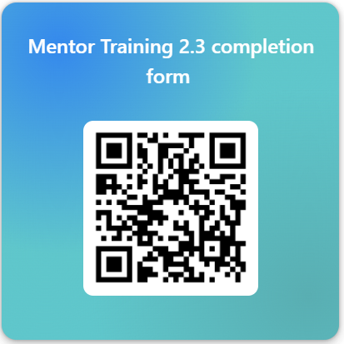
Please take two minutes to complete the completion form:
https://forms.office.com/e/MfMkyg3fjm

