Slide 1
Implementing the ITE Curriculum: Contextualising your mentoring
Secondary PGCE 2024-25
Subject Mentor Training
3.40pm Microsoft Teams
17.9.24

Slide 2
Welcome
Administrator: pgcesecondary@reading.ac.uk
Head of School: Dr Sarah Marston
Director of Teaching and Learning: Dr Jo-Anna Reed-Johnson
Head of ITT: Dr Catherine Foley
Director of Secondary: Will Bailey-Watson
Geography Lead: Martin Sutton
Notes:
Ask mentors to introduce themselves (school and RPT)
Not going to record but will share a shorter recorded version later and will be shared via the UoR Mentor Hub https://sitesb.reading.ac.uk/ioe-mentoring/

Slide 3
www.tinyurl.com/geogmentors
Google Drive for Geog
mentor material
Lesson plan proforma – every lesson
Lesson feedback proforma – 1 in 3
Geog handbook
Lots more

Slide 4
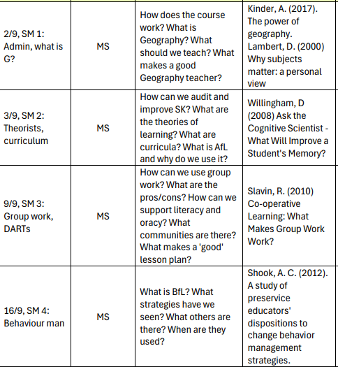
Subject Method Content
Notes:
Share the content of some of the early SM sessions – what will you cover and why? What might mentors pick up in their conversations in school with their RPTs?

Slide 5
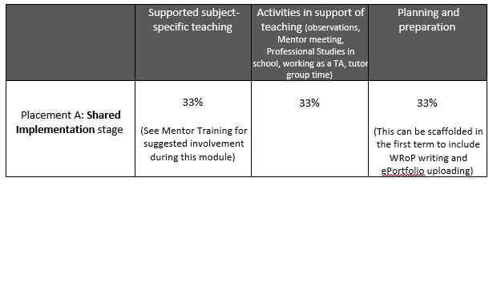
Up to and incl Fri 27th Sept = ‘Induction’
From Wed 2nd Oct = ‘Shared’
No more than 33%
teaching up to
Xmas break
(<40% just before?)
3 days until Oct HT
4 days until Xmas
5 days until Feb HT

Slide 6
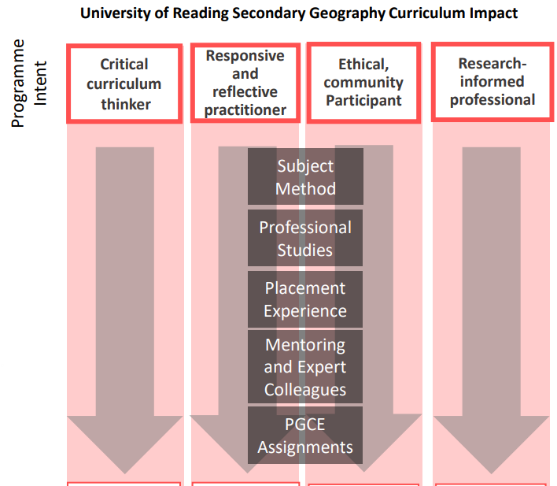
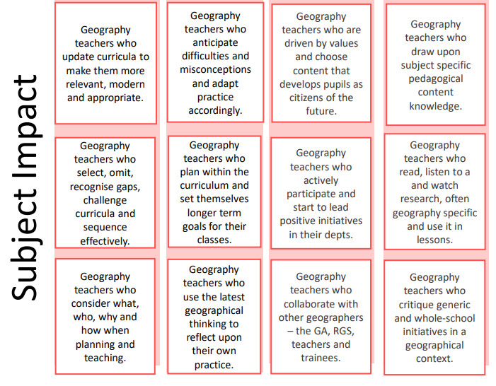
INTENT TO IMPACT
Notes:
Please download the poster version of this for your wall!
Our Vision for the Secondary Programme
Our vision statement and programme identity have been developed collaboratively in partnership with representatives of schools, local and regional alliances, university tutors and programme directors, and the Secondary Steering Group.
We agreed that our particular partnership, with its emphasis on subject-specificity, high expectations, inclusivity and diversity, aims to develop four fundamental traits that consistently characterise, and set apart, RPTs.
Our vision is therefore that RPTs become:
Critical Curriculum Thinkers
Responsive and Reflective Practitioners
Ethical Community Participants
Research-Informed Professionals
Responsive and reflective practitioner:
You will begin by focusing almost entirely on yourself. ​
What will I say? What will I do? What will my resources get them to do? ​
We will push you to think about the students and their learning. ​e.g. PGCE assignments, mentor meeting notes, lesson reflections, lesson plans showing reflection and advice, experimenting,​
online contributions… ​
Ethical community participant:
Not passive bystanders, but have desire for social justice and cohesion, and high expectations of everyone. ​
Contribute to communities, leave your mark. E.g. Asking & answering Qs in PS sessions, subject sessions, discussing with dept at school, ​
set up a school club,​
immersed in professional ​
associations, eduTwitter , attend conferences, TeachMeet icons, TES online...​
Research-informed professional:
Aware of limitations and boundaries​
Model that should be easily communicated​
Intentionality to eliminate or emphasise a practice​
Ecology exists, doesn’t operate in isolation, context is key​
Enquiry – always reflecting, checking effectiveness
(Sherrington) e.g. Discussions with school colleagues, challenge (professionally) assumed ideas, shared reading with staff, links to PGCE assignments, reflections in WRoPs on literature, notes from school CPD, notes from journal readings, evidence in lesson plans and lesson reflections…​
Critical curriculum thinker:
About what you teach, why this matters, how it fits together.​
What you don’t teach.​
How students affect this. E.g. Contribute at Dept meetings, notes, lesson plans, reflections, WRoPs, CPD attendance and participation, reading, awareness of school level C and National C, plan sequence of lessons…

Slide 7
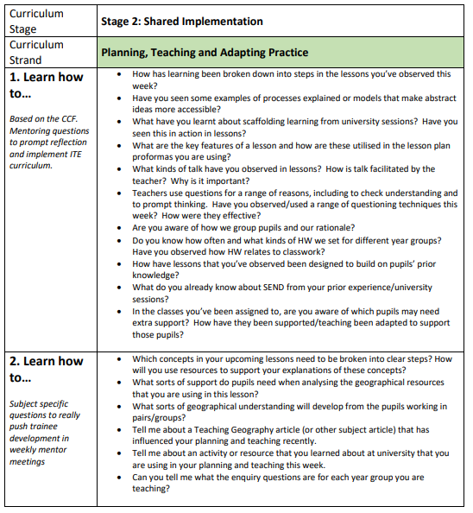
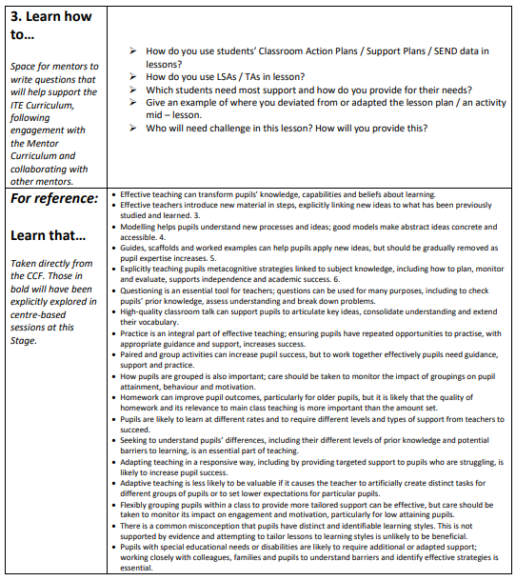
Mentoring
conversations
Notes:
Make use of the mentor conversation documents

Slide 8
Useful resources

Slide 9
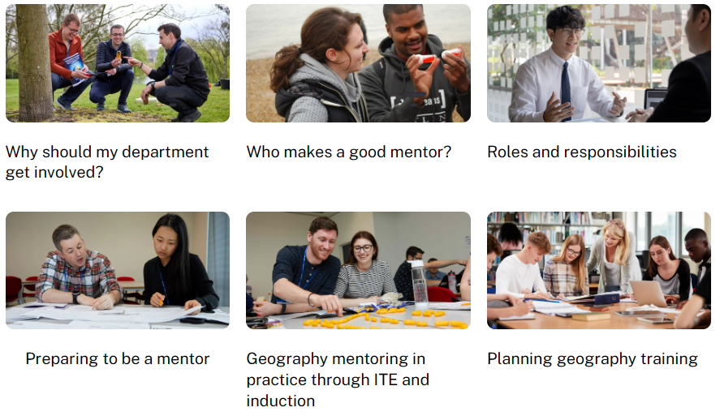
https://geography.org.uk/ite/geography-mentoring/

Slide 10
Mentor Curriculum
 | Content | Format | Date
Mentor Module 1 ‘Being a Mentor’ | 1.1) Mentor knowledge & skills ‘Mentor Professional Identity’ Mentor knowledge audit | Online (recorded) Online form | July 2024
 | 1.2) Meeting your RPT & being their mentor 1.3) & 2.1) Implementing the Trainee Curriculum: Induction & Shared Placement overview | Script & mentor handbook Video * | Early September 2024
 | 1.4) Being an RPT mentor in your school | Meeting with your ITTCo | Mid-September 2024
Mentor Module 2 ‘Constructive Conversations & Modelling Practice’ | 2.1) Implementing the ITE Curriculum Shared Placement overview 2.2) Contextualising your mentoring (subject-specific training meeting) | Video* Live online meeting with SL | Mid-September 2024 17th September 2024
 | 2.3) Mentor knowledge & skills ‘The Reflective Cycle, Observation & Feedback’ 2.4) Understanding trainee knowledge & development: (using the Mentor Conversations Guide) | Video Subject-specific mentor conversation prompts | October 2024 From October 2024
 | Professional Practice Review 1 | Hybrid/in-person tutor visit | November 20234
RPT assessment | RPT Assessment of Progress (Report 1) | Written report | December 2024
Notes:
*Note that 1.3 and 2.1 is one video (overviews of both the induction and shared stages)
Briefly talk through the mentor curriculum expectations for this term.

Slide 11
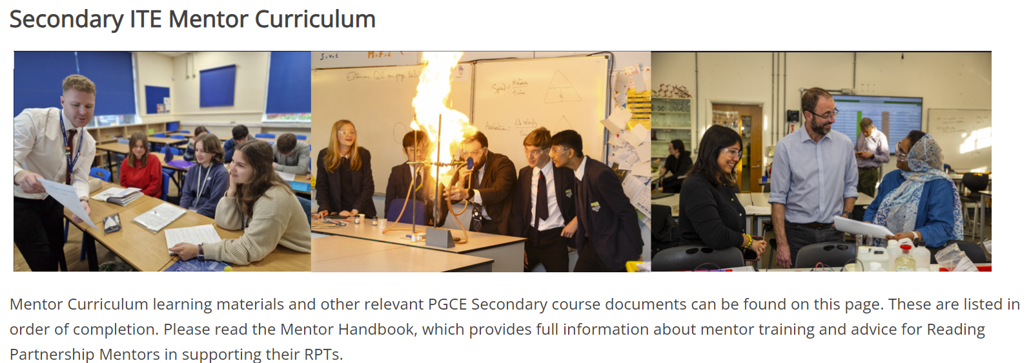
https://sitesb.reading.ac.uk/ioe-mentoring/
Notes:
Showcase the UoR mentor hub (and where to find things): https://sitesb.reading.ac.uk/ioe-mentoring/

Slide 12
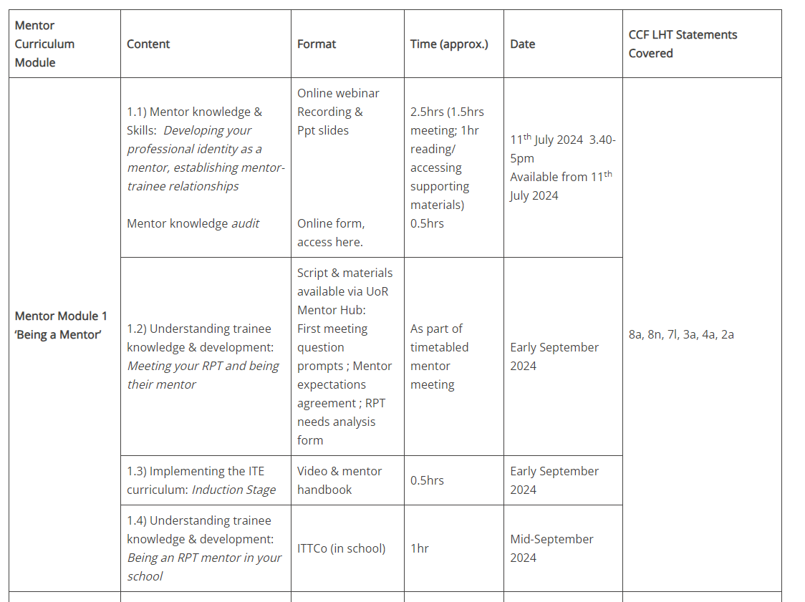

Slide 13
Notes:
The mentor handbook and first mentor training video – check that they have all been able to access these.
You could also check that they have completed the mentor audit (link in the hub).

Slide 14
In the Mentor HB
Notes:
Section 4 of HB
At each stage, there is a list of mentor actions that is a helpful reminder of what to do when!

Slide 15
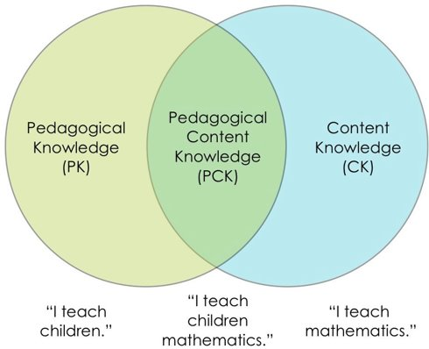
Being A Mentor
Professional role: mentoring a beginning teacher is as much about enabling them to make informed choices as it is about technical skill
PCK >>>>>
Make a personal connection
Needs analysis
Expectations & boundaries
Support
Professional
Pedagogic
Academic
Emotional
Geography”
Geography”

Slide 16
Being a Geography Mentor?
What makes it distinct from other subjects?
What might a mentor need to consider for a novice in relation to their subject?
Notes:
Take this opportunity to think specifically about your subject – what makes it distinct from other subjects and what might a mentor need to consider for a novice in relation to their subject?
Could discuss the connection mentors can create with their RPT through passion/love of subject or common difficulties that might be experienced

Slide 17
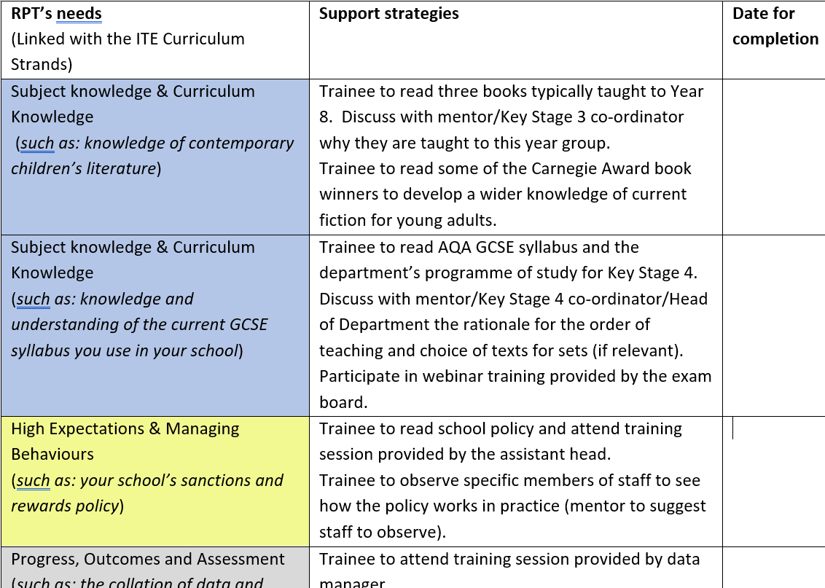
RPT Needs Analysis (in mentor HB)
Notes:
Example needs analysis. Can be used to personalise/tailor initial training focus or areas for support, based on their prior knowledge, experience and learning.
Appendix C

Slide 18
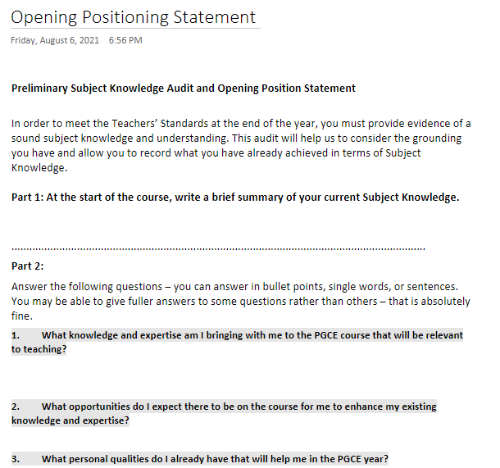
RPT email to you?
(Also in the e-p)

Slide 19
UoR Curriculum Focus: Behaviour Management
‘Behaviour in school is inseparable from academic achievement, safety, welfare and well-being, and all other aspects of learning. It is the key to all other aims, and therefore crucial.’
(Bennett, 2017, p. 12)
Notes:
On the Reading PGCE, managing behaviours has always been incredibly important. Bennett’s statement about behaviour has long been how we introduce RPTs to behaviour.
Academic achievement, safety, and pupil well-fare and wellbeing are three pillars that are integral to everything we do.

Slide 20
UoR Curriculum Focus: Behaviour Management
In 2024, behaviour management will have a renewed focus on the UoR PGCE, in response to:
RPT wellbeing and enjoyment of their work
RPT feedback about their experiences on placement
Mentor and school feedback about the contemporary challenges
Notes:
Over the past years we have received lots of feedback that has brought about this renewed curriculum priority.
We have heard from RPTs, mentors, and other school colleagues that behaviour management needs to be at the top of everyone’s agenda. Crucially, as a wellbeing issue for teachers staying in the profession, and being able to maintain successful and healthy work-life balances.

Slide 21
UoR Curriculum Focus: Behaviour Management
Historically, the PGCE curriculum covered:
Different possible approaches to managing behaviours
Importance of planning, subject specialism, motivation and inclusion
Support for conversations to have with departments
Lesson feedback
This year, alongside these existing components of the curriculum, all RPTs will be taught to implement seven foundational actions in every single lesson.
Mentors will need to support RPTs with the consistent and effective implementation of these foundational actions, as well as support them use other actions depending on the school policies and contexts.
Notes:
As stated, the UoR PGCE has always taken behaviour seriously, and this was seen through:
- the range of approaches to behaviour management that RPTs were given
The importance placed on planning lessons, subject specialism, motivating pupils and being inclusive practitioners
Support for RPTs to engage with their specific school and department’s policies
Regular and constructive feedback and managing behaviour following lesson observations
However, there was not a coherent set of common, non-negotiable expectations for RPTs, in any subject, in any school.
This year, our aim is to build upon the existing components of the curriculum by teaching the RPTs to implement seven foundational actions in every single lesson.
Over the next 20 minutes we are going to look at how mentors will need to support the RPTs to implement these consistently and effectively, and how we can develop this initiative based on your own expertise and experience.

Slide 22
UoR Curriculum Focus: Behaviour Management
Greet class positively (individually and/or as a group) to establish presence and mark a fresh start to the lesson.
Make expectations of desired behaviours explicit.
Highlight positive pupil behaviours where possible.
Implement a clear and consistent method of gaining attention and achieving silence.
Use pupils’ names whenever addressing them individually.
Only teach or give instructions to the whole group when there is silence.
Follow through on rewards, sanctions and promises.
Notes:
So the seven actions we expect every RPT to implement are:
1
2
3
4
5
6
7
These were the result of months of discussions with school leaders, ITTCos and Subject Leaders.

Slide 23
 | Potential challenges to implementing this action in your subject: | What strategies mentors might give RPTs for implementing effectively in your subject:
Greet class positively (individually and/or as a group) to establish presence and mark a fresh start to the lesson.
Make expectations of desired behaviours explicit.
Highlight positive pupil behaviours where possible.
Implement a clear and consistent method of gaining attention and achieving silence.
Use pupils’ names whenever addressing them individually.
Only teach or give instructions to the whole group when there is silence.
Follow through on rewards, sanctions and promises.
Notes:
Your task now is to discuss:
For each action, are there any potential challenges you envisage with RPTs implementing this consistently in our subject?
For each action, and in response to the potential challenges, are there any strategies that all mentors might want to have that will support RPTs in their implementation in our subject?

Slide 24
Is there anything else that you would argue every single RPT should be doing to support their behaviour management in every single lesson in your subject?
Greet class positively (individually and/or as a group) to establish presence and mark a fresh start to the lesson.
Make expectations of desired behaviours explicit.
Highlight positive pupil behaviours where possible.
Implement a clear and consistent method of gaining attention and achieving silence.
Use pupils’ names whenever addressing them individually.
Only teach or give instructions to the whole group when there is silence.
Follow through on rewards, sanctions and promises.
Notes:
These are the universal expectations across the programme. However, each subject has it’s own specific contexts and different sorts of behaviour challenges. I would now like to know if there is anything additional that you would like to see from every RPT in every single lesson in our subject?
Please do see this as an opportunity to really make a difference to the PGCE!
*(N.B. Subject Leaders to collate the challenges, strategies and subject specific suggestions to a. share with the wider tutor team and b. feed into the ITAP session on managing behaviours)*

Slide 25
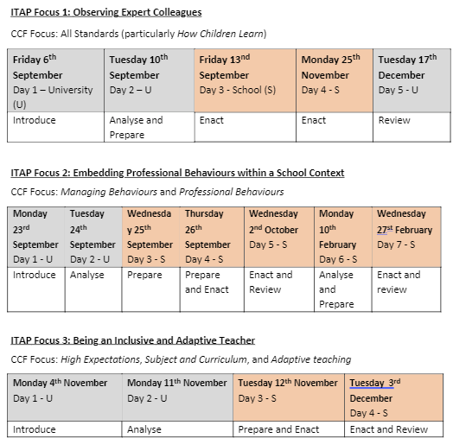
ITAPs for Place A
Intensive Teaching and Practice
UNIVERSITY
SCHOOL
Notes:
Explain rationale of ITAPs and mentors who worked with us last year how they thought the ITAPs went (and their involvement in them).
These are the three ITAPs that RPTs will complete whilst in school A.

Slide 26
ITAP 2 Embedding Professional Behaviours within a School Context: School Expectations
Time spent during the ITAP day(s) | Activities | Responsibilities
Day 1 – c. 10 minutes each (Prepare) | Discussion with SENDCO Discussion with behaviour lead Discussion with DSL Discussion with Senior Leader | ITTCo to arrange group interviews.
Day 1 – c. 20 minutes (Prepare) | Critically observe tutor time. | ITTCo to identify expert tutors.
Day 1 and 2 – c. 60 minutes (Prepare) | Shadow experienced teachers on different school duties. | Mentors to identify experienced duty staff in appropriate locations.
Day 1 – c. 60 minutes (Prepare) | Collate school priorities and shared language. | ITTCo and/or SLT to signpost school documents, policies, procedures and language.
Day 1 – c. 60 minutes (Prepare) | Simulation activities with peers for different scenarios around the school. | Programme Director to produce scenarios.
Day 2 – c. 30 minutes (Enact) | Lead tutor time and critical reflection. | Expert tutors to support.
Day 2 – 120 minutes (Prepare) | Produce scripts for setting up expectations and participation in upcoming lessons. | Programme Director to produce guidelines.
Day 2 – c. 60 minutes (Enact) | Involvement in lesson (after midday) where RPT is given some responsibility for displaying explicit professional behaviours (such as utilising school routine, using school language, following departmental priority). | Mentor to identify appropriate opportunities.
Day 2 – 30 minutes (Review) | Plan of action for how you will display professionalism within that school, completed in ITAP booklet. | ITTCo, mentor and tutor to review. Mentor to discuss at next mentor meeting. RPTs to ensure ITAP booklets uploaded to E-Portfolio by end of the day.
Wed 25th Sept
Thu 26th
Notes:
Talk through mentor involvement in ITAP 2

Slide 27
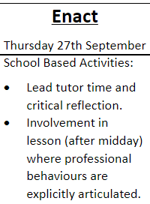
26th Sept
What might this look like in Geography?
School routine, school language, dept priority
Notes:
Take suggestions for how mentors might help facilitate the ‘enact’ part of ITAP2 (professional behaviours).

Slide 28
PROFESSIONAL PRACTICE REVIEW 1
ITE Curriculum Stage | Shared Implementation
Mentor Module | 2. Constructive Conversations and Modelling Practice
When | Tuesday 5 November – Friday 29 November
Format | Tutor to decide whether a hybrid meeting (RPT and Mentor in same room, Tutor online) or on-site meeting is required. Co-planning conversation.
RPT Preparation | Preparation should include identifying a lesson to co-plan, discussing curriculum aims for that lesson with Mentor, and building subject knowledge in the relevant area.
Mentor development focus | Knowledge of key themes and content from ITE curriculum, capacity to conduct constructive conversations, and support for RPT in preparation of teaching.
RPT assessment focus | RPT reveals how effectively they can draw upon subject knowledge, curriculum knowledge, and pedagogical content knowledge developed through the ITE curriculum, in order to plan lessons that reveal the quality of their learning and practice.
Notes:
Explain focus of this visit
What does this look like? Ask mentors who have worked with us previously to share ideas.

Slide 29
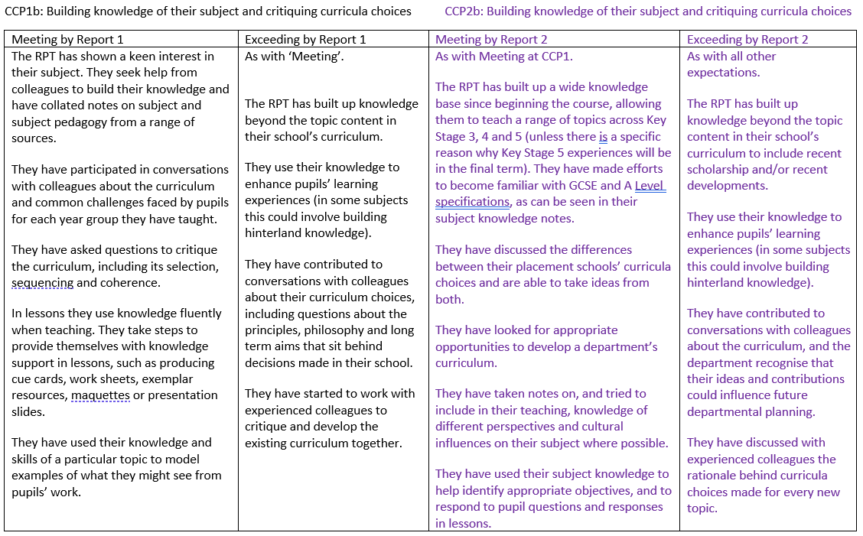
Notes:
What might these ‘look like’ in practice?
N.B. the RPT does not have to have demonstrated all the ‘exceeding’ indicators from CCP1 to ‘meet’ the indicators at CCP2. They must, however, continue to demonstrate they are still meeting the ‘meeting’ indicators from CCP1 throughout the course.
This will lead to the AoP/Report 1 due in December.

