Slide 1
Implementing the ITE Curriculum: Contextualising your mentoring
PE Mentor Training
4.00 – 4.45pm Microsoft Teams
17.9.24

Slide 2
Agenda
Welcome and Introductions
Being a subject mentor
Behaviour Management in PE
AI and Storytelling
Implementing ITAPs and Any Questions

Slide 3
Contact details
Administrator: pgcesecondary@reading.ac.uk
Head of School: Dr Sarah Marston
Director of Teaching and Learning: Dr Jo-Anna Reed-Johnson
Head of ITT: Dr Catherine Foley
Director of Secondary: Will Bailey-Watson
Subject Lead: Harvey Grout
Academic Tutor: Gwenda Lappin

Slide 4
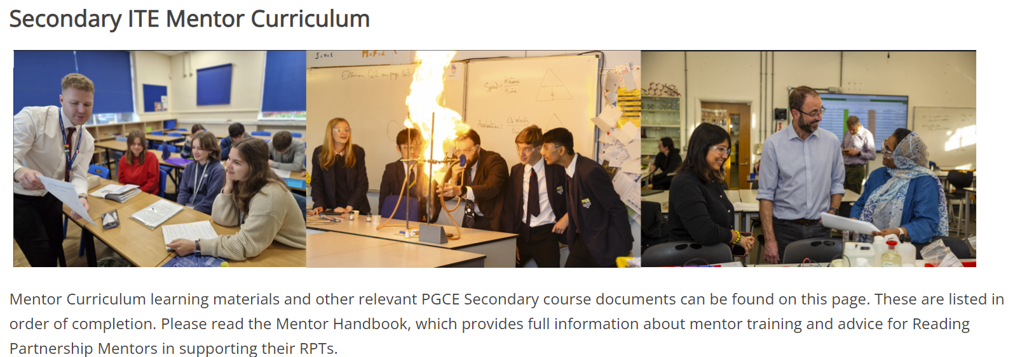
Being a PE Mentor
Notes:
USE THE HUB

Slide 5
Notes:
Section 4 of HB
At each stage, there is a list of mentor actions that is a helpful reminder of what to do when!

Slide 6
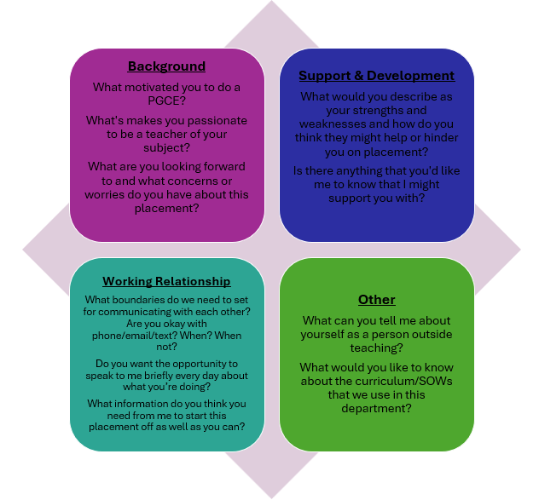
First meeting
Read and discuss Opening Position Statement
Ask questions from the ‘meeting your RPT’ document
Notes:
Find out when you are timetabled to have your first meeting with your RPT (likely to be as part of their department in duction on 19th or 20th Sept). The RPT should prepare for the meeting by sharing a copy of their Opening Position Statement, which you could look at together and incorporate into your conversation, using some of the suggested prompts suggested (see Appendix A of the Mentor HB).

Slide 7
RPT’s Needs (Linked with the ITE Curriculum Strands) | Support Strategies | Date for completion
Professional Behaviours & Teacher Wellbeing
High Expectations & Managing Behaviours
Subject & Curriculum Knowledge
Planning, Teaching and Adapting Practice
Progress, Outcomes and Assessment
Notes:
This is an optional activity. Take a few minutes to think about your RPT – are the specific areas of need that you can already identify and can we think of some strategies that would help at this point?

Slide 8
UoR Curriculum Focus: Behaviour Management
‘Behaviour in school is inseparable from academic achievement, safety, welfare and well-being, and all other aspects of learning. It is the key to all other aims, and therefore crucial.’
(Bennett, 2017, p. 12)
Notes:
On the Reading PGCE, managing behaviours has always been incredibly important. Bennett’s statement about behaviour has long been how we introduce RPTs to behaviour.
Academic achievement, safety, and pupil well-fare and wellbeing are three pillars that are integral to everything we do.

Slide 9
UoR Curriculum Focus: Behaviour Management
In 2024, behaviour management will have a renewed focus on the UoR PGCE, in response to:
RPT wellbeing and enjoyment of their work
RPT feedback about their experiences on placement
Mentor and school feedback about the contemporary challenges
Notes:
Over the past years we have received lots of feedback that has brought about this renewed curriculum priority.
We have heard from RPTs, mentors, and other school colleagues that behaviour management needs to be at the top of everyone’s agenda. Crucially, as a wellbeing issue for teachers staying in the profession, and being able to maintain successful and healthy work-life balances.

Slide 10
UoR Curriculum Focus: Behaviour Management
Historically, the PGCE curriculum covered:
Different possible approaches to managing behaviours
Importance of planning, subject specialism, motivation and inclusion
Support for conversations to have with departments
Lesson feedback
This year, alongside these existing components of the curriculum, all RPTs will be taught to implement seven foundational actions in every single lesson.
Mentors will need to support RPTs with the consistent and effective implementation of these foundational actions, as well as support them use other actions depending on the school policies and contexts.
Notes:
As stated, the UoR PGCE has always taken behaviour seriously, and this was seen through:
- the range of approaches to behaviour management that RPTs were given
The importance placed on planning lessons, subject specialism, motivating pupils and being inclusive practitioners
Support for RPTs to engage with their specific school and department’s policies
Regular and constructive feedback and managing behaviour following lesson observations
However, there was not a coherent set of common, non-negotiable expectations for RPTs, in any subject, in any school.
This year, our aim is to build upon the existing components of the curriculum by teaching the RPTs to implement seven foundational actions in every single lesson.
Over the next 20 minutes we are going to look at how mentors will need to support the RPTs to implement these consistently and effectively, and how we can develop this initiative based on your own expertise and experience.

Slide 11
UoR Curriculum Focus: Behaviour Management
Greet class positively (individually and/or as a group) to establish presence and mark a fresh start to the lesson.
Make expectations of desired behaviours explicit.
Highlight positive pupil behaviours where possible.
Implement a clear and consistent method of gaining attention and achieving silence.
Use pupils’ names whenever addressing them individually.
Only teach or give instructions to the whole group when there is silence.
Follow through on rewards, sanctions and promises.
Notes:
So the seven actions we expect every RPT to implement are:
1
2
3
4
5
6
7
These were the result of months of discussions with school leaders, ITTCos and Subject Leaders.

Slide 12
 | Potential challenges to implementing this action in your subject: | What strategies mentors might give RPTs for implementing effectively in your subject:
Greet class positively (individually and/or as a group) to establish presence and mark a fresh start to the lesson.
Make expectations of desired behaviours explicit.
Highlight positive pupil behaviours where possible.
Implement a clear and consistent method of gaining attention and achieving silence.
Use pupils’ names whenever addressing them individually.
Only teach or give instructions to the whole group when there is silence.
Follow through on rewards, sanctions and promises.
Notes:
You will now disappear into small groups. I will copy and paste the seven actions into the Teams chat.
Your task now is to discuss:
For each action, are there any potential challenges you envisage with RPTs implementing this consistently in our subject?
For each action, and in response to the potential challenges, are there any strategies that all mentors might want to have that will support RPTs in their implementation in our subject?
In each group could someone write down what you decide and we will collate these as a group. (N.B. Subject Leaders could share an e-document for groups to write on directly which could then be discussed with the group to save time.)

Slide 13
Is there anything else that you would argue every single RPT should be doing to support their behaviour management in every single lesson in our subject?
Greet class positively (individually and/or as a group) to establish presence and mark a fresh start to the lesson.
Make expectations of desired behaviours explicit.
Highlight positive pupil behaviours where possible.
Implement a clear and consistent method of gaining attention and achieving silence.
Use pupils’ names whenever addressing them individually.
Only teach or give instructions to the whole group when there is silence.
Follow through on rewards, sanctions and promises.
Notes:
These are the universal expectations across the programme. However, each subject has it’s own specific contexts and different sorts of behaviour challenges. I would now like to know if there is anything additional that you would like to see from every RPT in every single lesson in our subject?
Please do see this as an opportunity to really make a difference to the PGCE!
*(N.B. Subject Leaders to collate the challenges, strategies and subject specific suggestions to a. share with the wider tutor team and b. feed into the ITAP session on managing behaviours)*

Slide 14
UoR Curriculum Focus: Behaviour Management
Any questions about the curriculum focus on behaviour management?

Slide 15
AI and Storytelling
Storytelling as an incredibly powerful way of teaching PE
Teacher workload is regularly cited as a reason for poor retention
Generative AI is clearly going to be hugely influential in the future of teaching
Aim to support RPTs make informed decisions about how they might use AI effectively…particularly with storytelling.

Slide 16
AI
Use and discussion of AI should be open and transparent. Ideally RPTs will make it clear from the outset (e.g. highlight on their lesson plan), and all must be honest if asked whether AI has been used.
RPTs need to be able to share what they typed into the interface.
RPTs need to be able to share how they critically engaged with the outcome.

Slide 17
ITAPs
A sequence of days across the programme on specific themes, which they learn about at university and then have specific tasks to complete in school.
Key point that we always email ITTCos about these in advance.
There is room for flexibility – if a RPT would benefit from moving things around, then they can.

Slide 18
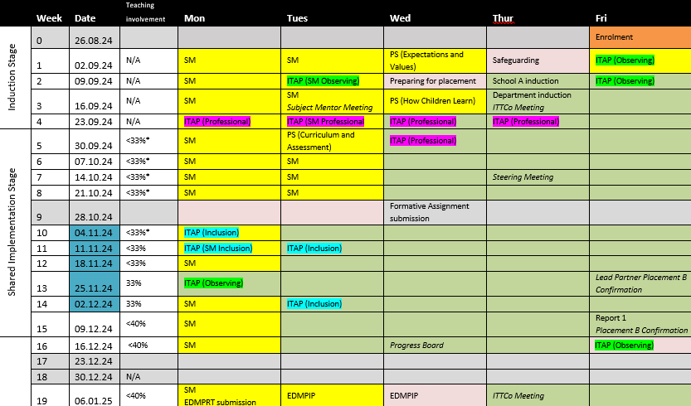
Notes:
Important date is Wednesday 2 October as they will have some teaching involvement.

Slide 19
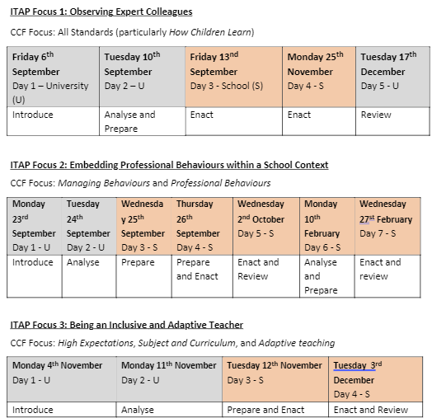
ITAPs
SCHOOL
UNIVERSITY
Notes:
Explain rationale of ITAPs and mentors who worked with us last year how they thought the ITAPs went (and their involvement in them).
These are the three ITAPs that RPTs will complete whilst in school A.

Slide 20
Any other questions…

