Slide 1
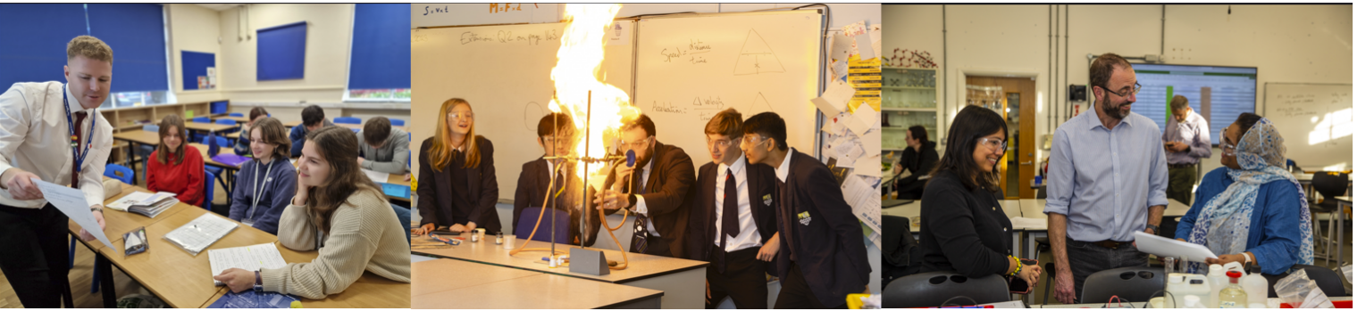
Mentor Training Materials 1.4
Secondary ITE – Mentor Curriculum 2024-25
‘Being an RPT mentor in your school’
ITTCo-Mentor Training
Notes:
This ppt is a suggested template; ITTCos are encouraged to adapt as they see fit to reflect the unique nature of their school’s setting, cohorts, ethos and the experience of your mentors.

Slide 2
Being an RPT Mentor in your school
ITTCo to lead with mentors in their school
1hr; mid-September
Focus: What does it mean to be a mentor in this school?

Slide 3
Key Dates
Event | Date | For who
Induction of RTPs | 12 / 13 / 19 / 20 September | RTP and mentors (some department time built into induction – ELW will email)
Subject Specific training at UoR (remote) | 17th September 2024 (3.40-5pm via Teams) | RTP Mentors
RTPs commence first placement | 27th September (in Weds – Fri until Oct half term then Tuesday –Friday after) – see guidance on % timetable | RTPs
Placement B Generic mentor training | 25th January 4-5pm via Teams | RPT Mentors
Spring Term Subject Mentor Training | 27th February 2024 (3.40-5pm via teams) | RTP Mentors
Report 1 deadline | 13 December 2024 | RTPs / RTP mentor / ITTCo
Report 2 deadline | Provisional Report 14th February 2025 Final report 21st March 2025 | RTPs / RTP mentor / ITTCo
Report 3 deadline | 20th June 2025 | RTPs / RTP mentor / ITTCo
Notes:
Please ensure mentors have downloaded and read the Manual of Guidance and the Mentor Handbook.

Slide 4
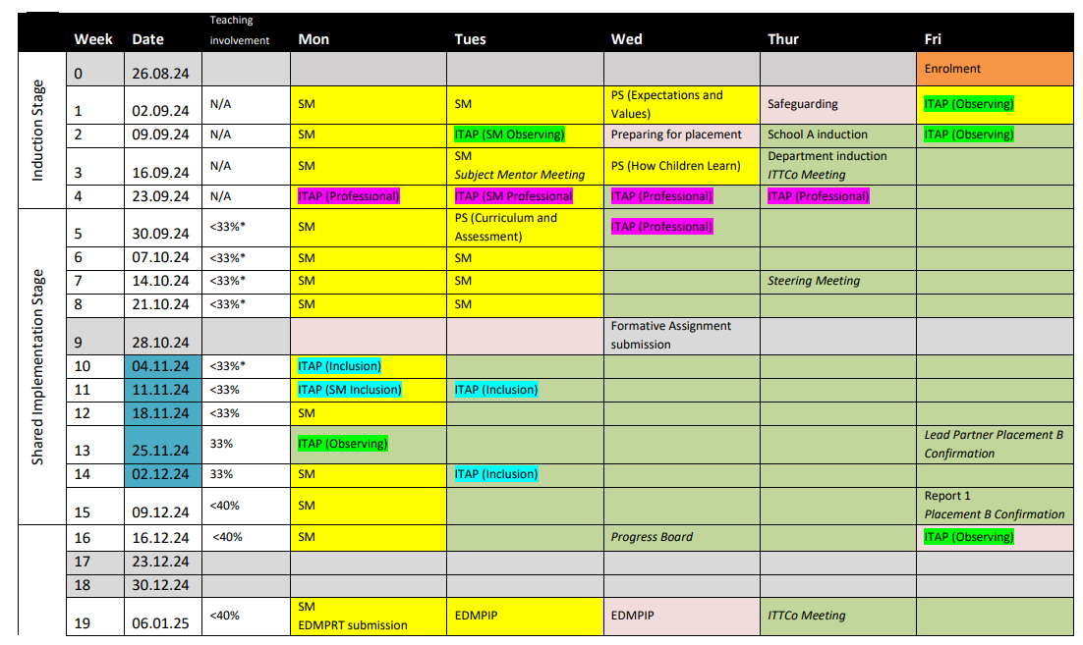
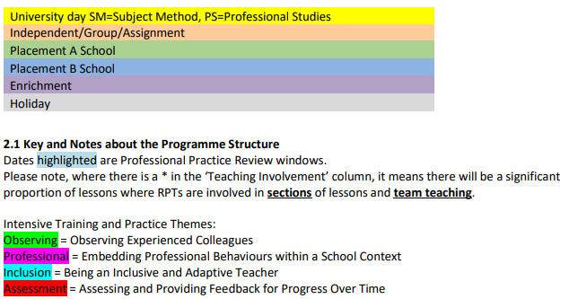
Programme Structure
Placement A 14 September- 14th February

Slide 5
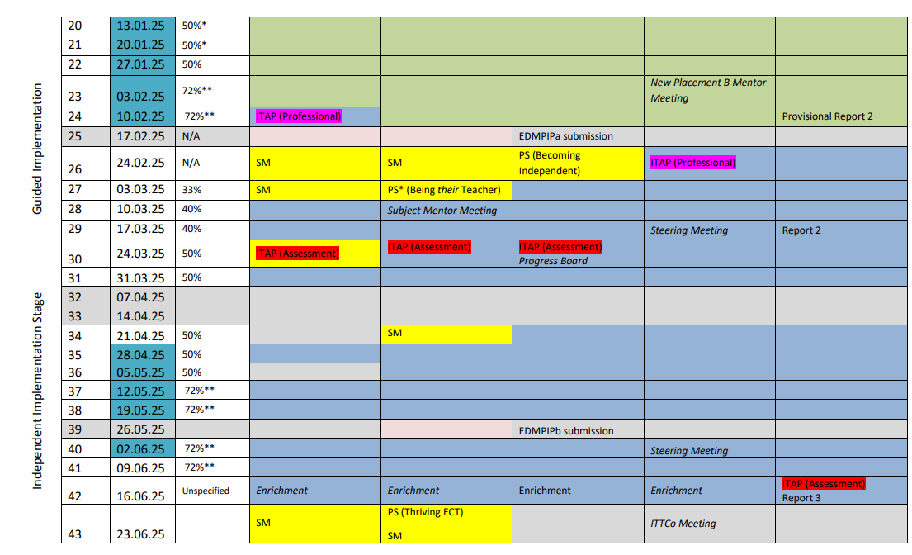
Placement B
27th February – 20th June

Slide 6
Our trainee teachers 2024-2025
Notes:
Share the names and subject specialisms of the trainee teachers you will be hosting this year. Depending on whether or not your mentors have met their RPTs, this is a good opportunity for them to share some information/background/experience/subject knowledge specialisms that they are bringing to the programme (the RPTs' Opening Position Statements are helpful here). This would also allow a discussion of how mentors might personalise their training to meet their RPTs' needs, and possibly considerations that they may need to have with regards, for example, if their RPT has very little/no school experience.

Slide 7
Communication: Getting it right
The school based mentor has responsibility for day to day communication with RPT and informing ITTCo of any issues. They also have a direct link with University tutor
The RPT could choose to involve the ITTCo and/or University Tutor / Subject leader – the version of events can sometimes become blurred when multiple people are involved
School Based Mentor
ITTCo (placement A and B)
RPT
University Tutor/SL
The ITTCo should be copied in on emails to university tutor / external communication with UoR
The University tutor / Subject Leader will sometimes communicate directly with the mentor/RPT and not necessarily the ITTCo so as mentor, please reply and CC ITTCO
Notes:
If communicating with university tutors/subject leads, it is helpful to cc the ITTCo

Slide 8
Consistency
ITTCo and mentor joint observation and feedback in Term 1
ITTCo / Mentor to review e-Portfolios
Fortnightly bulletin if necessary
ITTCo to join university visits from tutors if possible
Mentors to ensure consistency of high-quality feedback in department – model the REVIEW feedback style (see slide 19). Sit in on feedback given by other members of your department
Notes:
These are some of the ways in which ITTCos can ensure consistency in mentoring in their setting.

Slide 9
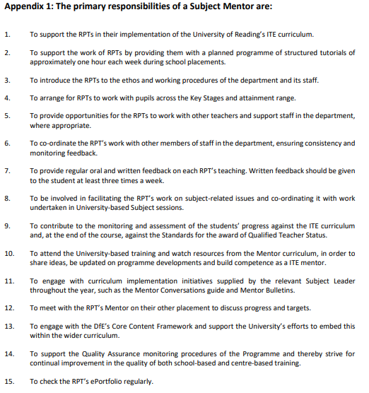
MOG: Subject Mentor Role

Slide 10
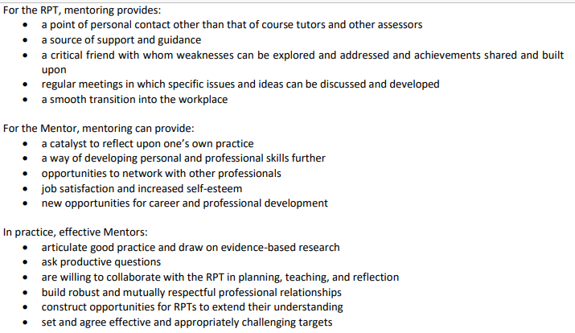
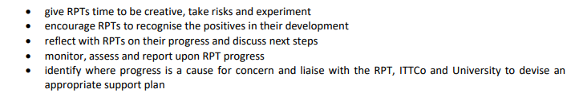
What this means in practice:
What does it mean to be a mentor in our school?
Notes:
Use this opportunity to discuss why they’ve been asked to be a mentor and what being a mentor means in the context of your school. You could frame this around your school ethos, for example, and draw out some of the considerations that might need to be made/mentors might need to think about to help their RPTs acclimatise to your school. For example, if your school is single sex or selective etc.

Slide 11
Mentor Curriculum Module | Content | Format | Time (approx.) | Date
Mentor Module 1 ‘Being a Mentor’ | 1.1) Mentor knowledge & Skills: Developing your professional identity as a mentor, establishing mentor-trainee relationships Mentor knowledge audit | Hybrid online & in-person Online form | 2.5hrs (1.5hrs meeting; 1hr reading/ accessing supporting materials) 0.5hrs | 11th July 2024 3.40-5pm Available from 5th July 2024
 | 1.2) Understanding trainee knowledge & development: Meeting your RPT and being their mentor | Script & materials available via UoR Mentor Hub | As part of timetabled mentor meeting | Early September 2024
 | 1.3) Implementing the ITE curriculum: Induction Stage | Video & mentor handbook | 0.5hrs | Early September 2024
 | 1.4) Understanding trainee knowledge & development: Being an RPT mentor in your school | ITTCo (in school) | 1hr | Mid-September 2024
Mentor Module 2 ‘Constructive Conversations & Modelling Practice’ | 2.1) Implementing the ITE curriculum: Shared Stage | Video & mentor handbook | 0.5hr | Late September 2024
 | 2.2) Implementing the ITE curriculum: Contextualising your mentoring (phase/subject-specific development) | Live webinar & materials available via UoR Mentor Hub | 1.5hrs | Late September 2024
 | 2.3) Mentor knowledge & skills: The reflective cycle, teacher knowledge, observation, feedback, and constructive conversations | Video & materials available via UoR Mentor Hub | 1.5hr | October 2024
 | 2.4) Understanding trainee knowledge & development: (using the Mentor Conversations Guide, linked to Mentor Bulletins) | Script available via UoR Mentor Hub | As part of timetabled mentor meetings | October – December 2024
 | 2.5) Implementing the ITE curriculum: Professional Practice Review | Hybrid/in-person tutor visit | 1hr | November 2024
 | RPT Assessment of Progress (Report 1) | Written report |  | December 2024
Notes:
This is the outline for the UoR Mentor Curriculum for 2024-25. Please direct them to the UoR Mentor Hub: https://sitesb.reading.ac.uk/ioe-mentoring/ emphasising that we are requesting all mentors to complete all mentor training this academic year. It is worth checking that they have engaged and have access to all of the training materials released so far.

Slide 12
Mentor Module 3 ‘Moving Forwards’ | 3.3) Understanding trainee knowledge & development: (using the Mentor Conversations Guide, linked to Mentor Bulletins) | Script available via UoR Mentor Hub | As part of timetabled mentor meetings | January -March 2025
 | 3.4) Understanding trainee knowledge & development: Being an RPT mentor in your school | ITTCo (in school) | 1hr | January 2025
 | 3.5) Implementing the ITE curriculum: Professional Practice Reviews | In-person tutor visit | 1.5hrs | January 2025
 | RPT Assessment of Progress (Report 2) | Written report |  | March 2025
Mentor Module 4 ‘Supporting Independence & Specialism’ | 4.1) Contextualising your mentoring (phase/subject-specific development) | Live webinar | 1.5hrs | Early March 2025
 | 4.2) Mentor knowledge & skills: Stretching your RPT, reflective mentor practice, supporting RPTs towards ECT | Video and materials available via UoR Mentor Hub | 1.5hrs | March 2025
 | 4.3) Implementing the ITE curriculum: Independent Stage | Video & Mentor Handbook | 0.5hr | March 2025
 | 4.4) Understanding trainee knowledge & development: (using the Mentor Conversations Guide, linked to Mentor Bulletins) | Script available via UoR Mentor Hub | As part of timetabled mentor meetings | March-June 2025
 | 4.5) Implementing the ITE curriculum: Professional Practice Reviews | In-person tutor visit | 1.5hrs | May 2025
 | 4.6) Mentor knowledge & skills: Mentor reflection (500 words) | Written submission via online forms | 0.5hr | June 2025
 | RPT Assessment of Progress (Report 3) | Written report |  | June 2025

Slide 13
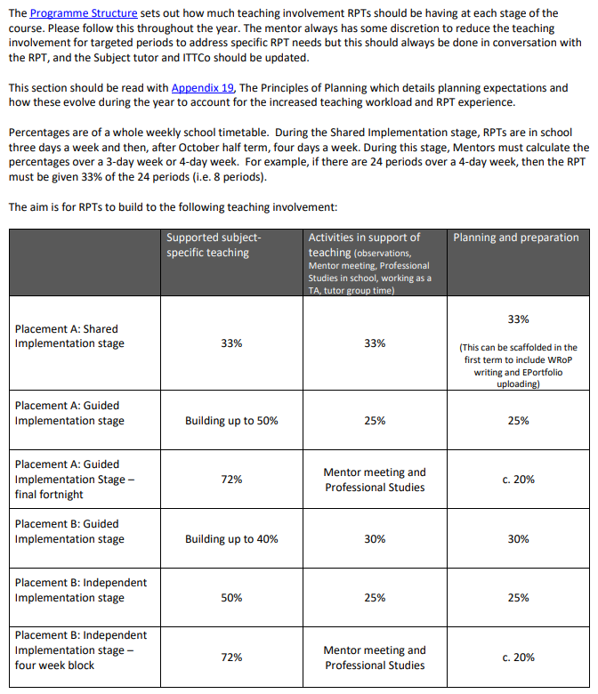
Timetable requirements
Please note Trainees are Wednesday-Friday until October half term (so 33% teaching load of 15 periods per week).
After October half term, Trainees are in school Tuesday-Friday so please bare this in mind for class allocation.
Please position mentor meeting on a Wednesday, Thursday or Friday each week.
Notes:
Slides 13 and 14 provide information on teaching involvement and timetabling from the MoG. Please talk this through with your mentors, as they should be aware of when the RPTs' teaching involvement increases.

Slide 14
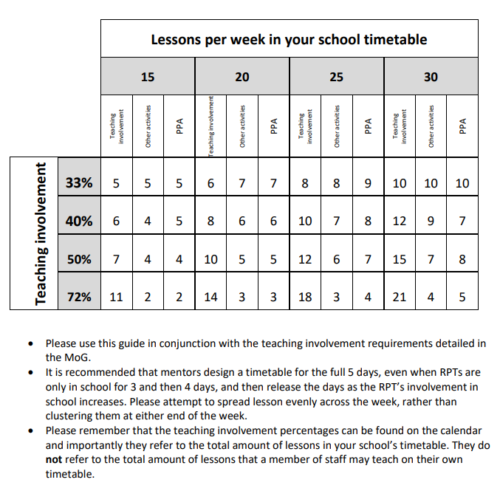

Slide 15
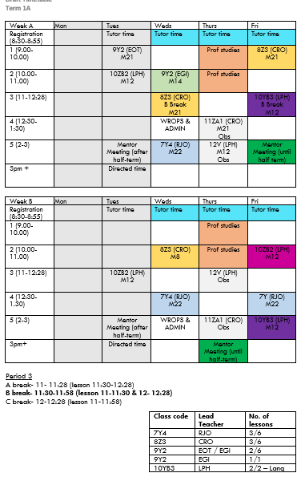
Example timetable
The mentor always has some discretion to reduce the teaching involvement for targeted periods to address specific RPT needs but this should always be done in conversation with the Academic tutor and ITTCo
Before half term: 5 lessons per week (can add more which are just observation lessons)
Should cover KS3, 4 and 5 (shared teaching)
Build in adding Tuesday for after half term
Timetable WRoPs and e-portfolio admin
Notes:
This is an example timetable, based on a 5 period day/two week timetable. Sharing an example timetable can be helpful for new mentors to see how this works in practice (and how they might want to plan for 72% teaching timetable, which the RPT will gradually build up to.
From the MoG:
‘Supported subject-specific teaching’ can involve:
• Teaching small sections of a lesson, using resources that the RPT has already observed being used effectively Institute of Education 25 August 2023
• Teaching small sections of a lesson from established resources
• Co-planning resources and observing an experienced teacher deliver them
• Micro-teaching within lessons, focussing on a particular aspect (e.g. substantive content exposition, welcoming pupils and setting starter, managing a transition, questioning pupils after a task, discussing homework, setting a difficult task by modelling an outcome with pupils, etc), with detailed planning and explicitly stated rationale
• Co-planning a full lesson with an experienced teacher, then teaching • Co-planning a lesson that is not currently taught or resourced, with an experienced teacher, then teaching
• Co-planning a short sequence of lessons, with an experienced teacher, then teaching.’
You may also want to discuss opportunities for 6th Form teaching, if that is appropriate for your school setting (see MoG, section 8.4)

Slide 16
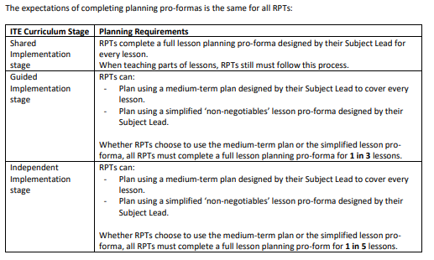
Lesson Planning
Notes:
These are the lesson planning expectations across the different phases of the course.
There is opportunity here to discuss mentors’ facilitating RPTs’ access to teaching resources and existing plans (curriculum maps, schemes of work/medium term plans). Talking the RPTs through existing materials, how to access them, how and when to use them (and how they might be adapted) is really helpful.

Slide 17
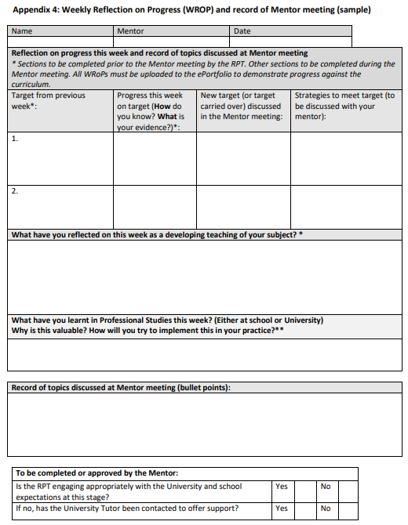

Weekly Records of Progress (WRoPs)
Is it important to complete these weekly, early identification of any issues with RPT engagement is essential.
Notes:
Whilst it is the RPTs’ responsibility to complete their WRoPs, they are most powerful when they are used as part of the weekly mentor meetings, so that mentors can discuss the progress made that week, assess previous targets and set new ones. We do also require the mentor to confirm that the RPT is engaging with their training. (WRoPs are stored in the e-Portfolios.)
This is a good opportunity to discuss how to set targets, SMART targets are helpful and should address the intended learning of RPT. For example 'improve timings' as a target is too vague and could be re-worded to something like: 'Consider the timing of activities for your Yr7 lesson, so that things don't overrun/there is dead time in the lesson'. Strategies can then be suggested to support the target, such as 'Observe the Yr7 lesson with teacher X, making a note of how much time is assigned to activities. Use a timer in your lesson as a reminder for yourself' etc.

Slide 18
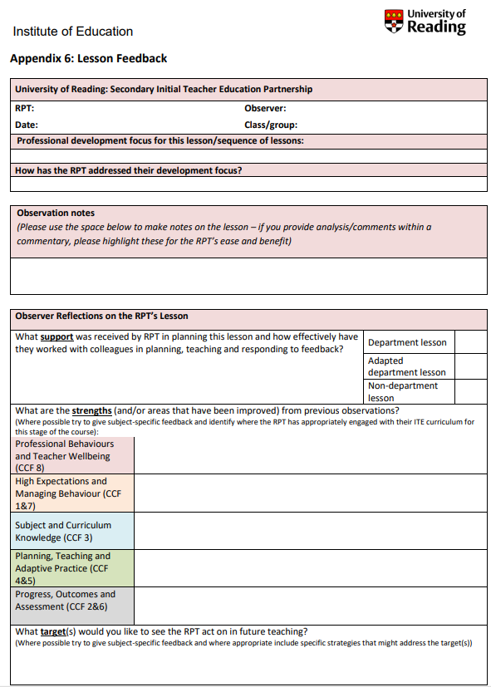
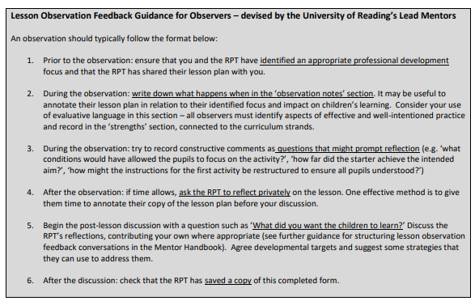
Lesson Feedback – page 73 MOG
Notes:
Note that we’ve added guidance for observers to the lesson feedback form. Please encourage mentors to refer to this and disseminate good practice with other colleagues who are not mentors but may observe their RPT and provide feedback.

Slide 19
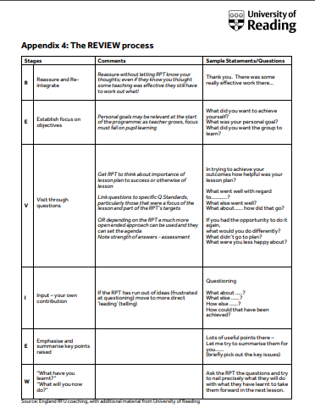
Lesson Feedback: The REVIEW process
(UoR ECTs will be used to this style of feedback)
Reassure and re-integrate
Establish focus on objectives
Visit through questions
Input – your own contribution
Emphasis and summarise key points raised
What have you learnt? What will you do now?
Please ensure this guidance is shared with ALL teachers who will be giving feedback
Notes:
You can use the opportunity to discuss how and when feedback should be given (positive framing; and soon after the observation wherever possible). Rather than asking how the RPT thought the lesson went, mentors/observers can ask: 'what did you want the pupils to learn? How far do you feel this was achieved?'
Note that mentor training 2.3 (a video released in October) will cover observation and feedback.

Slide 20
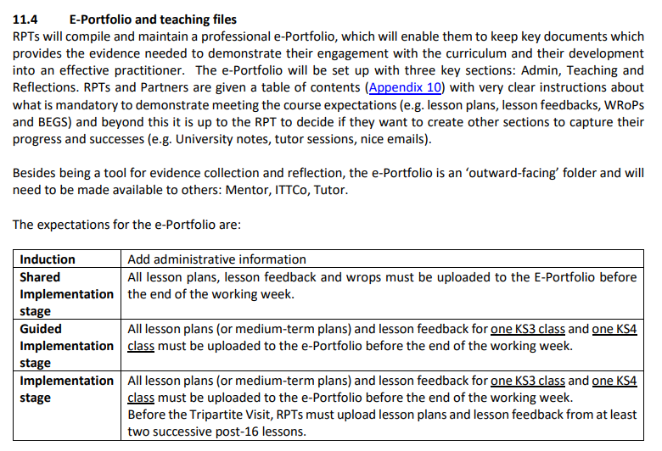
e-Portfolio
You trainee will be trained in how to complete these and they will show you(!) and these will be discussed in the mentor briefing on 27th September.
You will be emailed a link so you can access.
Previous mentors can offer support if necessary

Slide 21
School-Based Professional Studies
Notes:
Please share your PS timetable with your mentors, so that they are aware of what is covered when (it may form part of the mentor meeting conversation that week).

Slide 22
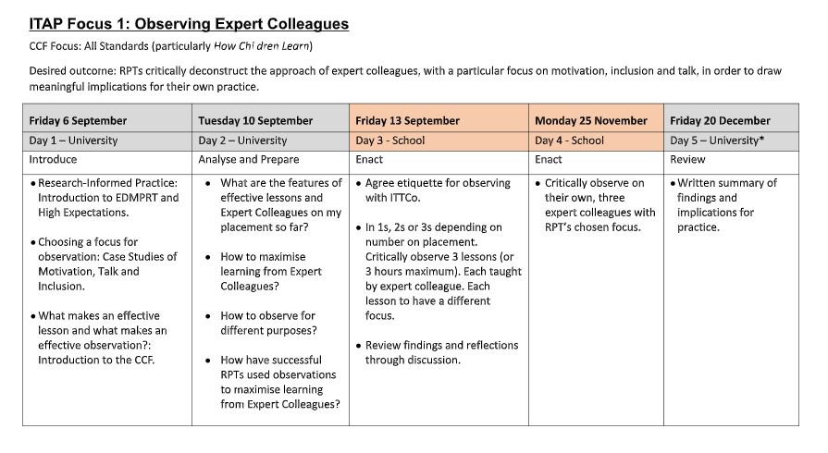
ITAPs (Intensive Training and Practice)
9. ITAPs - Google Drive
Notes:
RPTs will be responsible for completing a booklet. Ensure you are aware of when ITAPs are and refer to these in mentor meetings.

Slide 23
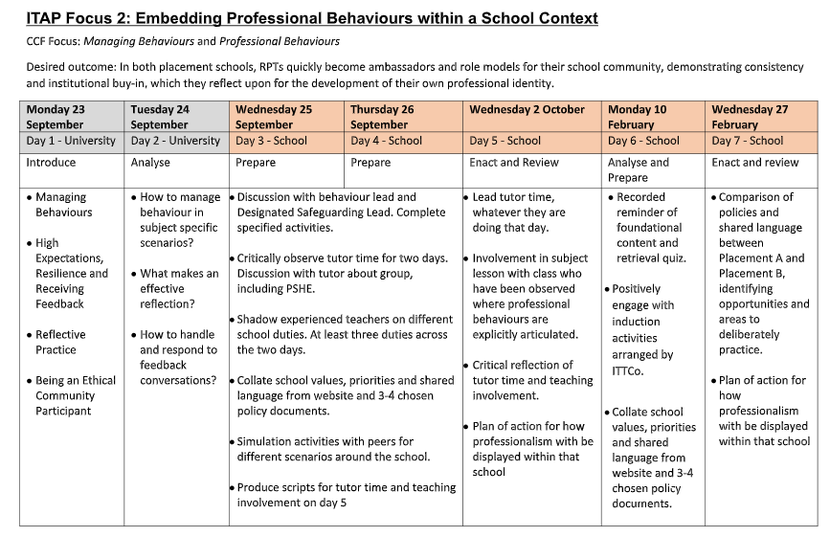
Notes:
Depending on how you're organising the school-based aspects of the ITAPs, please do share your expectations of mentor involvement in these activities.

Slide 24
Scenarios
Your RPT repeatedly misses deadlines, doesn't appear to read emails and is frequently late for meetings.
What do you do?
When in front of a class, your RPT appears very nervous and seems to be avoiding getting involved in teaching.
What do you do?
A colleague has requested that your RPT no longer observe them teach, as the RPT did not appear to be engaged in their lesson (they just sat at the back of the classroom typing on their laptop) or show any interest in talking about it with the teacher afterward.
What do you do?
Notes:
Use these scenarios to discuss how mentors might handle potentially difficult situations with their RPT. If you have experienced mentors, they will be able to share their experiences with new mentors.

