Slide 1
2.2) Implementing the ITE Curriculum: Contextualising your mentoring
Secondary PGCE 2024-25
English Mentor Training
4-5.20pm Microsoft Teams, 17.9.24
Dr Rachel Roberts r.l.Roberts@reading.ac.uk

Slide 2
Agenda
Welcome & introductions
Being an English Mentor
Behaviour Management Curriculum Focus
The PGCE Course Structure
Supporting Planning

Slide 3
Welcome
Administrator: Margie Choi pgcesecondary@reading.ac.uk
Head of School: Dr Sarah Marston
Director of Teaching and Learning: Dr Jo-Anna Reed-Johnson
Head of ITT: Dr Catherine Foley
Director of Secondary: Will Bailey-Watson/ Dr Rachel Roberts
Subject Lead: Dr Rachel Roberts

Slide 4
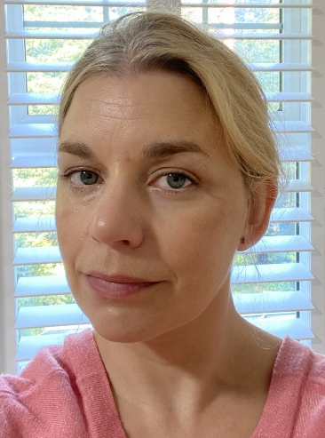
The English Team
Ali Silby
Rachel Roberts
Susie Ferguson
Robert Baldock

Slide 5
Being an English Reading Partnership Mentor
Notes:
See also App 1 of MoG: Role of the mentor

Slide 6
Mentor Curriculum
 | Content | Format | Date
Mentor Module 1 ‘Being a Mentor’ | 1.1) Mentor knowledge & skills ‘Mentor Professional Identity’ Mentor knowledge audit | Online (recorded) Online form | July 2024
 | 1.2) Meeting your RPT & being their mentor 1.3) & 2.1) Implementing the Trainee Curriculum: Induction & Shared Placement overview | Script & mentor handbook Video * | Early September 2024
 | 1.4) Being an RPT mentor in your school | Meeting with your ITTCo | Mid-September 2024
Mentor Module 2 ‘Constructive Conversations & Modelling Practice’ | 2.1) Implementing the ITE Curriculum Shared Placement overview 2.2) Contextualising your mentoring (subject-specific training meeting) | Video* Live online meeting with SL | Mid-September 2024 17th September 2024
 | 2.3) Mentor knowledge & skills ‘The Reflective Cycle, Observation & Feedback’ 2.4) Understanding trainee knowledge & development: (using the Mentor Conversations Guide) | Video Subject-specific mentor conversation prompts | October 2024 From October 2024
 | Professional Practice Review 1 | Hybrid/in-person tutor visit | November 20234
RPT assessment | RPT Assessment of Progress (Report 1) | Written report | December 2024
Notes:
*Note that 1.3 and 2.1 is one video (overviews of both the induction and shared stages)
Check that everyone has completed (or has access to) all of the mentor training materials released thus far.

Slide 7
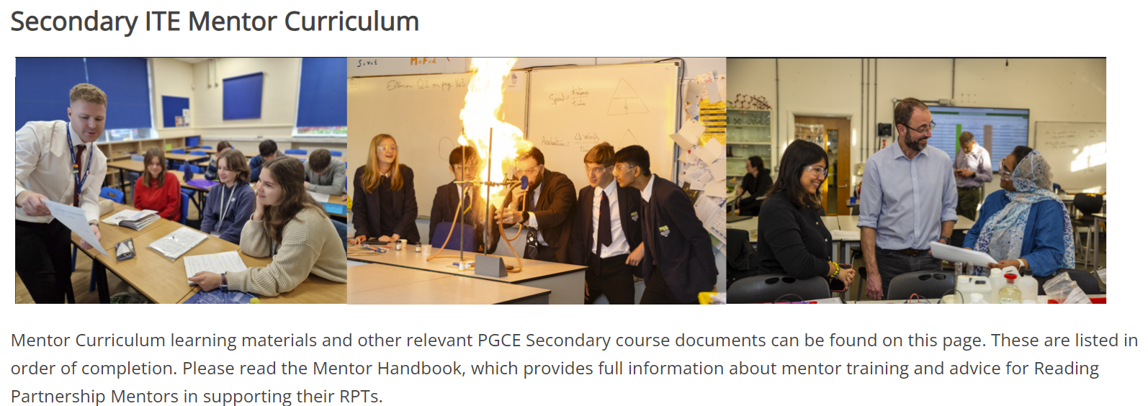
Notes:
Showcase the UoR mentor hub (and where to find things): https://sitesb.reading.ac.uk/ioe-mentoring/

Slide 8
Notes:
The mentor handbook and first mentor training video

Slide 9
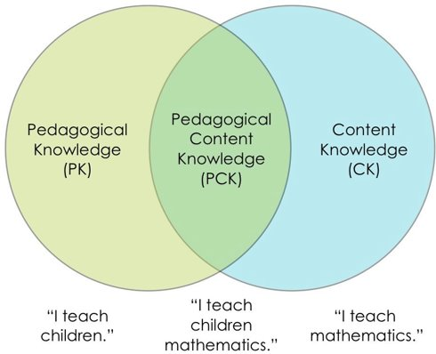
Being A Mentor
Professional role: mentoring a beginning teacher is as much about enabling them to make informed choices as it is about technical skill
PCK
Make a personal connection
Needs analysis
Expectations & boundaries
Support
Professional
Pedagogic
Academic
Emotional

Slide 10
Being an English Mentor
Notes:
What considerations do you need to think about as a mentor of an English specialist?

Slide 11
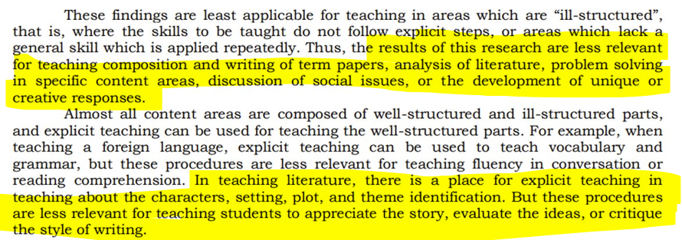
Making Generic Pedagogy English-y
(Rosenshine & Stevens, 1986, p379)
Notes:
Taking risks and thinking about English pedagogy

Slide 12
‘The understanding of what subject knowledge consists of indicates the pedagogical approaches most aligned with the discipline itself. Elliott (2021) suggests that there are two key pedagogies of English: communal reading and the following discussion of the text. English and English pedagogy is a conversation (Eaglestone, 2017), therefore, between texts, between readers, and between teachers and students. English pedagogy is unashamedly constructivist in its epistemological perspective; it cannot be anything else and remain true to the discipline.’ (Roberts, 2023, p84)
Notes:
“Dialogic teaching harnesses the power of talk to stimulate and extend students’ thinking and advance their learning and understanding” (Alexander 2000)
“Well-structured oral and collaborative activities maintain children’s time on task more consistently than do solitary written and text based tasks. Where students verbally share intentions, ideas and experiences, real learning will take place”. Nystrand (1997)

Slide 13
Key Pedagogies in English?
The texts (and language) is at the heart of English and the pupils’ relationship to it​
Starting point of pupils’ response/reaction to the text (Rosenblatt, 1938)​
Shared reading and discussion (Elliott, 2020); possibilities of interpretation ​
Fostering freedom of expression through writing and oracy​
From the Manifesto for English:
recognise that English as a discipline is founded on social, creative and cultural practices, and in this sense differs from some other subject disciplines in the pedagogies required to teach it
include dialogic episodes in classrooms, as a vital part of learning alongside teacher input
be responsive to students’ cultures and interests, recognising the importance of students’ voices being heard in classrooms, drawing on, and showing respect for their own linguistic resources
take note of insights from cognitive science but treat them with due care, judging with caution their applicability beyond experimental and laboratory settings and in relation to English as a subject discipline
be decided by teachers and departments, allowing them to judge what is appropriate to their own contexts, intentions and students
avoid overly structuring and scaffolding learning, which much evidence suggests is neither in the interests of higher attaining nor lower attaining students.
Notes:
Examples
Discussion
Practice… (modelling: I do/We do/You do)

Slide 14
https://learningfrommymistakesenglish.blogspot.com/
https://codexterous.home.blog/2021/08/08/literary-puzzles-using-the-do-now-in-english/

Slide 15
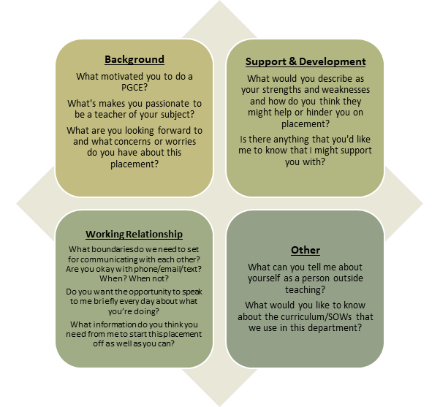
Notes:
Find out when you are timetabled to have your first meeting with your RPT (likely to be as part of their department in duction on 19th or 20th Sept). The RPT should prepare for the meeting by sharing a copy of their Opening Position Statement, which you could look at together and incorporate into your conversation, using some of the suggested prompts suggested (see Appendix A of the Mentor HB).

Slide 16
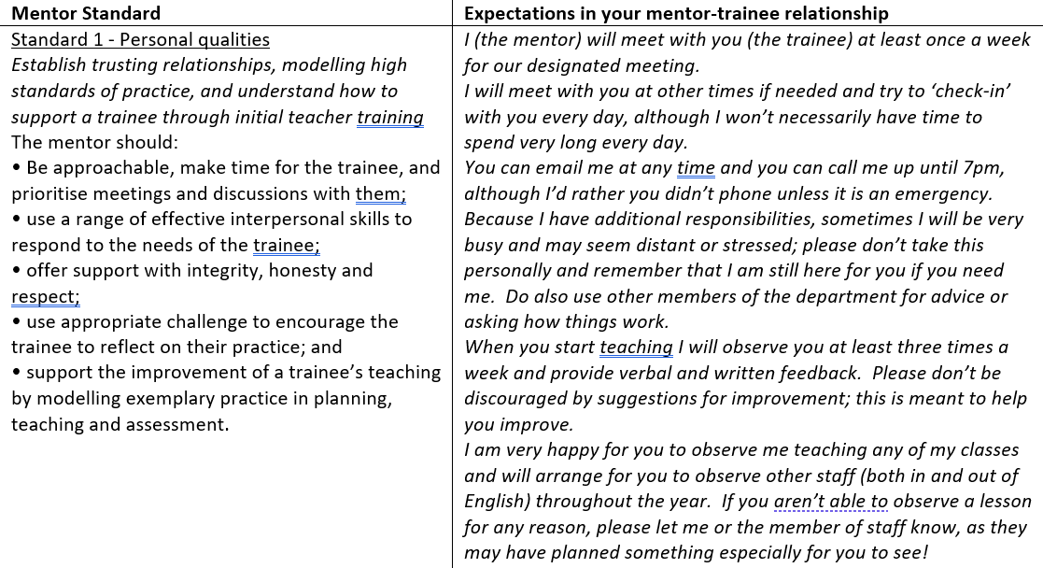
Example
Notes:
Mentor HB
App. B

Slide 17
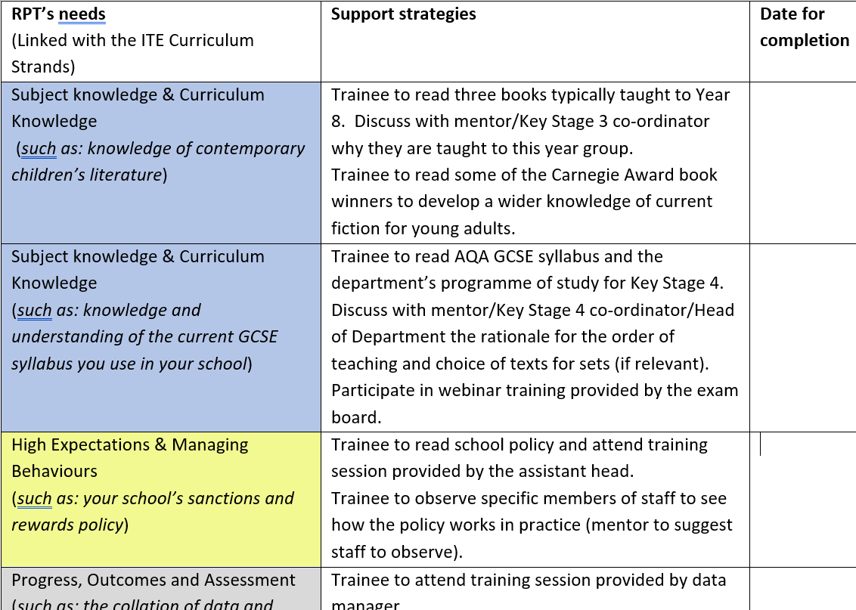
RPT Needs Analysis
Notes:
Example needs analysis. Can be used to personalise/tailor initial training focus or areas for support, based on their prior knowledge, experience and learning.
Appendix C

Slide 18
RPT’s Needs (Linked with the ITE Curriculum Strands) | Support Strategies | Date for completion
Professional Behaviours & Teacher Wellbeing
High Expectations & Managing Behaviours
Subject & Curriculum Knowledge
Planning, Teaching and Adapting Practice
Progress, Outcomes and Assessment
Notes:
Take a few minutes to think about your RPT – are the specific areas of need that you can already identify and can we think of some strategies that would help at this point?

Slide 19
Notes:
Section 4 of HB
At each stage, there is a list of mentor actions that is a helpful reminder of what to do when!

Slide 20
Mentor guidance (Section 4)
Expectations and the Mentoring Relationship
Induction
Implementing the ITE curriculum
Timetables and beginning teaching
Mentor meetings
Observation and feedback
Working with other colleagues
WRoPs and the e-Portfolio
Assessing progress
Support and difficulties
CCF and mentor conversations​
Notes:
Please read this section of the HB carefully.

Slide 21
UoR Curriculum Focus: Behaviour Management
‘Behaviour in school is inseparable from academic achievement, safety, welfare and well-being, and all other aspects of learning. It is the key to all other aims, and therefore crucial.’
(Bennett, 2017, p. 12)
Notes:
On the Reading PGCE, managing behaviours has always been incredibly important. Bennett’s statement about behaviour has long been how we introduce RPTs to behaviour.
Academic achievement, safety, and pupil well-fare and wellbeing are three pillars that are integral to everything we do.

Slide 22
UoR Curriculum Focus: Behaviour Management
In 2024, behaviour management will have a renewed focus on the UoR PGCE, in response to:
RPT wellbeing and enjoyment of their work
RPT feedback about their experiences on placement
Mentor and school feedback about the contemporary challenges
Notes:
Over the past years we have received lots of feedback that has brought about this renewed curriculum priority.
We have heard from RPTs, mentors, and other school colleagues that behaviour management needs to be at the top of everyone’s agenda. Crucially, as a wellbeing issue for teachers staying in the profession, and being able to maintain successful and healthy work-life balances.

Slide 23
UoR Curriculum Focus: Behaviour Management
Historically, the PGCE curriculum covered:
Different possible approaches to managing behaviours
Importance of planning, subject specialism, motivation and inclusion
Support for conversations to have with departments
Lesson feedback
This year, alongside these existing components of the curriculum, all RPTs will be taught to implement seven foundational actions in every single lesson.
Mentors will need to support RPTs with the consistent and effective implementation of these foundational actions, as well as support them use other actions depending on the school policies and contexts.
Notes:
As stated, the UoR PGCE has always taken behaviour seriously, and this was seen through:
- the range of approaches to behaviour management that RPTs were given
The importance placed on planning lessons, subject specialism, motivating pupils and being inclusive practitioners
Support for RPTs to engage with their specific school and department’s policies
Regular and constructive feedback and managing behaviour following lesson observations
However, there was not a coherent set of common, non-negotiable expectations for RPTs, in any subject, in any school.
This year, our aim is to build upon the existing components of the curriculum by teaching the RPTs to implement seven foundational actions in every single lesson.
Over the next 20 minutes we are going to look at how mentors will need to support the RPTs to implement these consistently and effectively, and how we can develop this initiative based on your own expertise and experience.

Slide 24
UoR Curriculum Focus: Behaviour Management
Greet class positively (individually and/or as a group) to establish presence and mark a fresh start to the lesson.
Make expectations of desired behaviours explicit.
Highlight positive pupil behaviours where possible.
Implement a clear and consistent method of gaining attention and achieving silence.
Use pupils’ names whenever addressing them individually.
Only teach or give instructions to the whole group when there is silence.
Follow through on rewards, sanctions and promises.
Notes:
So the seven actions we expect every RPT to implement are:
1
2
3
4
5
6
7
These were the result of months of discussions with school leaders, ITTCos and Subject Leaders.

Slide 25
 | Potential challenges to implementing this action in your subject: | What strategies mentors might give RPTs for implementing effectively in your subject:
Greet class positively (individually and/or as a group) to establish presence and mark a fresh start to the lesson.
Make expectations of desired behaviours explicit.
Highlight positive pupil behaviours where possible.
Implement a clear and consistent method of gaining attention and achieving silence.
Use pupils’ names whenever addressing them individually.
Only teach or give instructions to the whole group when there is silence.
Follow through on rewards, sanctions and promises.
Notes:
You will now disappear into small groups. I will copy and paste the seven actions into the Teams chat.
Your task now is to discuss:
For each action, are there any potential challenges you envisage with RPTs implementing this consistently in our subject?
For each action, and in response to the potential challenges, are there any strategies that all mentors might want to have that will support RPTs in their implementation in our subject?
In each group could someone write down what you decide and we will collate these as a group. (N.B. Subject Leaders could share an e-document for groups to write on directly which could then be discussed with the group to save time.)

Slide 26
Is there anything else that you would argue every single RPT should be doing to support their behaviour management in every single lesson in your subject?
Greet class positively (individually and/or as a group) to establish presence and mark a fresh start to the lesson.
Make expectations of desired behaviours explicit.
Highlight positive pupil behaviours where possible.
Implement a clear and consistent method of gaining attention and achieving silence.
Use pupils’ names whenever addressing them individually.
Only teach or give instructions to the whole group when there is silence.
Follow through on rewards, sanctions and promises.
Notes:
These are the universal expectations across the programme. However, each subject has it’s own specific contexts and different sorts of behaviour challenges. I would now like to know if there is anything additional that you would like to see from every RPT in every single lesson in our subject?
Please do see this as an opportunity to really make a difference to the PGCE!

Slide 27
UoR Curriculum Focus: Behaviour Management
Any questions about the curriculum focus on behaviour management?

Slide 28
ITAPs and course structure

Slide 29
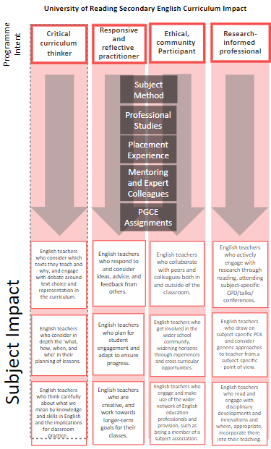

Slide 30
Notes:
Please download the poster version of this for your wall!
Our Vision for the Secondary Programme
Our vision statement and programme identity have been developed collaboratively in partnership with representatives of schools, local and regional alliances, university tutors and programme directors, and the Secondary Steering Group.
We agreed that our particular partnership, with its emphasis on subject-specificity, high expectations, inclusivity and diversity, aims to develop four fundamental traits that consistently characterise, and set apart, RPTs.
Our vision is therefore that RPTs become:
Critical Curriculum Thinkers
Responsive and Reflective Practitioners
Ethical Community Participants
Research-Informed Professionals
Responsive and reflective practitioner:
You will begin by focusing almost entirely on yourself. ​
What will I say? What will I do? What will my resources get them to do? ​
We will push you to think about the students and their learning. ​e.g. PGCE assignments, mentor meeting notes, lesson reflections, lesson plans showing reflection and advice, experimenting,​
online contributions… ​
Ethical community participant:
Not passive bystanders, but have desire for social justice and cohesion, and high expectations of everyone. ​
Contribute to communities, leave your mark. E.g. Asking & answering Qs in PS sessions, subject sessions, discussing with dept at school, ​
set up a school club,​
immersed in professional ​
associations, eduTwitter , attend conferences, TeachMeet icons, TES online...​
Research-informed professional:
Aware of limitations and boundaries​
Model that should be easily communicated​
Intentionality to eliminate or emphasise a practice​
Ecology exists, doesn’t operate in isolation, context is key​
Enquiry – always reflecting, checking effectiveness
(Sherrington) e.g. Discussions with school colleagues, challenge (professionally) assumed ideas, shared reading with staff, links to PGCE assignments, reflections in WRoPs on literature, notes from school CPD, notes from journal readings, evidence in lesson plans and lesson reflections…​
Critical curriculum thinker:
About what you teach, why this matters, how it fits together.​
What you don’t teach.​
How students affect this. E.g. Contribute at Dept meetings, notes, lesson plans, reflections, WRoPs, CPD attendance and participation, reading, awareness of school level C and National C, plan sequence of lessons…

Slide 31
English Content
Induction Stage (Sept)
Knowledge & pedagogy
Planning & progress
Talk
Group work
Working with TAs
Reading
Guided Stage (Jan-mid-March)
Poetry
Post-16
Spoken language
Language & non-fiction
Media
Shared Stage (Oct-Dec)
Writing
Reading as a writer; writing as a reader
Assessment
Questioning
Modelling
Plan-teach-assess cycle
Memory
Adaptive teaching
Dyslexia
Language and grammar
EAL
Spelling & vocab
Essay writing
Contexts
SoW
Plays
Shakespeare
Independent Stage (March-June)
Creativity
Transition

Slide 32
Core Content Framework
‘Theory’ (research-informed knowledge about teaching)
‘Practice’
Notes:
Check that everyone has heard of the CCF…

Slide 33
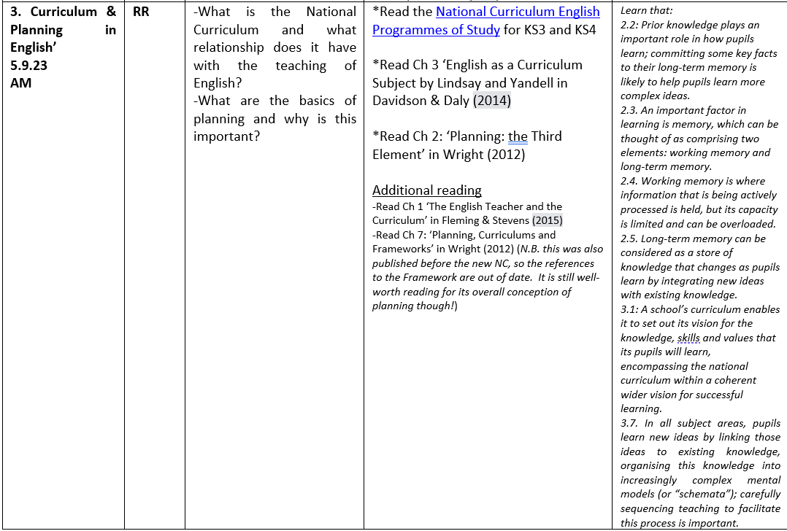
Notes:
Each SM (and PS) session links directly to CCF LT statements

Slide 34
Classroom Practice
Learn that…
4.3 Learn that modelling helps pupils understand new processes and ideas; good models make abstract ideas concrete and accessible.
4.4 Guides, scaffolds and worked examples can help pupils apply new ideas, but should be gradually removed as pupil expertise increases.
Learn how to…
Plan effective lessons, by:
Using modelling, explanations and scaffolds, acknowledging that novices need more structure early in a domain.
Cognitive load theory
Abstract into concrete
Explicit demonstration of skill
I, we, you

Slide 35
Scenario
George appears to be struggling with planning. They tend to rely on existing resources for lesson objectives but the planned lesson activities don’t always match up with the objectives that they are working towards. When they do create their own lesson objectives, they don’t always ‘fit’ what the intended learning appears to be.

Slide 36
Planning – what they’ve learnt
What do I want them to learn?
Why do I want them to learn it?
What do I need to do to enable them to learn it? (Savage, 2015 p17)

Slide 37
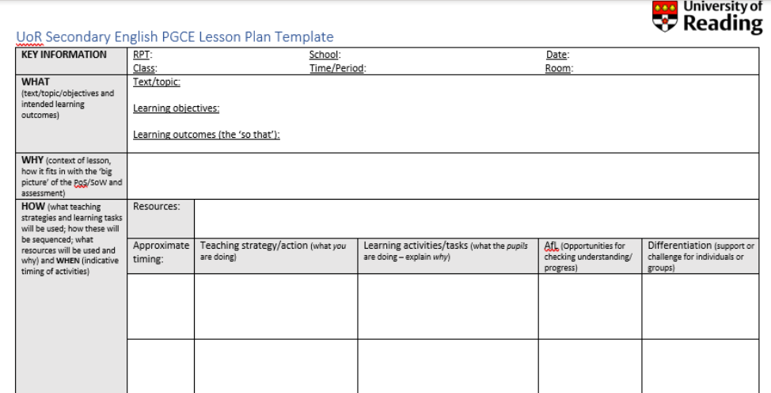
Notes:
Underpinned by LT statements
2.7 – regular purposeful practice
2.8 – retrieval and spacing practice to strengthen recall
2.9 – worked examples
3.4 – worked examples
3.4 – modelling
4.4 – guides, scaffolds – remove towards independence
6.1 – effective assessment

Slide 38
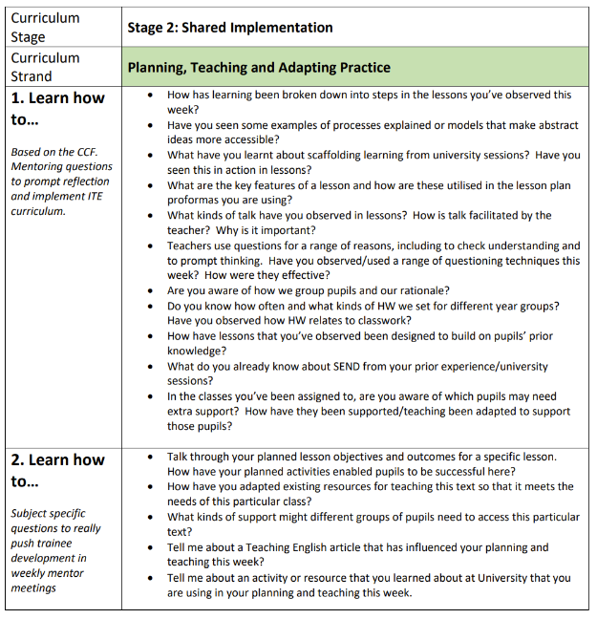
Notes:
Make use of the mentor conversation documents
(note: Stage 2 begins in two weeks – 2nd Oct)

Slide 39
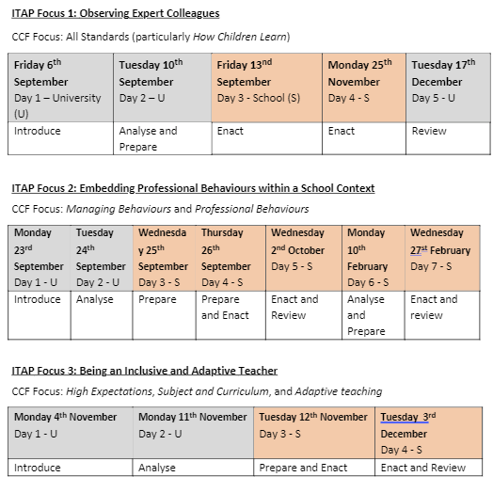
ITAPs
SCHOOL
UNIVERSITY
Notes:
Explain rationale of ITAPs and mentors who worked with us last year how they thought the ITAPs went (and their involvement in them).
These are the three ITAPs that RPTs will complete whilst in school A.

Slide 40
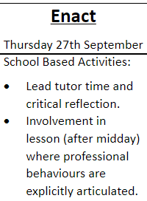
What might this look like in English?

Slide 41
ITAP 2 Embedding Professional Behaviours within a School Context: School Expectations Wednesday 27th September: School-based Implementation Thursday 28th September: School-based Implementation and Review
Time spent during the ITAP day(s) | Activities | Responsibilities
Day 1 – c. 10 minutes each (Prepare) | Discussion with SENDCO Discussion with behaviour lead Discussion with DSL Discussion with Senior Leader | ITTCo to arrange group interviews.
Day 1 – c. 20 minutes (Prepare) | Critically observe tutor time. | ITTCo to identify expert tutors.
Day 1 and 2 – c. 60 minutes (Prepare) | Shadow experienced teachers on different school duties. | Mentors to identify experienced duty staff in appropriate locations.
Day 1 – c. 60 minutes (Prepare) | Collate school priorities and shared language. | ITTCo and/or SLT to signpost school documents, policies, procedures and language.
Day 1 – c. 60 minutes (Prepare) | Simulation activities with peers for different scenarios around the school. | Programme Director to produce scenarios.
Day 2 – c. 30 minutes (Enact) | Lead tutor time and critical reflection. | Expert tutors to support.
Day 2 – 120 minutes (Prepare) | Produce scripts for setting up expectations and participation in upcoming lessons. | Programme Director to produce guidelines.
Day 2 – c. 60 minutes (Enact) | Involvement in lesson (after midday) where RPT is given some responsibility for displaying explicit professional behaviours (such as utilising school routine, using school language, following departmental priority). | Mentor to identify appropriate opportunities.
Day 2 – 30 minutes (Review) | Plan of action for how you will display professionalism within that school, completed in ITAP booklet. | ITTCo, mentor and tutor to review. Mentor to discuss at next mentor meeting. RPTs to ensure ITAP booklets uploaded to E-Portfolio by end of the day.
Notes:
Mentor involvement in ITAP 2

Slide 42
PPRs and assessment of progress

Slide 43
PROFESSIONAL PRACTICE REVIEW 1
ITE Curriculum Stage | Shared Implementation
Mentor Module | Constructive Conversations and Modelling Practice
When | Tuesday 5 November – Friday 29 November
Format | Tutor to decide whether a hybrid meeting (RPT and Mentor in same room, Tutor online) or on-site meeting is required. Co-planning conversation.
RPT Preparation | Preparation should include identifying a lesson to co-plan, discussing curriculum aims for that lesson with Mentor, and building subject knowledge in the relevant area.
Mentor development focus | Knowledge of key themes and content from ITE curriculum, capacity to conduct constructive conversations, and support for RPT in preparation of teaching.
RPT assessment focus | RPT reveals how effectively they can draw upon subject knowledge, curriculum knowledge, and pedagogical content knowledge developed through the ITE curriculum, in order to plan lessons that reveal the quality of their learning and practice.
Notes:
Explain focus of this visit

Slide 44
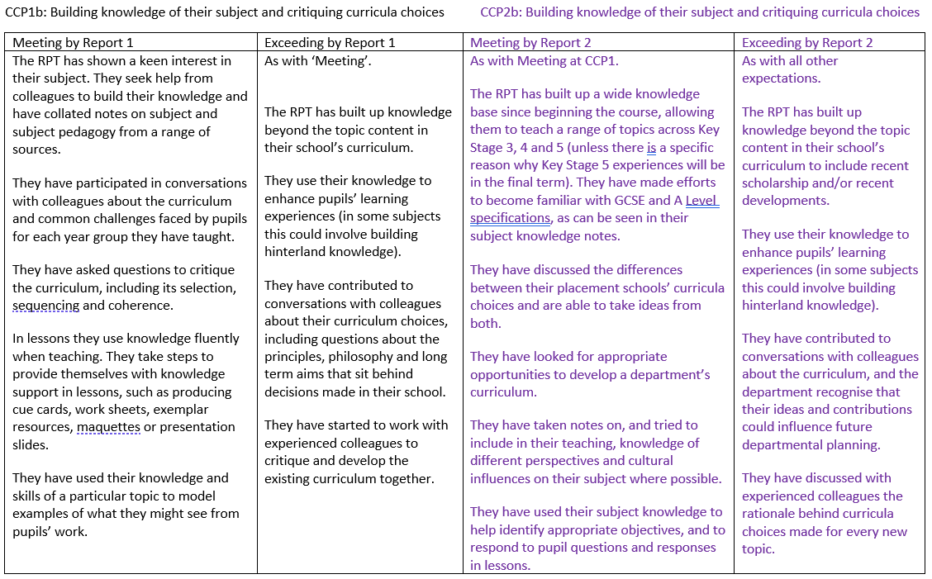
Notes:
N.B. the RPT does not have to have demonstrated all the ‘exceeding’ indicators from CCP1 to ‘meet’ the indicators at CCP2. They must, however, continue to demonstrate they are still meeting the ‘meeting’ indicators from CCP1 throughout the course.
This will lead to the AoP/Report 1 due in December.

Slide 45
Useful resources
https://earlycareer.chartered.college/

Slide 46
Questions?

Slide 47
Mentor training attendance form
https://forms.office.com/e/bwDMZ62z08
Notes:
Please ask mentors to complete this very short form to confirm that they have attended and engaged with the training: https://forms.office.com/e/bwDMZ62z08

