Slide 1
Mentor Curriculum 1.1
ITE Mentor Curriculum
Mentor Professional Identity & Establishing a Mentor-Trainee Relationship
Dr Rachel Roberts r.l.roberts@reading.ac.uk
Notes:
Hello and welcome to the first PG primary mentor training session.

Slide 2
Welcome & Introductions
Name | Role | Email
Dr Rachel Roberts | Principle Lead Mentor, Deputy Programme Director Secondary PGCE & English Subject Lead | r.l.roberts@reading.ac.uk
Dr Catherine Foley | Head of ITE | c.m.foley@reading.ac.uk
Scarlett Murphy | Primary PG ITE programme Director | s.l.e.murphy@reading.ac.uk
Cara Broadhurst Jane Austen Armstrong Susan Thomas Emma Rawlinson Fiona Ludlow Gill Martin | Primary UG Programme Director Primary Lead Mentor (UG) Primary Lead Mentor (UG) Primary Lead Mentor (UG) Primary Lead Mentor (PG) Primary Lead Mentor (PG) | c.broadhurst@reading.ac.uk
Primary PG Admin Primary UG Admin | Admin Admin | pgceprimary@reading.ac.uk ess11i3@reading.ac.uk
Notes:
Introductions – who’s who
I'm Rachel Roberts

Slide 3
Content
Overview of the mentor curriculum
The mentor’s role: professional identity & values
Mentor knowledge & trainee teachers’ development
The mentor-trainee relationship
Effective teaching & Reflective Practice
Notes:
This session will cover:

Slide 4
Mentors Matter!
Notes:
Explain rationale behind new mentor curriculum, recognising how many may have previously mentored.

Slide 5
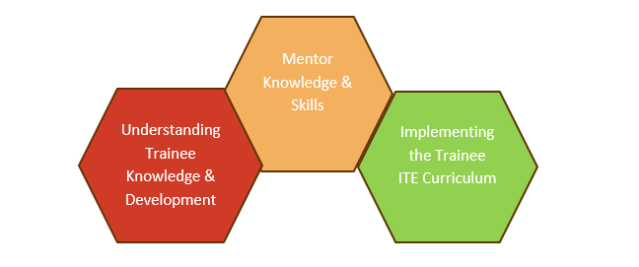
Mentor Curriculum
Notes:
The ITT Core Content Framework (CCF) is core to the ITE Curriculum (focusing on the ‘Learn that…’ statements), and the Mentor Curriculum (focusing on the ‘Learn how to…’ statements) which are interwoven through both curriculums and training materials. Our approach to mentor training is underpinned by evidence on effective professional development which:
builds knowledge;
motivates teachers;
develops teaching techniques;
embeds practice (EEF, 2021)

Slide 6
RPT Curriculum:
Mentor Curriculum:
Notes:
Designed to map against the RPT curriculum & therefore development.
Successful completion of the Mentor Curriculum modules results in Certification of Mentoring, in recognition of RPMs’ efforts and their ongoing professional development.

Slide 7
Mentoring 2024-25 | Mentoring 2025-2026 (once completed all modules in other column)
New Mentor Training (for 24-25, every mentor is defined as a ‘new mentor’) (September and January)
Meeting your RPT conversation prompts (September and January) that aligns with main placement school and contrasting (Spring)
Introduction video to Induction, Shared, Guided and Independent Implementation modules with live online training (recorded) | Introduction video to Induction, Shared, Guided and Independent Implementation modules with live online training (recorded)
Mentor Knowledge and Skills videos (October, January, March) to support target setting, completing AoPs and stretching your RPT
Mentor Meetings structured around the Mentor Conversations Guides | Mentor Meetings structured around the Mentor Conversations Guides
Interim and Progress reviews per placement as usual | Interim and Progress reviews per placement as usual
Mentor time allocated at 1.5 hours a week | Mentor time allocated at 1.5 hours a week
ITTCo conversation with mentors
Mentor feedback and reflection of the year
Notes:
Consolidation of mentor provision
Funding
Manageability
Contribution to CPD and appraisal targets

Slide 8
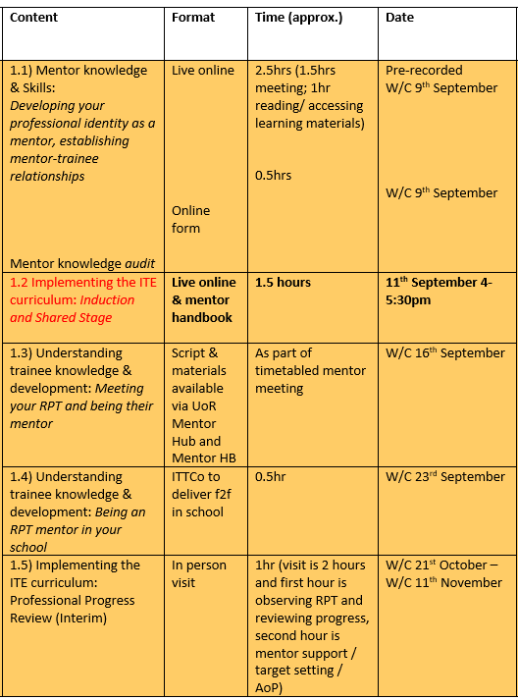
Module 1: Being a mentor
Notes:
All training needs to be attended (if live online) or watched / completed regardless of when you have a student. If you do not attend training in the Autumn / Spring, you will need to complete the sessions during the summer
The first year (2024-2025) of mentor training will include:
21 hours includes (pre recorded, time spent with visits on visits, looking at and responding to documentation etc). Please see table for more details
The second year will include 7.5 hrs (pre-recorded / live online after school only) and will mirror what mentors already usually complete every year prior to September 2024.

Slide 9
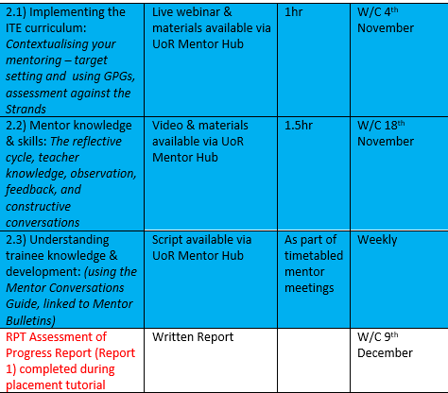
Module 2: Constructive Conversations & Modelling Practice

Slide 10
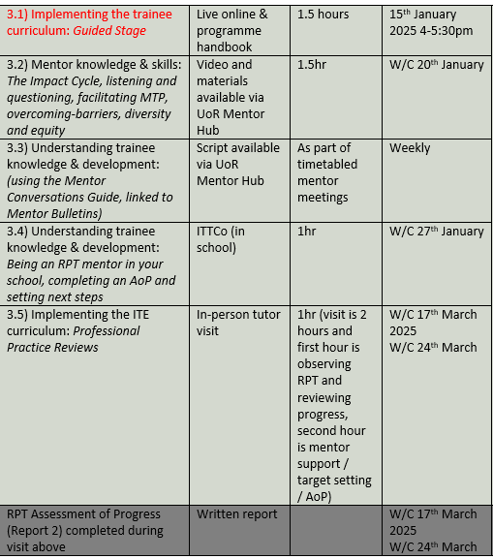
Module 3: Moving Forwards

Slide 11
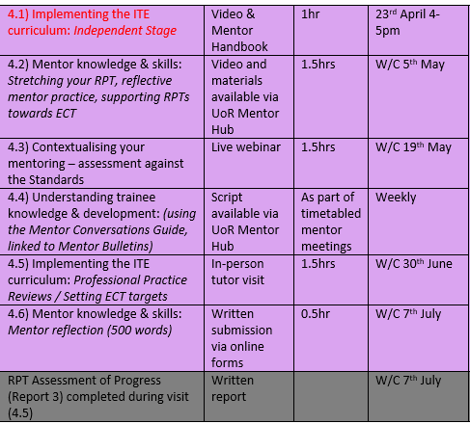
Module 4: Supporting Independence
Notes:
Take any questions at this point.
Anticipate Q about not having an RPT for SchB
1.5hrs

Slide 12
Professional Identity & Values

Slide 13
What is a mentor?
… ‘off-line help from one person to another in making significant transitions in knowledge, work or thinking’ (Megginson & Clutterbuck, 1995, p. 12).
The mentor’s role is part of a significant professional transition (i.e. from trainee to qualified teacher) and emphasise the importance of a positive interpersonal relationship between mentor and trainee (NFER, 2008; CUREE, 2005)
Which can be problematic…

Slide 14
Mentors as…
‘teachers of teaching’ (Grimmett et al, 2018, p. 341)
Mentor’s practice
Trainee’s practice
Plan
Teach
Assess
Plan
Teach
Assess
Notes:
why did you go into teaching? What motivated you to be a teacher?
Most likely not the huge bonuses or the automatic and undisputed professional respect from the rest of society. Most people who enter the teaching profession are motivated with a desire to help others; to pass on their passion for their subject and to make a difference to children’s lives; these are quite altruistic motivations (Lortie, 1975; Nias, 1996).
What motivates them to be mentors?
In ITT mentors have a somewhat liminal role: they are employed by their schools to teach, yet are required by ITT programmes to induct beginning teachers into the profession. Tensions may arise from conflicting demands of either party. Mentors need to conceive of themselves as ‘teachers of teaching’ (Grimmett et al, 2018, p. 341); Gimmett et al’s work with mentors in Australia found this conception led to more productive mentor-trainee relationships and mentors moved away from a view of teaching purely as a skill and focused more on care for the trainee, rather than assessment of them. In time-constrained and workload-heavy environments, the focus of mentoring can easily fall upon the latter.

Slide 15
Describe, in one word, the most recent lesson that you taught…
Notes:
Describe, in one word, the most recent lesson that you taught… [take some examples] exhausting? Exciting? As teachers, our initial reaction to our practice tends to be affective. Because teaching consists of interpersonal interactions it necessarily involves emotions (Day & Leitch, 2001; Hargreaves, 1998), at least until the day that we are all replaced by screens.

Slide 16
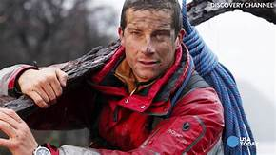
Mr Grylls
‘Good teaching is charged with positive emotions. It is not just a matter of knowing one’s subject, being efficient, having the correct competences, or learning all the right techniques. Good teachers are not just well-oiled machines. They are emotional, passionate beings who connect with their students and fill their work and their classes with pleasure, creativity, challenge and joy’. (Hargreaves, 1998, p835)
Notes:
A few years ago I visited a school specialising in caring for children with social, emotional and mental health needs, where I had a conversation with a 6’3” ex-rugby playing PE teacher, a big beaded bear of a man – let’s call him Mr Grylls, whose eyes filled with tears when I asked him how he felt about leaving his school, as he was due to do at the end of the year. ‘Ah,’ he said, ‘I’m sorry, I don’t mean to get all emotional.’ And his voice broke, ‘I’m really going to miss them; you build up such a strong relationship with kids in a school like this – you have to – they have to trust you and you have to be there for them.’ He located his understanding of his professional practice in the values that he held dear and it was the expression of this core belief (in Mr Grylls’ case the importance of relationships) that was exposed through affect.
Teaching involves emotions (Day & Leitch, 2001; Hargreaves, 1998)
Altruistic motivations of teachers (Lortie, 1975; Nias, 1996)
Reciprocal relationship of care (Noddings, 2003)
Mentor-trainee relationship is ‘Emotionally charged’ (Hawkey, 2006, p. 145)

Slide 17
Emotional Labour & Your Identity
Teaching involves emotional labour (Hochschild, 2012)
Training to teach is itself emotional (Yuan & Lee, 2016) - and is intertwined with formation of teacher identity (Nicols, Schutz, Rodger, & Bilica, 2017; Zembylas, 2005).
Notes:
Emotional labour (Hochschild, 2012)
Training is emotional (Yuan & Lee, 2016) and – intertwined with formation of teacher identity (Nicols, Schutz, Rodger, & Bilica, 2017; Zembylas, 2005)
Importance of recognising this – both for the RPT but also for the mentor. (anecdote of Dan S storming out of my lesson whilst I was being observed by my trainee)

Slide 18
Facets of the mentor role
‘Mentors can fill many roles, including the provision of practical advice about careers or a course of study, contributions to professional development, or dissemination of political guidance and strategies’ (Montgomery et al., 2014).
role-model (Anderson & Shannon in Kerry & Mayes, 1995),
guide (Izadinia, 2017),
provider of assistance (Tomlinson, 1995),
developer of reflective practice (Ballantyne, Packer, & Hansford, 1995),
emotional supporter (Marable & Raimondi, 2007).

Slide 19
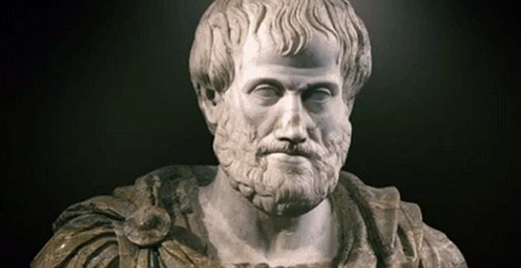
Techne (skills)
Episteme (knowledge)
Phronesis (practical wisdom)
Notes:
Aristotle (2014) suggested that we have different kinds of virtues or intelligence: techne (skills), episteme (knowledge) and phronesis (practical wisdom).
Sometimes we focus overly on technical aspects of teaching: how can we do this better for a greater outcome; what can I do to make my teaching more effective; it is the narrative of ‘Even Better If…’ which can never come to a satisfying ‘I’ve done enough!’. But to consider teaching simply as a set of skills (techne) reduces what we do and ignores teaching’s fundamentally ethical foundation (Carr, 2000).
Mentors have a wealth of both deep Pedagogical Content Knowledge (Shulman 1986) and professional experience. In guiding beginning teachers, mentors can embody a kind of phronesis, as they make ethical choices based on their professional knowledge and experience. Mentors need to ask: what is in the best interests of my trainee and those of the pupils they teach or will go on to teach? It is my belief, therefore, that mentoring, like teaching, is caring and functions via a positive professional relationship.

Slide 20
Effective mentoring
Knowledge and expertise
Time
Structure
Relationship
Dialogue
Effective mentoring engages with values (Montgomery, 2017)
Notes:
Discuss shared values…
Take a moment to reflect on what your values are as a teacher and what you hope to achieve through being a mentor.

Slide 21
Mentor Knowledge & Trainee Development

Slide 22
Types of knowledge:
DECLARATIVE (can be explained using words)
PROCEDURAL (demonstrated through actions)
(Hattie & Yates, 2014)
Notes:
We address what we mean by knowledge (and teacher knowledge) very early on in the PGCE… and the next 5 slides are taken directly from a PS session – it’s important that RPTs understand what they are learning to do over the year.

Slide 23
What makes great teaching? (Coe et al., 2014)
(Pedagogical) content knowledge
Quality of instruction
Classroom climate
Classroom management
Teacher beliefs
Professional behaviours

Slide 24
Maths
English
Guided Reading / Comprehension
Spelling / phonics
Speaking and listening
Handwriting
Science
Art
DT
History
Geography
French
Music
PE (including swimming)
RE
Computing
PSHE and Citizenship
SRE
Content Knowledge
Notes:
Need to know all the subjects taught in Primary – that is a lot of content! Then specific to Year group, setting / scheme, how to adapt for SEND etc…

Slide 25
BUT: Great content or subject knowledge doesn’t equal a great teacher…
Notes:
Content knowledge is not enough

Slide 26
Pedagogical Knowledge
Notes:
How pupils learn;
Teaching and learning theories;
Knowledge of learners
Knowledge of principles of classroom behaviour and management

Slide 27
RPTs should be able to articulate
Why we teach what we do, in the way that we teach it
What they are teaching, with deep and confident subject knowledge
How they are teaching it, and the reasons for the decisions they make
Who they are teaching, and what they bring to their learning

Slide 28
BUT: You are teaching something (knowledge, skills…)
Notes:
Pedagogical knowledge is not enough…
You can’t teach something you don’t know!

Slide 29
Pedagogical Content Knowledge (PCK)
‘The most regularly taught topics in one’s subject area, the most useful forms of representation of those ideas, the most powerful analogies, illustrations, examples, explanations, and demonstrations – in a word, the ways of representing and formulating the subject that make it comprehensible to others’ (Shulman, 1986, p9)

Slide 30
Mentor knowledge
 | Teaching context | Mentoring context
Content knowledge | Maths/English etc | Planning, behaviour management, AfL, differentiation, etc
Pedagogical knowledge | How to teach children – behaviour management, scaffolding etc | How to teach mentees – collaboration, reflection, guidance
Pedagogical content knowledge | Ways of representing knowledge, common errors, misconceptions | Ways of understanding what goes on in the classroom, how to observe, judging an appropriate tone for relationships, how to tell if pace is right
Contextual knowledge | Curriculum, policy, school environment | Standards, policy, school and university environment
(Jones & Straker, 2006: Shulman, 1986)

Slide 31
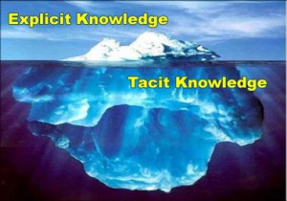
Tacit knowledge in teaching
Problem: practical knowledge of mentors = tacit (Zanting et al, 2003)
‘practical knowledge is developed or adjusted by teaching experience and integrates content knowledge, knowledge about students, the curriculum, the specific teaching situation, and pedagogy’ (p196)

Slide 32
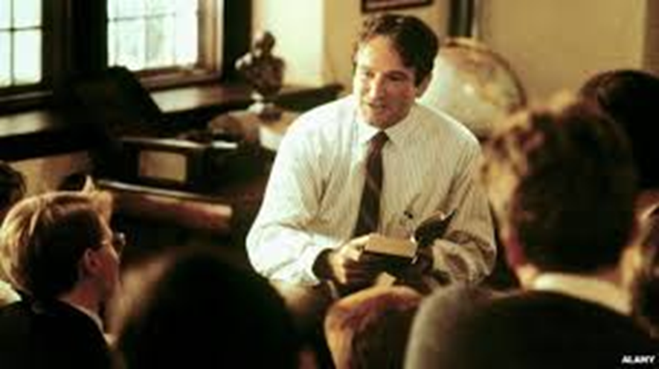
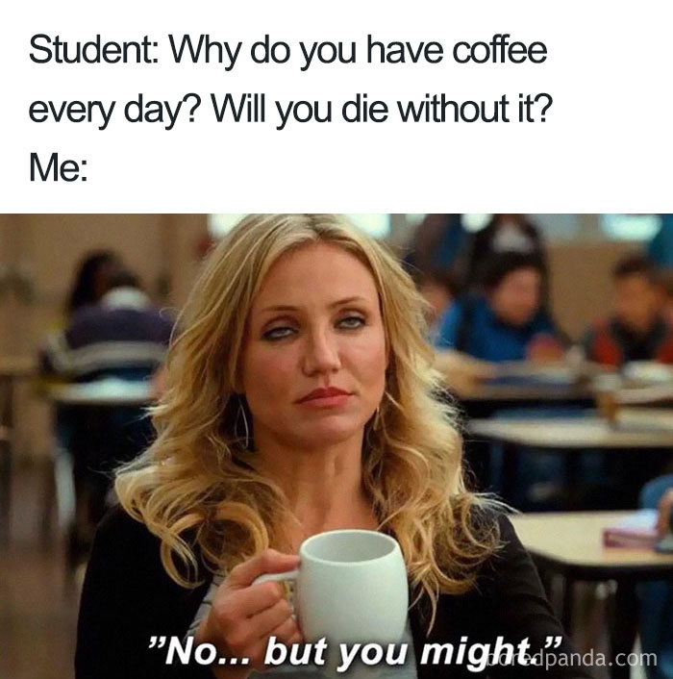
The stages of beginning teachers’ development
Early idealism
Personal survival
Dealing with difficulties
Hitting a plateau
Moving on
(Furlong & Maynard,1995)
Notes:
Early idealism: ‘in which trainees tend to identify quite closely with the pupils and seek inspiration in the example of significant teachers recalled from their own schooldays. Their analysis of these teachers... Tends to be framed in terms of the teachers’ personality and the relationships that they established, rather than reference to the planning and structure of their lessons or their pedagogical strategies.’
Personal survival: ‘in which trainees tend to feel vulnerable and crave the assurance of being seen as a teachers. They are therefore keen to fit in and become anxious ab out securing effective control of their classes.
Dealing with difficulties: ‘in which the emphasis is on establishing themselves as a teacher by implementing specific policies (particularly in relation to managing pupils’ behaviour) and demonstrating their ability to organise and execute different kinds of learning activities.
Hitting a plateau: in which progress my stall as the trainees demonstrate their competence and confidence in running a classroom, and implementing different kinds of activity. Only if they are sufficiently challenged and encouraged to look more closely at the pupils’ experience and the evidence of their learning will they move on.
Moving on: the final phase in which they are able and willing to adapt their teaching in response to critical evaluation of the pupils’ needs and their ongoing learning.
Burn et al (2015), p36
Hagger et al 2008 intentionality
Intentionality
Frame of reference
Response to feedback
Attitude to context
Aspiration

Slide 33
Dreyfus’ model of expertise development
Notes:
Opportunity to reflect on your own development – remembering what you found difficult/didn’t know when you started training.

Slide 34
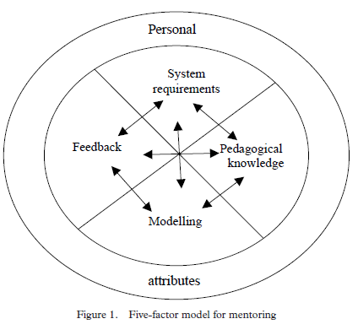
What do mentors do?
A 2002 factor analysis of primary science teachers' responses showed five factors:
System requirements
Pedagogical knowledge
Modelling effective teaching
Feedback
Personal attributes
(Hudson, 2007; 2013a, 2013b)

Slide 35
Mentoring and support
Professional support
Pedagogic support
Academic support
Emotional support (Roberts, 2019)
Notes:
Professional support (such as showing the trainee how to put ‘praise points’ onto the database and discussing when this would be appropriate)
Pedagogic support (such as demonstrating how to ‘model’ some writing during a lesson and discussing how it worked afterwards)
Academic support (such as suggesting a book on basic grammar knowledge that you’ve read)
Emotional support (such as comforting them if they have a difficult lesson) (Roberts, 2019)

Slide 36
Notes:
BUT

Slide 37
Notes:
Mentor-mentee relationship central to the mentee’s progress

Slide 38
Mentors as…
‘teachers of teaching’ (Grimmett et al, 2018, p. 341)
Mentor’s practice
Trainee’s practice
Plan
Teach
Assess
Plan
Teach
Assess
Notes:
So, to return to the notion of mentors thinking of themselves as ‘teachers of teaching’

Slide 39
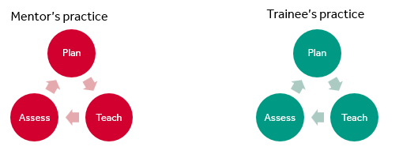
Research
Classroom practice
Reflection
Context
Notes:
How do you teach teaching – it’s not a straightforward case of trainees copying what their mentors do…
Consider:
How you might draw on research?
How you might deconstruct your classroom practice? (modelling)
How you might provoke/scaffold reflection in your RPT’s practice?
What do you need to think about/make explicit about your context (school, subject, cohort etc.)?

Slide 40
Challenging the beginning teacher’s assumptions, being a critical friend and demonstrating how to do something they are having difficulties with.
Coaching
Acting as a sounding-board, being there to listen and offer support.
Counselling
Helping a beginning teacher develop resourcefulness, make them aware of the information, resources, people, organisations and more formal repositories of knowledge.
Networking
Giving advice – a balance between giving a beginning teacher the answer and encouraging them to find their own solutions to problems through reflective thinking.
Guiding
Developmental Mentoring Model
(Adapted from Cluttterbuck in Golder et al, 2020, p13)
Notes:
The mentor model that we advocate is a developmental one.

Slide 41
Mentor-Trainee Relationships

Slide 42
(Schutz,1994)

Slide 43
The mentor-mentee relationship
Central to the development of the trainee (Hawkey, 1998)
Provision of developmental feedback is pivotal (Hobson, Ashby, Malderez & Tomlinson, 2009; Hudson & Hudson, 2014; Mercardo & Mann, 2015)
Notes:
Take a minute to reflect on the relationships that you had with your mentor(s). What made them function/work?
Back to the red umbrella!

Slide 44
Mentor Standards
Standard 1 - Personal qualities: Establish trusting relationships, modelling high standards of practice, and understand how to support a trainee through initial teacher training
Standard 2 – Teaching: Support trainees to develop their teaching practice in order to set high expectations of all pupils and to meet their needs
Standard 3 – Professionalism: Set high expectations and induct the trainee to understand their role and responsibilities as a teacher
Standard 4 – Self-development and working in partnership: Continue to develop their own professional knowledge, skills and understanding and invest time in developing a good working relationship within relevant ITT partnerships. (DfE, 2016)
Notes:
Not statutory but useful benchmark

Slide 45
Establishing a positive relationship
Acknowledge the power dynamic
Begin with core values, passions and interests
Subject/topic/phase-specific support (put a list of useful resources together e.g. subject organisations/useful websites/books)
Using a ‘needs analysis’ - this will then be tailored to the specific experience/needs of your RPT
Demonstrate that you think they are significant, competent and likeable (Schutz, 1994)
Set boundaries and expectations – write a mentoring agreement

Slide 46
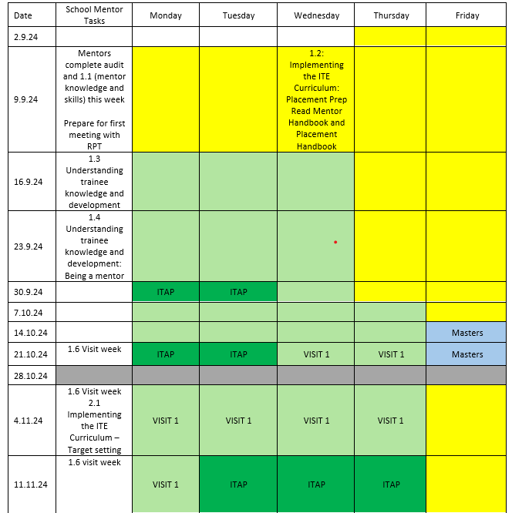
Meeting your RPT
Mentor training 1.2
(see Mentor HB)
RPT to prep –questions they want to ask / share AoP / Initial needs
Use ‘meeting your RPT question prompts’ to structure discussion;
Create (or prepare) a mentor ‘agreement’, using the Mentor Standards
Become familiar with Initial Needs document / AoP
Notes:
Mentor agreement – doesn’t need to be ‘submitted’ anywhere, but worth sharing with ITTCo (as well as the RPT!)
Mentor directed tasks are available on timetable in Mentor handbook

Slide 47
Meeting your RPT question prompts
1. What would you describe as your strengths and weaknesses? Let’s have a look at your Initial needs / AoP document to identify where we can develop these.
2. How are you at managing your time - is this something you feel you need to develop?
3. What do you expect to gain from this placement?
4. What boundaries do we need to set for communicating with each other? Are you okay with phone/email/text? When? When not? How quick does my response need to be?
5. Do you want the opportunity to speak to me briefly every day about what you’re doing or are you happy to keep it to the weekly mentor meeting?
6. How were you mentored on your previous placement? Tell me about what went well and what could have been better, remembering to remain professional in your responses.
7. What can you tell me about yourself as a person outside teaching?
8. What are you looking forward to and what concerns or worries do you have about this placement?
9. What information do you think you need from me to start this placement off as well as you can? What do you expect of me throughout the placement?
10. What kind of pedagogical approaches and techniques have you had the opportunity to experiment with in your first placement? Is there a particular pedagogical approach that you would like to develop in this placement?
11. What would you like to know about the curriculum/SOWs that we use in this school? (Connollly, Bates, & Shea, 2020, p. 419)

Slide 48
Mentor Agreement
Mentor Standard | Expectations in your mentor-trainee relationship
Standard 1 - Personal qualities Establish trusting relationships, modelling high standards of practice, and understand how to support a trainee through initial teacher training The mentor should: • Be approachable, make time for the trainee, and prioritise meetings and discussions with them; • use a range of effective interpersonal skills to respond to the needs of the trainee; • offer support with integrity, honesty and respect; • use appropriate challenge to encourage the trainee to reflect on their practice; and • support the improvement of a trainee’s teaching by modelling exemplary practice in planning, teaching and assessment. | I (the mentor) will meet with you (the trainee) at least once a week for our designated meeting. I will meet with you at other times if needed and try to ‘check-in’ with you every day, although I won’t necessarily have time to spend very long every day. You can email me at any time and you can call me up until 7pm, although I’d rather you didn’t phone unless it is an emergency. Because I have additional responsibilities, sometimes I will be very busy and may seem distant or stressed; please don’t take this personally and remember that I am still here for you if you need me. Do also use other members of the school for advice or asking how things work. When you start teaching I will observe you at least once a week and provide verbal and written feedback. Please don’t be discouraged by suggestions for improvement; this is meant to help you improve. I am very happy for you to observe me teaching any of my classes and will arrange for you to observe other staff (both in and out of the year group) throughout the year. If you aren’t able to observe a lesson for any reason, please let me or the member of staff know, as they may have planned something especially for you to see! Each week we will spend some time talking and thinking about what is being taught in each year lesson, where resources and be found etc. It would be great to hear your ideas or approaches that you’ve learnt at university or through your own study. We are always happy to experiment.
Notes:
Example of how the mentor standards might be used to draw up a mentor agreement (note that this is just for standard 1 and it doesn’t need to have this level of detail! See full example in mentor HB

Slide 49
Effective Teaching & Reflective Practice
Notes:
ITE curriculum

Slide 50
PCK
SUPPORTIVE ENVIRONMENT
MANAGE CLASSROOM
ACTIVATE THINKING
Notes:
Important for RPTs to have a concept of effective teaching – codified by reference to the GTT
Worth exploring these: https://www.greatteaching.com/resources
Effective teaching: the Great Teaching Toolkit (Evidence Based Education, 2020);
- The Science of Learning (University of Bristol, www.scienceoflearning-ebc.org);

Slide 51
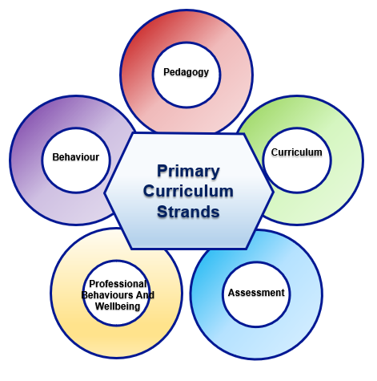
The Primary PG ITE Curriculum
Core Content Framework (CCF)
Pedagogical Content Knowledge
Phase / Subject Expertise
Partnership Experience and Expertise
Notes:
As a mentor, you do need to be aware of the ITE curriculum – PS key concepts and subject specific things (which will be made available via the Mentor Hub) and enable you to refer to what the RPT may have learnt/covered at university at different points. This captures the research and evidence base that we draw on for the central learning on the PGCE. Also the mentor bulletins – hopefully useful and developmental for you!

Slide 52
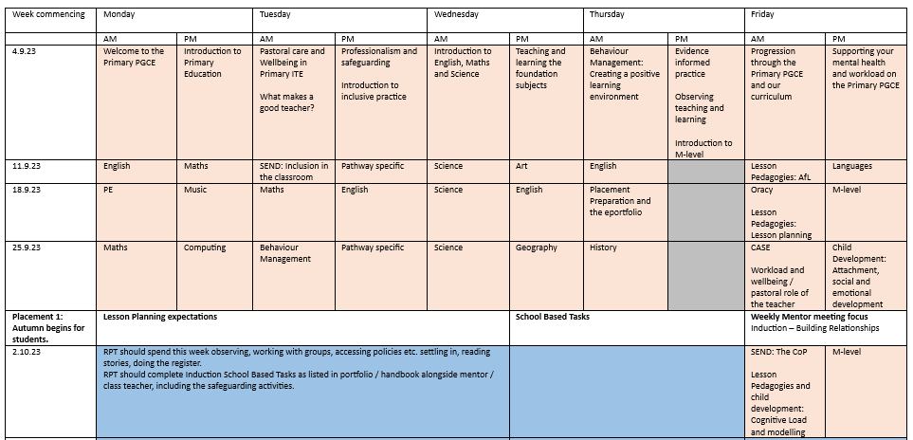
Example ‘Programme on a Page’

Slide 53
The Reflective Cycle adapted from Gibbs (1988, p. 50)
Experience
Description of feelings/ reactions
Evaluation
Analysis
Personal action plan
Conclusions (general)
Conclusions (specific)

Slide 54
KNOWING HOW TO HELP
Plan
Teach
Assess
Much of ‘teacher knowledge’ is tacit, so you need to try to be really explicit about what you do and why…
Notes:
Trainees can struggle to see the direct connection between assessment and planning at first.

Slide 55
For example…
Why can planning be difficult for a beginning teacher?
You can help them by:
Discussing the relationship between the ‘big picture’ of National Curriculum requirements or exam board specifications and the ‘little picture’ of individual lessons
Explicit demonstration of the difference between objectives and outcomes
Deconstructing the decisions you have made in planning and how this worked in practice; discussing your own teaching after your trainee observes you is helpful
Joint planning (this might include you planning and the trainee teaching or vice versa)
Notes:
Expertise and tacit knowledge – the need to be explicit about what you do and why
What other things do you expect your RPT might find difficult initially?
How might you support them in these areas?

Slide 56
Problems with reflection
‘Reflective practice is … encouraged by the mentors and embedded in the way that trainees are taught to think about their practice. This, as the literature suggests, could lead to a culture of continual drive for improvement which is performative (Ball, 2013). Combined with regular observation of the trainee teachers, mentor conversations which focus on continual progress and reflective practice such that the language of evaluation used in teaching acts as a kind of Foucauldian panopticon, in which trainees internalise ways of behaving and, possibly, ways of thinking.’ (Roberts, 2019, p121)

Slide 57
Mentoring scenarios
A: Your trainee appears to be quite disorganised; they are sometimes late and frequently don’t send you documentation when it is due.
What do you do?
B: Despite feedback from you and other colleagues, your trainee seems to keep repeating the same basic mistakes in lessons.
What do you do?
C: Although your trainee is making progress, you notice that they are very anxious and tend to take criticism very personally.
What do you do?
D: You feel that there are some elements of your trainee’s conduct that aren’t professional (but not in such a way as to be obviously not meeting Part 2 of the Standards).
What do you do?

Slide 58
Lead Mentors
5 LMs recruited for Primary, with 2 working specifically on PG:
Jane Austen Armstrong (UG)
Susan Thomas (UG)
Emma Rawlinson (UG)
Fiona Ludlow (PG)
Gill Martin (PG)
Will be assigned to a group of schools (and their mentors), loosely geographical
Notes:
You will be assigned to a LM in September and they will be in touch with you then.

Slide 59
Reviewing
Notes:
What might mentors want/expect from the Lead Mentors?

Slide 60
To Do:
Mentor training 1.1 completion form
https://forms.office.com/e/uGuaTbDqtm
Mentor Audit (online form) https://forms.office.com/e/VinZ69MgVR
Mentor Handbook
Notes:
Mentor training 1.1 confirmation form: https://forms.office.com/e/bFuu5eJwK0 (2mins)
Mentor Audit: https://forms.office.com/e/VinZ69MgVR Please take some time to complete the audit (approx.15mins)
Link to Mentor Hub/dropbox will be shared.

Slide 61
References
Ballantyne, R., Packer, J., & Hansford, B. (1995). The crisis in teacher education: A European concern? London: Falmer Press.
Centre for the Use of Research and Evidence in Education. [CUREE]. (2005). National Framework for Mentoring and Coaching. Retrieved from http://www.curee.co.uk/resources/publications/national-framework-mentoring-and-coaching
Clutterbuck in Golder, Keyworth & Shaw (2020), Ch1 in Mentoring English Teachers in the Secondary School. Ed. D. Hickman. Abingdon: Routledge.
CUREE (2005). Mentoring and coaching CPD capacity building project – National framework for mentoring and coaching. Retrieved from: http://www.curee.co.uk/resources/publications/national-framework-mentoring-and-coaching
Day, C., & Leitch, R. (2001). Teachers' and teacher educators' lives: the role of emotion. Teaching and Teacher Education, 12, 403-415.
Gibbs, G. (1988). Learning by Doing: A guide to teaching and learning methods. Oxford: Oxford Further Education Unit.
Hargreaves, A. (1998). The emotional politics of teaching and teacher development: with implications for educational leadership. International Journal of Leadership in Education, 1(4), 315-336.
Hawkey, K. (2006). Emotional intelligence and mentoring in pre-service teacher education: a literature review. Mentoring & Tutoring, 14(2), 137-147.
Hobson, A., & Malderez, A. (2013). Judgementoring and other threats to realizing the potential of school-based mentoring in teacher education. International Journal of Mentoring and Coaching, 2(2), 89-108.
Hochschild, A. (2012). The Managed Heart: commercialization of human feeling (3rd ed.). Palo Alto, California: University of California Press.
Hudson, P. (2007). Examining mentors’ practices for enhancing preservice teachers’ pedagogical development in mathematics and science. Mentoring and Tutoring, 15 (2), 201-217.
Hudson, P. (2013). Mentoring as professional development: ‘growth for both’ mentor and mentee. Professional Development in Education, 39(5), 771-783.
Izadinia, M. (2017). Pre-services teachers’ use of metaphors for mentoring relationships. Journal of Education for Teaching, 43(5), 506-519.
Jones, M., & Straker, K. (2006). What informs mentors’ practice when working with trainees and newly qualified teachers? An investigation into mentors’ professional knowledge base. Journal of Education for Teaching, 32 (2), 165-184.
Kelchtermans, G. (2009). Who I am in how I teach is the message: self-understanding, vulnerability and reflection. Teachers and Teaching: theory and practice, 15(2), 257-272.

Slide 62
Lortie, D. (1975). Schoolteacher. Chicago: University of Chicago.
Maynard, T., & Furlong, J. (1995). Learning to teach and models of mentoring. In T. Kerry & A. Mayes (Eds.) Issues in mentoring (pp.10-24). London: Routledge.
Megginson, D., & Clutterbuck, D. (1995). Mentoring in Action (1st ed.). London: Kogan Page.
Montgomery (2017) ‘Mapping a Mentoring Roadmap and Developing a Supportive Network for Strategic Career Advancement’ SAGE Open April-June 2017: 1–13
National Foundation for Educational Research. [NFER]. (2008). Mentoring and Coaching for Professionals: A study of the research evidence. Retrieved from https://www.nfer.ac.uk/media/2003/mcm01.pdf
Nias, J. (1996). Thinking about feeling: the emotions in teaching. Cambridge Journal of Education, 26(3), 293-316.
Nicols, S., Schutz, P., Rodgers, K., & Bilica, K. (2017). Early career teachers' emotion and emerging teacher identities. Teachers and Teaching, 23(4), 406-421.
Noddings, N. (2003). Caring: a feminine approach to ethics and moral education. Oakland: University of California Press.
Roberts, R. (2019). Critical Conversations: The Role of Evaluative Language in Mentor Meetings in ITT. Unpublished EdD thesis, University of Reading.
Schutz, W. (1994). The Human Element. San Francisco: Jossey-Bass.
Shulman, L. (1986). Those who understand: Knowledge growth in teaching. Educational Researcher, 15(2), 4-14.
Tomlinson, P. (1995). Understanding Mentoring. Buckingham: Open University Press.
Yuan, R., & Lee, I. (2016). 'I need to be strong and competent': a narrative inquiry of a student-teacher's emotions and identities in teaching practicum. Teachers and Teaching, 22(7), 819-841.
Zanting, Verloop & Vermunt (2003) ‘Using interviews and concept maps to access mentor teachers’ practical knowledge’ Higher Education 46: 195–214
Zembylas, M. (2005). Teaching with Emotion: a postmodern enactment. Greenwich, Connecticut: Information Age Publishing.
Notes:
Thank you for listening.

